Slide 1
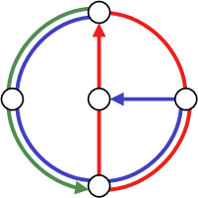

The Layered World of Scientific Conferences
Michael Kuhn
Roger Wattenhofer
APWEB 2008
Shenyang, China
Distributed
Computing
Group
Notes:
Good morning to everybody.
My name is Stefan Schmid and I present our paper „A Self-Repairing P2P System Resilient to Dynamic Adversarial Churn“.

Slide 2
The Proximity of Scientific Conferences
The web around APWeb
  How does the proximity of conferences look like?
Different aspects of proximity
  Scope
  Quality
Why do we care about conference proximity?
APWEB
1. | WAIM
2. | WISE
3. | GCC
4. | DASFAA
5. | SKG
6. | ISPA
7. | PDCAT
8. | DEXA
9. | ICDF
10. | PAKDD

Slide 3
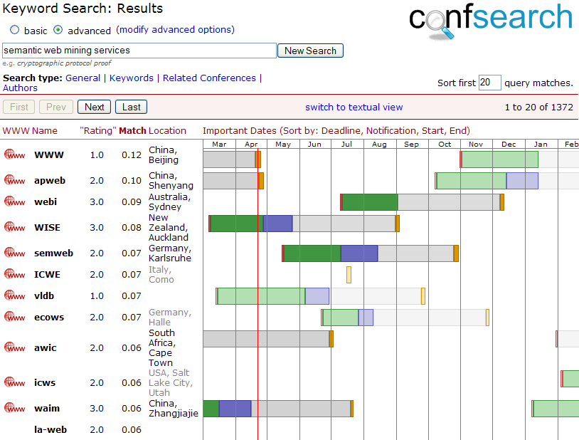
Application: Conference Search
Different search types
  For related conferences
  By keywords
  By author
Based on DBLP
  Freely available
Wiki-Approach for some attributes
  Important dates
  Location
  Link to website
Try it at www.confsearch.org!

Slide 4
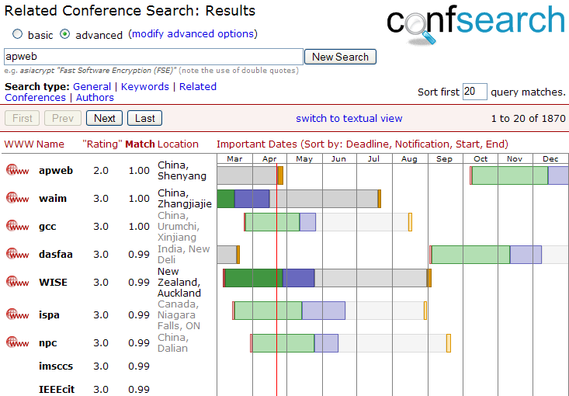
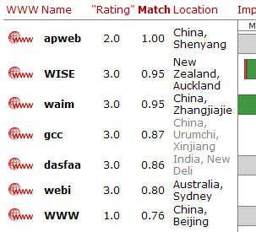

Slide 5
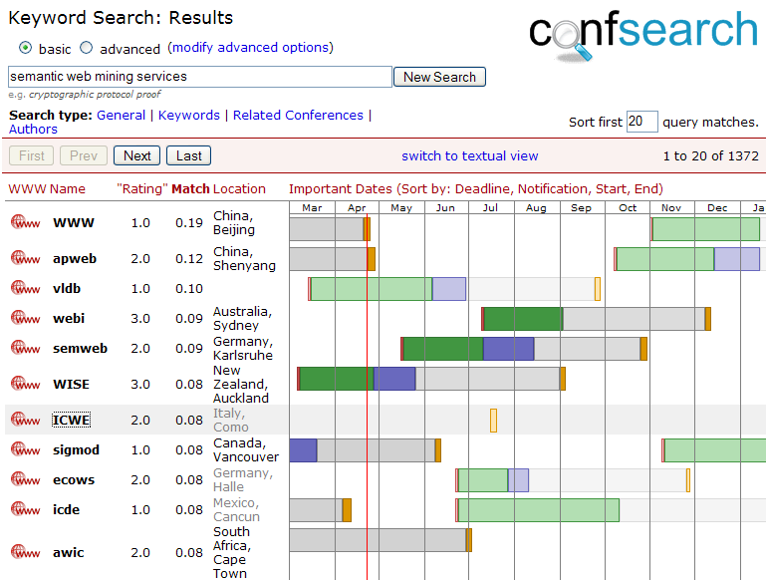


Slide 6
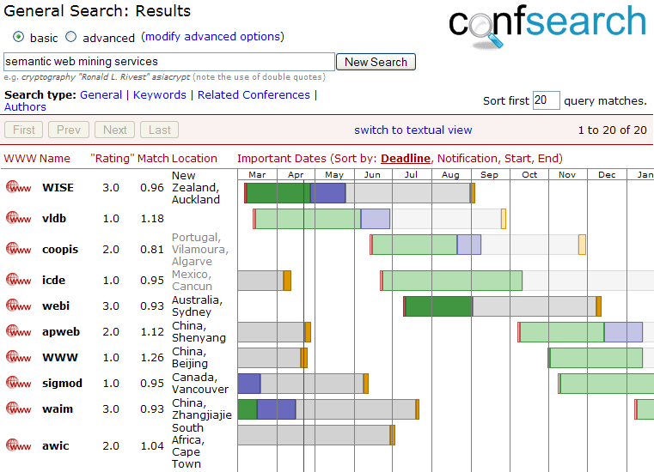


Slide 7
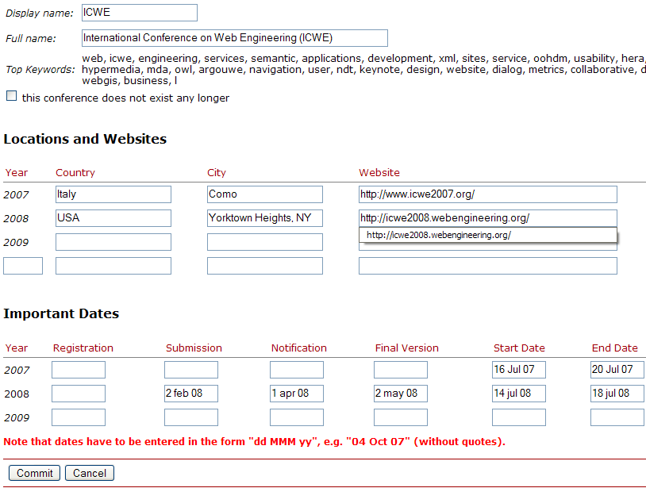

Slide 8
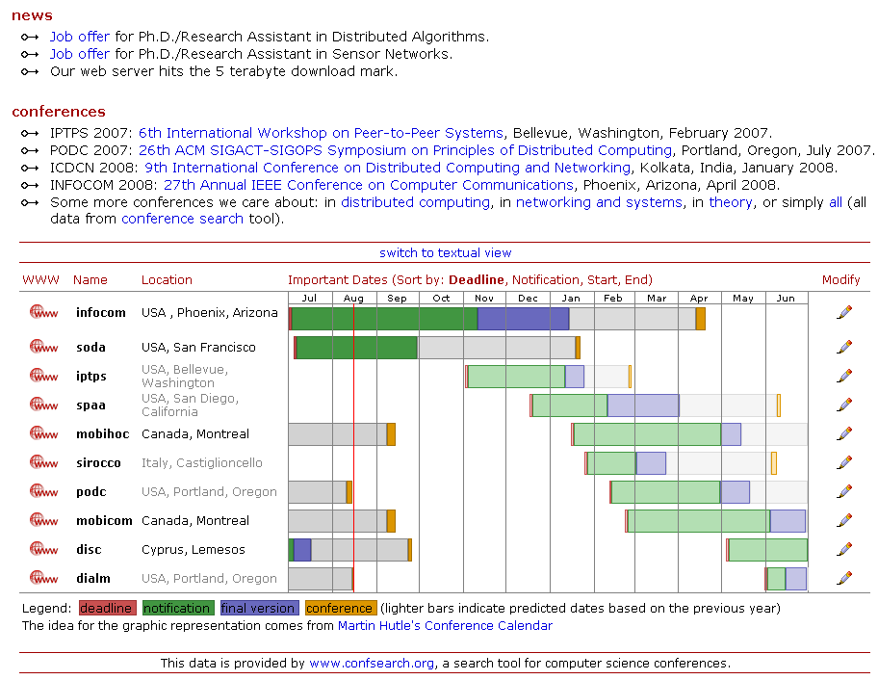

Slide 9
„Social similarity“ and the Conference Graph
A single author tends to submit to similar conferences
  Conferences C₁ and C₂ are similar if many authors often submit to both of them
  Data available from DBLP
Problem: Conferences have unequal „size“
  Just counting the number of authors over-estimates the proximity of large venues
  Normalization required:

Slide 10
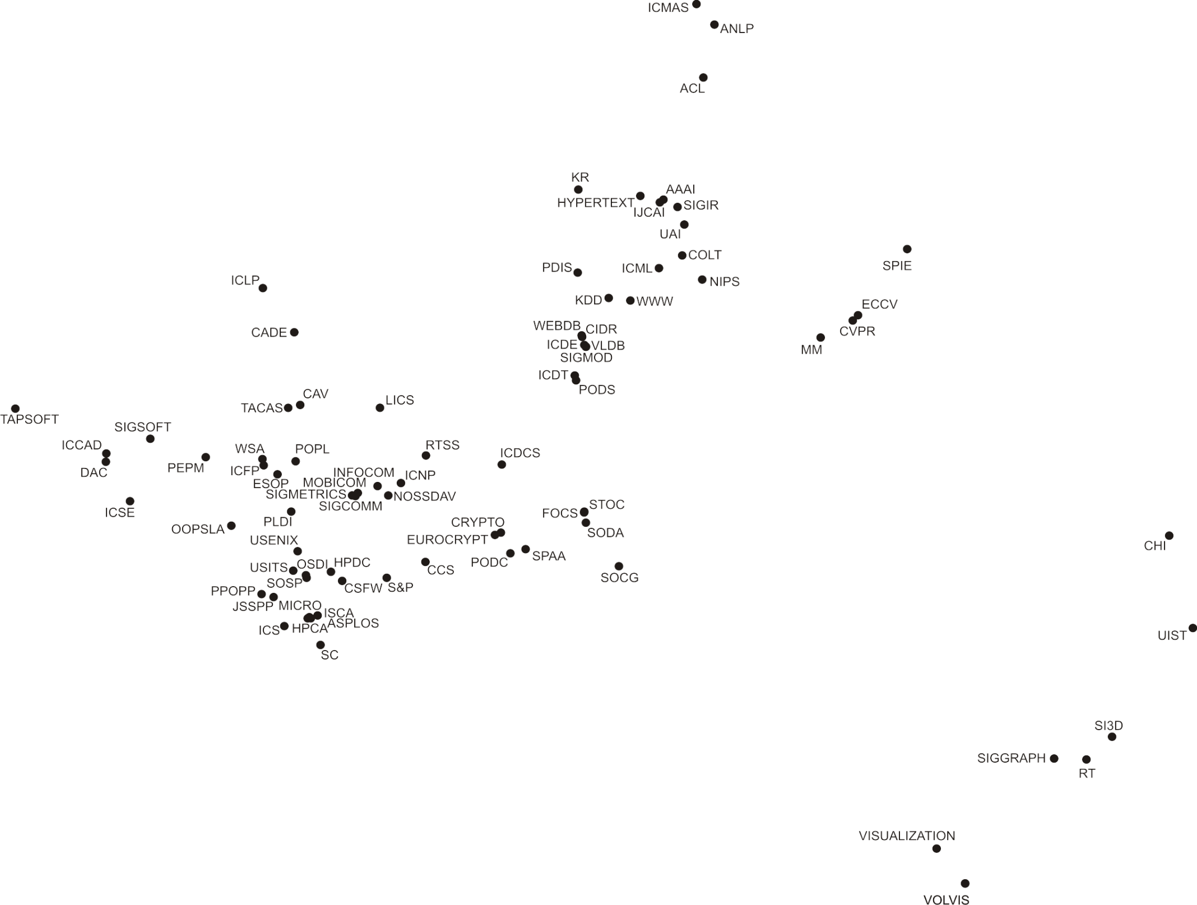
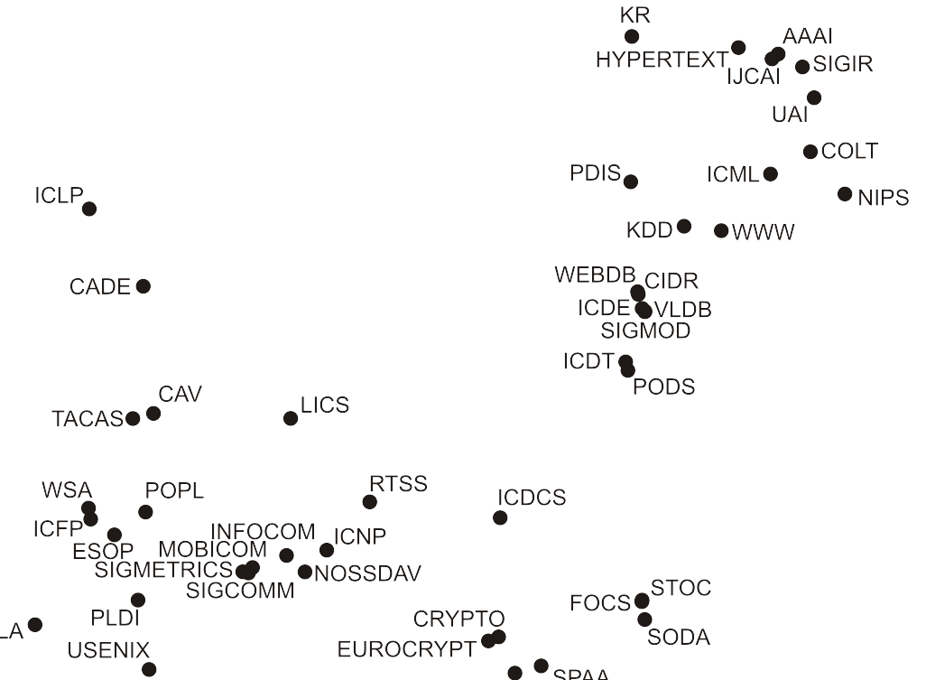

Slide 11
Some Examples
PODC Principles of Distributed Computing
DISC | 1.00
OPODIS | 0.49
SPAA | 0.46
SIROCCO | 0.36
ICDCS | 0.32
SRDS | 0.30
STOC | 0.27
SODA | 0.24
FOCS | 0.22
DIAL-M | 0.21
AAAI National Conference on Artificial Intelligence
IJCAI | 0.76
ATAL | 0.37
ICML | 0.33
AGENTS | 0.32
AIPS | 0.31
ECAI | 0.26
KR | 0.25
UAI | 0.25
CP | 0.23
FLAIRS | 0.20
Symposium on Parallel Algorithms & Architectures
Agent Theories, Architectures, and Languages
Structural Information & Communication Complexity
European Conference on Artificial Intelligence
Int. Conference on Distributed Computing Systems
Proximity is not purely thematic!

Slide 12
The Concept of Layers
Layers correspond to different reasons (catalysts) for edges
  Thematic scope and quality are such reasons
  Similar to the concept of „social dimensions“ of Watts, Dodds, Newman (2002)
Total graph is the sum of its layers:

Slide 13
Thematic Layer
Comparing publication titles allows to estimate thematic similarity of conferences
  Score for each conference-keyword pair
    TF-IDF (Term-Frequency Inverse-Document-Frequency)
  Similarity: cardinality of the intersection of the top-50 keywords

Slide 14
Layer Separation by Subtraction
Assumption: 2 major layers: thematic layer (t) and quality layer (q)
  Total weight T = x₁t + x₂q + x₃r
  Remainder r is neglected
The qualitative similarity q can be determined from T and t!
  Result is only a rough estimate due to considerable simplifications (independence of layers, neglecting r, etc.)
q ≈ T - αt
Quality layer
Social similarity
(total weight)
Thematic layer

Slide 15
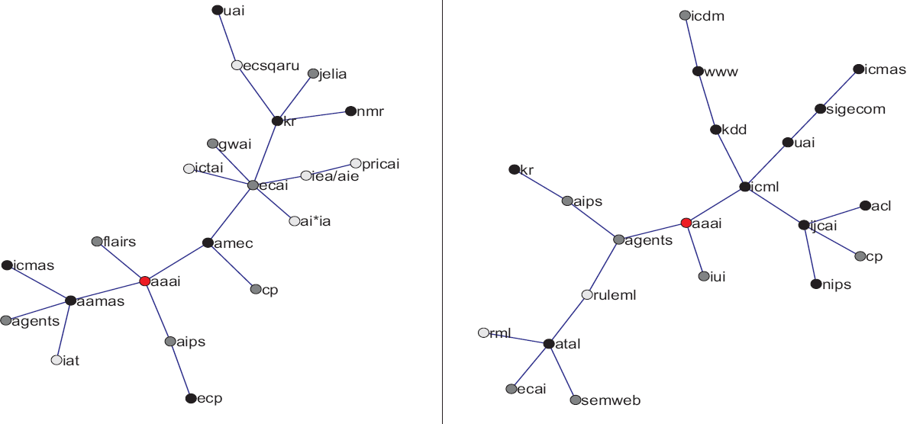
Example: Thematic and Quality Layer for AAAI

Slide 16
Proximity Based Conference Rating (1)
In the quality layer a tier-1 conference is supposed to have many tier-1 conferences in its proximity (the same holds for tier-2 and tier-3)
  Unknown ratings can be „interpolated“
  Intial ratings taken from Libra (MSR Asia)
  Existing approaches mostly citation based (initiated by Garfield in 1972)

Slide 17
Proximity Based Conference Rating (2)
Intial ratings taken from Libra
  Libra vs. „Internet List“: „Error“-rate 34.5%
  Conference rating is difficult and partly subjective
  Tier-1 vs. Tier-3: 4.5% Error (α = 0)
1) Roughly detect tier
(1,2 vs. 2,3)
2) Use specific Alpha
for fine separation
Tier-3
Total
Tier-2
Tier-1
Recall:
q ≈ T - αt

Slide 18

Proximity Based Conference Rating (3)
Libra vs. „Internet List“: 34.5%
Random: 66.7%
Total error drops from 50.5% to 40.3%
After „thematic correction“: 40.3%
Total graph: 50.5%
Diagonal elements
dominate
Estimated Tier
 | T1 | T2 | T3 | % Correct
T1 | 54 | 28 | 3 | 64%
T2 | 38 | 112 | 48 | 57%
T3 | 19 | 92 | 172 | 61%
Tier (Libra)
Few „serious“ errors:
22 of 567 = 3.9%

Slide 19
Conclusion and Future Work
We have seen that
  „Social similarity“ is a good measure to relate conferences
  „Social similarity“ consists of thematic and a quality layer
  The thematic layer can be estimated using publication titles
  The quality layer can be emphasized by subtracting the thematic component
  These ideas can be used for conference rating and search
    www.confsearch.org
It would be interesting to look at
  A generic method for layer separation (that works on various graphs)
  Looking at combinations of the presented conference rating ideas with citation based approaches

Slide 20
Thanks for Your Attention
Questions?

