Slide 1
Local Checkability,
No Strings Attached
Klaus-Tycho Förster, Thomas Lüdi, Jochen Seidel, Roger Wattenhofer
January 06, 2016 @ ICDCN 2016 - Singapore

Slide 2
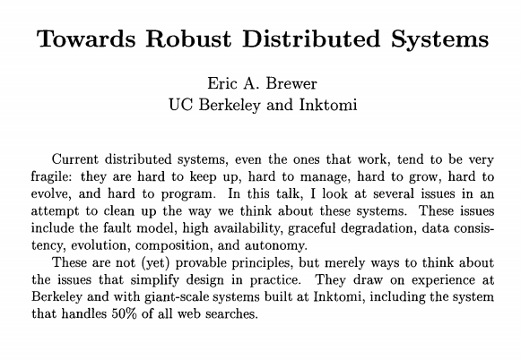
Deciding vs Checking
Prove

Slide 3
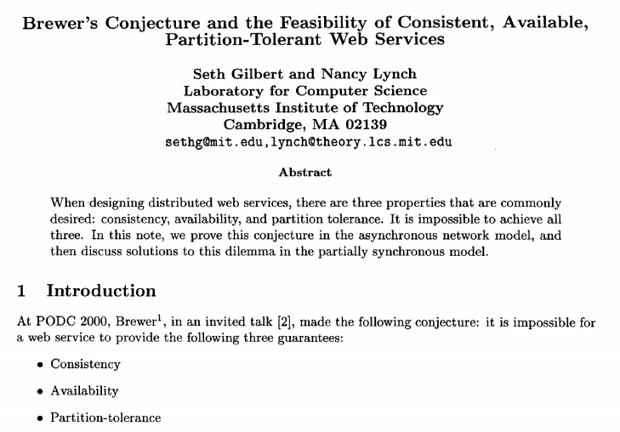
Deciding vs Checking
Prove
Verify

Slide 4
Complexity Theory
P
NP
Prove
In polynomial time
Verify
In polynomial time

Slide 5
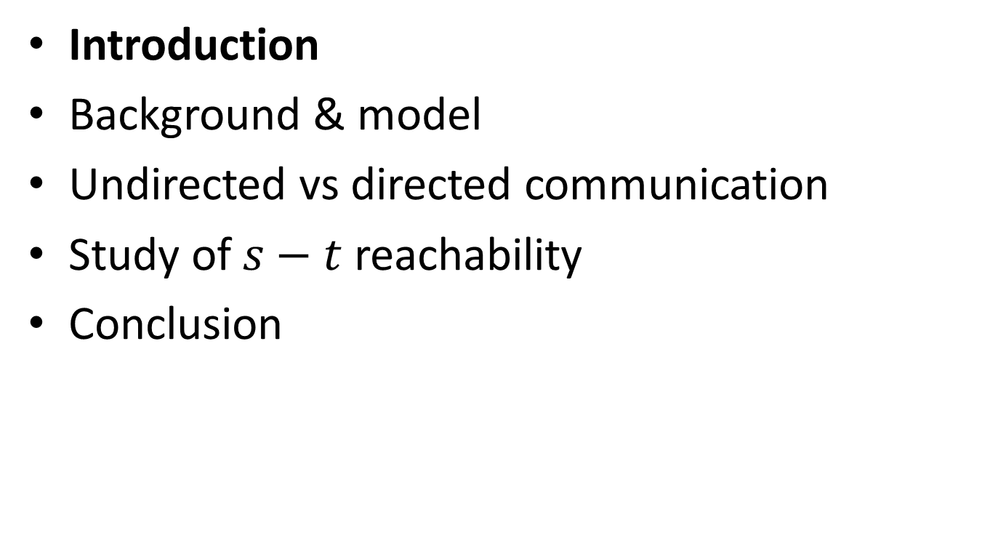
Overview
Introduction
Background & model
Undirected vs directed communication
Study of $s−t$ reachability
Conclusion

Slide 6
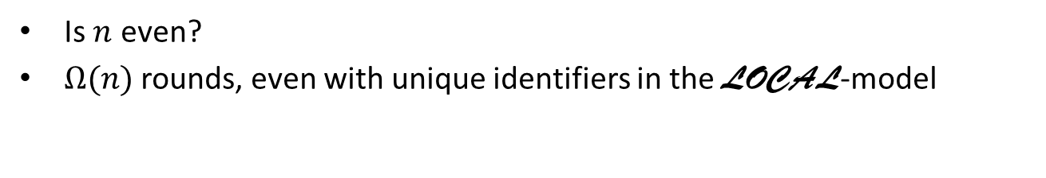
Let's get Distributed
Is $n$ even?
$Ω(n)$ rounds, even with unique identifiers in the LOCAL-model

Slide 7
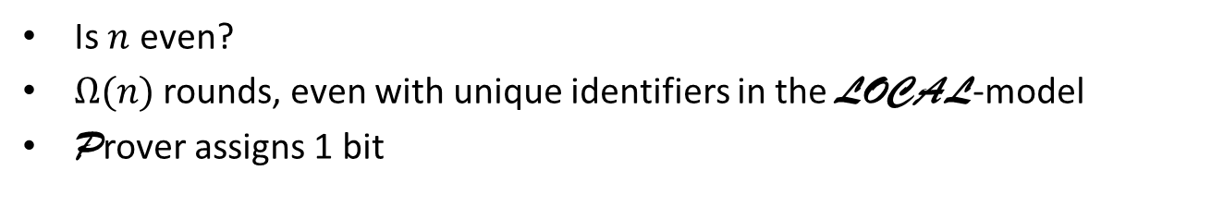
Let's get Distributed
1
0
0
1
1
0
Is $n$ even?
$Ω(n)$ rounds, even with unique identifiers in the LOCAL-model
Prover assigns 1 bit

Slide 8
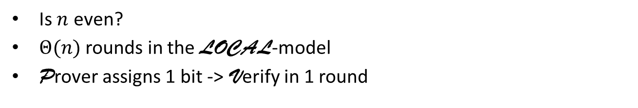
Let's get Distributed
Yes
Yes
1
Yes
0
0
Yes
Yes
1
Yes
1
0
Is $n$ even?
$Θ(n)$ rounds in the LOCAL-model
Prover assigns 1 bit -> Verify in 1 round

Slide 9
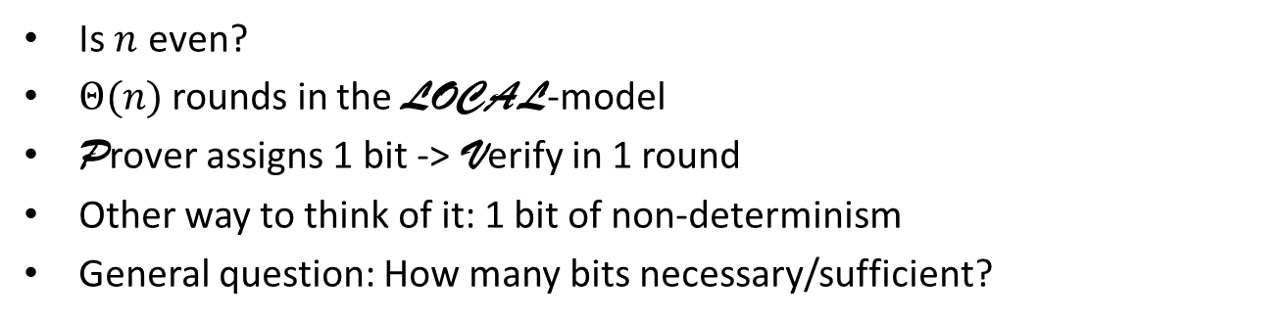
Let's get Distributed
Yes
Yes
1
Yes
0
0
Yes
Yes
1
Yes
1
0
Is $n$ even?
$Θ(n)$ rounds in the LOCAL-model
Prover assigns 1 bit -> Verify in 1 round
Other way to think of it: 1 bit of non-determinism
General question: How many bits necessary/sufficient?

Slide 10
Accepting a proof
Yes
Yes
1
Yes
0
0
Yes
Yes
1
Yes
1
0
Every node outputs Yes -> Proof accepted
One node outputs No -> Proof rejected

Slide 11
Accepting a proof
Yes
Yes
1
Yes
0
0
No
No
1
No
1
1
Every node outputs Yes -> Proof accepted
One node outputs No -> Proof rejected
  Prover chose the wrong proof

Slide 12
Accepting a proof
Yes
Yes
1
Yes
0
0
No
1
Yes
No
Yes
1
1
0
Every node outputs Yes -> Proof accepted
One node outputs No -> Proof rejected
  Prover chose the wrong proof
  Property does not hold

Slide 13
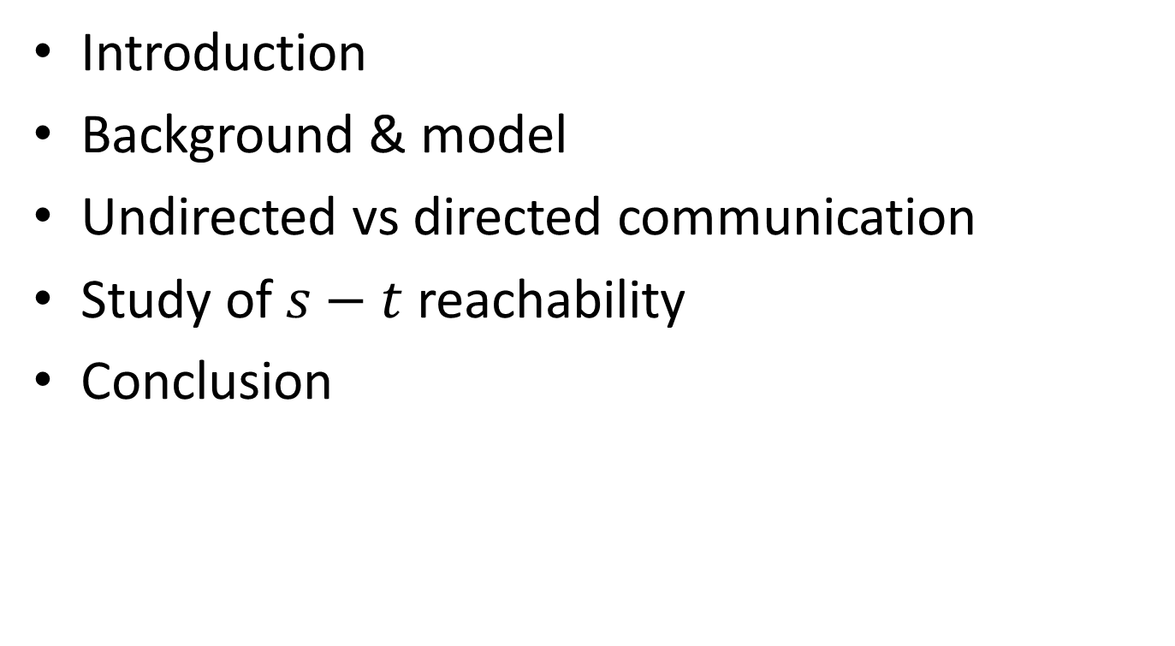
Overview
Introduction
Background & model
Undirected vs directed communication
Study of $s−t$ reachability
Conclusion

Slide 14
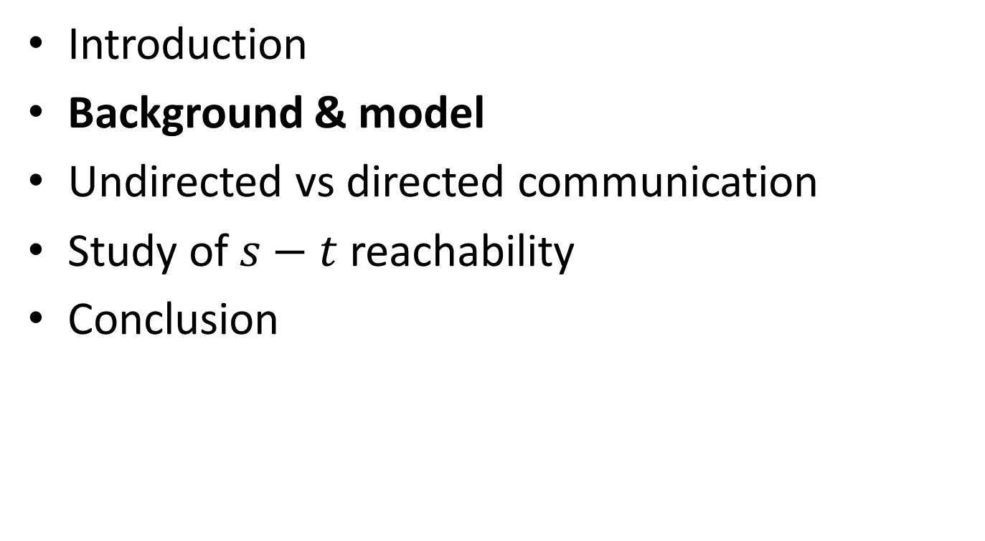
Overview
Introduction
Background & model
Undirected vs directed communication
Study of $s−t$ reachability
Conclusion

Slide 15
Some Related Work
[Naor and Stockmeyer, STOC 1993]:
What can be computed locally?
[Göös and Suomela, PODC 2011]:
Locally Checkable Proofs (LCP)
[Korman et al., ICDCN 2006, …]:
Proof Labeling Schemes (PLS)
[Fraigniaud et al., FOCS 2011,…]:
Nondeterministic Local Decision (NLD)
  [Fraigniaud et al., DISC 2012,…]: “Randomization”
Another way to think of it [Blin et al., SSS 2014]:
  “any mechanism insuring silent self-stabilization is essentially equivalent to a proof-labeling scheme”

Slide 16
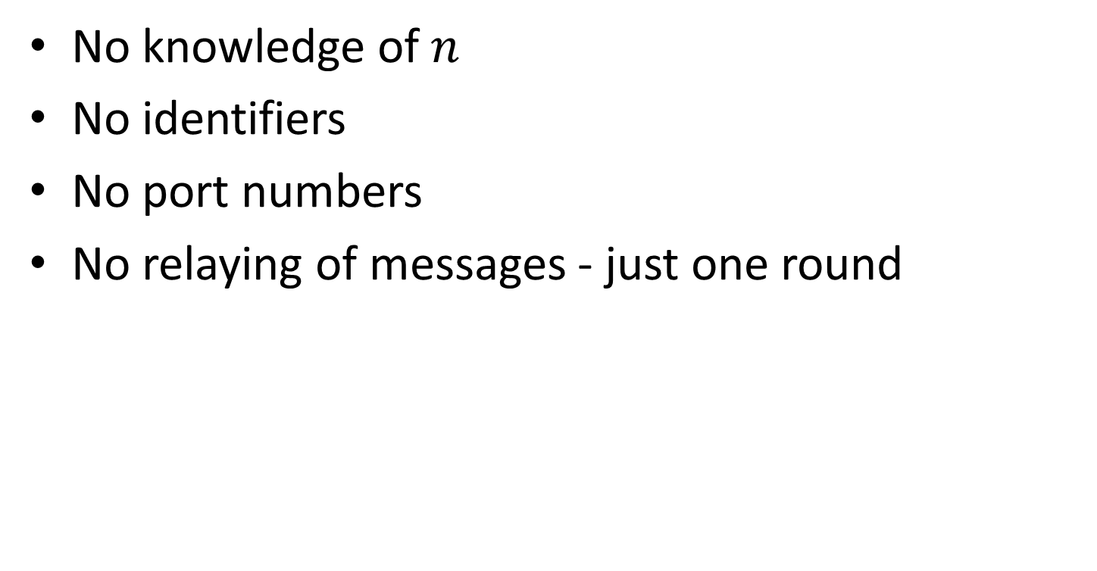
“No Strings attached”
No knowledge of $n$
No identifiers
No port numbers
No relaying of messages - just one round

Slide 17
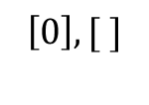
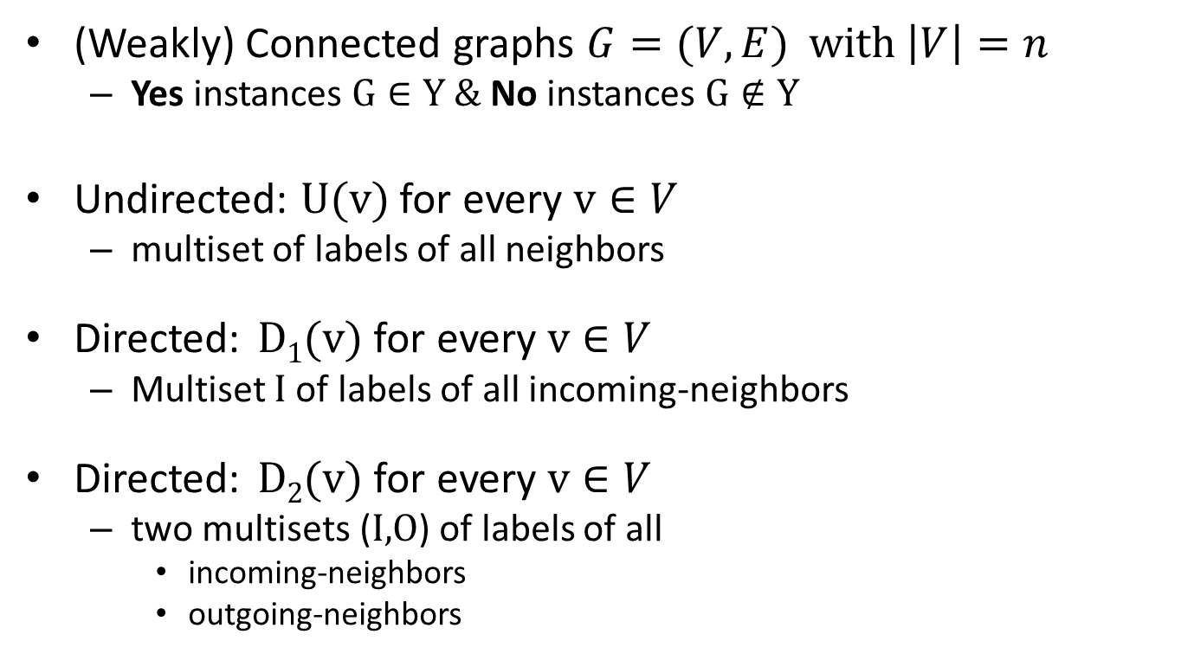

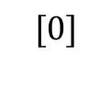
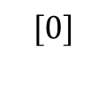
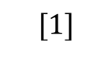
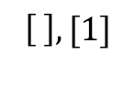
Graphs and Communication
(Weakly) Connected graphs $G=(V,E)$ with $\left|V\right|=n$
  Yes instances $G∈Y$ & No instances $G∉Y$
Undirected: $\text{U}\text{(}\text{v}\text{)}$ for every $\text{v}∈V$
  multiset of labels of all neighbors
Directed: $\text{D}\text{1}\text{(}\text{v}\text{)}$ for every $\text{v}∈V$
  Multiset I of labels of all incoming-neighbors
Directed: $\text{D}\text{2}\text{(}\text{v}\text{)}$ for every $\text{v}∈V$
  two multisets (I,O) of labels of all
    incoming-neighbors
    outgoing-neighbors
$$[0]$$
$$[1]$$
1
0
$$[0]$$
$$[ ]$$
1
0
$$\left[0\right],[ ]$$
$$\left[ \right],[1]$$
1
0

Slide 18
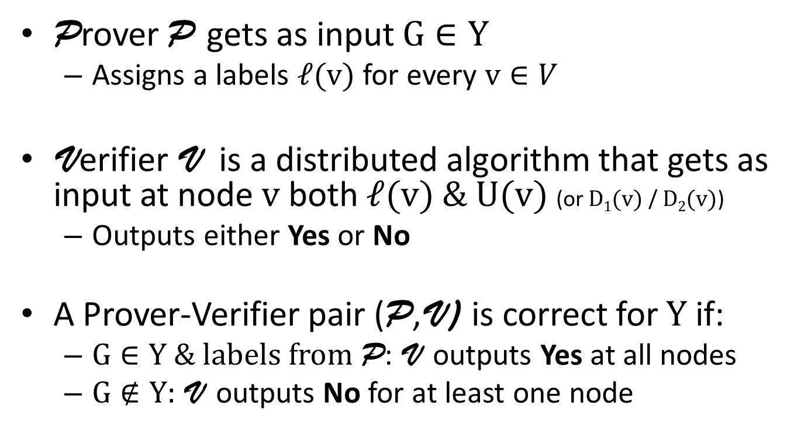
Local Checkability
Prover P gets as input $G∈Y$
  Assigns a labels $\text{ℓ}\text{(}\text{v}\text{)}$ for every $\text{v}∈V$
Verifier V is a distributed algorithm that gets as input at node $\text{v}$ both $\text{ℓ}\text{(}\text{v}\text{)}$ & $\text{U}\text{(}\text{v}\text{)}$ (or $\text{D}\text{1}\text{(}\text{v}\text{)}$ / $\text{D}\text{2}\text{(}\text{v}\text{)}$)
  Outputs either Yes or No
A Prover-Verifier pair (P,V) is correct for $Y$ if:
  $G∈Y$ & labels from P: V outputs Yes at all nodes
  $G∉Y$: V outputs No for at least one node

Slide 19
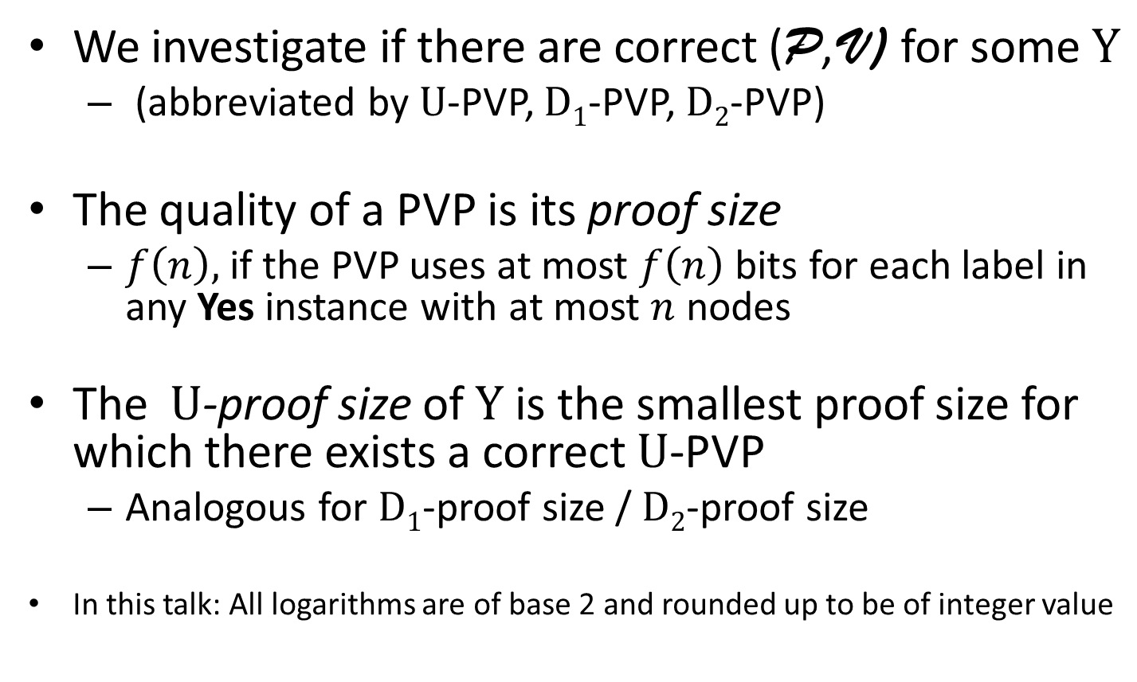
Prover-Verifier Pairs
We investigate if there are correct (P,V) for some $Y$
  (abbreviated by $\text{U}$-PVP, $\text{D}\text{1}$-PVP, $\text{D}\text{2}$-PVP)
The quality of a PVP is its proof size
  $f\left(n\right),$ if the PVP uses at most $f\left(n\right)$ bits for each label in any Yes instance with at most $n$ nodes
The $\text{U}$-proof size of $Y$ is the smallest proof size for which there exists a correct $\text{U}$-PVP
  Analogous for $\text{D}\text{1}$-proof size / $\text{D}\text{2}$-proof size
In this talk: All logarithms are of base 2 and rounded up to be of integer value

Slide 20
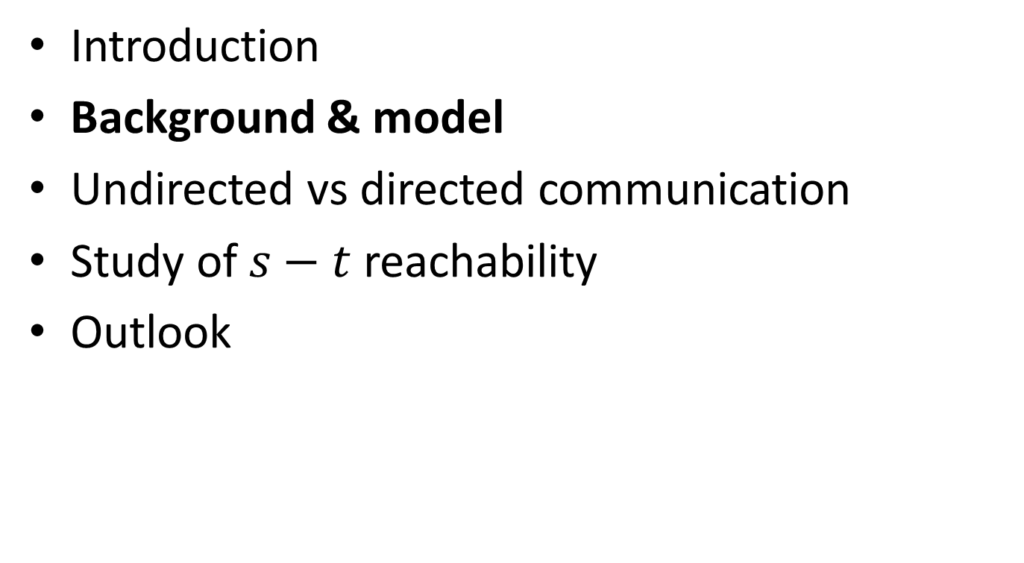
Overview
Introduction
Background & model
Undirected vs directed communication
Study of $s−t$ reachability
Outlook

Slide 21
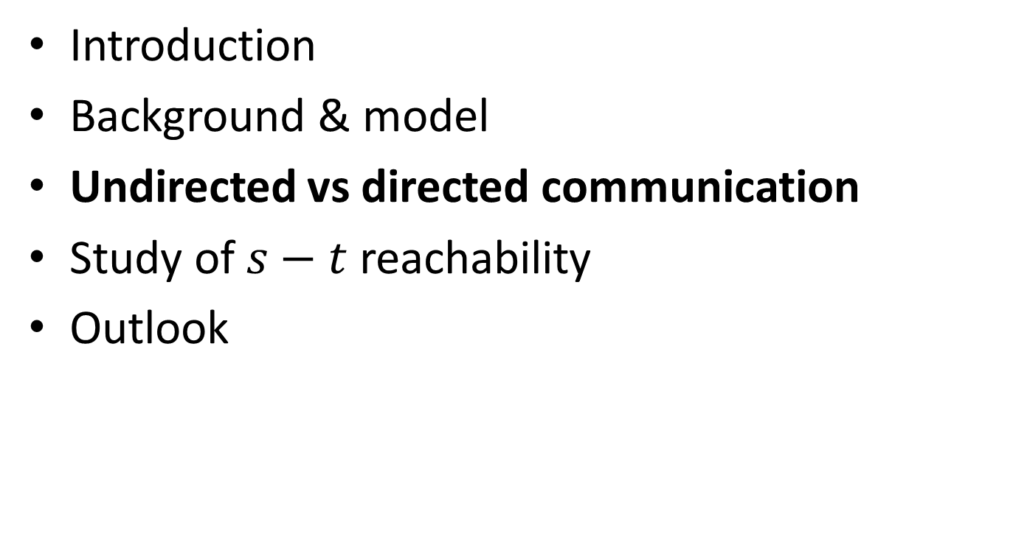
Overview
Introduction
Background & model
Undirected vs directed communication
Study of $s−t$ reachability
Outlook

Slide 22
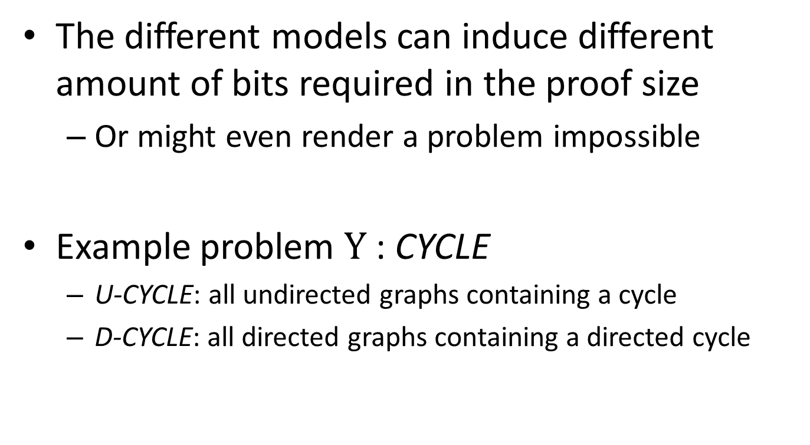
Undirected vs Directed Communication
The different models can induce different amount of bits required in the proof size
  Or might even render a problem impossible
Example problem $Y$: CYCLE
  U-CYCLE: all undirected graphs containing a cycle
  D-CYCLE: all directed graphs containing a directed cycle

Slide 23




D-CYCLE: Is there a $\text{D}\text{1}$-PVP?
$$[A]$$
$$G:$$
$$[ ]$$
A
B
c₂
c₁
a
b

Slide 24
D-CYCLE: Is there a $\text{D}\text{1}$-PVP?
$$[A]$$
Yes
Yes
Yes
Yes
$$G:$$
$$[ ]$$
A
B
c₂
c₁
a
b

Slide 25

D-CYCLE: Is there a $\text{D}\text{1}$-PVP?
$$[A]$$
Yes
Yes
Yes
Yes
$$G:$$
$$[ ]$$
A
B
c₂
c₁
a
b
$$H:$$
B
A
B
b’
a
b

Slide 26
D-CYCLE: Is there a $\text{D}\text{1}$-PVP?
$$[A]$$
Yes
Yes
Yes
Yes
$$G:$$
$$[ ]$$
A
B
c₂
c₁
a
b
Yes
Yes
Yes
$$H:$$
B
A
B
b’
a
b

Slide 27


D-CYCLE: Is there a $\text{D}\text{1}$-PVP?
$$[A]$$
Yes
Yes
Yes
Yes
$$G:$$
$$[ ]$$
A
B
c₂
c₁
a
b
Yes
Yes
Yes
$$H:$$
B
A
B
b’
a
b
There is no $\text{D}\text{1}$-PVP for D-CYCLE

Slide 28
CYCLE
Problem | Directed one-way | Directed two-way | Undirected
CYCLE | Impossible

Slide 29

D-CYCLE: Is there a $\text{D}\text{2}$-PVP?

Slide 30
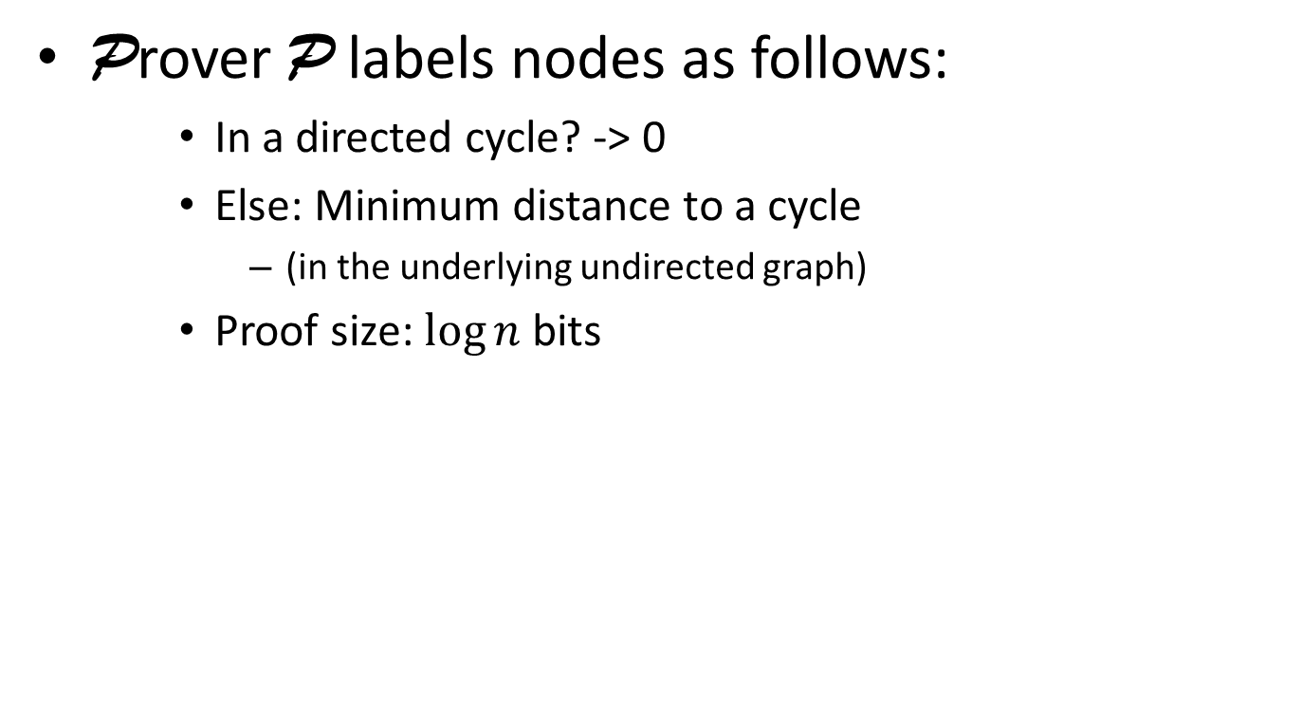
D-CYCLE: Is there a $\text{D}\text{2}$-PVP?
Prover P labels nodes as follows:
    In a directed cycle? -> 0
    Else: Minimum distance to a cycle
      (in the underlying undirected graph)
    Proof size: $\log{n }$bits

Slide 31
D-CYCLE: Is there a $\text{D}\text{2}$-PVP?
Prover P labels nodes as follows:
    In a directed cycle? -> 0
    Else: Minimum distance to a cycle
      (in the underlying undirected graph)
    Proof size: $\log{n }$bits
0
0
1
0
0
5
0
2
1
0
0
4
3

Slide 32
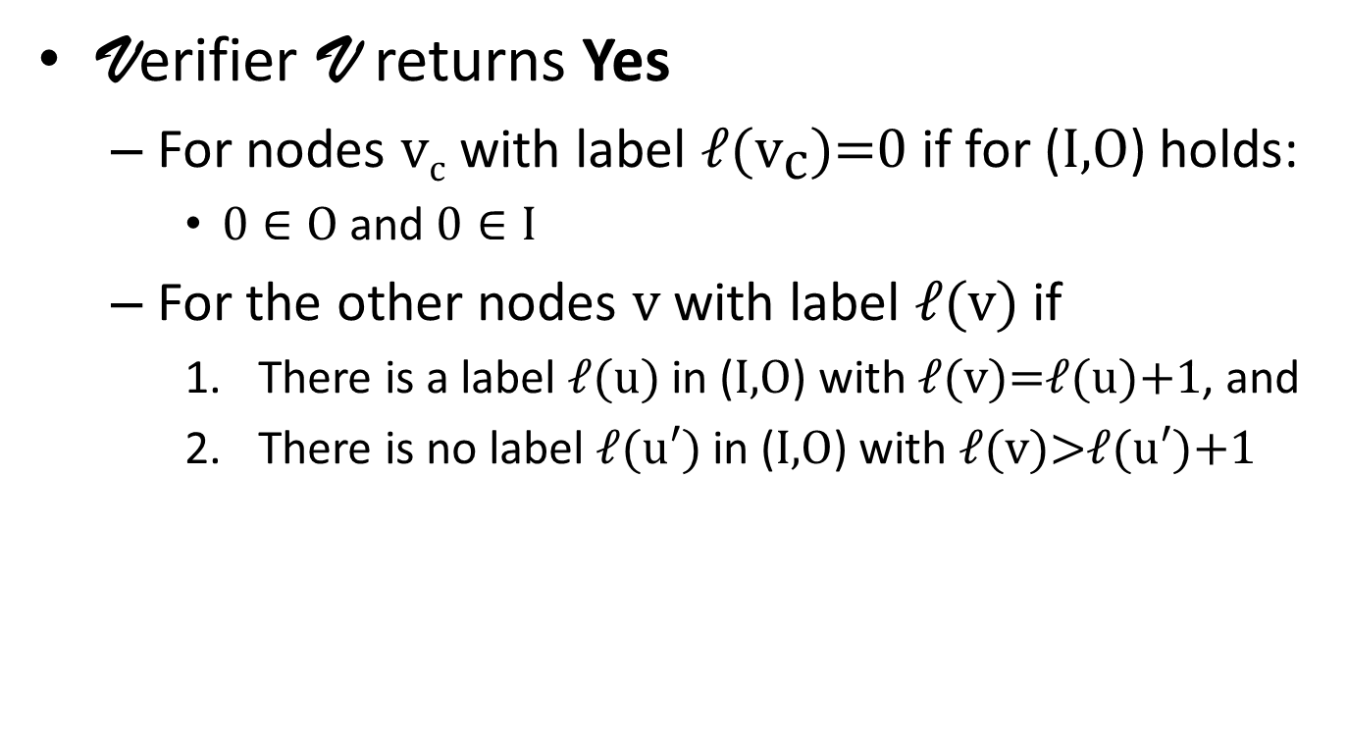
D-CYCLE: Is there a $\text{D}\text{2}$-PVP?
Verifier V returns Yes
  For nodes $\text{v}\text{c}$ with label $\text{ℓ}\text{(}{\text{v}}_{\text{c}}\text{)=0}$ if for (I,O) holds:
    $\text{0}∈O$and $\text{0}∈I$
  For the other nodes $\text{v}$ with label $\text{ℓ}\text{(}\text{v}\text{)}$ if
    There is a label $\text{ℓ}\text{(}\text{u}\text{)}$ in (I,O) with $\text{ℓ}\text{(}\text{v}\text{)=}\text{ℓ}\text{(}\text{u}\text{)}\text{+1}$, and
    There is no label $\text{ℓ}\text{(}\text{u}\text{′}\text{)}$ in (I,O) with $\text{ℓ}\text{(}\text{v}\text{)>}\text{ℓ}\text{(}\text{u}\text{′)+1}$

Slide 33
D-CYCLE: Is there a $\text{D}\text{2}$-PVP?
Verifier V returns Yes
  For nodes $\text{v}\text{c}$ with label $\text{ℓ}\text{(}{\text{v}}_{\text{c}}\text{)=0}$ if for (I,O) holds:
    $\text{0}∈O$and $\text{0}∈I$
  For the other nodes $\text{v}$ with label $\text{ℓ}\text{(}\text{v}\text{)}$ if
    There is a label $\text{ℓ}\text{(}\text{u}\text{)}$ in (I,O) with $\text{ℓ}\text{(}\text{v}\text{)=}\text{ℓ}\text{(}\text{u}\text{)}\text{+1}$, and
    There is no label $\text{ℓ}\text{(}\text{u}\text{′}\text{)}$ in (I,O) with $\text{ℓ}\text{(}\text{v}\text{)>}\text{ℓ}\text{(}\text{u}\text{′)+1}$
0
0
1
0
0
5
0
2
1
0
0
4
3

Slide 34
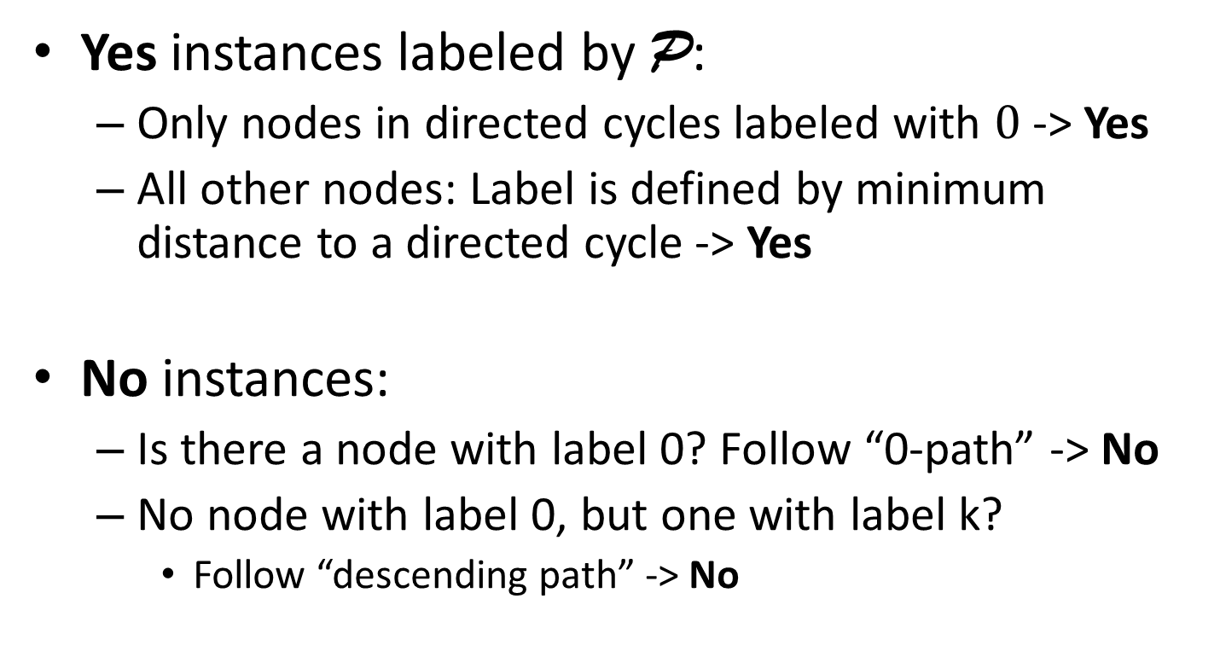

Is the described $\text{D}\text{2}$-PVP correct?
Yes instances labeled by P:
  Only nodes in directed cycles labeled with $\text{0}$ -> Yes
  All other nodes: Label is defined by minimum distance to a directed cycle -> Yes
No instances:
  Is there a node with label 0? Follow “0-path” -> No
  No node with label 0, but one with label k?
    Follow “descending path” -> No

Slide 35


D₂-proof size: $Ω\left(\log{n}\right)$ bits
Yes
$$G:$$
A
B
A
B
v₁
v_{i-1}
v_{i}
v_{i+1}
v_{i+2}
v_{j-1}
v_{j}
v_{j+1}
v_{j+2}
v_{n-2}
v_{n-1}
v_{n}
B
Yes
Yes
Yes
Yes
Yes
Yes
Yes
Yes
Yes
Yes
Yes
Yes

Slide 36
D₂-proof size: $Ω\left(\log{n}\right)$ bits
Yes
Yes
$$G:$$
A
B
A
B
v₁
v_{i-1}
v_{i}
v_{i+1}
v_{i+2}
v_{j-1}
v_{j}
v_{j+1}
v_{j+2}
v_{n-2}
v_{n-1}
v_{n}
B
Yes
Yes
Yes
Yes
Yes
Yes
Yes
Yes
Yes
Yes
Yes
Yes

Slide 37

D₂-proof size: $Ω\left(\log{n}\right)$ bits
Yes
Yes
$$G:$$
A
B
A
B
v₁
v_{i-1}
v_{i}
v_{i+1}
v_{i+2}
v_{j-1}
v_{j}
v_{j+1}
v_{j+2}
v_{n-2}
v_{n-1}
v_{n}
$$H:$$
A
B
A
B
B
u_{i}
u_{i+1}
u_{i+2}
u_{j-1}
u_{j}
u_{j+1}
u'_{i+2}
u'_{j-1}
Yes
Yes
Yes
Yes
Yes
Yes
Yes
Yes
Yes
Yes
Yes
Yes

Slide 38
D₂-proof size: $Ω\left(\log{n}\right)$ bits
Yes
Yes
$$G:$$
A
B
A
B
v₁
v_{i-1}
v_{i}
v_{i+1}
v_{i+2}
v_{j-1}
v_{j}
v_{j+1}
v_{j+2}
v_{n-2}
v_{n-1}
v_{n}
Yes
$$H:$$
A
B
A
B
B
u_{i}
u_{i+1}
u_{i+2}
u_{j-1}
u_{j}
u_{j+1}
u'_{i+2}
u'_{j-1}
Yes
Yes
Yes
Yes
Yes
Yes
Yes
Yes
Yes
Yes
Yes
Yes

Slide 39
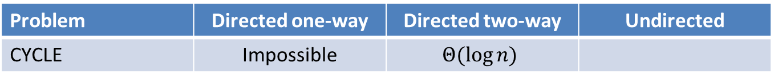
CYCLE
Problem | Directed one-way | Directed two-way | Undirected
CYCLE | Impossible | $$Θ(\log{n)}$$

Slide 40








U-proof size: At least 2 Bits
$$G1:$$
0
0
0
$$H1:$$
0
0
$$G2:$$
0
1
0
$$H2:$$
0
1
0
$$G3:$$
1
1
0
$$H3:$$
0
1
1
0
$$G4:$$
1
0
0
$$H4:$$
0
0

Slide 41
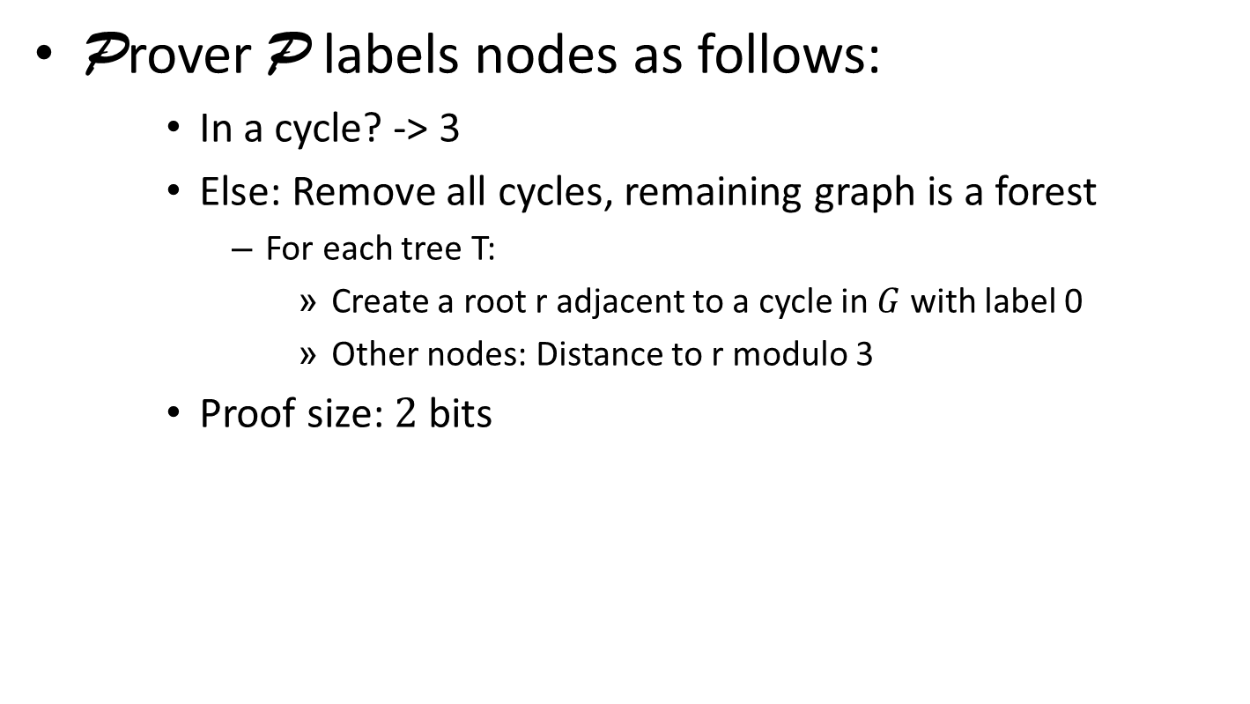
U-PVP for CYCLE with 2 bits
Prover P labels nodes as follows:
    In a cycle? -> 3
    Else: Remove all cycles, remaining graph is a forest
      For each tree T:
        Create a root r adjacent to a cycle in $G$ with label 0
        Other nodes: Distance to r modulo 3
    Proof size: $2$bits
3
3
0
3
3
2
3
2
1
3
3
1
0

Slide 42
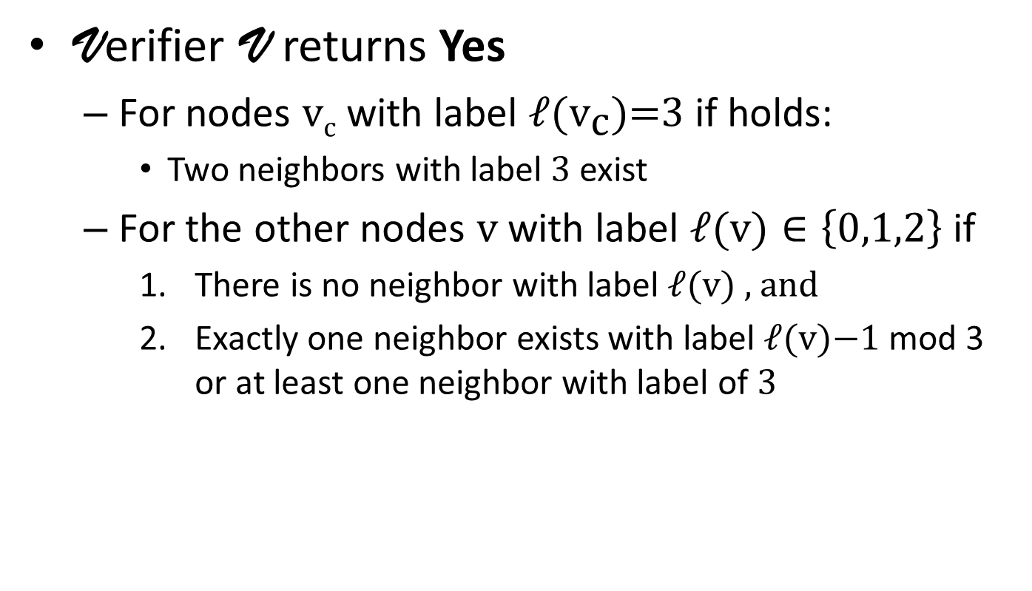
U-PVP for CYCLE with 2 bits
Verifier V returns Yes
  For nodes $\text{v}\text{c}$ with label $\text{ℓ}\text{(}{\text{v}}_{\text{c}}\text{)=3}$ if holds:
    Two neighbors with label $\text{3}$exist
  For the other nodes $\text{v}$ with label $\text{ℓ}\text{(}\text{v}\text{)}∈\left\{0,1,2\right\}$ if
    There is no neighbor with label $\text{ℓ}\text{(}\text{v}\text{)}$ , and
    Exactly one neighbor exists with label $\text{ℓ}\text{(}\text{v}\text{)−1}$ mod 3 or at least one neighbor with label of $\text{3}$

Slide 43
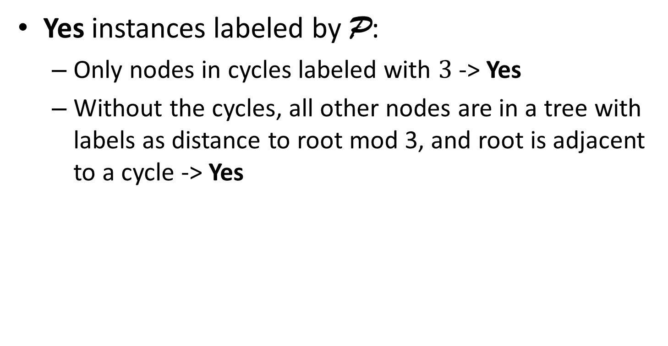

Is the described $\text{U}$-PVP correct?
Yes instances labeled by P:
  Only nodes in cycles labeled with $\text{3}$ -> Yes
  Without the cycles, all other nodes are in a tree with labels as distance to root mod 3, and root is adjacent to a cycle -> Yes
3
3
0
3
3
2
3
2
1
3
3
1
0

Slide 44
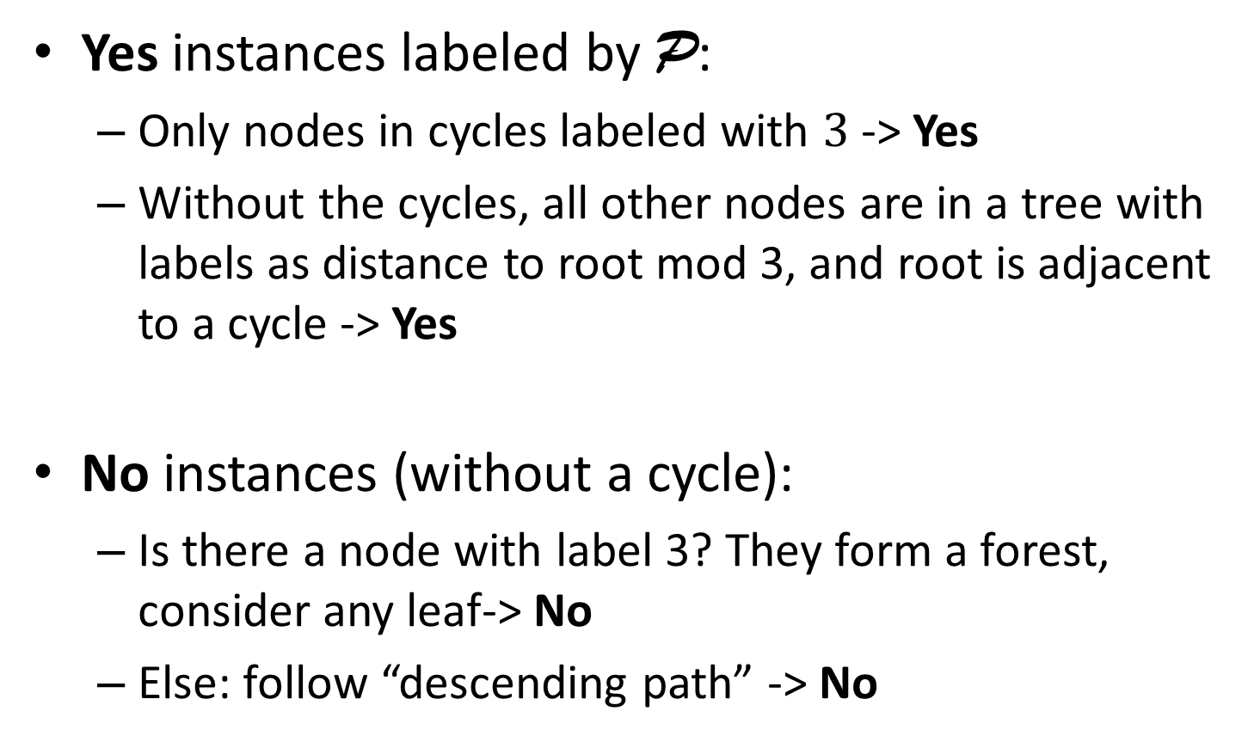
Is the described $\text{U}$-PVP correct?
Yes instances labeled by P:
  Only nodes in cycles labeled with $\text{3}$ -> Yes
  Without the cycles, all other nodes are in a tree with labels as distance to root mod 3, and root is adjacent to a cycle -> Yes
No instances (without a cycle):
  Is there a node with label 3? They form a forest, consider any leaf-> No
  Else: follow “descending path” -> No

Slide 45
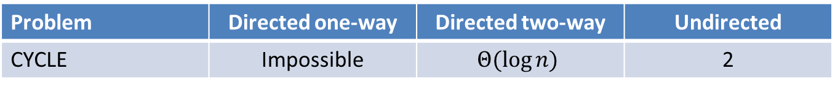
CYCLE, ACYCLIC, TREE
Problem | Directed one-way | Directed two-way | Undirected
CYCLE | Impossible | $$Θ(\log{n)}$$ | 2

Slide 46
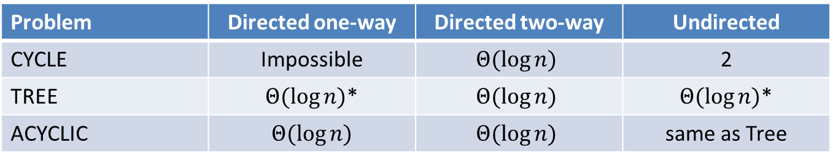
CYCLE, ACYCLIC, TREE
Problem | Directed one-way | Directed two-way | Undirected
CYCLE | Impossible | $$Θ(\log{n)}$$ | 2
TREE | $Θ(\log{n)}$* | $$Θ(\log{n)}$$ | $Θ(\log{n)}$*
ACYCLIC | $Θ(\log{n)}$ | $$Θ(\log{n)}$$ | same as Tree
Idea for Tree:
Label root as 0
Other nodes: Label is distance from root
Idea for Acyclicity:
Label nodes without incoming edges as 0
Other nodes: Max. incoming label plus 1
*: [Korman et al., Distributed Computing 2010]: Proof labeling schemes

Slide 47
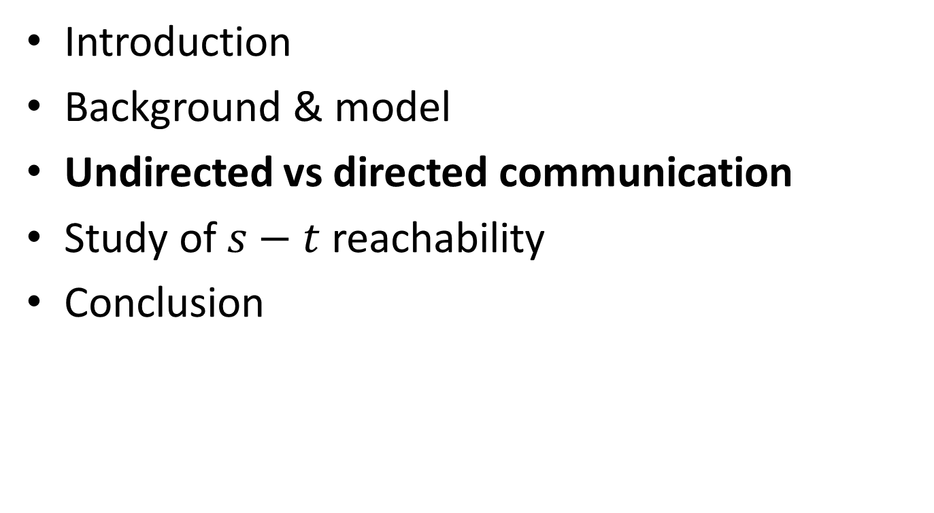
Overview
Introduction
Background & model
Undirected vs directed communication
Study of $s−t$ reachability
Conclusion

Slide 48
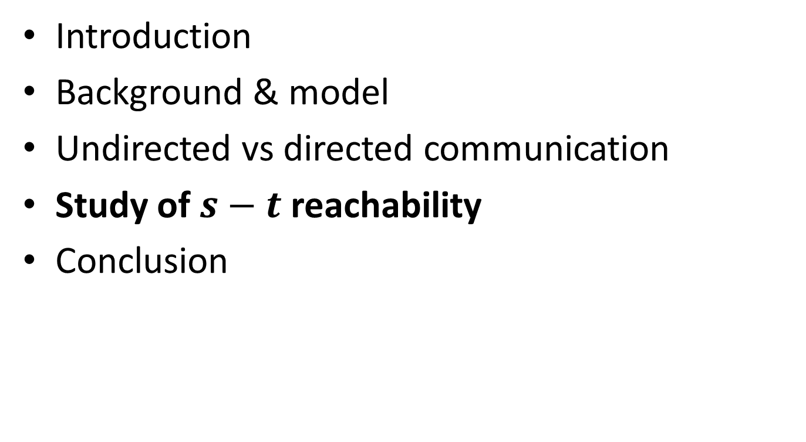
Overview
Introduction
Background & model
Undirected vs directed communication
Study of $s−t$ reachability
Conclusion

Slide 49

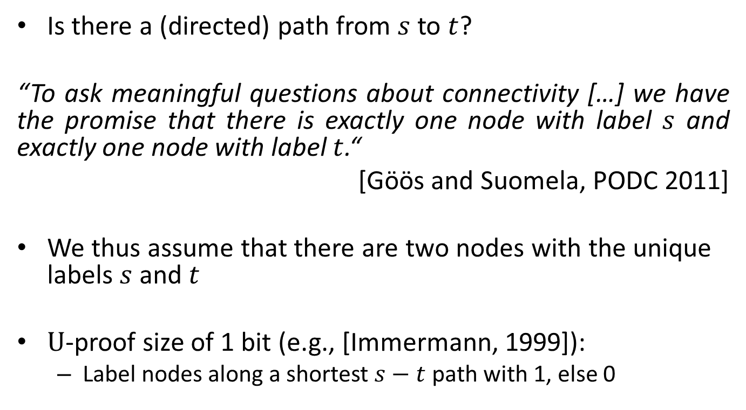
$s−t$ Reachability
Is there a (directed) path from $s$ to $t$?
“To ask meaningful questions about connectivity […] we have the promise that there is exactly one node with label $s$ and exactly one node with label $t$.“
[Göös and Suomela, PODC 2011]
We thus assume that there are two nodes with the unique labels $s$ and $t$
$\text{U}$-proof size of 1 bit (e.g., [Immermann, 1999]):
  Label nodes along a shortest $s−t$ path with 1, else 0

Slide 50
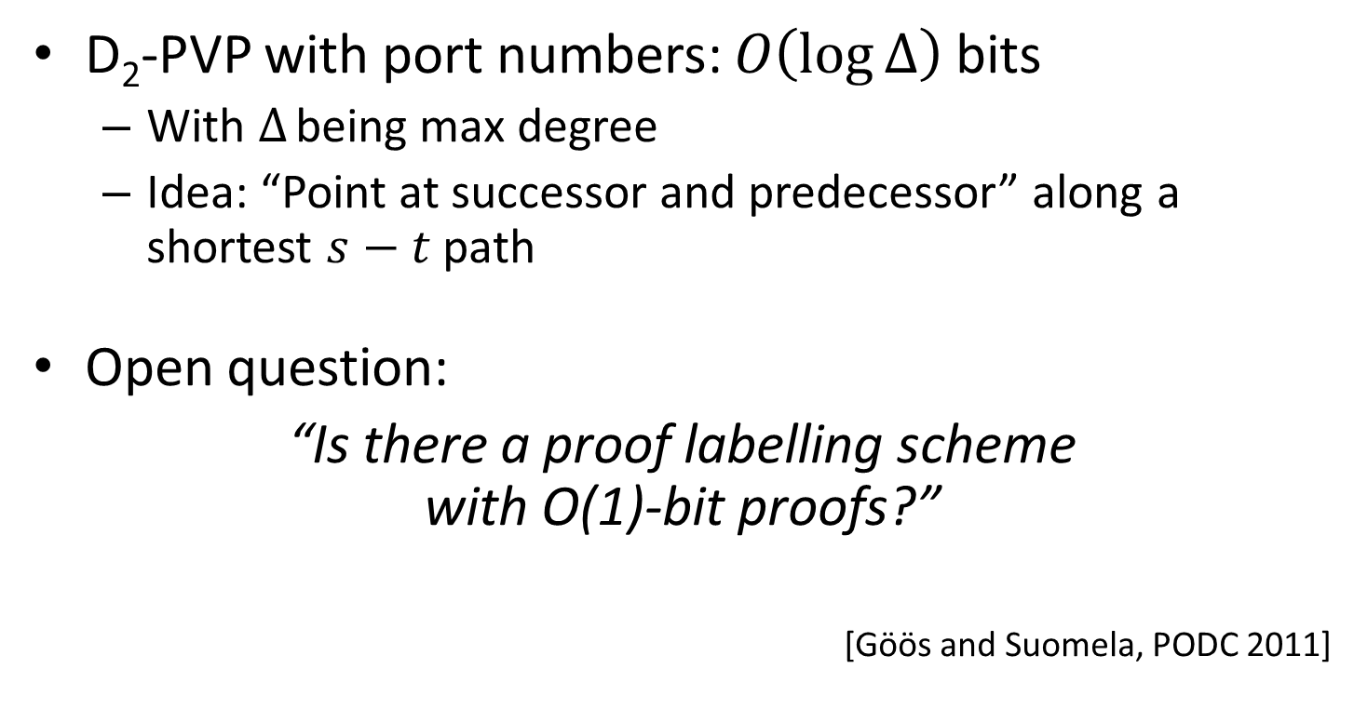

Directed $s−t$ Reachability
D₂-PVP with port numbers: $O\left(\log{Δ}\right)$ bits
  With $Δ$ being max degree
  Idea: “Point at successor and predecessor” along a shortest $s−t$ path
Open question:
“Is there a proof labelling scheme
with O(1)-bit proofs?”
  [Göös and Suomela, PODC 2011]

Slide 51
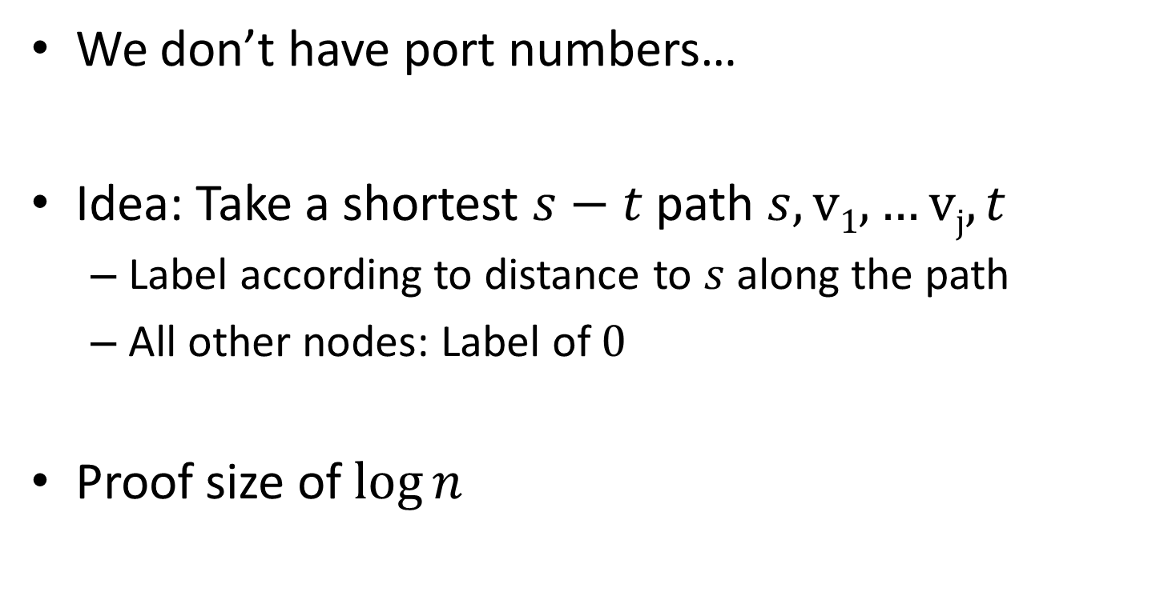

D₁-PVP for $s−t$ Reachability
We don’t have port numbers…
Idea: Take a shortest $s−t$ path $s,v1,…vj,t$
  Label according to distance to $s$along the path
  All other nodes: Label of $0$
Proof size of $\log{n}$

Slide 52



D₁-proof size: $Ω\left(\log{n}\right)$ bits
$$s$$
$$t$$

Slide 53
D₁-proof size: $Ω\left(\log{n}\right)$ bits
$$s$$
Yes
$$t$$

Slide 54



D₁-proof size: $Ω\left(\log{n}\right)$ bits
$$s$$
$$t$$
$$s$$
B
A
$$G:$$
$$t$$
A
C

Slide 55
D₁-proof size: $Ω\left(\log{n}\right)$ bits
$$s$$
$$t$$
$$s$$
B
A
$$G:$$
$$t$$
A
C

Slide 56



D₁-proof size: $Ω\left(\log{n}\right)$ bits
$$s$$
$$t$$
$$s$$
B
A
$$s$$
B
A
$$G:$$
$$H:$$
$$t$$
A
C
$$t$$
A
C

Slide 57

D₁-proof size: $Ω\left(\log{n}\right)$ bits
$$s$$
$$t$$
There is no D₁-PVP with $f(∆)$ bits!
$$s$$
B
A
$$s$$
B
A
$$G:$$
$$H:$$
$$t$$
A
C
$$t$$
A
C

Slide 58
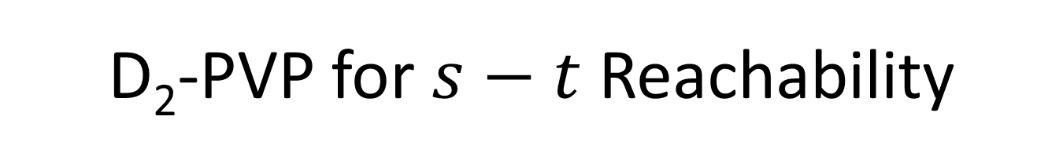
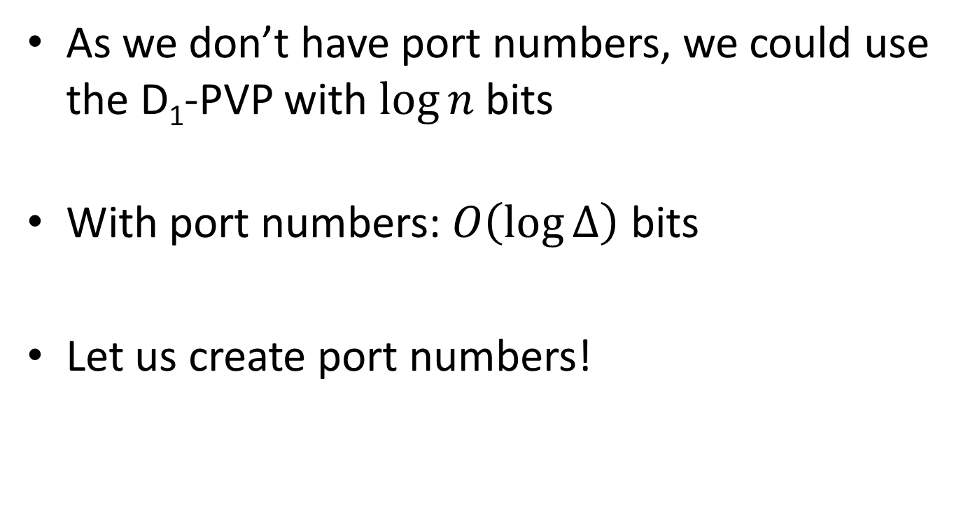
D₂-PVP for $s−t$ Reachability
As we don’t have port numbers, we could use the D₁-PVP with $\log{n}$bits
With port numbers: $O\left(\log{Δ}\right)$ bits
Let us create port numbers!

Slide 59
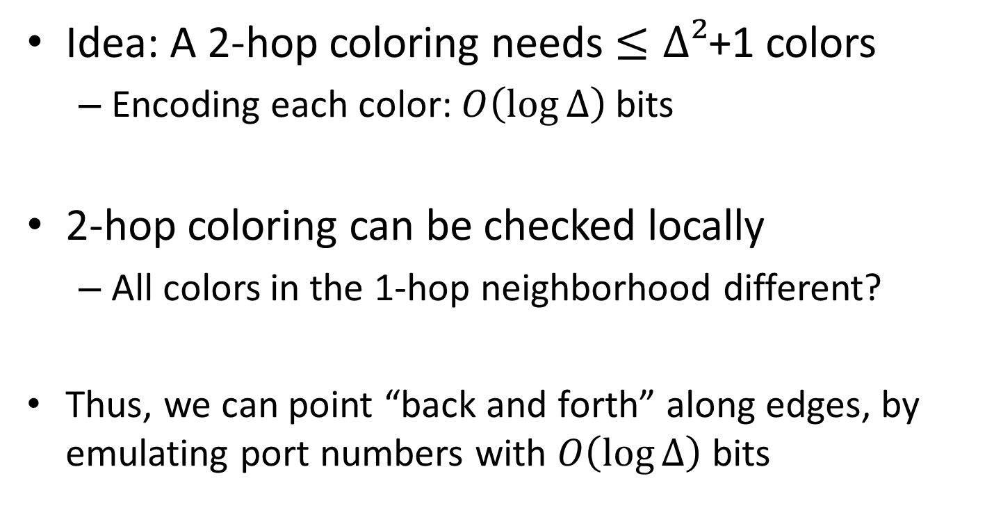


D₂-PVP for $s−t$ Reachability
Idea: A 2-hop coloring needs $≤∆²$+1 colors
  Encoding each color: $O\left(\log{Δ}\right)$ bits
2-hop coloring can be checked locally
  All colors in the 1-hop neighborhood different?
  Thus, we can point “back and forth” along edges, by emulating port numbers with $O\left(\log{Δ}\right)$ bits
$$s$$
$$t$$

Slide 60
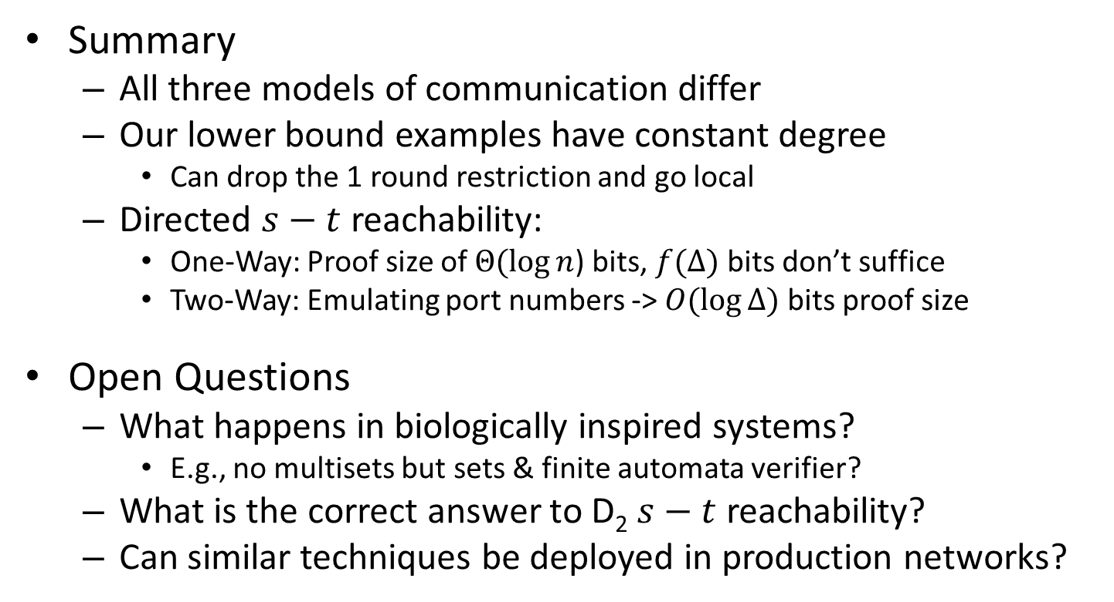
Conclusion
Summary
  All three models of communication differ
  Our lower bound examples have constant degree
    Can drop the 1 round restriction and go local
  Directed $s−t$ reachability:
    One-Way: Proof size of $Θ(\log{n}$) bits, $f(Δ)$ bits don’t suffice
    Two-Way: Emulating port numbers -> $O(\log{Δ})$ bits proof size
Open Questions
  What happens in biologically inspired systems?
    E.g., no multisets but sets & finite automata verifier?
  What is the correct answer to D₂ $s−t$ reachability?
  Can similar techniques be deployed in production networks?

Slide 61
Thank you
Klaus-Tycho Förster, Thomas Lüdi, Jochen Seidel, Roger Wattenhofer
January 06, 2016 @ ICDCN 2016 - Singapore

