Slide 1
Cluestr: Mobile Social Networking for Enhanced Group Communication
Reto Grob (Swisscom)
Michael Kuhn (ETH Zurich)
Roger Wattenhofer (ETH Zurich)
Martin Wirz (ETH Zurich)
GROUP 2009
Sanibel Island, FL, USA

Slide 2
Biggest online social network?

Slide 3
Facebook
(200M)
Orkut
(67M)
MySpace
(250M)
LinkedIn
(35M)
Classmates
(50M)
Windows Live
Spaces (120M)
E-Mail
(1.6B Internet users)
(March 2009)
Mobile Phone Contact Book
(4B mobile subscribers)
(March 2009)

Slide 4

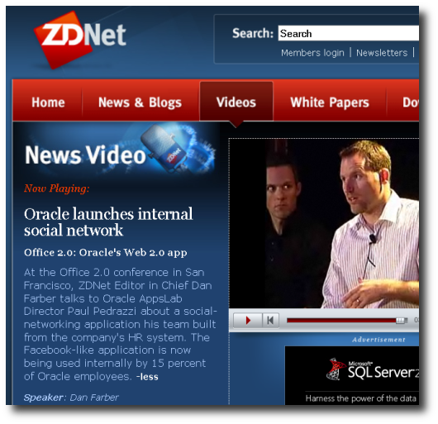
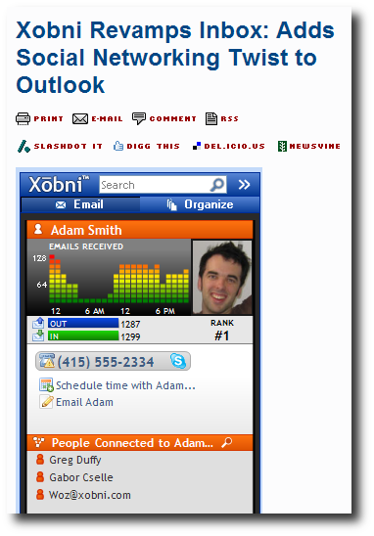

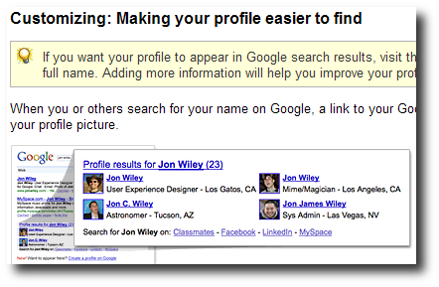
borders between offline and online interaction are diminishing

Slide 5
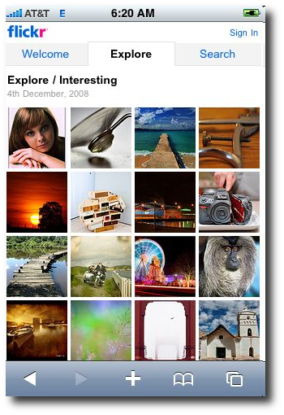
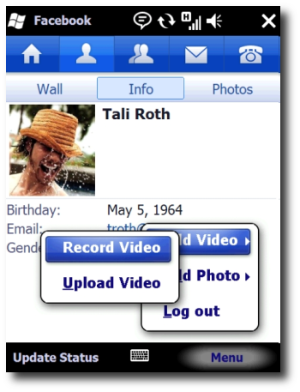
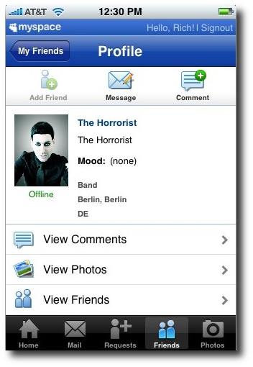

social interaction gets mobile

Slide 6
online communication gets mobile
virtual meets real-world communication
mobile group interaction

Slide 7
Our Survey
(342 participants from Europe)
„There‘s no
training tonight!“
„What movie are we
going to watch?“
„Be home
at 8pm!“
little support in current devices
hardly anybody is willing to manually maintain groups

Slide 8
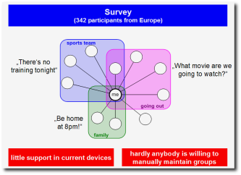
How to bridge this gap?
Our approach:
mechansim for group initialization on mobile devices

Slide 9
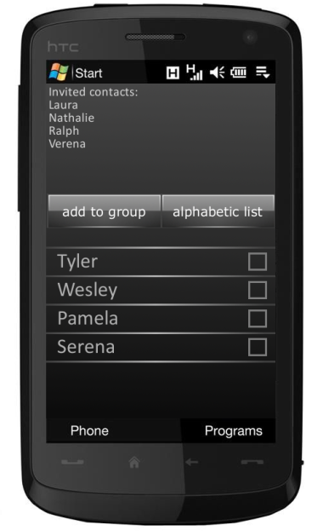
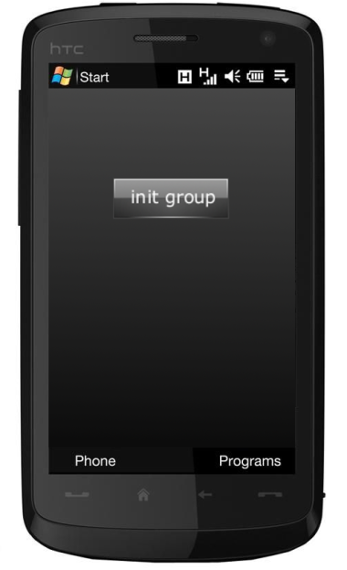
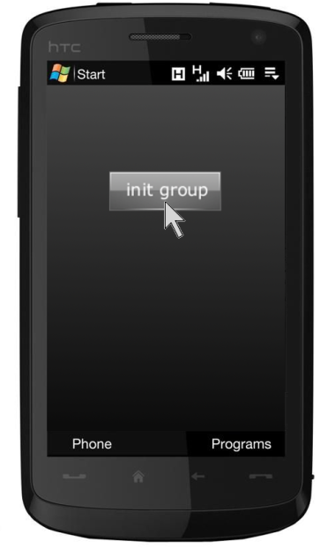
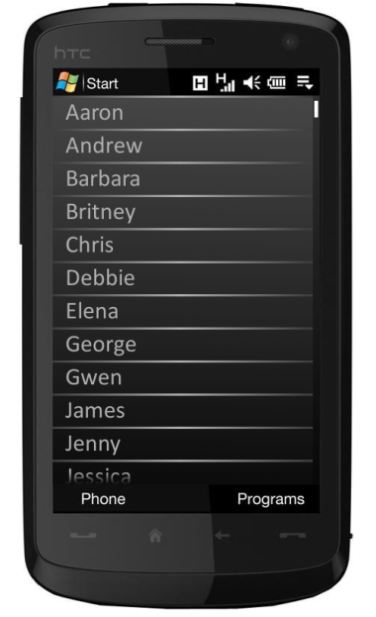
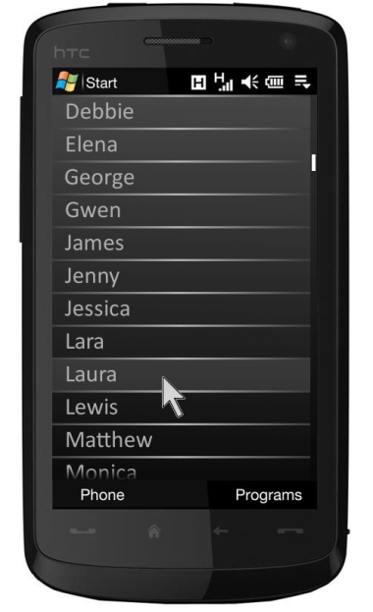
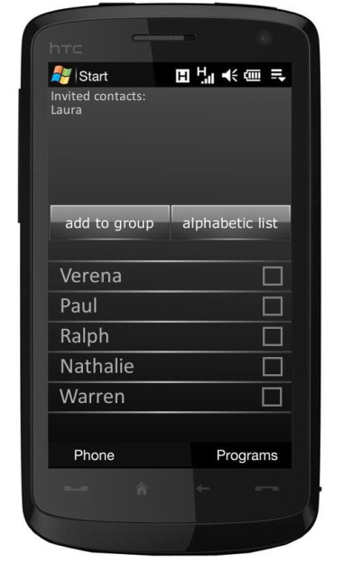
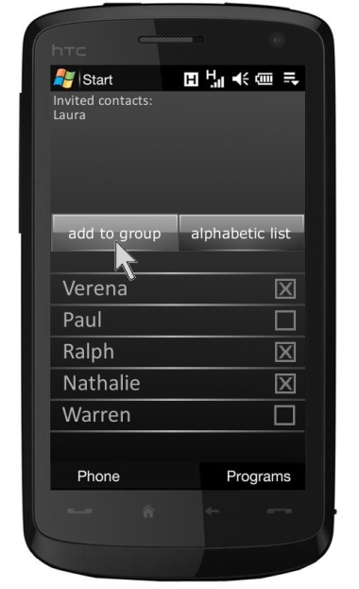
updated group
recommended contacts
group
(i.e. „invited“ contacts)
new recommendations

Slide 10

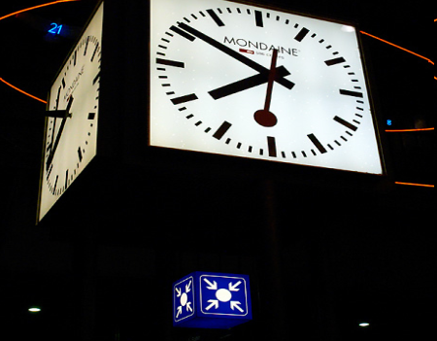
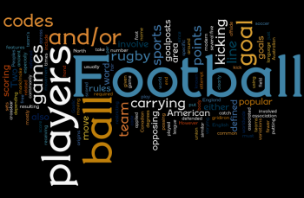
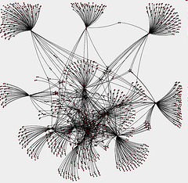
How to know which contacts to recommend?
manual grouping
analysis of communication patterns
semantic analysis
analysis of social network

Slide 11



Architecture

Slide 12
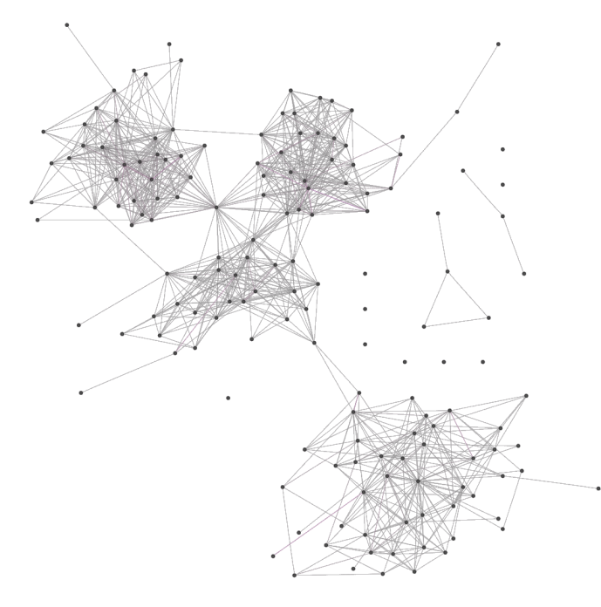
social network => recommendation?
recommend best connected contacts
Either: device needs to know inter-friend-connections
=> privacy
Or: server needed for each recommendation step
=> server load
=> tunnel/mountains
=> traffic/costs
clustering

Slide 13
clusters approximate communities!

Slide 14
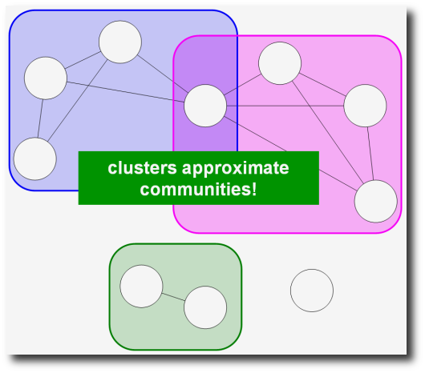
Clustering for Recommendation:
send request to the server
server returns clusters
use clusters for recommendations
only once for entire recommendation process
if no connection available, old data can be used

Slide 15
4
6
currently invited group

Slide 16
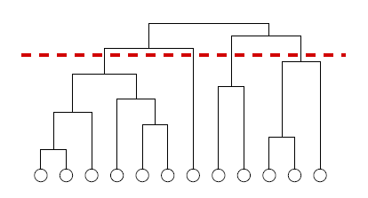
CONGA
S. Gregory. An algorithm to find overlapping community structure in networks.
In PKDD, 2007
Hierarchical, divisive algorithm to cluster undirected, unweighted networks
Based on algorithm presented by Girwan an Newman in 2002
Extended to allow overlapping clusters

Slide 17
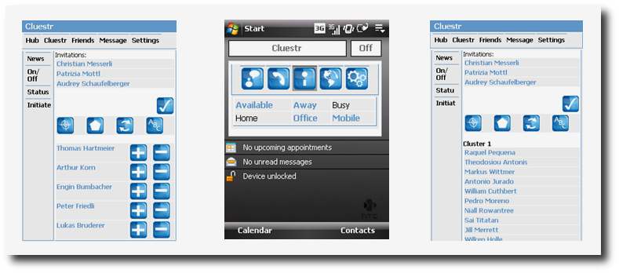
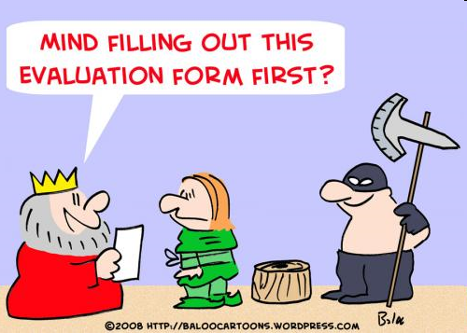
cluestr

Slide 18

Evaluation
Clustering accurracy
  How well do clusters
  represent communities?
Effect of sparsity
  How well do algorithms perform in bootstrapping phase?
Performance of group initialization
  How much time can be saved during group initialization?

Slide 19

Ground Truth
Friend-of-friend information for mobile phone contacts not available
Facebook data
  4 subjects (2 male, 2 female)
  assigned contacts to communities

Slide 20

identified by algorithm
identified by subjects (ground truth)
F-measure:

Slide 21
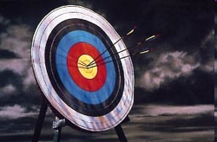
Clustering Accuracy
How well do clusters represent communities?
Number of clusters well matches number of communities
 | Recall | Precision | F-Measure
Average | 0.83 | 0.82 | 0.83

Slide 22
Effects of Sparsity
Bootstrapping
  Only few participants
  Missing friendship links
Randomly removed links (10%-90%)
Randomly removed nodes (10%-90%)
How well does clustering work under such conditions?
cluster sizes shrink only slowely
precision stays,
recall moderately decays
precision and recall only slightly decay
non-existing nodes cannot be recommended

Slide 23
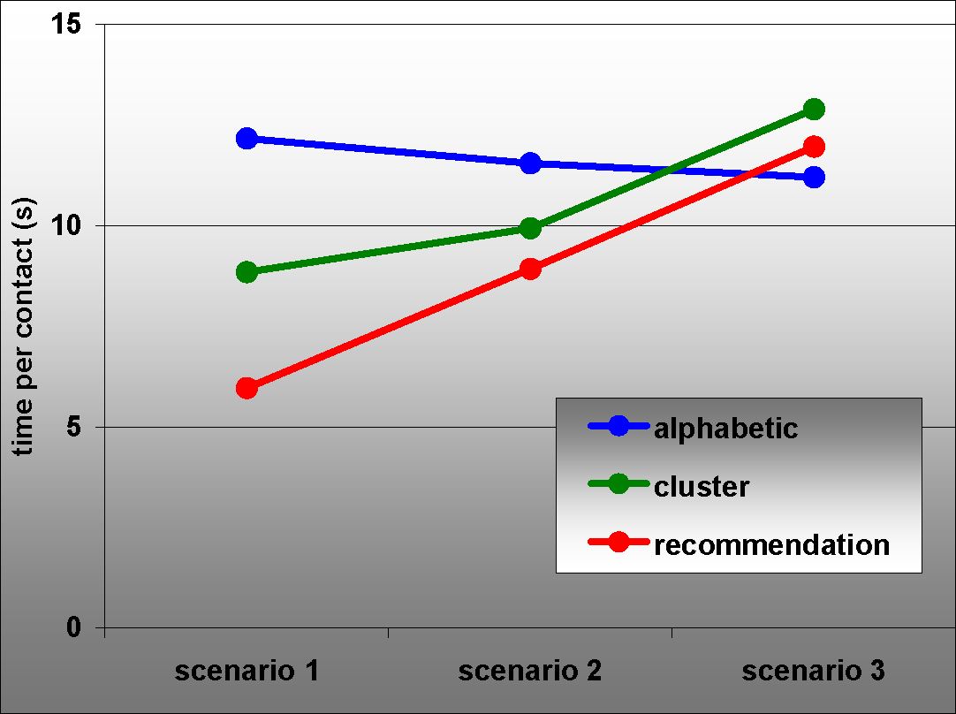
Time Savings
Community related: Considerable time savings
Random:
only slightly slower
Sending message to contacs of a community
Sending message to some contacs of a community
Sending message to random contacts

Slide 24
Conclusion
We have shown that:
  Social network contains community information
  This information can be extracted by clustering algorithms
  The clusters can be used for contact recommendation
  Such recommendations save a significant amount of time
Our work bridges gap identified by our survey:
  Group interaction is important, but badly supported by current devices

Slide 25
Questions?

