Slide 1
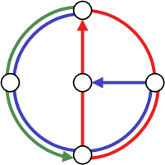

Ad-Hoc and Sensor Networks
Worst-Case vs. Average-Case
IZS 2004
Distributed
Computing
Group
Roger Wattenhofer

Slide 2
Overview
Paper is a short survey, err… opinion!
Routing in Ad-Hoc Networks
  What are Ad-Hoc Networks?
  What is Routing?
  What is known?
Dominating Set Based Routing
… even more opinion!

Slide 3

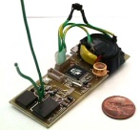






Radio
Power
Wireless ad-hoc
nodes (“terminodes”)
are distributed
Processor
Sensor?
Memory
Notes:
Picture is from the Berkeley Smart Dust project: The RF motes' final design was finished in the early part of 1999. Since then, various projects have been undertaken to test communication protocols for distributed sensor networks with the RF motes.

Slide 4
What are Ad-Hoc Networks?

Slide 5
Routing in Ad-Hoc Networks
Multi-Hop Routing
  Moving information through a network from a source to a destination if source and destination are not within
  transmission range of each other
Reliability
  Nodes in an ad-hoc network are not 100% reliable
  Algorithms need to find alternate routes when nodes are failing
Mobile Ad-Hoc Network (MANET)
  It is often assumed that the nodes are mobile (“Moteran”)

Slide 6
Simple Classification of Ad-hoc Routing Algorithms
Proactive Routing
Small topology changes trigger a lot of updates, even when there is no communication
→ does not scale
Reactive Routing
Flooding the whole network does not scale
Distance Vector Routing:
as in a fixnet nodes
maintain routing tables
using update messages
Flooding:
when node received
message the first time,
forward it to all neighbors
no mobility
critical mobility
mobility very high
Source Routing (DSR, AODV):
flooding, but re-use old routes
Notes:
DSDV
10 tricks → 2^10 algorithms

Slide 7
Discussion
Lecture “Mobile Computing”: 10 Tricks → 2¹⁰ routing algorithms
In reality there are almost that many!
Q: How good are these routing algorithms?!? Any hard results?
A: Almost none! Method-of-choice is simulation…
Perkins: “if you simulate three times, you get three different results”
Flooding is key component of (many) proposed algorithms
At least flooding should be efficient
Notes:
Wattenhofer: “even if you don’t implement provably good algorithms (because they are too complicated, or too simple), they still help you to understand the problem”

Slide 8
Overview
Paper is a short survey, err… opinion!
Routing in Ad-Hoc Networks
Dominating Set Based Routing
  Flooding vs. Dominating Sets
  Algorithm Overview
  Phase A
  Phase B
… even more opinion!

Slide 9
Finding a Destination by Flooding
Notes:
One active node > weight 1

Slide 10
Finding a Destination Efficiently
Notes:
One active node > weight 1

Slide 11
(Connected) Dominating Set
A Dominating Set DS is a subset of nodes such that each node is either in DS or has a neighbor in DS.
A Connected Dominating Set CDS is a connected DS, that is, there is a path between any two nodes in CDS that does not use nodes that are not in CDS.
It might be favorable to
have few nodes in the
(C)DS. This is known as the
Minimum (C)DS problem.
Notes:
Dominating set problem:
how many queens do you need to attack/own all 64 squares of the chess board. How many for a CDS?
Popular in 1850 among chess players
(also famous: maximum independent set)
Answer 5. rows 2,3,4,5,8 in column D, is also CDS. Show it! Ask them what they think.
Dominating set is an important problem. Domination number \gamma of a graph is the size of the smallest dominating set

Slide 12
Formal Problem Definition: M(C)DS
Input: We are given an (arbitrary) undirected graph.
Output: Find a Minimum (Connected) Dominating Set,
that is, a (C)DS with a minimum number of nodes.
Problems
  M(C)DS is NP-hard
  Find a (C)DS that is “close” to minimum (approximation)
  The solution must be local (global solutions are impractical for mobile ad-hoc network) – topology of graph “far away” should not influence decision who belongs to (C)DS

Slide 13
Overview
Paper is a short survey, err… opinion!
Routing in Ad-Hoc Networks
Dominating Set Based Routing
  Flooding vs. Dominating Sets
  Algorithm Overview
  Phase A
  Phase B
… even more opinion!

Slide 14
Algorithm Overview
Input:
Local Graph
Fractional
Dominating Set
Dominating
Set
Connected
Dominating Set
0.2
0.2
0.5
0
0.3
0
0.3
0.8
0.5
0.2
0.1
Phase A:
Distributed
linear program
rel. high degree
gives high value
Phase B:
Probabilistic
algorithm
Phase C:
Connect DS
by “tree” of
“bridges”

Slide 15
Overview
Paper is a short survey, err… opinion!
Routing in Ad-Hoc Networks
Dominating Set Based Routing
  Flooding vs. Dominating Sets
  Algorithm Overview
  Phase A
  Phase B
… even more opinion!

Slide 16
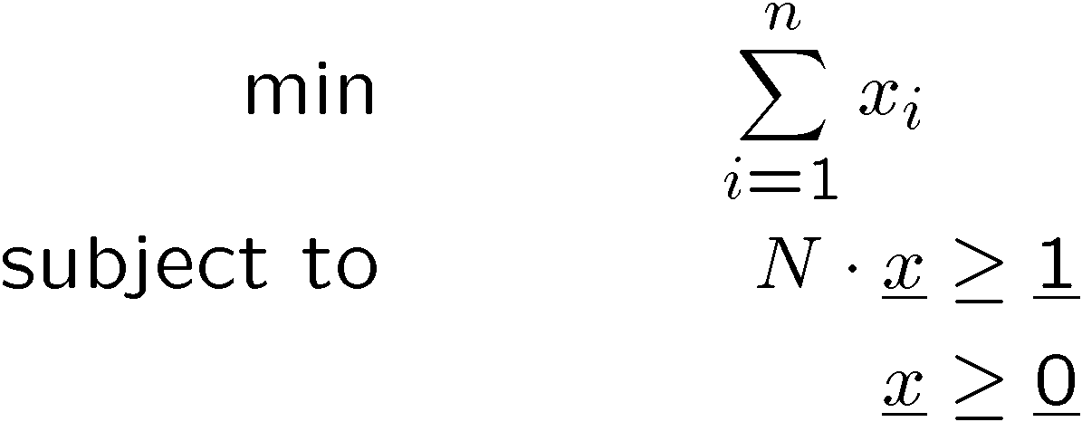
Phase A is a Distributed Linear Program
Nodes 1, …, n: Each node u has variable x_{u} with x_{u} ¸ 0
Sum of x-values in each neighborhood at least 1 (local)
Minimize sum of all x-values (global)
0.5+0.3+0.3+0.2+0.2+0 = 1.5 ¸ 1
Linear Programs can be solved optimally in polynomial time
But not in a distributed fashion! That’s what we do here…
Linear Program
0.2
0.2
0.5
0
0.3
0
0.3
0.8
0.5
0.2
0.1
Adjacency matrix
with 1’s in diagonal

Slide 17
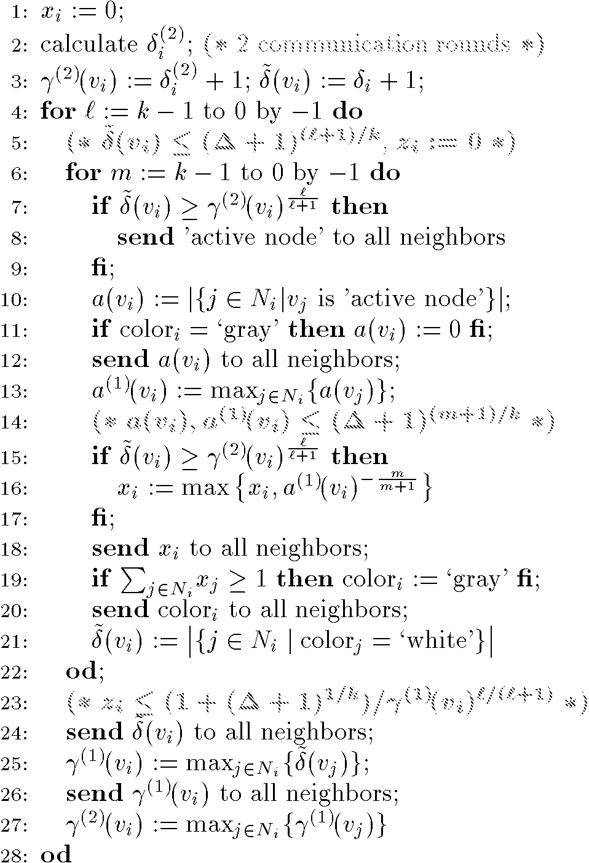
Phase A Algorithm
Notes:
A constant series of steps. In each step each node talks to all the neighbors, and then does local computation…

Slide 18
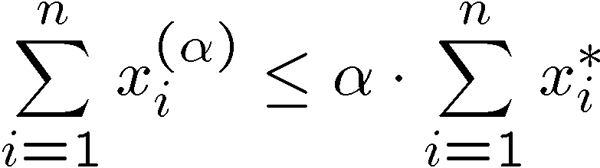
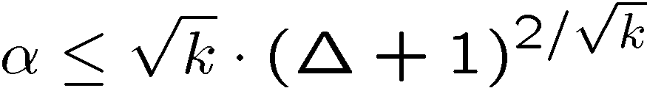
Result after Phase A
Distributed Approximation for Linear Program
Instead of the optimal values x_{i}* at nodes, nodes have x_{i}^{(α)}, with
The value of α depends on the number of rounds k (the locality)
Notes:
For some special kind of graphs alpha with only 1 round (regular graphs)

Slide 19
Overview
Paper is a short survey, err… opinion!
Routing in Ad-Hoc Networks
Dominating Set Based Routing
  Flooding vs. Dominating Sets
  Algorithm Overview
  Phase A
  Phase B
… even more opinion!

Slide 20

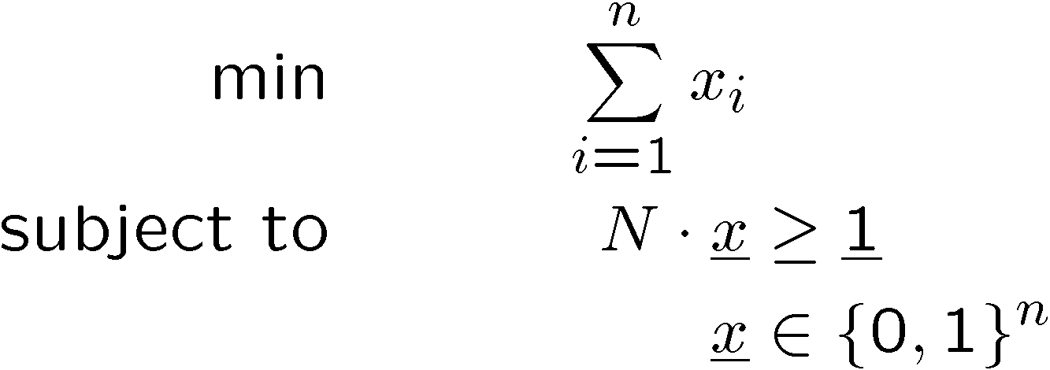

Dominating Set as Integer Program
What we have after phase A
What we want after phase B

Slide 21
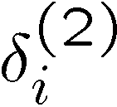
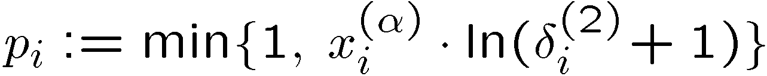
Phase B Algorithm
Each node applies the following algorithm:
Calculate (= maximum degree of neighbors in distance 2)
Become a dominator (i.e. go to the dominating set) with probability
Send status (dominator or not) to all neighbors
If no neighbor is a dominator, become a dominator yourself
From phase A
Highest degree in distance 2
Notes:
1 takes two rounds…

Slide 22
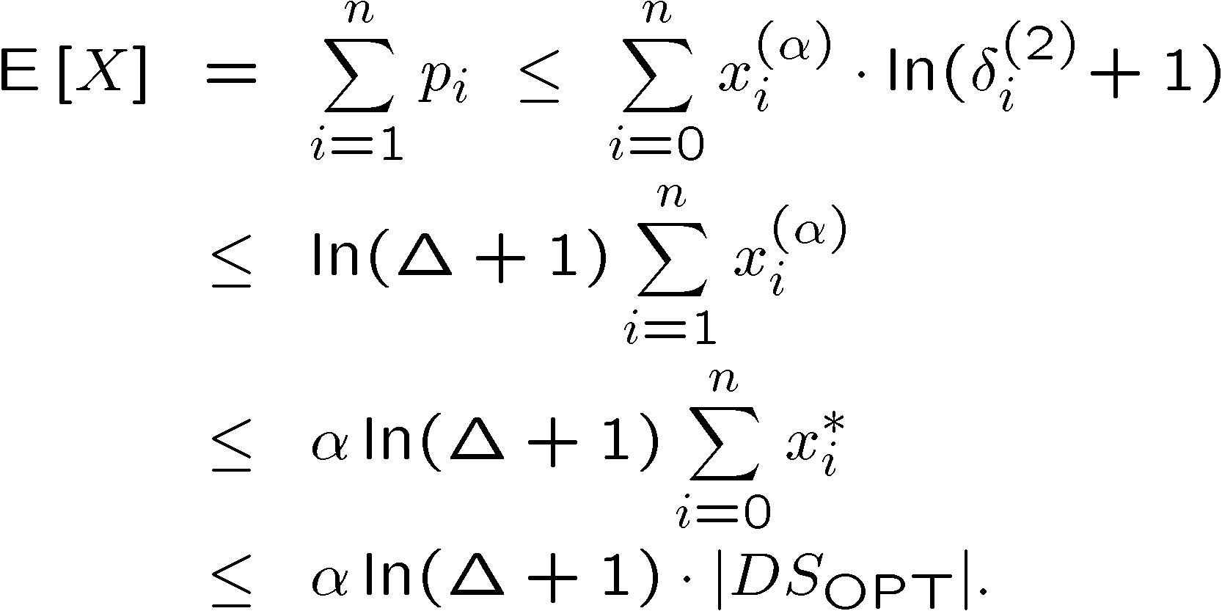
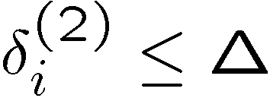
Expected number of dominators in step 2
By definition
By step 2:
Using Phase A:
x_{i}* is the optimum

Slide 23
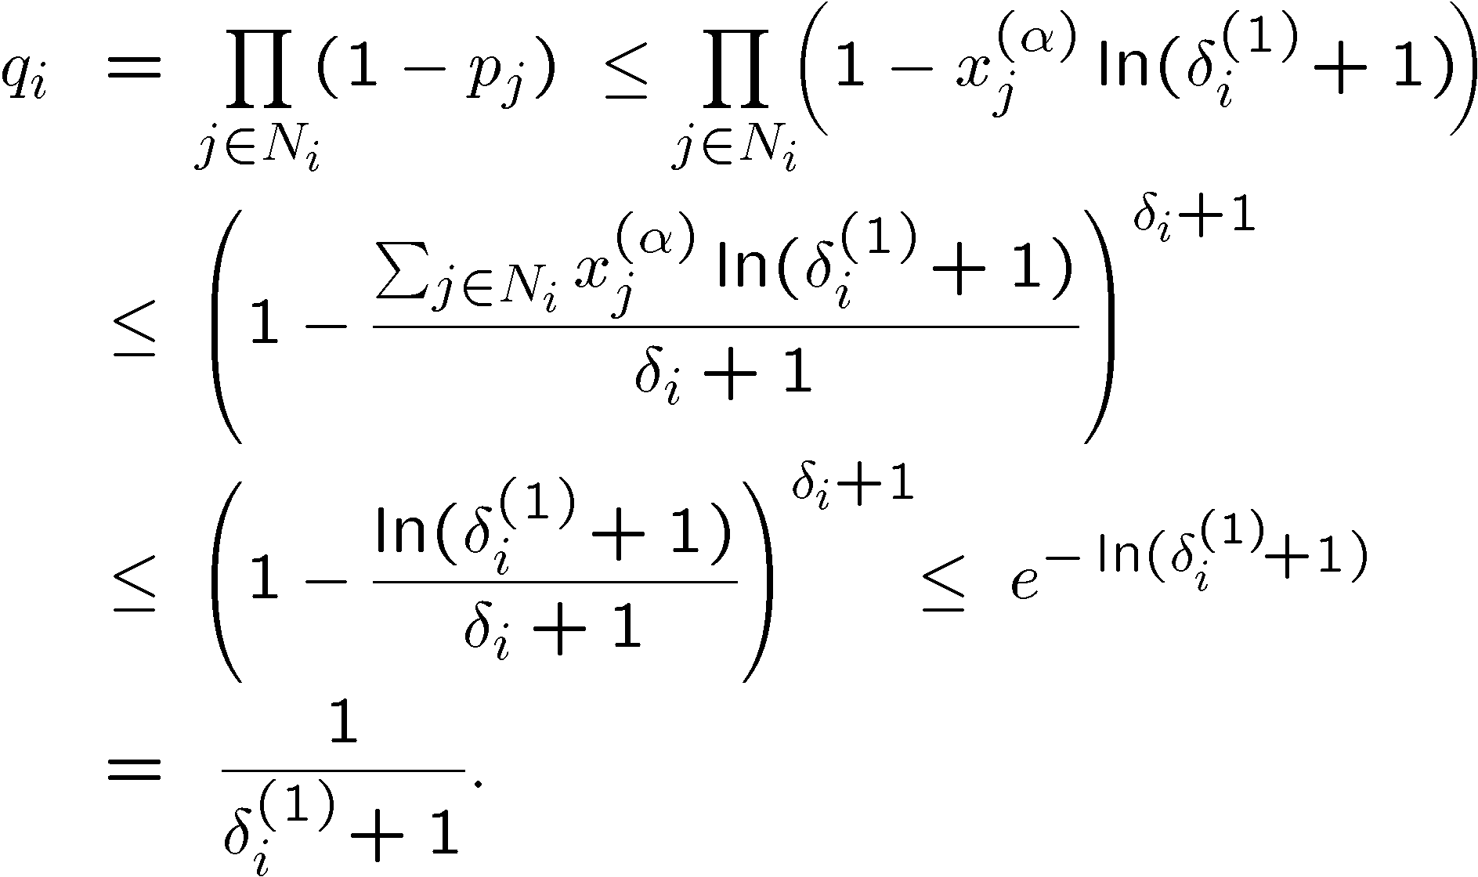
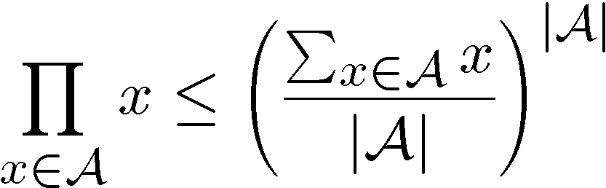
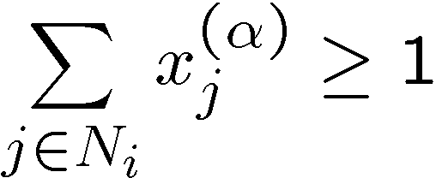
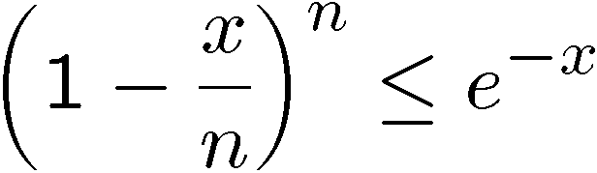
Expected number of additional dominators in step 4
Pr[node i not dominated]
No neighbor dominator after step 2

Slide 24
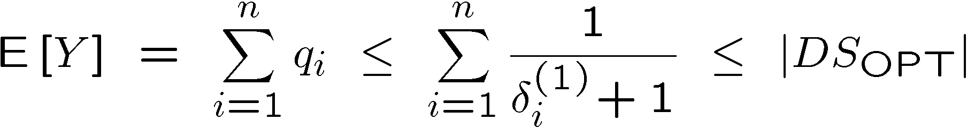
Result after Phase B
With
Not covered nodes
become dominators
Previous slide
Solution of Dual LP,
and Dual · Primal
Theorem: E[|DS|] · O(α ln Δ ¢ |DS_{OPT}|)

Slide 25
Milestones in (Connected) Dominating Sets
Global algorithms
  Johnson (1974), Lovasz (1975), Slavik (1996): Greedy is optimal
  Guha, Kuller (1996): An optimal algorithm for CDS
  Feige (1998): ln Δ lower bound unless NP 2 n^{O(log log n)}
Local (distributed) algorithms
  “Handbook of Wireless Networks and Mobile Computing”: All algorithms presented have no guarantees
  Gao, Guibas, Hershberger, Zhang, Zhu (2001): “Discrete Mobile Centers” O(loglog n) time, but nodes know coordinates
  Kuhn, Wattenhofer (2003): Tradeoff time vs. approximation

Slide 26
Improvements
Improved algorithms (Kuhn, Wattenhofer, 2004):
  O(log²Δ / ε⁴) time for a (1+ε)-approximation of phase A with logarithmic sized messages.
  If messages can be of unbounded size there is a constant approximation of phase A in O(log n) time, using the graph decomposition by Linial and Saks.
  An improved and generalized distributed randomized rounding technique for phase B.
Lower bounds (Kuhn, Moscibroda, Wattenhofer, 2004):
  Several lower bounds: It is for example shown that a polylogarithmic dominating set approximation needs at least Ω(log Δ / loglog Δ) time. Therefore the unbounded message algorithm is almost tight.

Slide 27
Overview
Paper is a short survey, err… opinion!
Routing in Ad-Hoc Networks
Dominating Set Based Routing
… even more opinion!

Slide 28
What does a typical ad-hoc network look like?
?

Slide 29
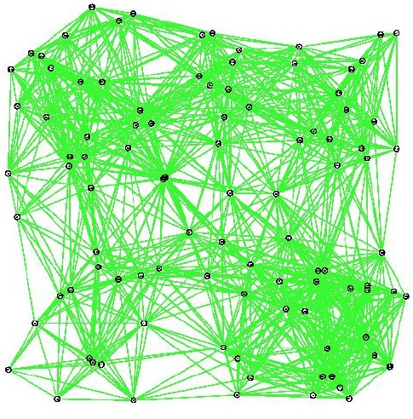
Like this?

Slide 30
Like this?
Notes:
One active node > weight 1

Slide 31
Or rather like this?
Notes:
One active node > weight 1

Slide 32
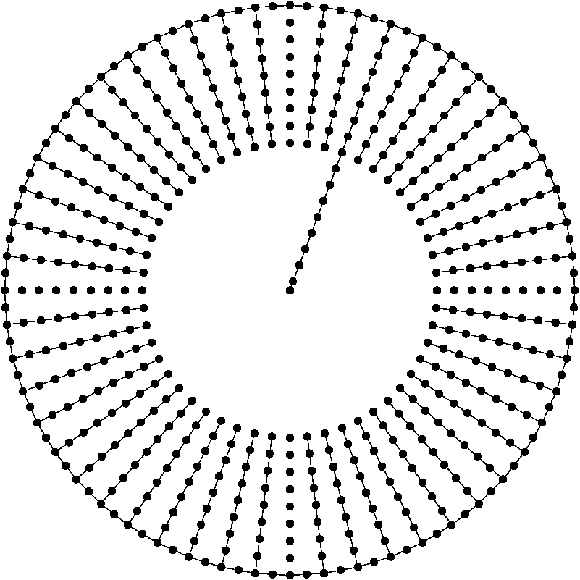
Or even like this?

Slide 33
What about typical mobility?
Brownian Motion?
Random Way-Point?
Statistical Data Model?
Maximum Speed Model?
No Mobility at all?!?

Slide 34
Has anybody ever seen a typical ad-hoc network?!?
If yes, please tell me what it looks like!
Opinion:
Why does the majority of the researchers assume that ad-hoc nodes are distributed uniformly at random? Do results that base on uniformity assumption work for “real” ad-hoc networks?

Slide 35
Overview of our Ad-Hoc/Sensor Networking Research
Research Question | Average-Case Algo | Worst-Case Algo
Backbone | Marking | k-Local
Topology Control | K-Neigh | XTC
Geo-Routing | Greedy Routing | GOAFR+
Positioning | DV-Hop of APS | GHoST
Data Gathering | “MST/TSP” | Broadcast/Echo
Interference | Topology Control | LITE & LISE
Multihop Initialization | MIS | Probabilistic DS
Models | Euclidean UDG | Quasi-UDG

Slide 36
Lessons to be learned?
Average-case µ Worst-case (A worst-case algorithm also works in the average-case, but not vice versa)
Average-case as great source of inspiration
Algorithm should at least be correct (whatever that means)!
It seems to be easier to tune a worst-case algorithm for the average case than vice versa (e.g. AFR → GOAFR+)

Slide 37
Questions?
Comments?
Distributed
Computing
Group
Roger Wattenhofer
Thanks to my students Fabian Kuhn, Aaron Zollinger, Regina Bischoff,
Thomas Moscibroda, Pascal von Rickenbach, Martin Burkhart, etc.

