Slide 1
Sharing a Medium
Between Concurrent Protocols Without Overhead
Using the Capture Effect
Michael König
Roger Wattenhofer

Slide 2


Wireless Sensor Networks

Slide 3
Priority Traffic – CSMA
?
?

Slide 4
Priority Traffic – Scheduling

Slide 5
The Capture Effect

Slide 6
The Capture Effect

Slide 7
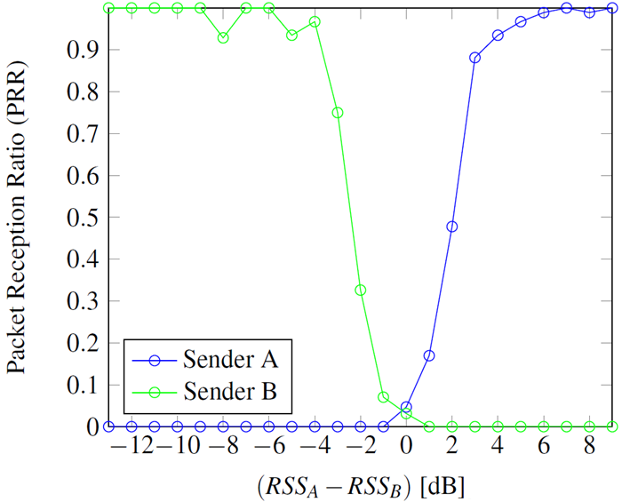
The Capture Effect – Power Difference

Slide 8
The Capture Effect – Packet Timing
(weaker)
Preamble
SFD
Len
Payload ...
(stronger)
Preamble
SFD
Len
Payload ...
Time

Slide 9
The Capture Effect – Packet Timing
(weaker)
Preamble
SFD
Len
Payload ...
(stronger)
160 µs
Preamble
SFD
Len
Payload ...
Time

Slide 10
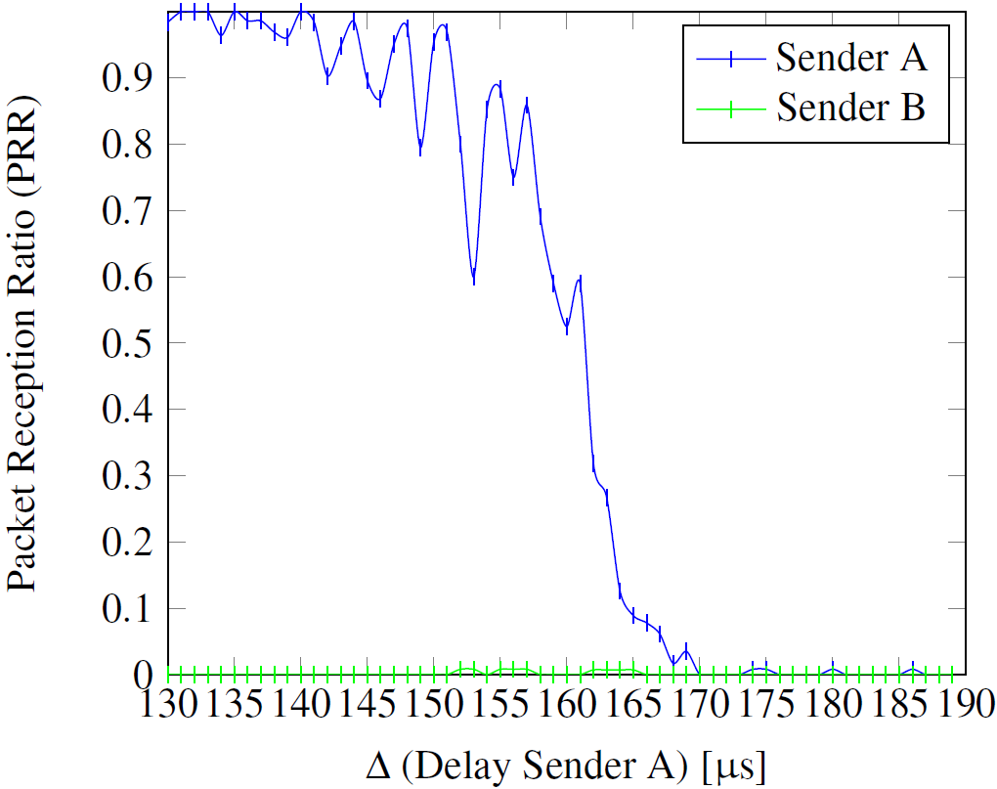
The Capture Effect – Packet Timing

Slide 11
Priority Traffic – Using the Capture Effect

Slide 12
Halfway Summary
Method | Alarm Delay | Regular Operation Impairment
CSMA | Arbitrarily large | None
Scheduling | Bounded | Constant fraction
Capture Effect | None | None
*

Slide 13
Network Heterogeneity
vs

Slide 14

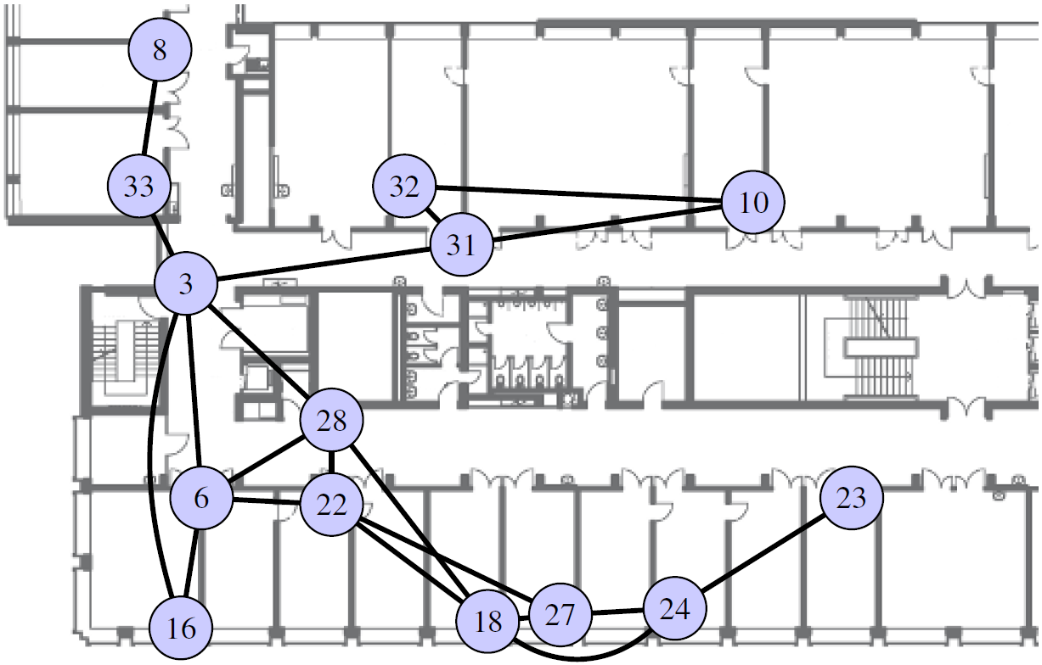
Testbed Example

Slide 15
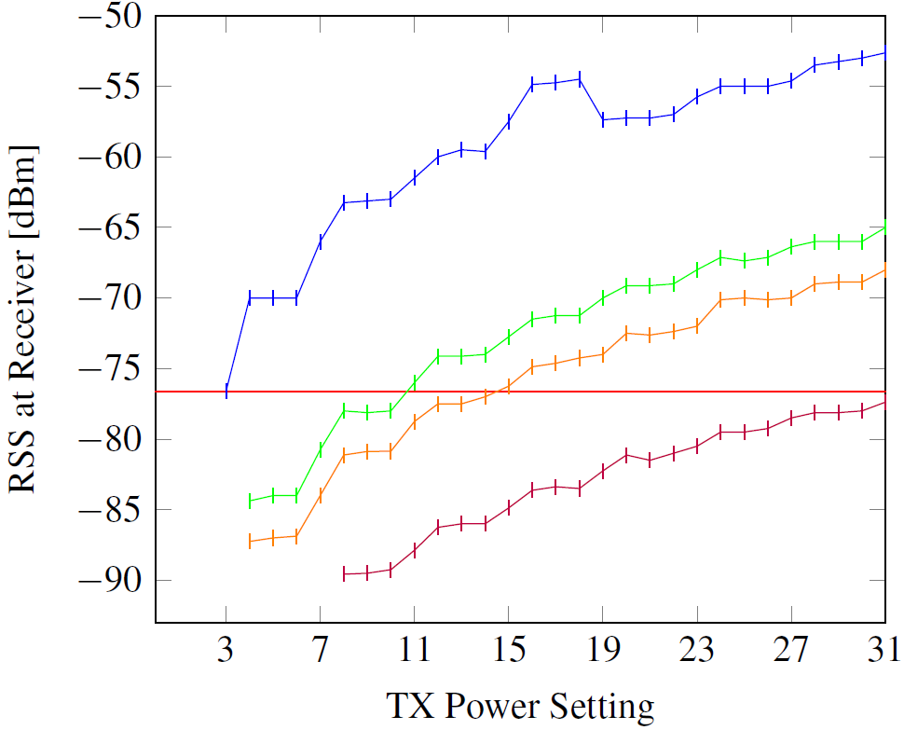
Network Heterogeneity

Slide 16
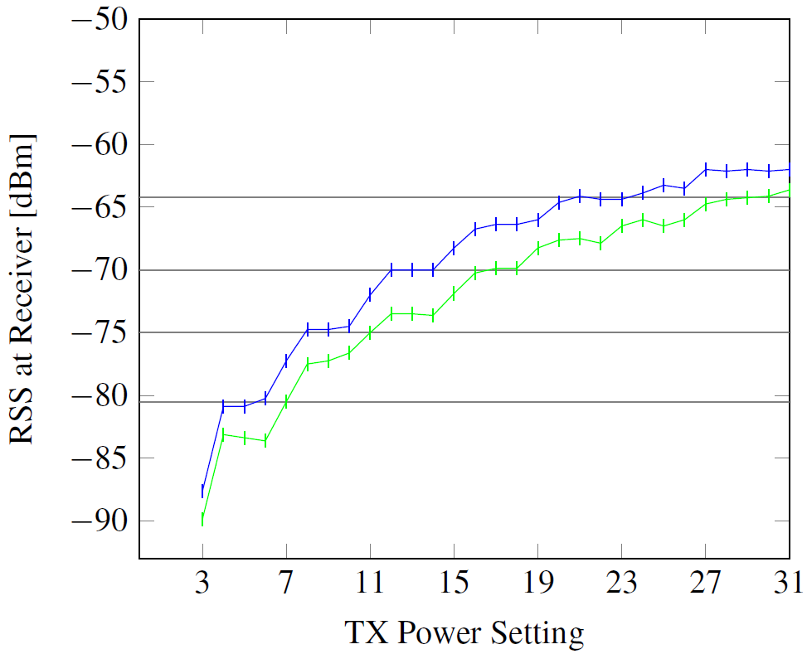
Network Heterogeneity

Slide 17
“Layer” Abstraction: Receiving
-64 dBm
Layer 4
-70 dBm
Layer 3
-75 dBm
Layer 2
-81 dBm
Layer 1

Slide 18
“Layer” Abstraction: Sending
Layer 4
Layer 3
Layer 2
Layer 1

Slide 19
“Layer” Abstraction
Layer 4
Layer 3
Layer 2
Layer 1

Slide 20
“Layer” Abstraction: Caveat
Layer 4
Layer 3
Layer 2
Layer 1

Slide 21
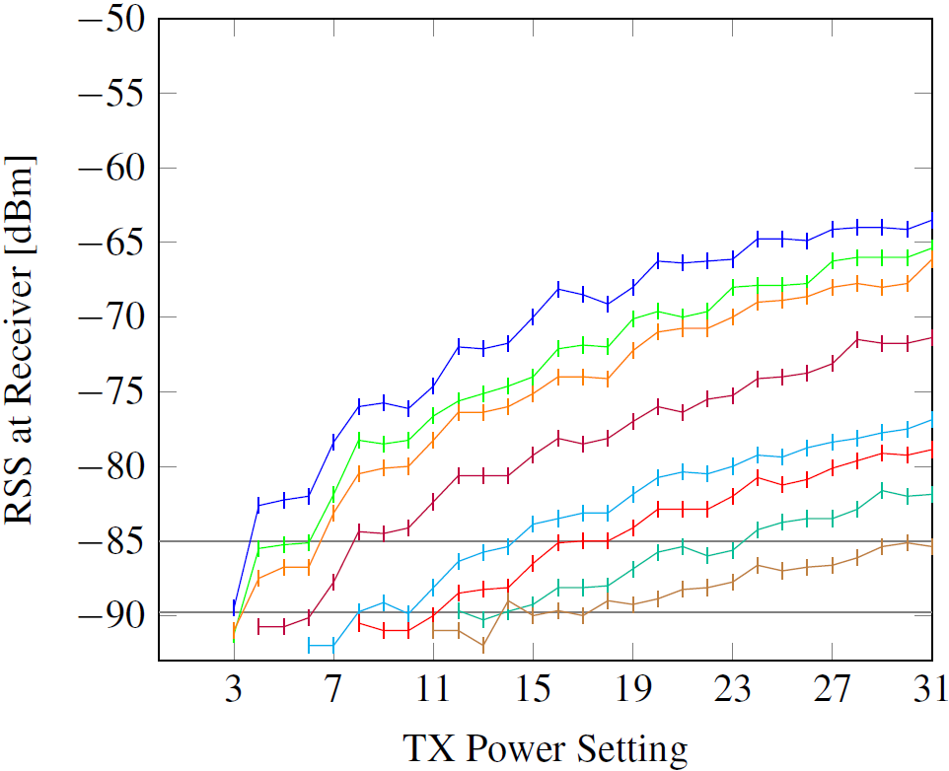
Feasible number of layers
vs

Slide 22
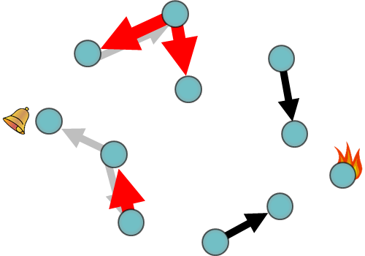
Summary
Layer 4
Layer 3
Layer 2
Layer 1

Slide 23
Questions
Michael König

Slide 24
Backup Slides

Slide 25
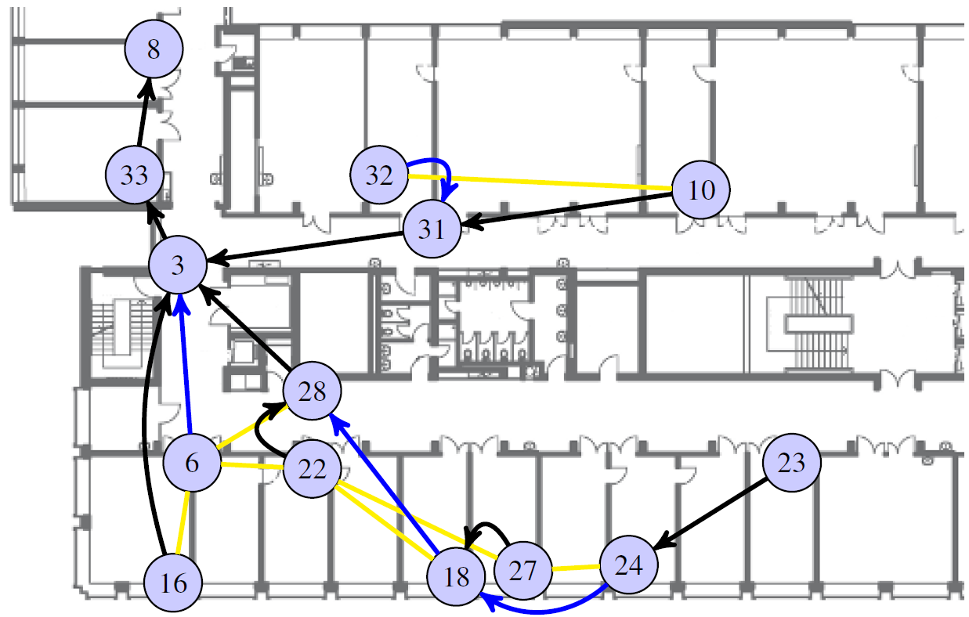
Layer 1 - Convergecast

