Slide 1
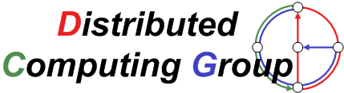
Gradient Clock Synchronization in Wireless Sensor Networks
Philipp Sommer
Roger Wattenhofer

Slide 2
Time Synchronization is a well-studied Problem
Time, Clocks, and the Ordering of Events in a Distributed System
L. Lamport, Communications of the ACM, 1978.
Internet Time Synchronization: The Network Time Protocol
D. Mills, IEEE Transactions on Communications, 1991
Reference Broadcast Synchronization (RBS)
J. Elson, L. Girod and D. Estrin, OSDI'02
Timing-sync Protocol for Sensor Networks (TPSN)
S. Ganeriwal, R. Kumar and M. Srivastava, SenSys'03
Flooding Time Synchronization Protocol (FTSP)
M. Maróti, B. Kusy, G. Simon and Á. Lédeczi, SenSys'04
and many more ...
State-of-the-art time sync protocol for wireless sensor networks

Slide 3
Preview: FTSP vs. GTSP
NEW
Gradient Time Synchronization Protocol (GTSP)
  Details will follow soon
Network synchronization error (global skew)
  Pair-wise synchronization error between any nodes in the network
FTSP (avg: 7.7 μs)
GTSP (avg: 14.0 μs)

Slide 4
Preview: FTSP vs. GTSP (2)
Neighbor Synchronization error (local skew)
  Pair-wise synchronization error between neighboring nodes
Synchronization error between two direct neighbors
FTSP (avg: 15.0 μs)
GTSP (avg: 2.8 μs)

Slide 5
Time in Sensor Networks
Common time is essential for many applications:
  Assigning a global timestamp to sensed data/events
  Co-operation of multiple sensor nodes
  Precise event localization (e.g., shooter detection)
  Coordination of wake-up and sleeping times (energy efficiency)
  TDMA-based MAC layer
Global
Global
Local
Local
Local

Slide 6
Outline
Introduction
Clock Synchronization Basics
Gradient Time Synchronization Protocol (GTSP)
Evaluation
Conclusions

Slide 7
Sensor Node Clocks
Each node has a hardware clock H(t)
  Counter register of the microcontroller
  Crystal quartz oscillator (e.g., 32kHz, 7.37 MHz)
  Subject to clock drift (30 ppm)
Each node has a logical clock L(t)
  Holds the estimation of the current global time
  Computed as a function of the current hardware clock H(t)
  Logical clock rate

Slide 8
Clock Synchronization Algorithm
Exchange messages with current clock value L(t) with others
  Adjust clock rates and offset
  Repeat this process frequently
Uncertainty (jitter) in the message delay
  Various sources of errors (deterministic and undeterministic)
  Can be reduced (but not eliminated) by timestamping at MAC layer

Slide 9
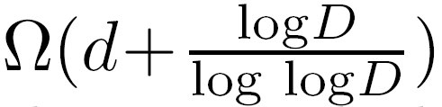
Theoretical Bounds on the Synchronization Accuracy
Two nodes u and v cannot be synchronized perfectly
  Worst-case example:
Error increases with distance from the reference node
Lower bound result from theoretical work
  Clock error between nodes distance d apart depends on the network diameter D:
  R. Fan and N. Lynch. Gradient Clock Synchronization. In PODC ’04: Proceedings of the twenty-third annual ACM symposium on principles of distributed computing, 2004.
u
u
0
1
2
3
0
1
2
3
μ
μ + ε
v
v
0
1
2
3
0
1
2
3

Slide 10
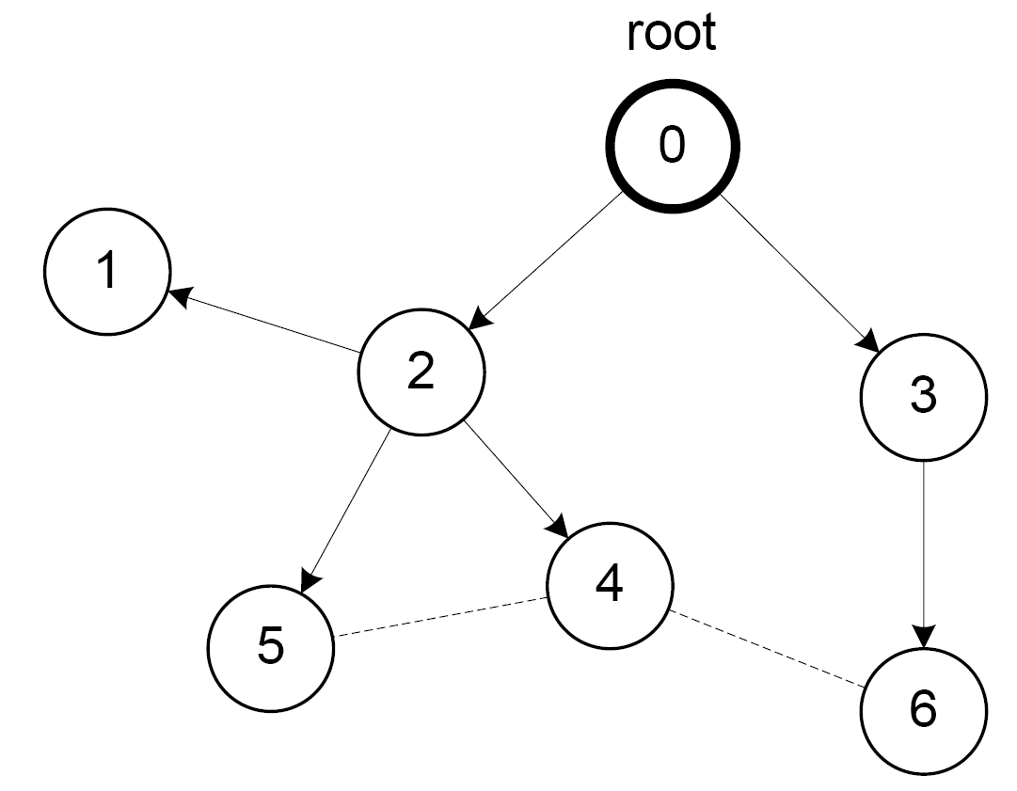
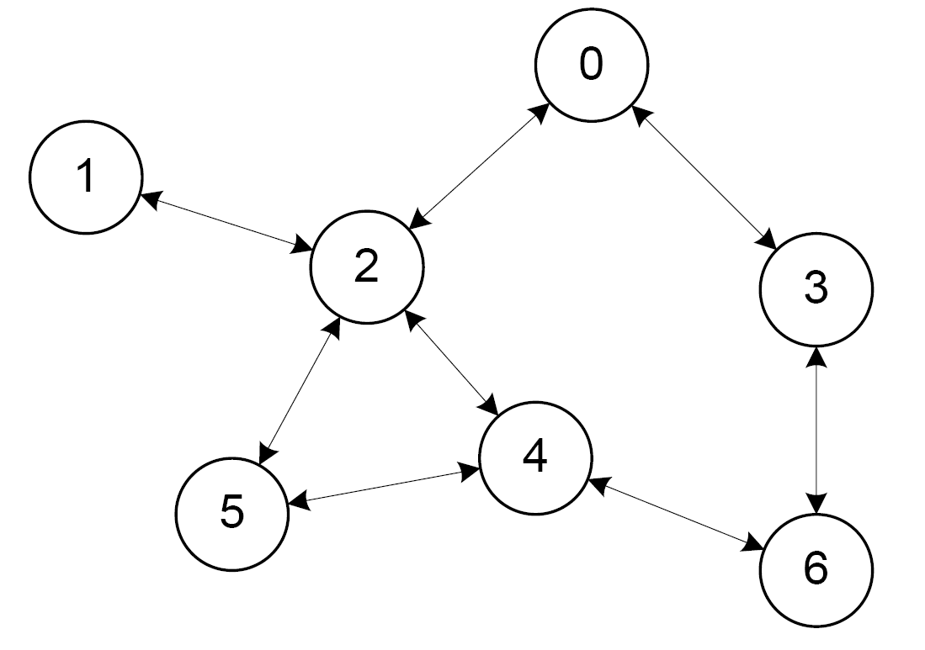
Gradient Clock Synchronization
Global property: Minimize clock error between any two nodes
Local (“gradient”) property: Small clock error between two nodes if the distance between the nodes is small.
FTSP
GTSP

Slide 11

Gradient Time Synchronization Protocol (GTSP)
Synchronize with all neighboring nodes
  Broadcast periodic time beacons, e.g., every 30 s
  No reference node necessary
How to synchronize clocks without having a leader?
  Follow the node with the fastest/slowest clock?
  Idea: Go to the average clock value/rate of all neighbors (including node itself)

Slide 12
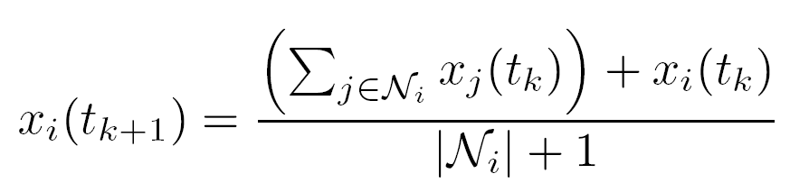
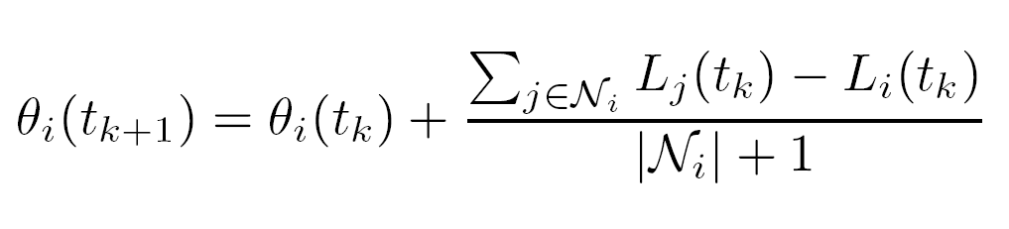
Drift and Offset Compensation in GTSP
Update rule for the logical clock rate:
Update rule for the logical clock offset:
  Note: We will jump directly to a higher clock value if the offset exceeds a certain threshold, e.g., 20 μs.

Slide 13
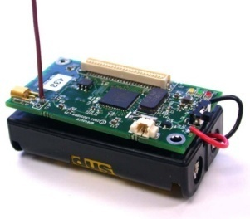

Experimental Evaluation
Mica2 platform using TinyOS 2.1
  System clock: 7.37 MHz (crystal quartz)
  Hardware clock: System clock divided by 8 = 921 kHz
  Clock granularity of 1 microsecond (1 clock tick ≈ 1 μs)
Testbed of 20 Mica2 nodes
  Base station triggers external events by sending time probe packets
  Ring topology is enforced by software

Slide 14
Experimental Results
Network synchronization error (global clock skew)
  7.7 μs with FTSP, 14.0 μs with GTSP
FTSP needs more time to synchronize all nodes after startup
FTSP
GTSP

Slide 15
Experimental Results (2)
Neighbor synchronization error (local clock skew)
  5.3 μs with FTSP, 4.0 μs with GTSP
FTSP
GTSP

Slide 16


Neighbor Synchronization Error: FTSP vs. GTSP
FTSP has a large clock error for neighbors with large stretch in the tree (Node 8 and Node 15)
FTSP
GTSP

Slide 17
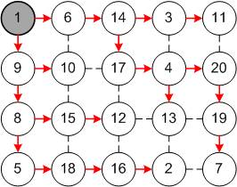
Multi-Hop Time Synchronization in Practice
Is this really a problem in practice?
  Ring topology of 20 nodes seems to be „artificial“!?
Finding a tree-embedding with low stretch is hard
  In a n = m*m grid you will have two
  neighbors with a stretch of at least
  Example: FTSP on a 5x4 grid topology
  Node 2 and 7 have a distance of 13 hops!

Slide 18
Simulation Results
Simulation of GTSP for larger network topologies
  Network error of ~1 ms for 100 nodes in a line topology
  Neighbor error below 100 μs for the same topology

Slide 19
Conclusions and Future Work
Gradient Time Synchronization Protocol (GTSP)
  Distributed time synchronization algorithm (no leader)
  Improves the synchronization error between neighboring nodes while still providing precise network-wide synchronization
  Bridging the gap between theory and practice
Is there a „perfect“ clock synchronization protocol?
  Goal: Minimizing local and global skew at the same time

