Slide 1

A Lower Bound for the Distributed Lovász Local Lemma
Sebastian Brandt, Orr Fischer, Juho Hirvonen, Barbara Keller,
Tuomo Lempiäinen, Joel Rybicki, Jukka Suomela, Jara Uitto
Aalto University, Comerge AG, ETH Zurich, Tel Aviv University

Slide 2
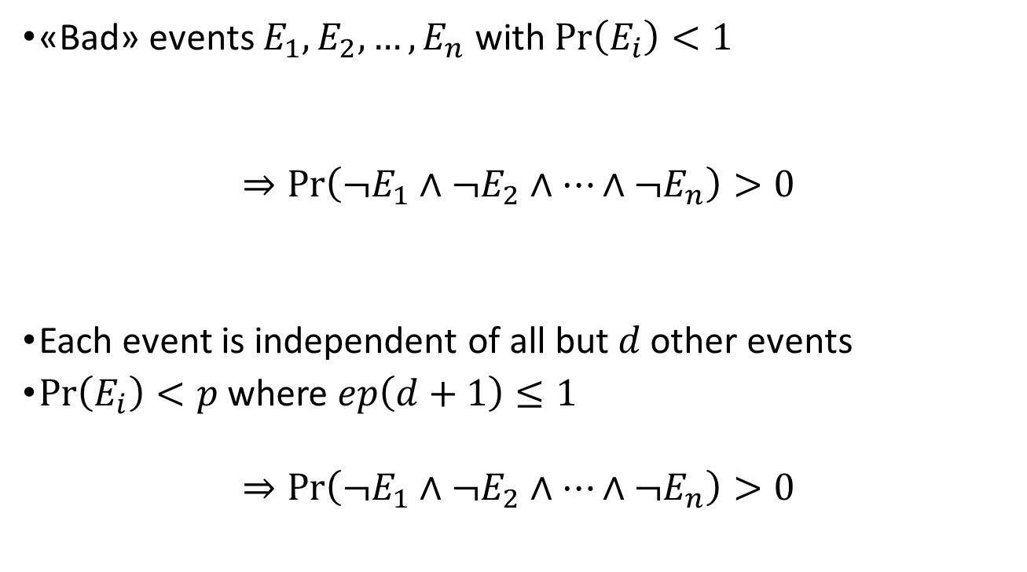
The Lovász Local Lemma
«Bad» events $E_{1},E_{2},…, E_{n}$ with $\operatorname{Pr}\left(E_{i}\right)<1$
$$⇒\operatorname{Pr}\left(¬E_{1}∧¬E_{2}∧…∧¬E_{n}\right)>0$$
Each event is independent of all but $d$ other events
$Pr\left(E_{i}\right)<p$ where $ep\left(d+1\right)≤1$
$$⇒\operatorname{Pr}\left(¬E_{1}∧¬E_{2}∧…∧¬E_{n}\right)>0$$
mutually independent
Lovász Local Lemma

Slide 3

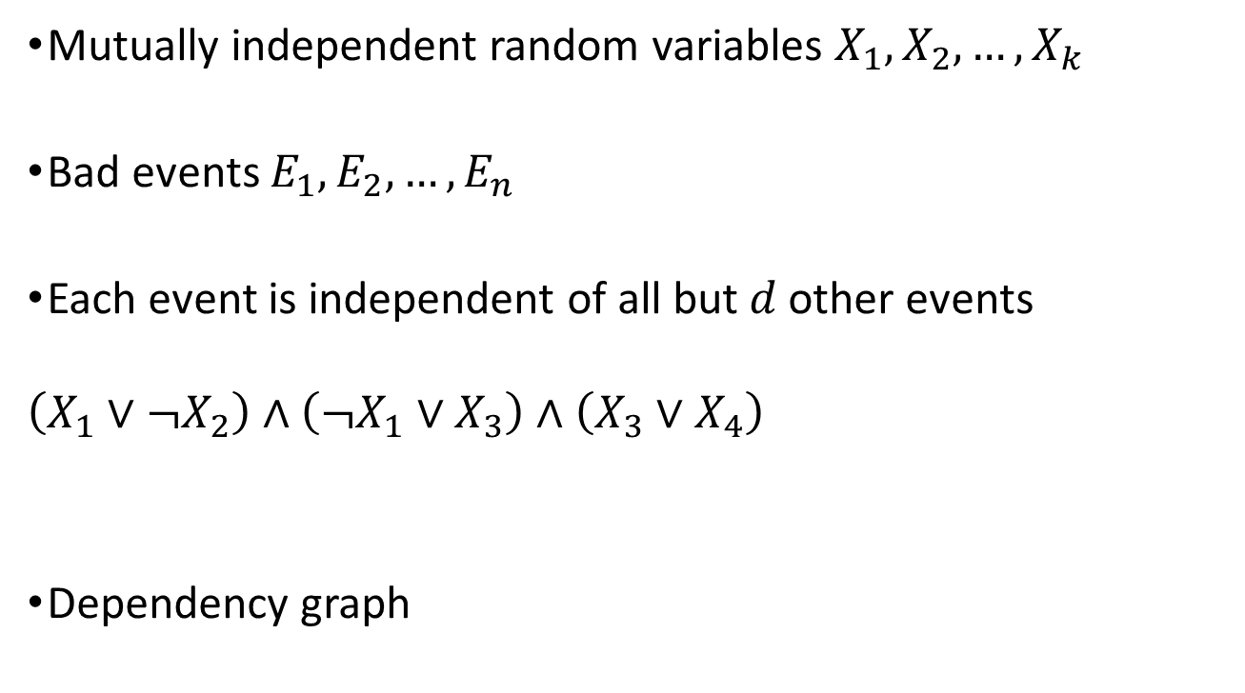








The Constructive LLL
Mutually independent random variables $X_{1},X_{2},…,X_{k}$
Bad events $E_{1},E_{2},…, E_{n}$
Each event is independent of all but $d$ other events
$$\left(X_{1}∨¬X_{2}\right)∧\left(¬X_{1}∨X_{3}\right)∧\left(X_{3}∨X_{4}\right)$$
Dependency graph
$$E_{1}$$
$$E_{2}$$
$$E_{3}$$
$$X_{1},X_{3}$$
$$X_{3},X_{4}$$
$$E_{2}$$
$$E_{3}$$
$$X_{1},X_{2}$$
$$E_{1}$$

Slide 4
Distributed Computing

Slide 5

Distributed Computing

Slide 6
Distributed Computing

Slide 7

Distributed Computing

Slide 8
Distributed Computing

Slide 9
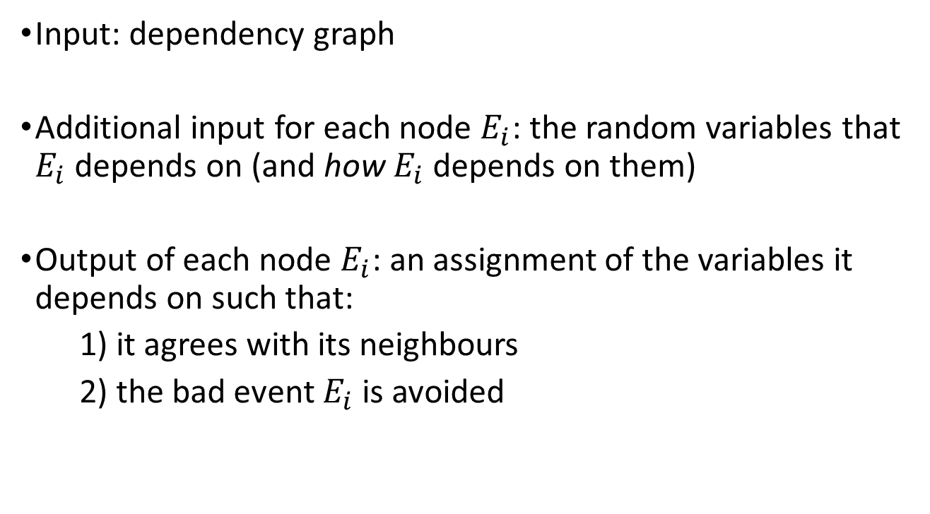
The Distributed LLL
Input: dependency graph
Additional input for each node $E_{i}$: the random variables that $E_{i}$ depends on (and how $E_{i}$ depends on them)
Output of each node $E_{i}$: an assignment of the variables it depends on such that:
1) it agrees with its neighbours
2) the bad event $E_{i}$ is avoided

Slide 10
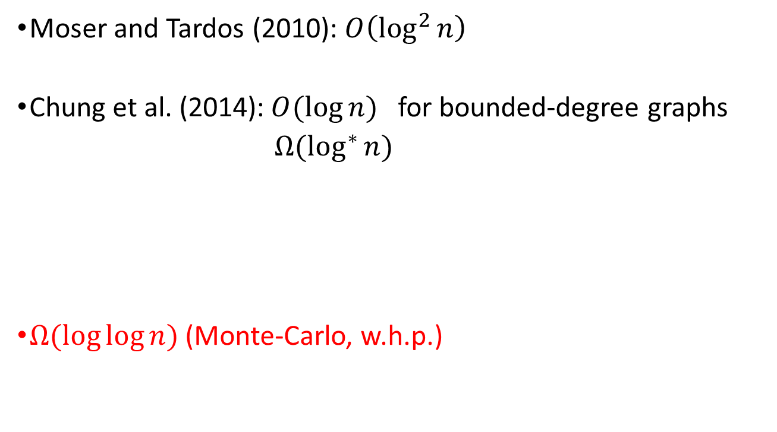
Our result
Moser and Tardos (2010): $O\left(\log^{2}{n}\right)$
Chung et al. (2014):$O(\log{n})$ for bounded-degree graphs
$Ω(\log^{∗}{n})$
$Ω(\log{\log{n}})$ (Monte-Carlo, w.h.p.)

Slide 11
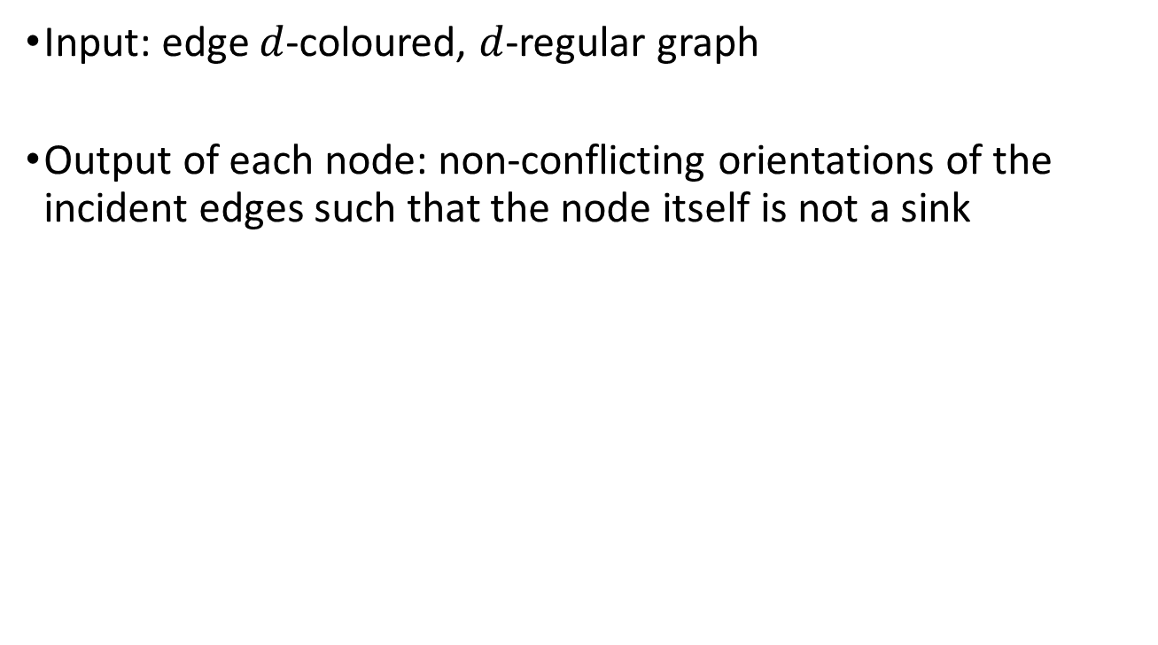
Sinkless Orientation
Input: edge $d$-coloured, $d$-regular graph
Output of each node: non-conflicting orientations of the incident edges such that the node itself is not a sink

Slide 12
Sinkless Orientation
Input: edge $d$-coloured, $d$-regular graph
Output of each node: non-conflicting orientations of the incident edges such that the node itself is not a sink

Slide 13
Sinkless Orientation
Input: edge $d$-coloured, $d$-regular graph
Output of each node: non-conflicting orientations of the incident edges such that the node itself is not a sink

Slide 14
Sinkless Orientation
Input: edge $d$-coloured, $d$-regular graph
Output of each node: non-conflicting orientations of the incident edges such that the node itself is not a sink

Slide 15
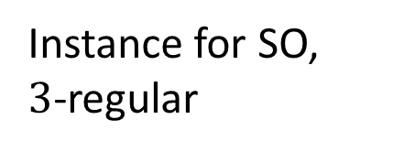
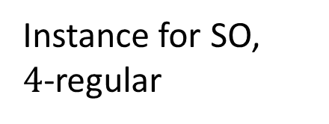
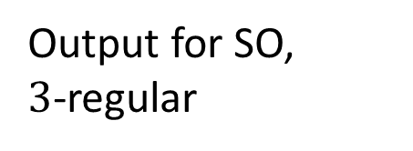
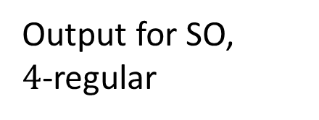
Reduction from SO to LLL
Instance for SO,
$3$-regular
Output for SO,
$3$-regular
Instance for SO,
$4$-regular
Output for SO,
$4$-regular
Instance for LLL
Output for LLL

Slide 16
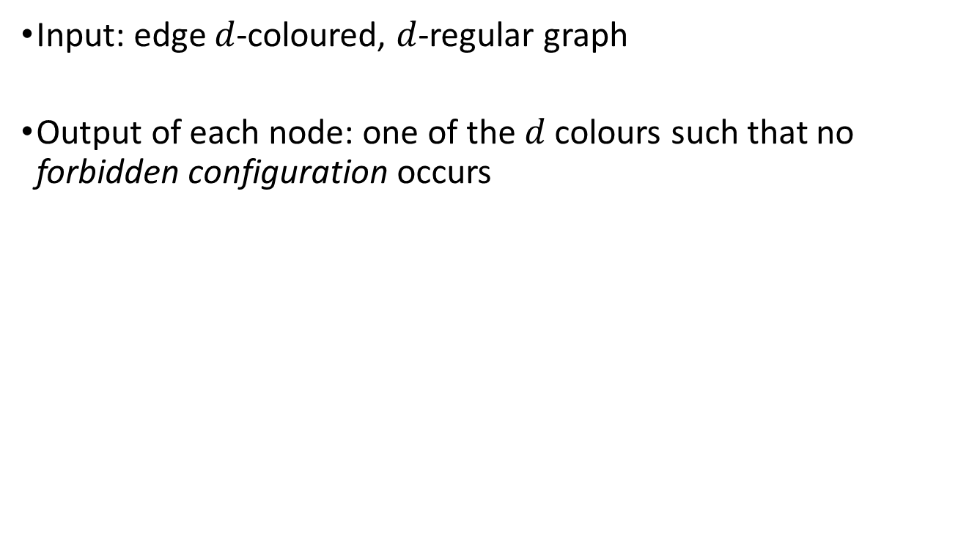
Sinkless Colouring
Input: edge $d$-coloured, $d$-regular graph
Output of each node: one of the $d$ colours such that no forbidden configuration occurs
Forbidden!
Fine!

Slide 18
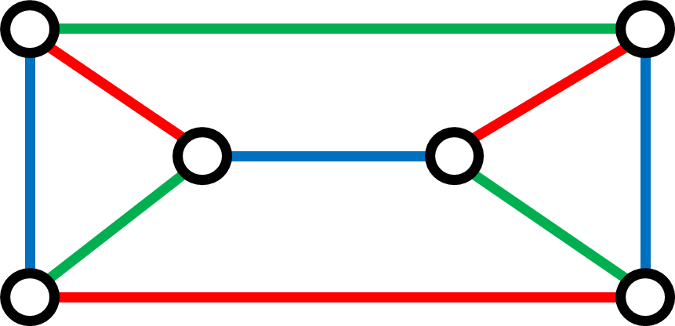
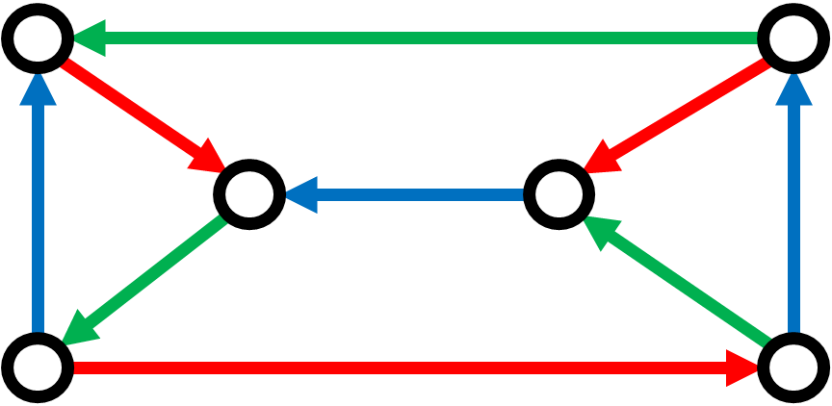
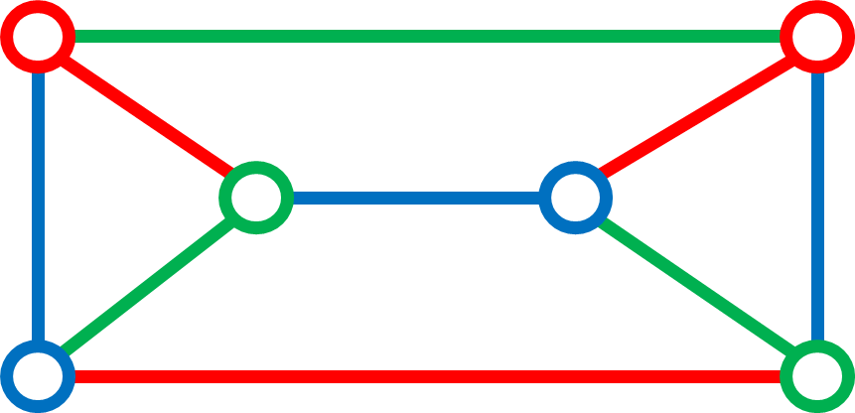

Slide 19

$$t$$
SO algorithm
SC algorithm

Slide 20

$$t+1$$
SO algorithm
$$t$$
SO algorithm
SC algorithm

Slide 21

$$t$$
SO algorithm
$$t−1$$
SC algorithm

Slide 22
$$t$$
SO algorithm
$$t−1$$
SO algorithm
SC algorithm

Slide 23




$$t$$
SO algorithm
$$t−1$$
SO algorithm
SC algorithm
$$…$$
$$…$$
$$…$$
$$…$$
$$0$$
SC algorithm

Slide 24
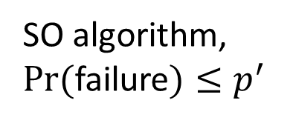
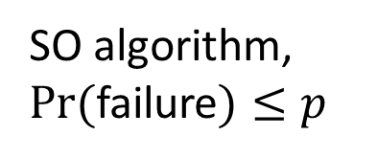
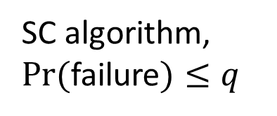
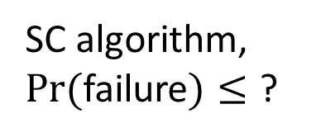
SO algorithm, $Pr⁡($failure$)≤p$
$$t$$
SO algorithm, $Pr⁡($failure$)≤p^{′}$
SC algorithm, $Pr⁡($failure$)≤q$
$$t−1$$
$$…$$
$$…$$
$$…$$
$$…$$
SC algorithm, $Pr⁡($failure$)≤$ ?
$$0$$

Slide 25

$$p^{′}=C⋅\sqrt[12]{p}$$
SO algorithm, $Pr⁡($failure$)≤p$
$$t$$
SO algorithm, $Pr⁡($failure$)≤p^{′}$
SC algorithm, $Pr⁡($failure$)≤q$
$$t−1$$
$$…$$
$$…$$
$$…$$
$$…$$
SC algorithm, $Pr⁡($failure$)≤$ ?
$$0$$

Slide 26

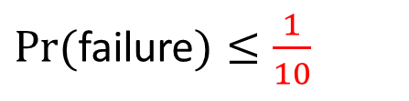
$$p^{′}=C⋅\sqrt[12]{p}$$
w.h.p.
SO algorithm, $Pr⁡($failure$)≤p$
$$t∈Θ(\log{\log{n}})$$
SO algorithm, $Pr⁡($failure$)≤p^{′}$
SC algorithm, $Pr⁡($failure$)≤q$
$$t−1$$
$$…$$
$$…$$
$$…$$
$$…$$
SC algorithm
$$0$$
$Pr⁡($failure$)≤\frac{1}{10}$

Slide 27
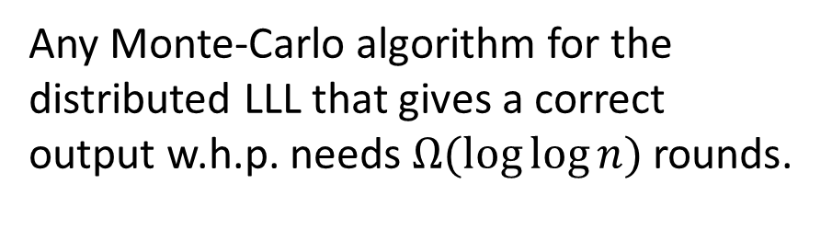
Any Monte-Carlo algorithm for the distributed LLL that gives a correct output w.h.p. needs $Ω(\log{\log{n}})$ rounds.

Slide 28
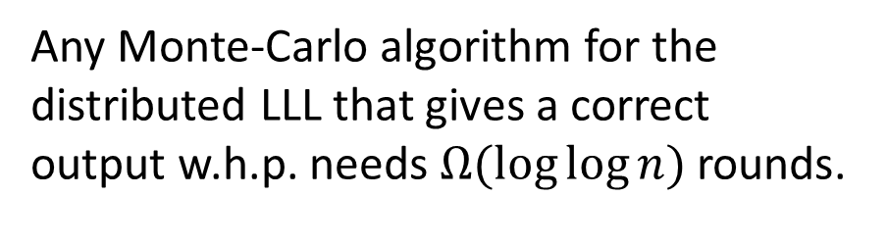
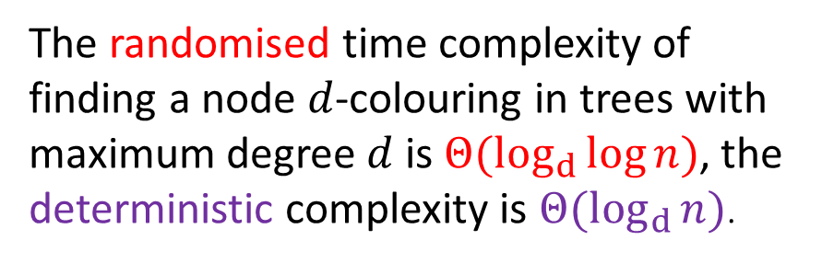
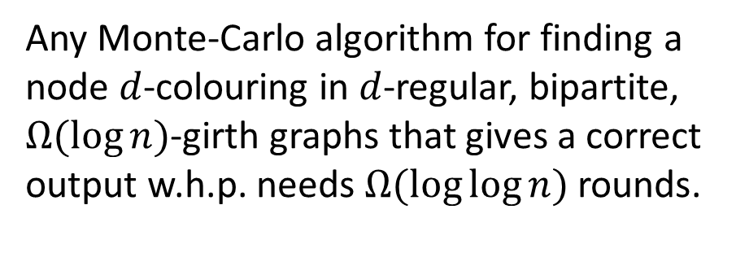
Any Monte-Carlo algorithm for the distributed LLL that gives a correct output w.h.p. needs $Ω(\log{\log{n}})$ rounds.
Any Monte-Carlo algorithm for finding a node $d$-colouring in $d$-regular, bipartite, $Ω(\log{n})$-girth graphs that gives a correct output w.h.p. needs $Ω(\log{\log{n}})$ rounds.
Chang et al. (2016)
The randomised time complexity of finding a node $d$-colouring in trees with maximum degree $d$ is $Θ(\log_{d}{\log{n}})$, the deterministic complexity is $Θ(\log_{d}{n})$.

Slide 29


Slide 31
Backup Slides

Slide 32
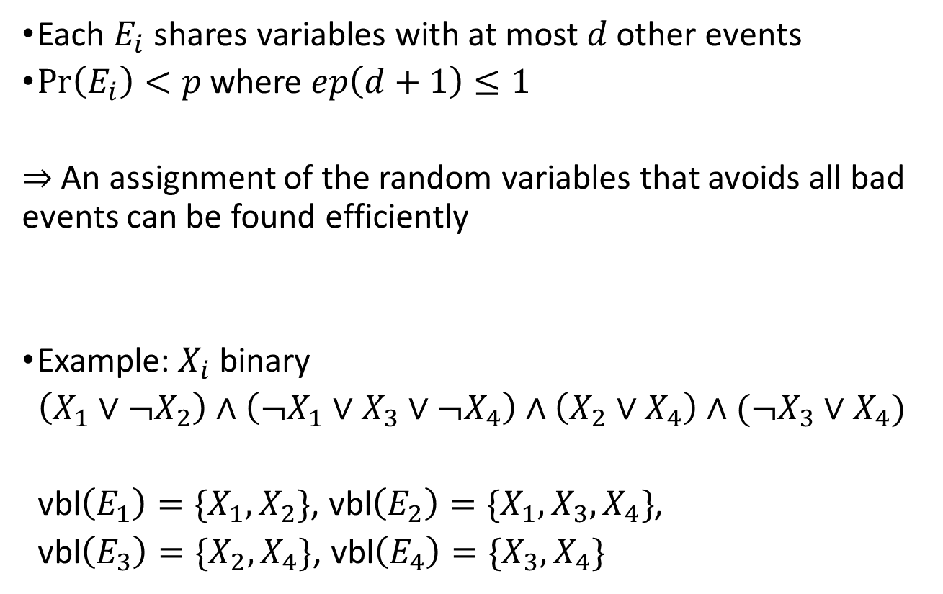
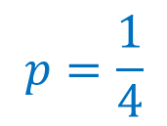
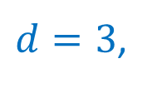
The Constructive LLL
Each $E_{i}$ shares variables with at most $d$ other events
$Pr\left(E_{i}\right)<p$ where $ep\left(d+1\right)≤1$
    $⇒$ An assignment of the random variables that avoids all bad events can be found efficiently
Example: $X_{i}$ binary
$\left(X_{1}∨¬X_{2}\right)∧\left(¬X_{1}∨X_{3}∨¬X_{4}\right)∧\left(X_{2}∨X_{4}\right)∧(¬X_{3}∨X_{4})$
vbl$\left(E_{1}\right)=\{X_{1},X_{2}\}$, vbl$\left(E_{2}\right)=\{X_{1},X_{3},X_{4}\}$,
vbl$\left(E_{3}\right)=\{X_{2},X_{4}\}$, vbl$\left(E_{4}\right)=\{X_{3},X_{4}\}$
Moser and Tardos, 2010
$$p=\frac{1}{4}$$
$d=3$,

Slide 33

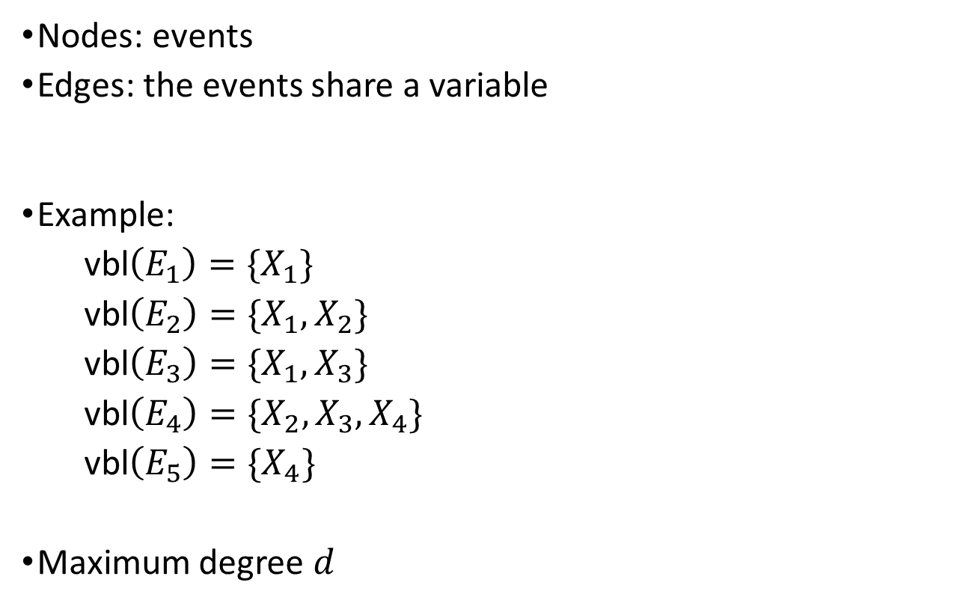




The Dependency Graph
Nodes: events
Edges: the events share a variable
Example:
vbl$\left(E_{1}\right)=\{X_{1}\}$
vbl$\left(E_{2}\right)=\{X_{1},X_{2}\}$
vbl$\left(E_{3}\right)=\{X_{1},X_{3}\}$
vbl$\left(E_{4}\right)=\{X_{2},X_{3},X_{4}\}$
vbl$\left(E_{5}\right)=\{X_{4}\}$
Maximum degree $d$
$$E_{5}$$
$$E_{4}$$
$$E_{3}$$
$$E_{2}$$
$$E_{1}$$

Slide 34
Distributed Computing
Input: simple undirected graph (+ some task-specific input)
Nodes: computational entities
Edges: communication channels
Synchronous rounds
In each round, each node ...
1) sends an arbitrarily large message to each neighbour
2) receives sent messages
3) performs local computations
Each node has to output a correct answer
Time complexity: number of rounds (worst-case input)

Slide 35
Reduction from SO to LLL

Slide 36
Reduction from SO to LLL

Slide 37







Reduction from SO to LLL
$$X_{2}$$
$$X_{3}$$
$$X_{5}$$
$$X_{6}$$
$$X_{1}$$
$$X_{4}$$
$$X_{7}$$

Slide 38
Reduction from SO to LLL
$$X_{2}$$
$$X_{3}$$
$$X_{5}$$
$$X_{6}$$
$$X_{1}$$
$$X_{4}$$
$$X_{7}$$
or

Slide 39








Reduction from SO to LLL
$$E_{5}$$
$$E_{6}$$
$$E_{7}$$
$$E_{8}$$
$$X_{2}$$
$$X_{3}$$
$$X_{5}$$
$$X_{6}$$
$$X_{1}$$
$$X_{4}$$
$$X_{7}$$
$$E_{1}$$
$$E_{2}$$
$$E_{3}$$
$$E_{4}$$
or

Slide 40

Reduction from SO to LLL
$$E_{5}$$
$$E_{6}$$
$$E_{7}$$
$$E_{8}$$
$$X_{2}$$
$$X_{3}$$
$$X_{5}$$
$$X_{6}$$
$$X_{1}$$
$$X_{4}$$
$$X_{7}$$
$$E_{1}$$
$$E_{2}$$
$$E_{3}$$
$$E_{4}$$
$$f\left(4\right)≤16$$
or

Slide 41
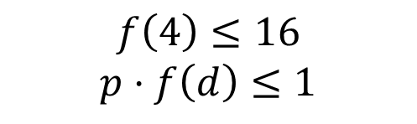
Reduction from SO to LLL
$$E_{5}$$
$$E_{6}$$
$$E_{7}$$
$$E_{8}$$
$$X_{2}$$
$$X_{3}$$
$$X_{5}$$
$$X_{6}$$
$$X_{1}$$
$$X_{4}$$
$$X_{7}$$
$$E_{1}$$
$$E_{2}$$
$$E_{3}$$
$$E_{4}$$
$$f\left(4\right)≤16$$
$$p⋅f\left(d\right)≤1$$
or

Slide 42
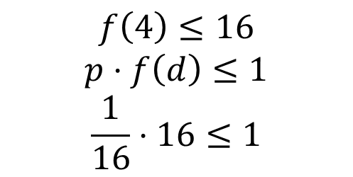
Reduction from SO to LLL
$$E_{5}$$
$$E_{6}$$
$$E_{7}$$
$$E_{8}$$
$$X_{2}$$
$$X_{3}$$
$$X_{5}$$
$$X_{6}$$
$$X_{1}$$
$$X_{4}$$
$$X_{7}$$
$$E_{1}$$
$$E_{2}$$
$$E_{3}$$
$$E_{4}$$
$$f\left(4\right)≤16$$
$$p⋅f\left(d\right)≤1$$
$$\frac{1}{16}⋅16≤1$$
or

Slide 43
Reduction from SO to LLL
$$E_{5}$$
$$E_{6}$$
$$E_{7}$$
$$E_{8}$$
$$X_{2}$$
$$X_{3}$$
$$X_{5}$$
$$X_{6}$$
$$X_{1}$$
$$X_{4}$$
$$X_{7}$$
$$E_{1}$$
$$E_{2}$$
$$E_{3}$$
$$E_{4}$$
$$f\left(4\right)≤16$$
$$p⋅f\left(d\right)≤1$$
$$\frac{1}{16}⋅16≤1$$
or

Slide 44
Reduction from SO to LLL

Slide 45
Reduction from SO to LLL

Slide 46
Reduction from SO to LLL

Slide 47
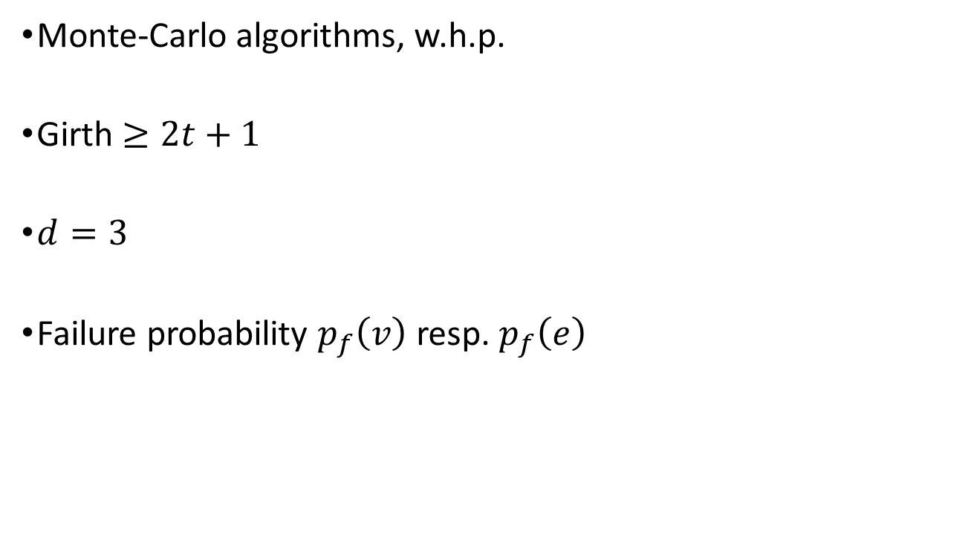
Technicalities
Monte-Carlo algorithms, w.h.p.
Girth $≥2t+1$
$d=3$
Failure probability $p_{f}\left(v\right)$ resp. $p_{f}\left(e\right)$

