Slide 1
Lower and Upper bounds for Online Directed Graph Exploration
Klaus-Tycho Förster
@GRASTA-MAC 2015

Slide 2
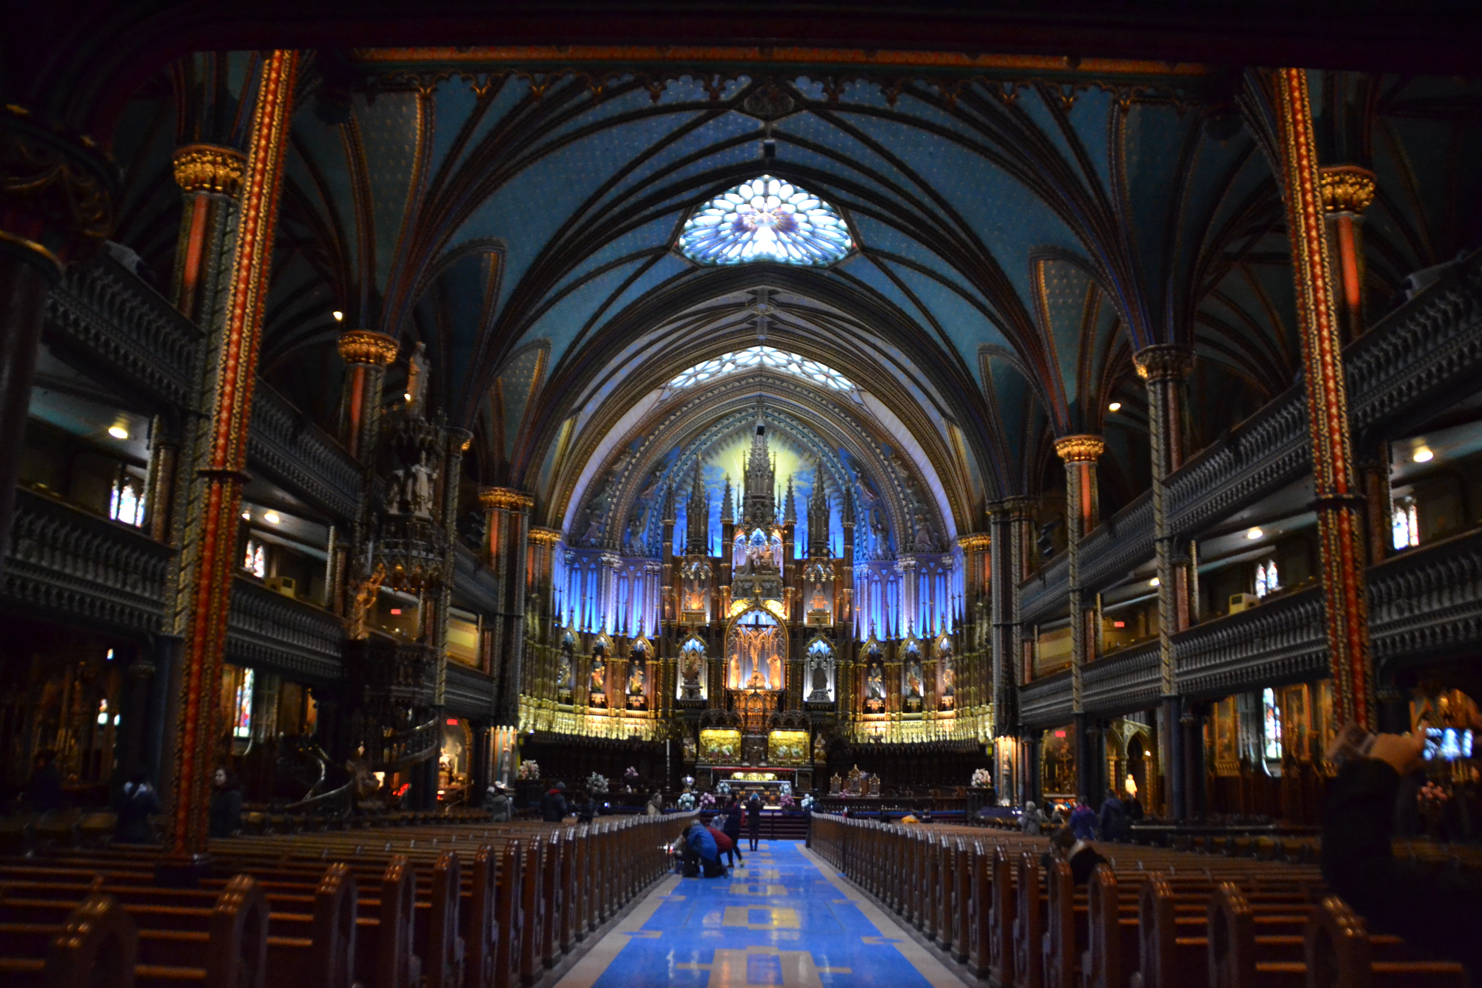
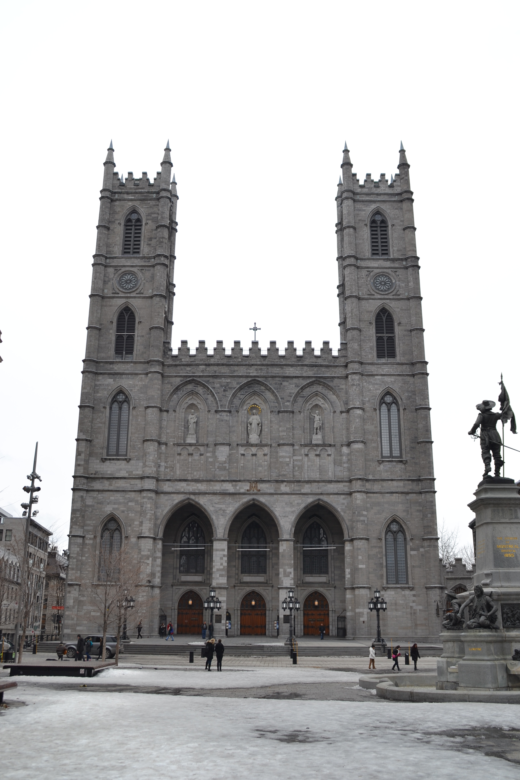
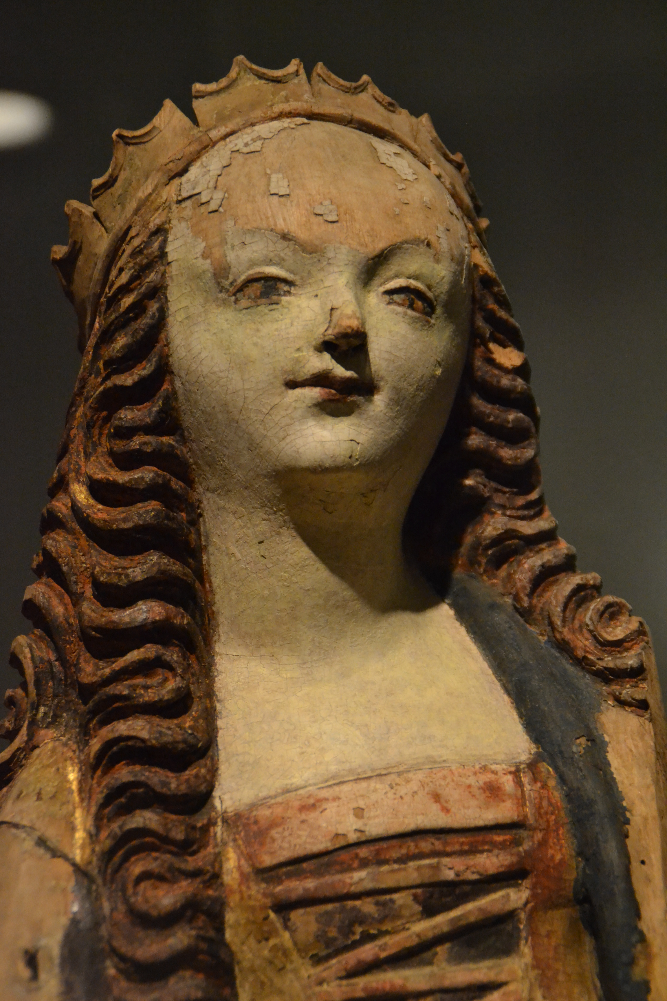
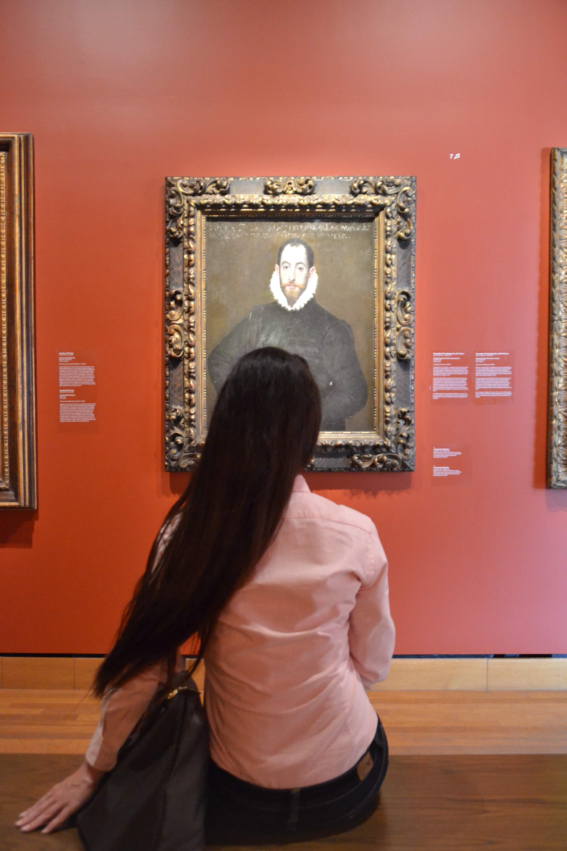
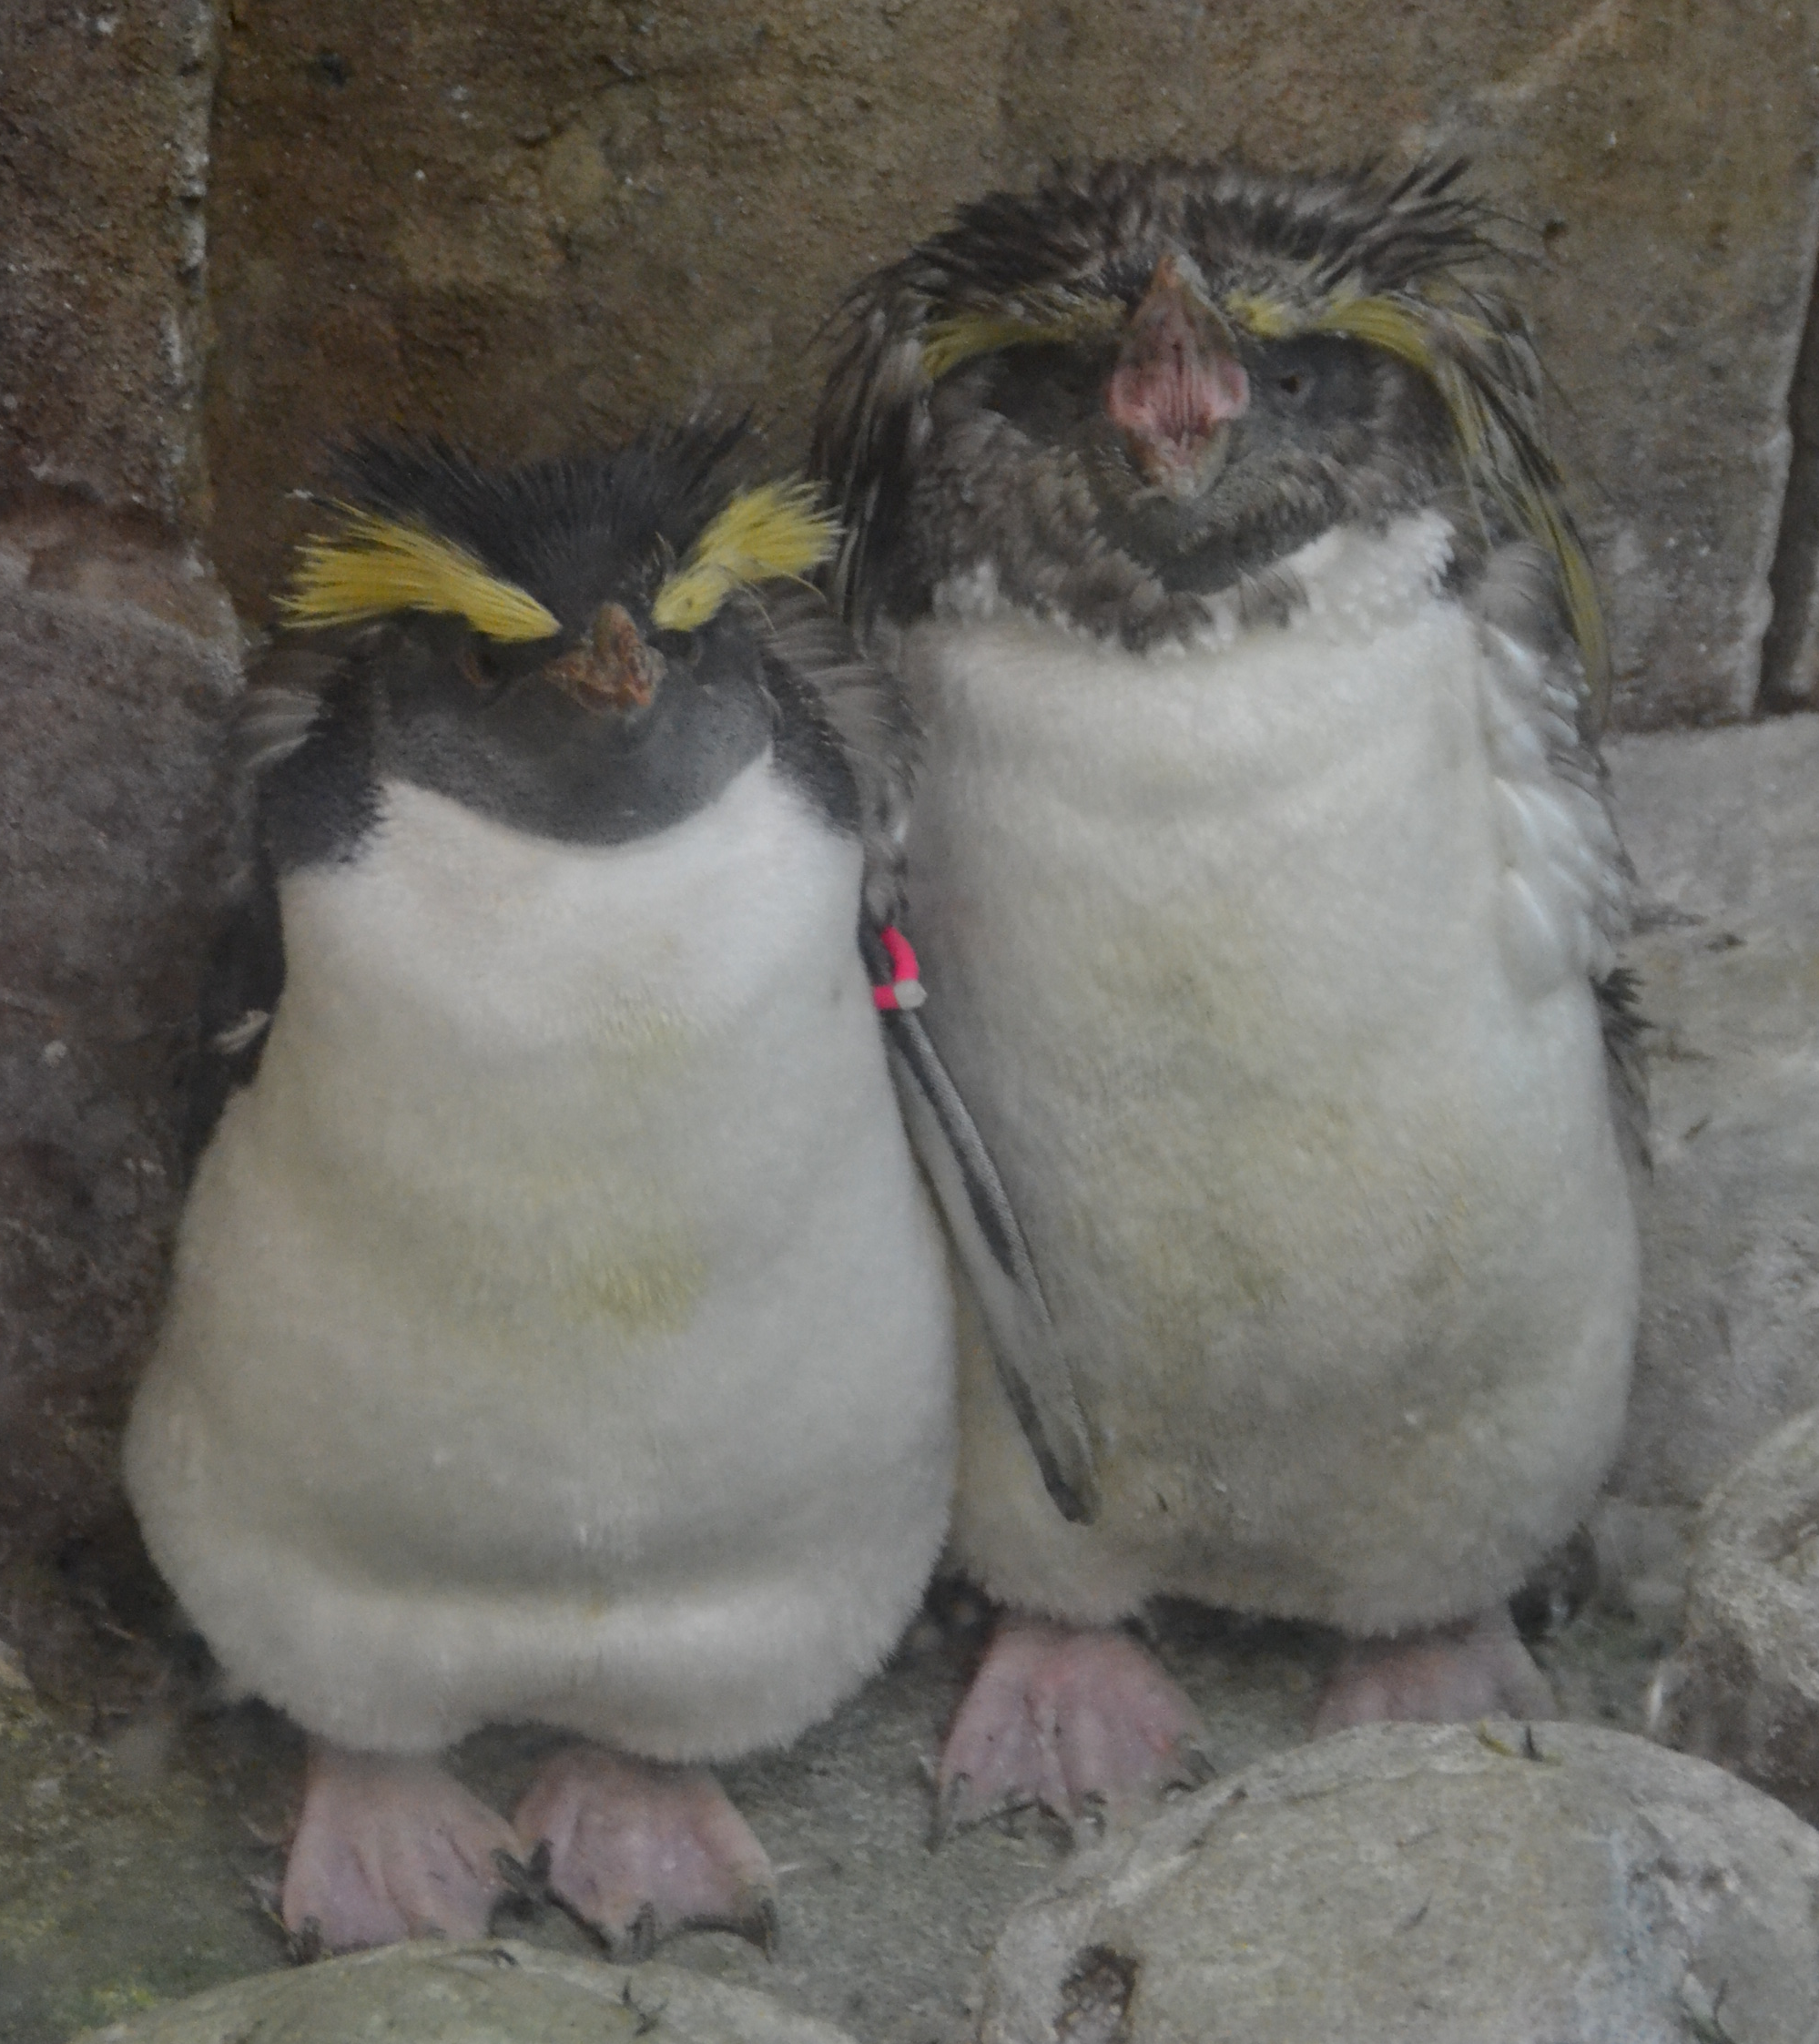
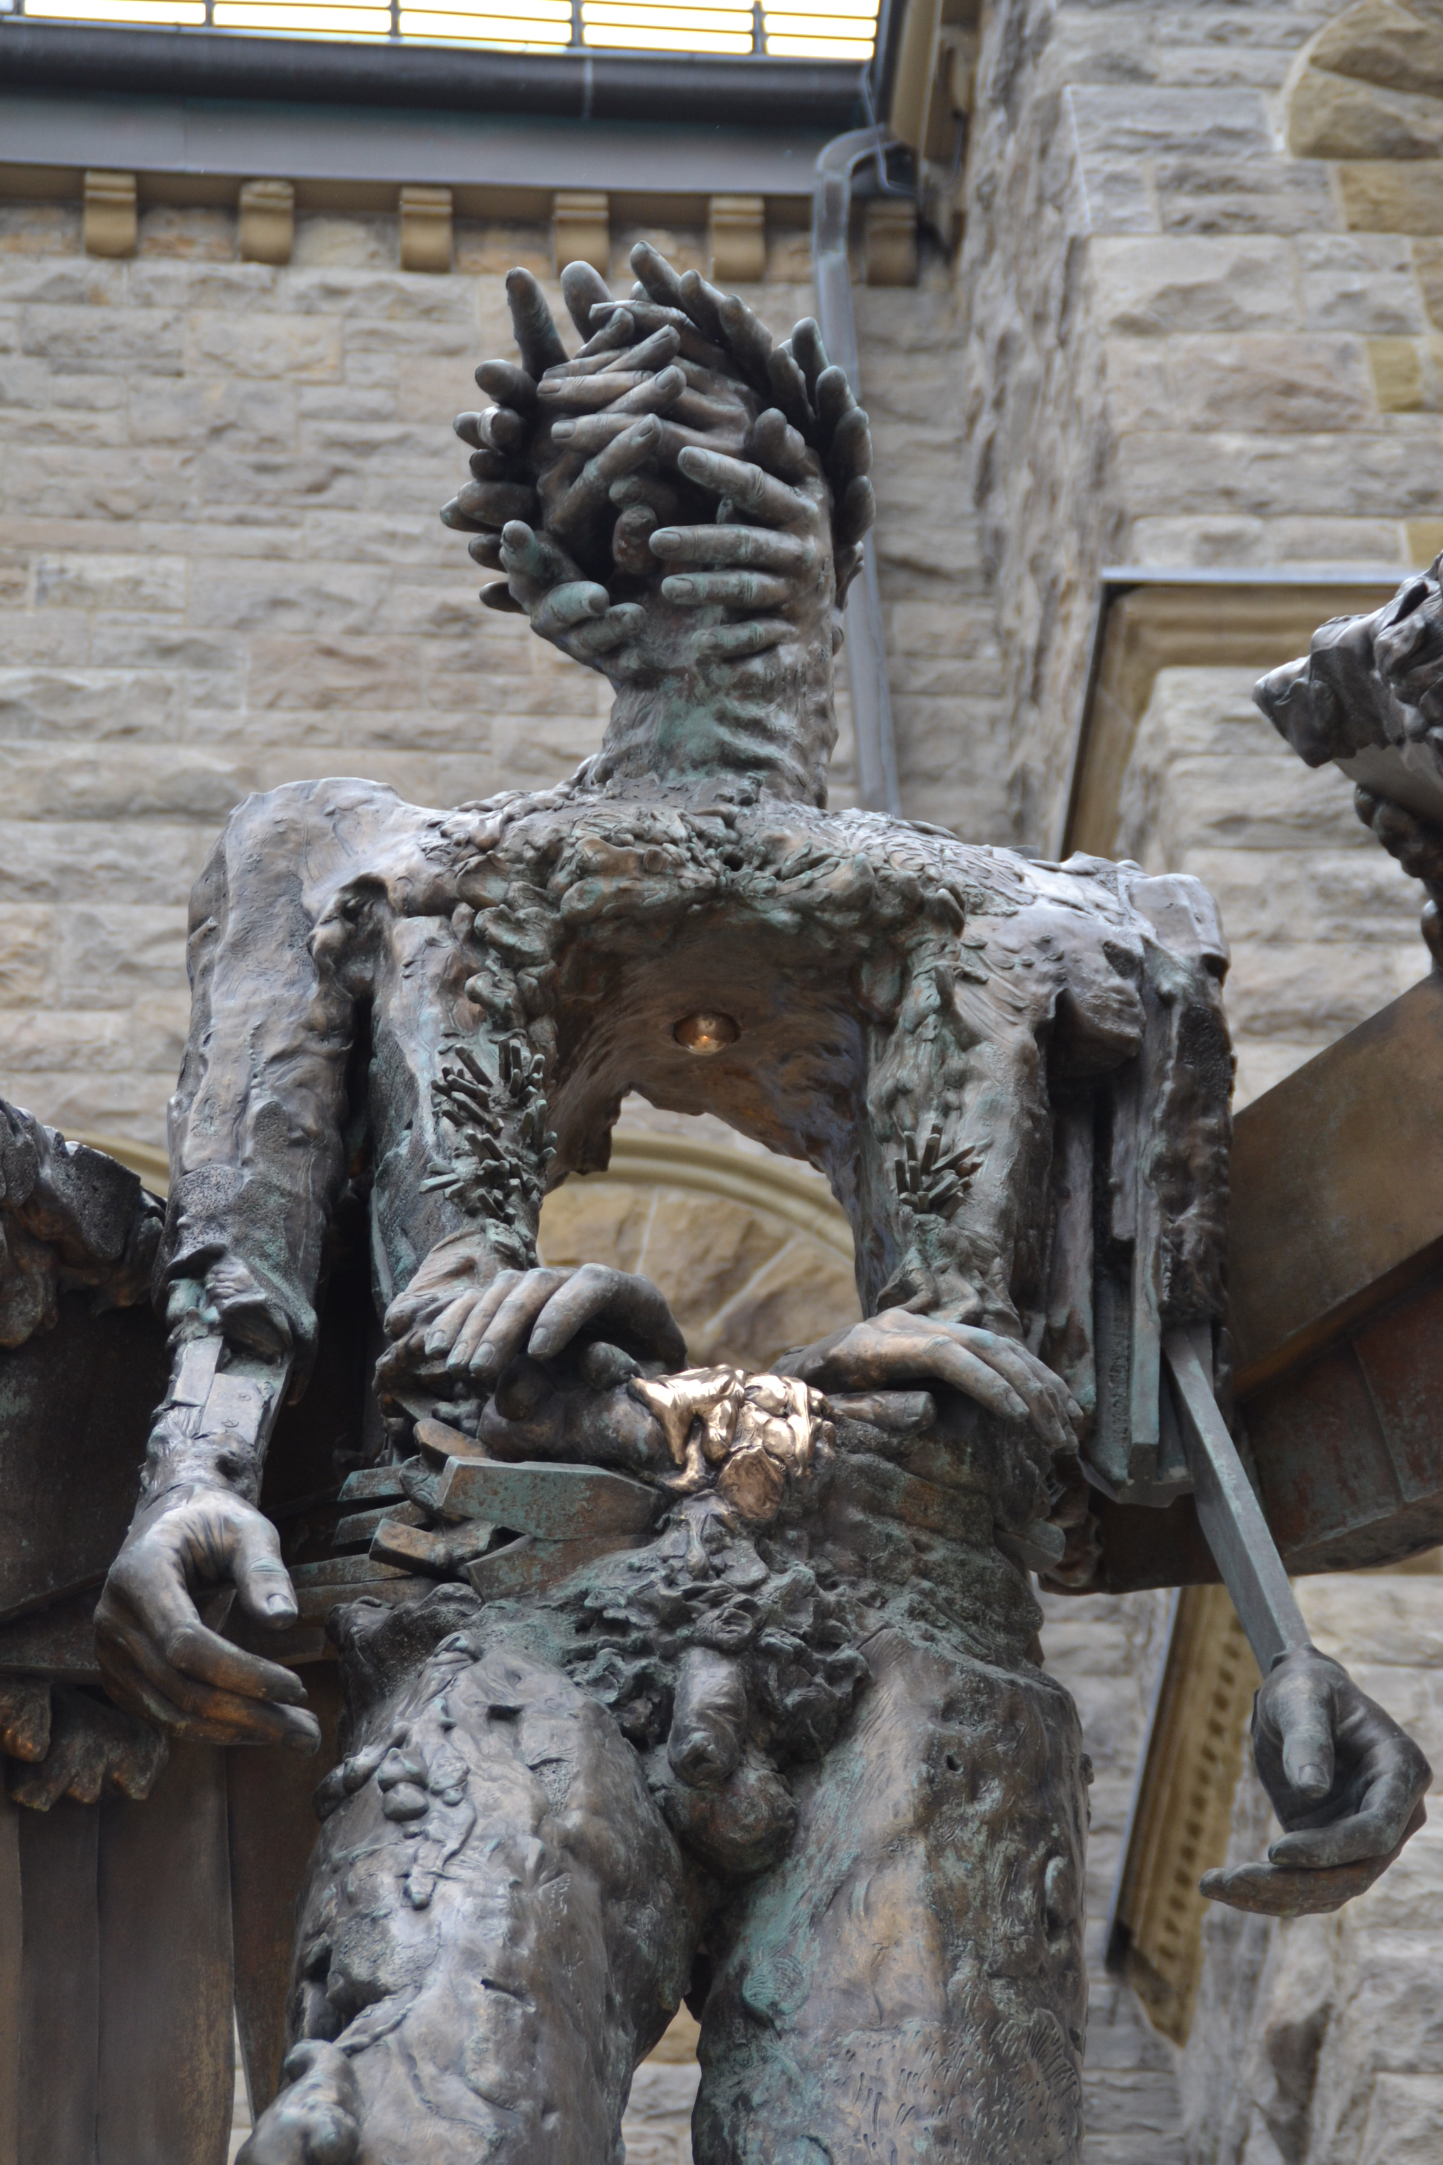

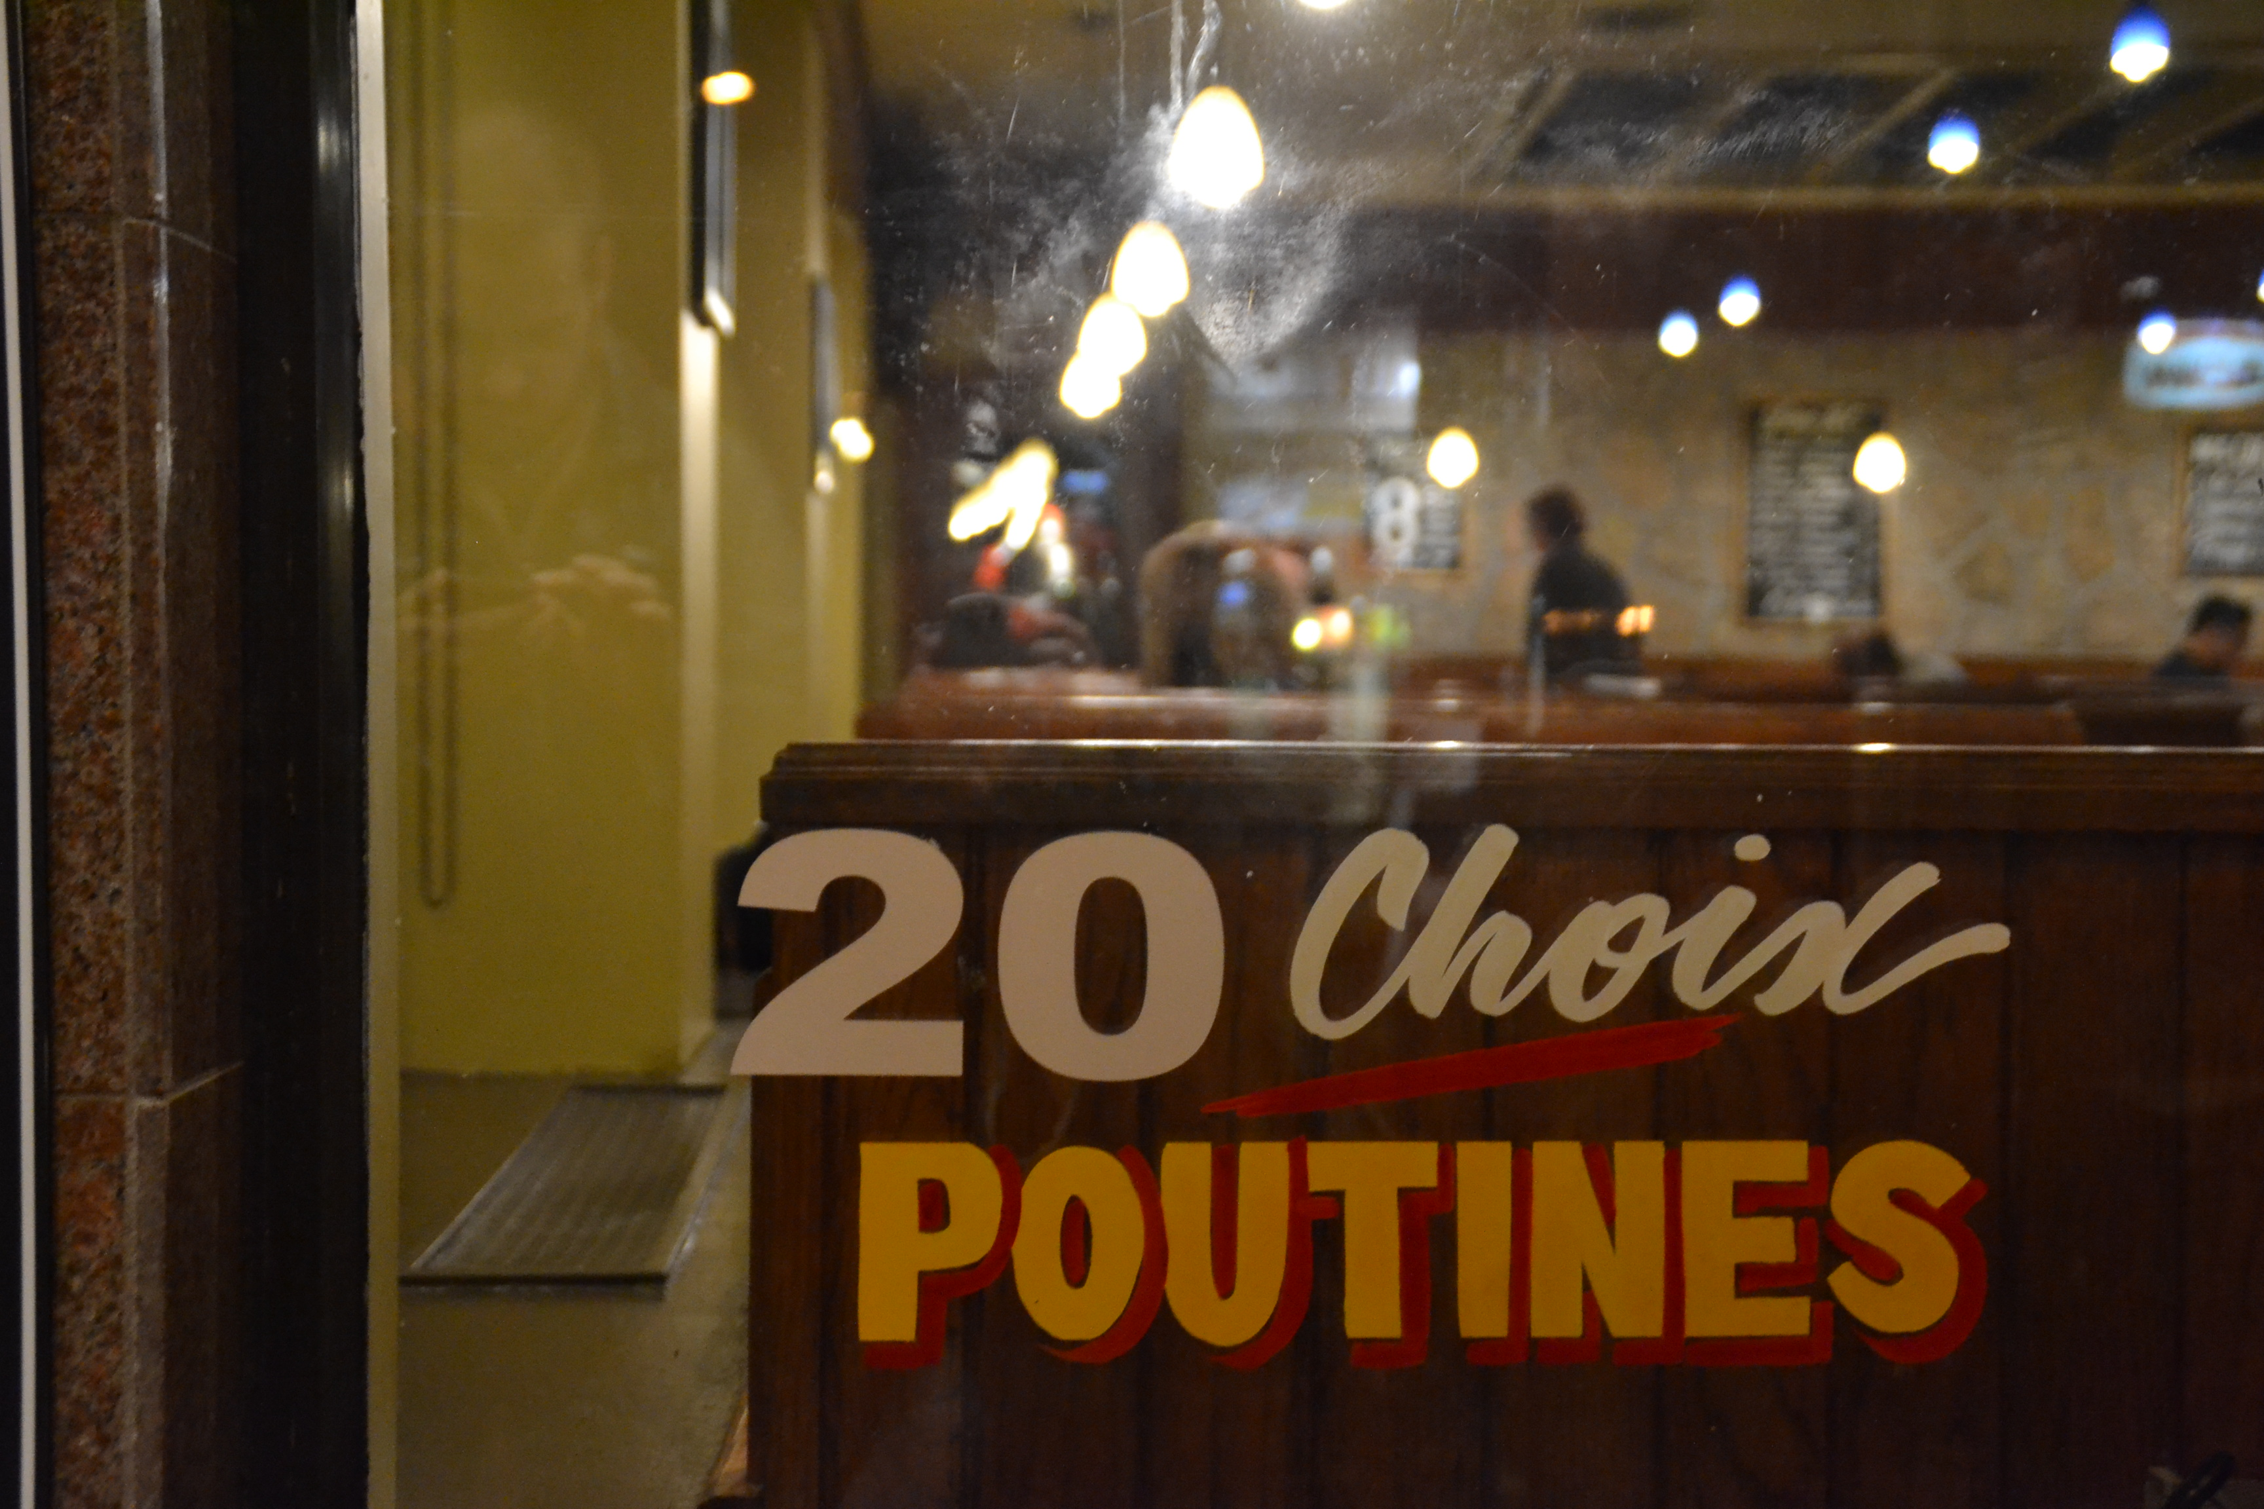
When in Montreal …

Slide 3
Montreal: Full of one way streets ….
“About 25 per cent of streets are one-way”
Valérie Gagnon, spokesperson for the city of Montreal

Slide 4
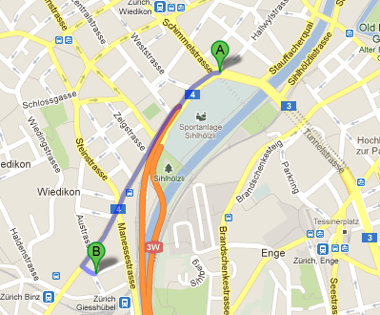
Navigating in Zurich

Slide 5
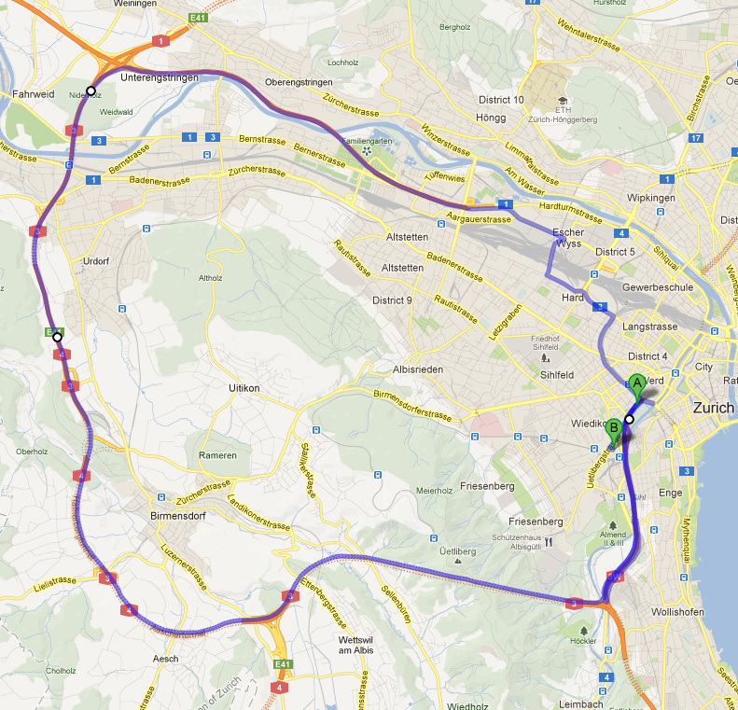
Zurich: Full of one-way streets too…

Slide 6
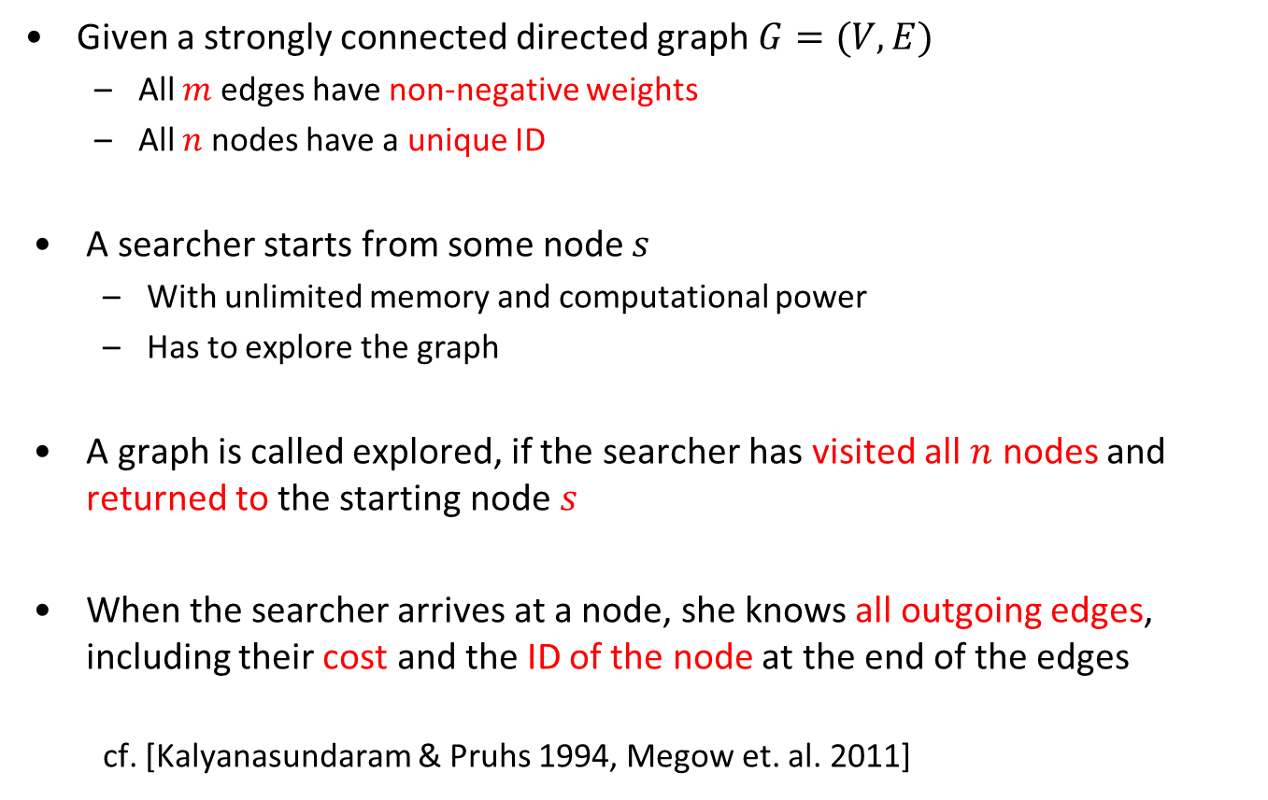
Formal Model
Given a strongly connected directed graph$G=(V,E)$
  All $m$ edges have non-negative weights
  All $n$ nodes have a unique ID
A searcher starts from some node $s$
  With unlimited memory and computational power
  Has to explore the graph
A graph is called explored, if the searcher has visited all $n$ nodes and returned to the starting node $s$
When the searcher arrives at a node, she knows all outgoing edges, including their cost and the ID of the node at the end of the edges
  cf. [Kalyanasundaram & Pruhs 1994, Megow et. al. 2011]

Slide 7
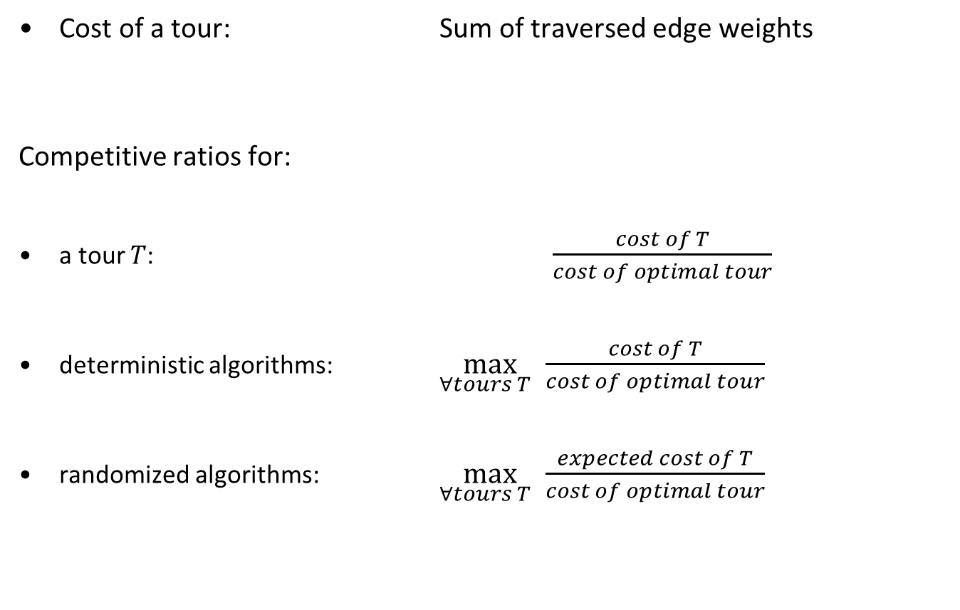
How good is a tour, how good is a strategy?
Cost of a tour: Sum of traversed edge weights
Competitive ratios for:
a tour $T$: $\frac{cost of T}{cost of optimal tour}$
deterministic algorithms: $\max_{∀tours T }{\frac{cost of T}{cost of optimal tour}}$
randomized algorithms: $\max_{∀tours T }{\frac{expected cost of T}{cost of optimal tour}}$

Slide 8
Applications of Graph Exploration
One of the fundamental problems of robotics
cf. [Burgard et al. 2000, Fleischer & Trippen 2005]
Exploring the state space of a finite automaton
cf. [Brass et al. 2009]
A model for learning
cf. [Deng & Papadimitriou 1999]

Slide 9
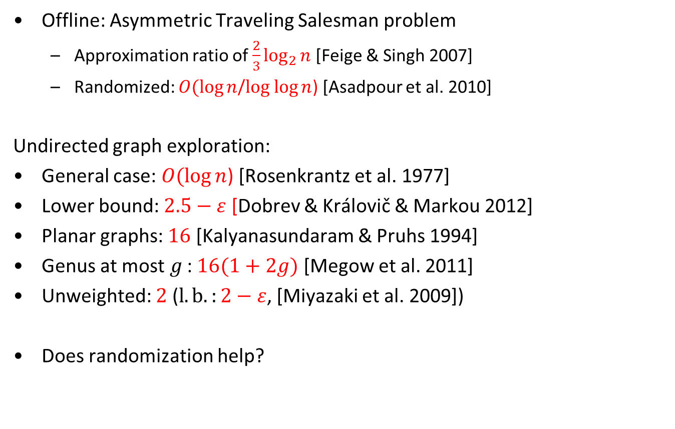
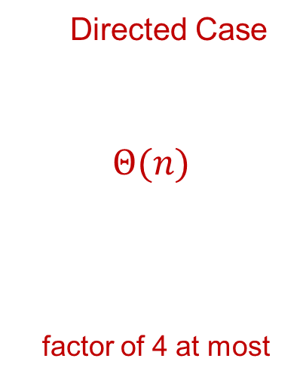
Some Related Work
Offline: Asymmetric Traveling Salesman problem
  Approximation ratio of $\frac{2}{3}\log_{2}{n}$[Feige & Singh 2007]
  Randomized: $O(\log{n}$/$log log{n}$) [Asadpour et al. 2010]
Undirected graph exploration:
General case: $O(\log{n}$) [Rosenkrantz et al. 1977]
Lower bound: $2.5−ε$ [Dobrev & Královič & Markou 2012]
Planar graphs: $16$ [Kalyanasundaram & Pruhs 1994]
  Genus at most$g$: $16(1+2g)$ [Megow et al. 2011]
Unweighted: $2$ ($l.b.:2−ε$, [Miyazaki et al. 2009])
Does randomization help?
Directed Case
$$Θ(n)$$
factor of 4 at most

Slide 10
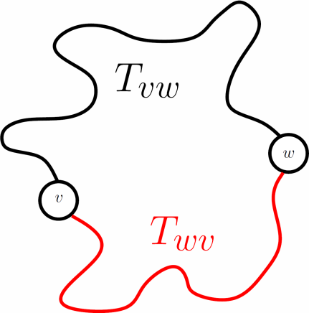
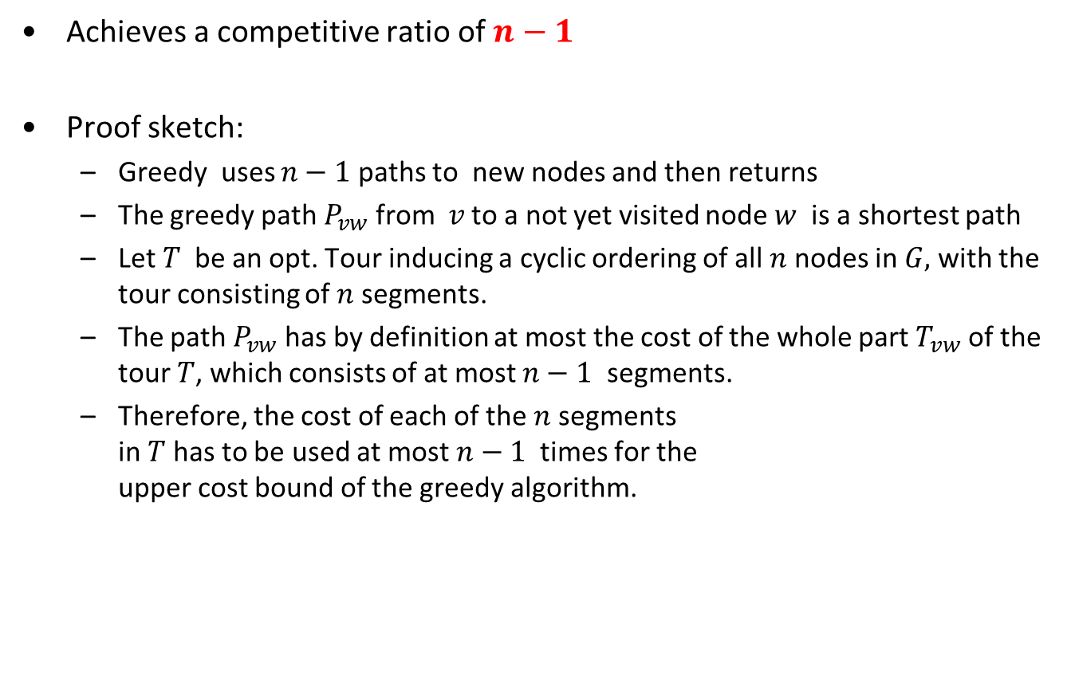
Exploring with a Greedy Algorithm
Achieves a competitive ratio of $n−1$
Proof sketch:
  Greedy uses $n−1$ paths to new nodes and then returns
  The greedy path $P_{vw}$ from $v$ to a not yet visited node $w$ is a shortest path
  Let $T$ be an opt. Tour inducing a cyclic ordering of all $n$ nodes in $G,$ with the tour consisting of $n$ segments.
  The path $P_{vw}$ has by definition at most the cost of the whole part $T_{vw}$ of the tour $T$, which consists of at most $n−1$ segments.
  Therefore, the cost of each of the $n$ segments
  in $T$ has to be used at most $n−1$ times for the
  upper cost bound of the greedy algorithm.

Slide 11
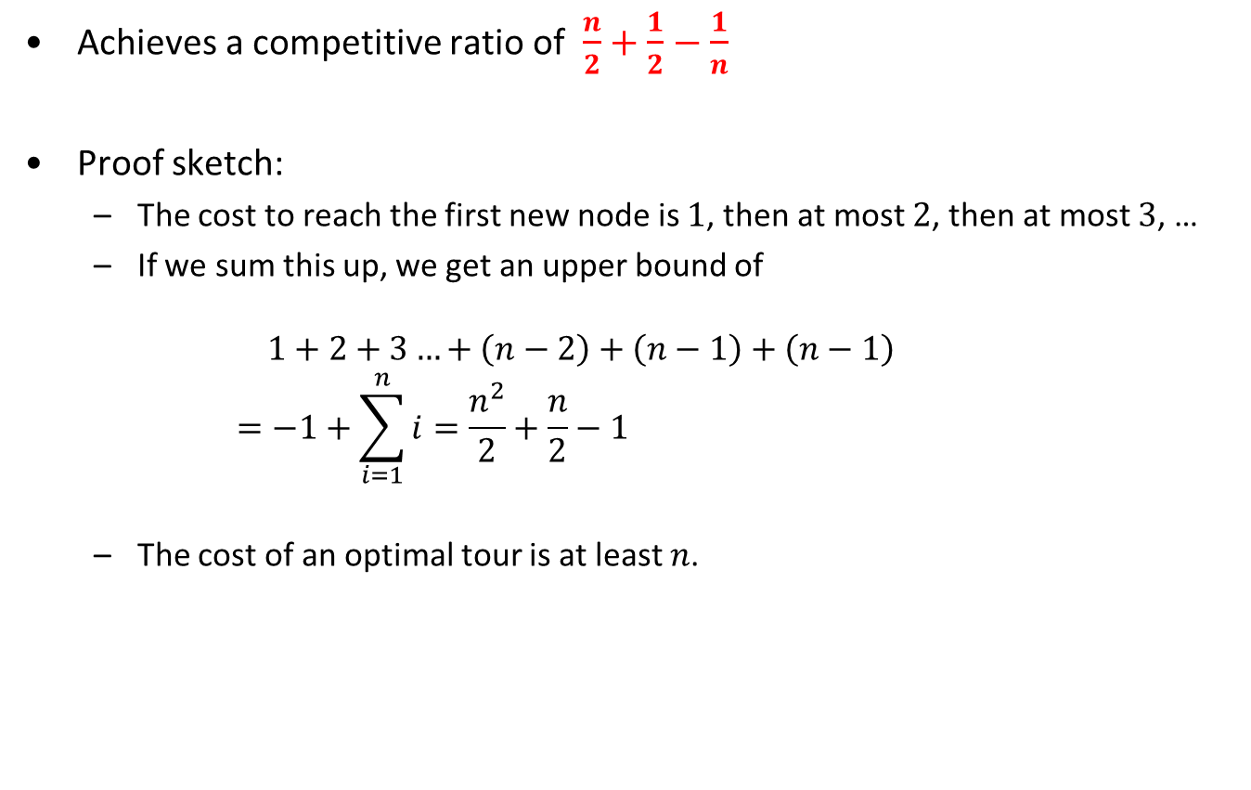
Exploring with a Greedy Algorithm – Unweighted Case
Achieves a competitive ratio of $\frac{n}{2}+\frac{1}{2}−\frac{1}{n}$
Proof sketch:
  The cost to reach the first new node is $1$, then at most $2$, then at most $3$, …
  If we sum this up, we get an upper bound of
  $1+2+3…+\left(n−2\right)+\left(n−1\right)+\left(n−1\right)$
  $=−1+\sum_{i=1}^{n}{i}=\frac{n^{2}}{2}+\frac{n}{2}−1$
  The cost of an optimal tour is at least $n$.

Slide 12
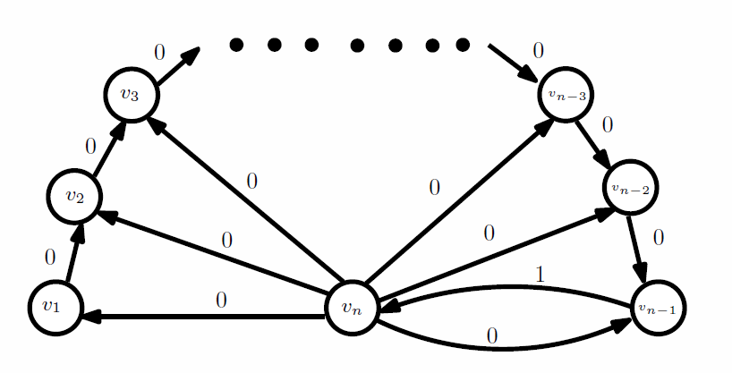
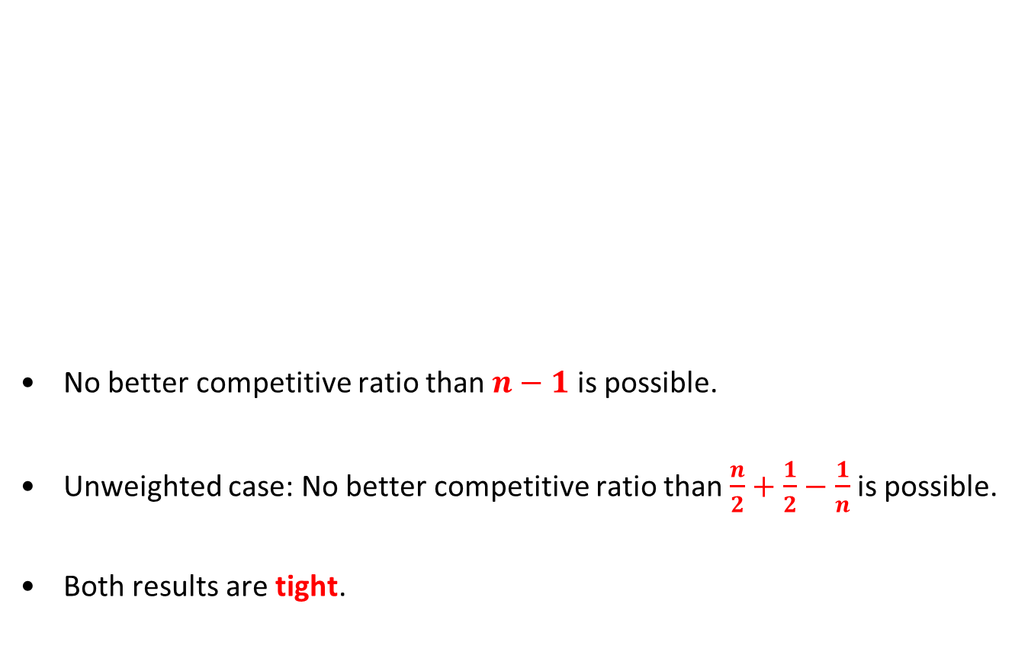
Lower Bounds for Deterministic Online Algorithms
No better competitive ratio than $n−1$ is possible.
Unweighted case: No better competitive ratio than $\frac{n}{2}+\frac{1}{2}−\frac{1}{n}$ is possible.
Both results are tight.

Slide 13
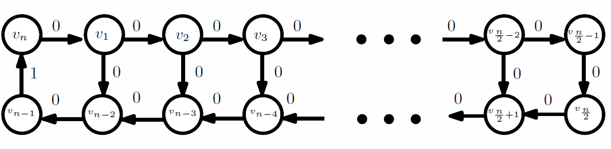
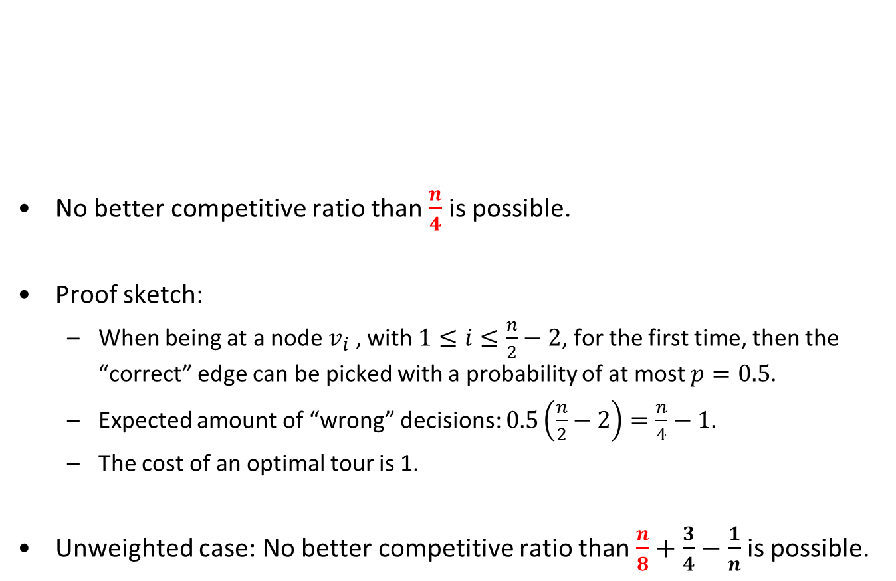
Lower Bounds for Randomized Online Algorithms
No better competitive ratio than $\frac{n}{4}$ is possible.
Proof sketch:
  When being at a node $v_{i}$ , with $1≤i≤\frac{n}{2}−2$, for the first time, then the “correct” edge can be picked with a probability of at most $p=0.5$.
  Expected amount of “wrong” decisions: $0.5\left(\frac{n}{2}−2\right)=\frac{n}{4}−1.$
  The cost of an optimal tour is 1.
Unweighted case: No better competitive ratio than $\frac{n}{8}+\frac{3}{4}−\frac{1}{n}$ is possible.

Slide 14
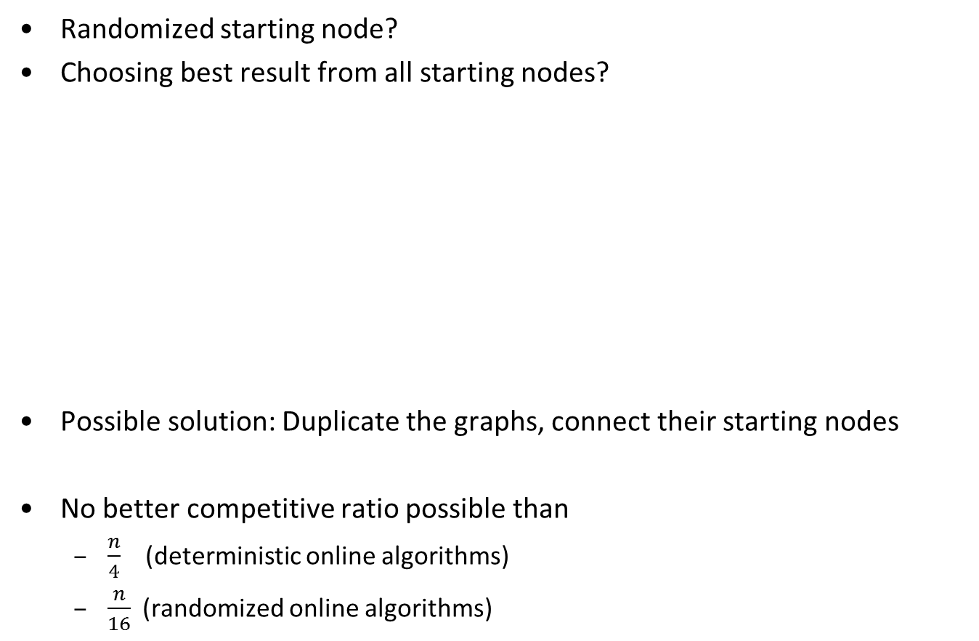
Variations of the Model
Randomized starting node?
Choosing best result from all starting nodes?
Possible solution: Duplicate the graphs, connect their starting nodes
No better competitive ratio possible than
  $\frac{n}{4}$ (deterministic online algorithms)
  $\frac{n}{16}$(randomized online algorithms)

Slide 15
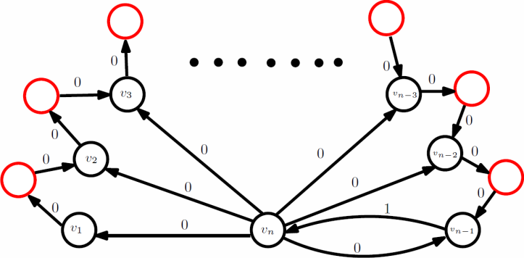
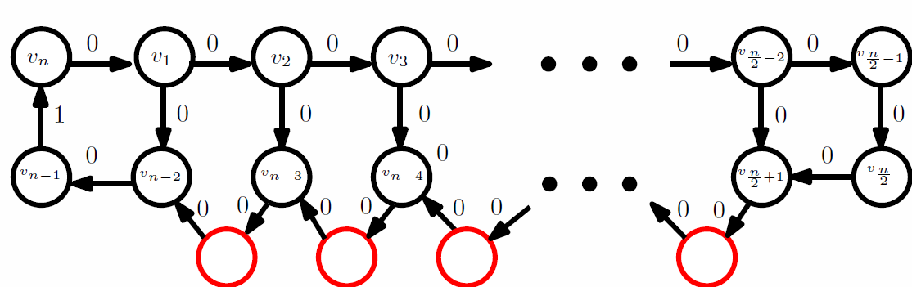
Variations of the Model
What if the searcher also sees incoming edges?
What if the searcher does not see the IDs of the nodes at the end of outgoing edges, but knows the IDs of outgoing and incoming edges?
  Greedy algorithm still works with same ratio (all nodes have been visited if
  all edges have been seen as incoming and outgoing edges)
  Lower bound examples also still work
decreases lower bound
by a factor of less than 2
decreases lower bound
by a factor of less than 1.5

Slide 16
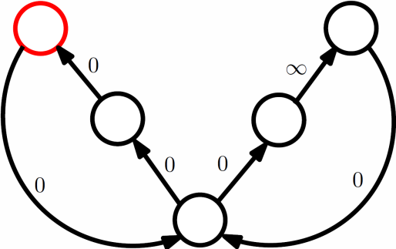
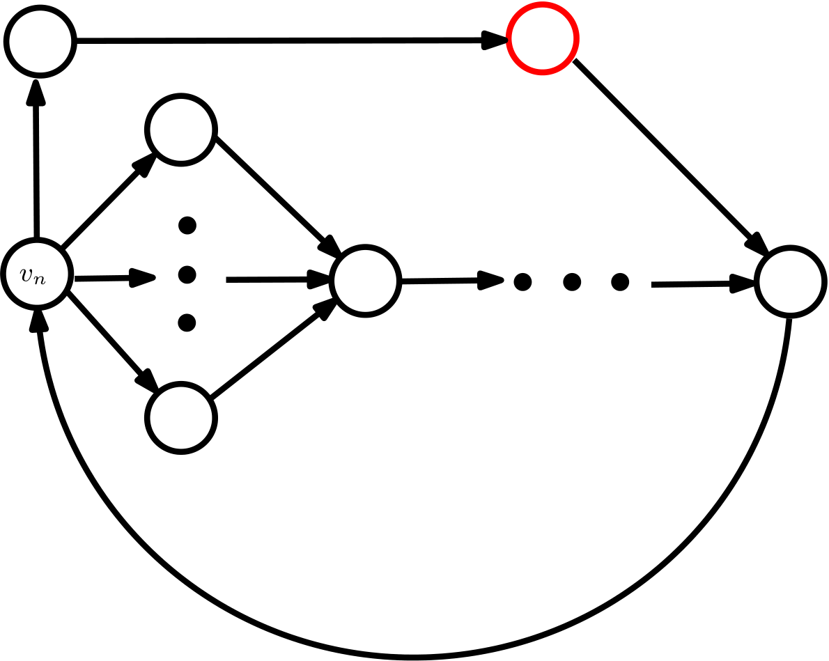
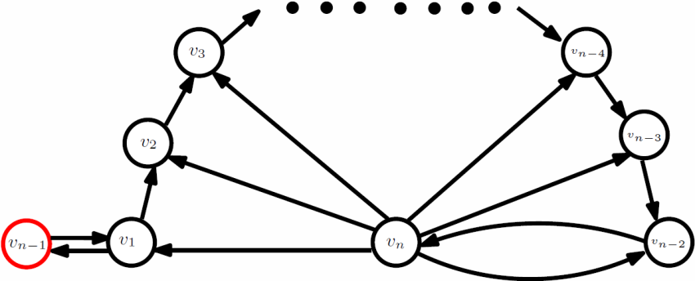
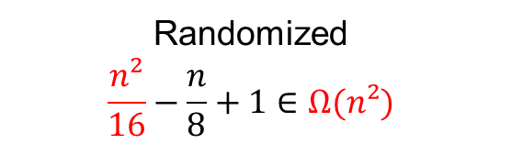
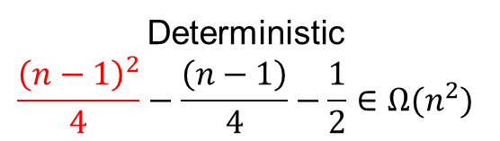
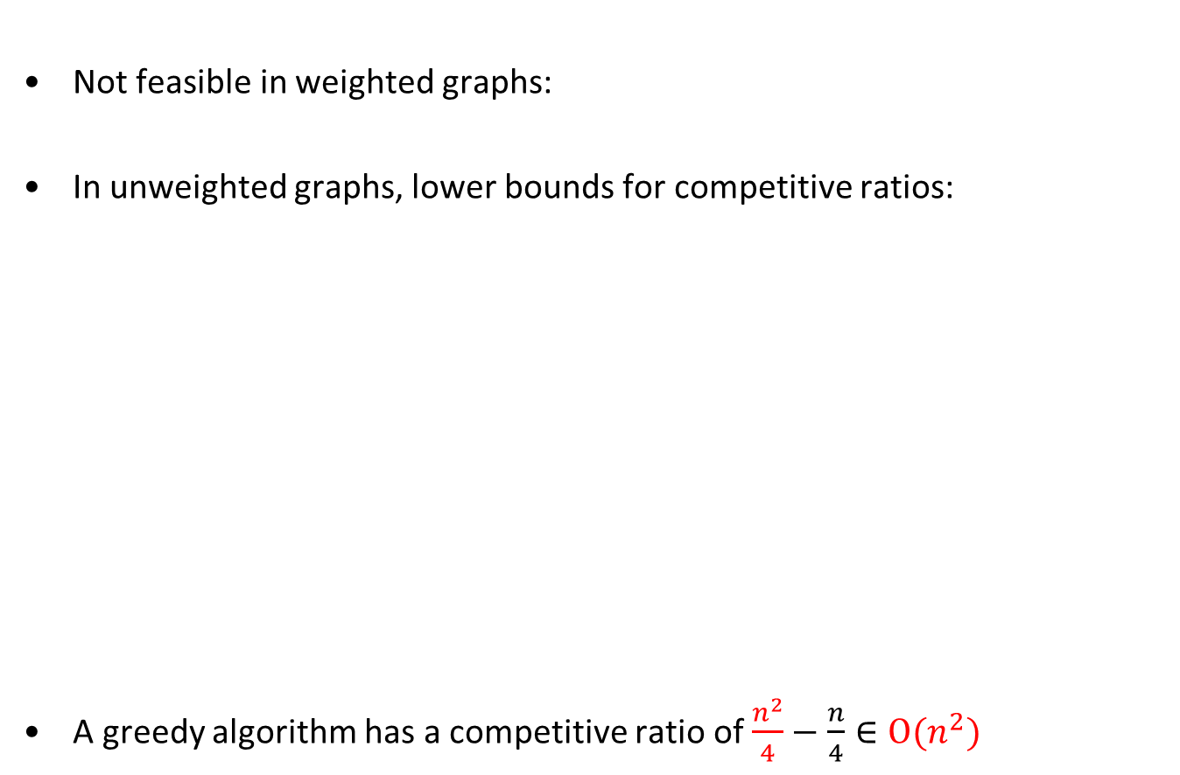
Searching for a Node
Not feasible in weighted graphs:
In unweighted graphs, lower bounds for competitive ratios:
A greedy algorithm has a competitive ratio of $\frac{n^{2}}{4}−\frac{n}{4}∈Ο(n^{2})$
Deterministic
$$\frac{{\left(n−1\right)}^{2}}{4}−\frac{\left(n−1\right)}{4}−\frac{1}{2}∈Ω(n^{2})$$
Randomized
$$\frac{n²}{16}−\frac{n}{8}+1∈Ω(n²)$$

Slide 17
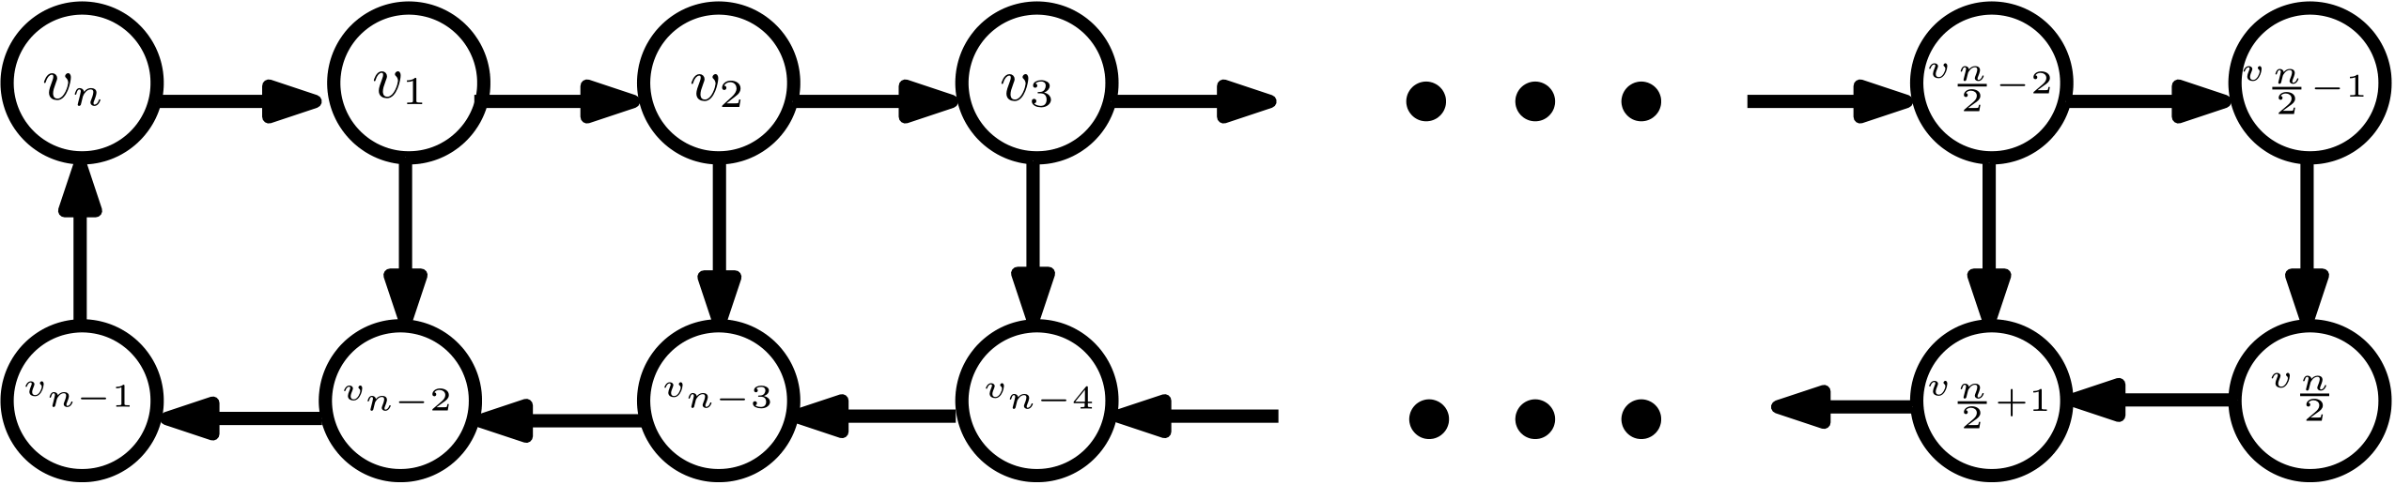
Adding Geometry
searcher knows coordinates of nodes
graph is Euclidean & planar

Slide 18
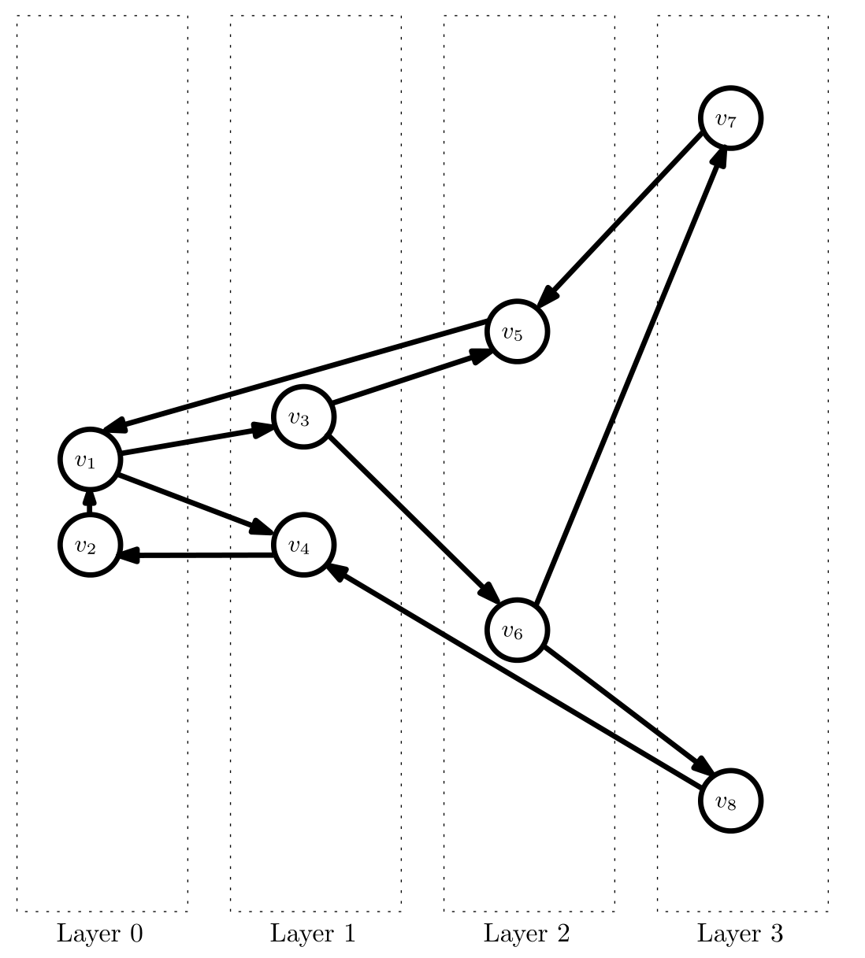
Adding Geometry

Slide 19
Adding Geometry

Slide 20
Adding Geometry

Slide 21
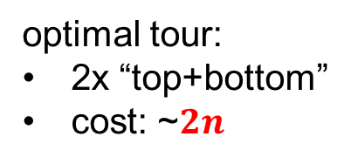

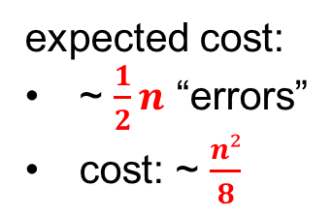
Adding Geometry
optimal tour:
2x “top+bottom”
cost: ~$2n$
expected cost:
~ $\frac{1}{2}n$ “errors”
cost: ~ $\frac{n²}{8}$
lower bound of $\frac{n}{16}+\frac{5}{8}+\frac{1}{2n}+ε∈Ω(n)$

Slide 22
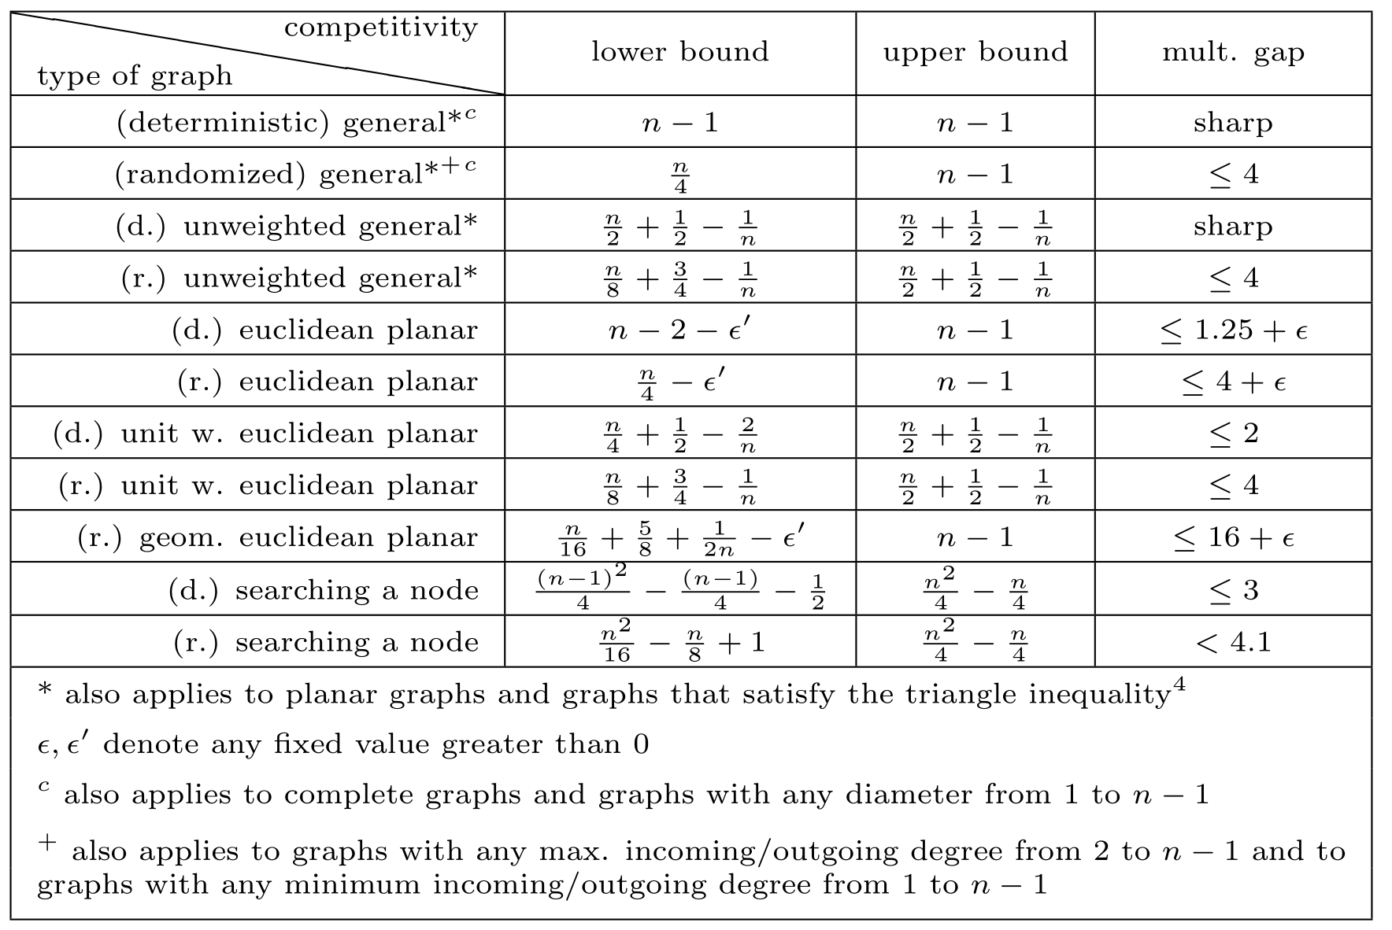
Overview of our Results

Slide 23
Thank you
Klaus-Tycho Förster

