Slide 1
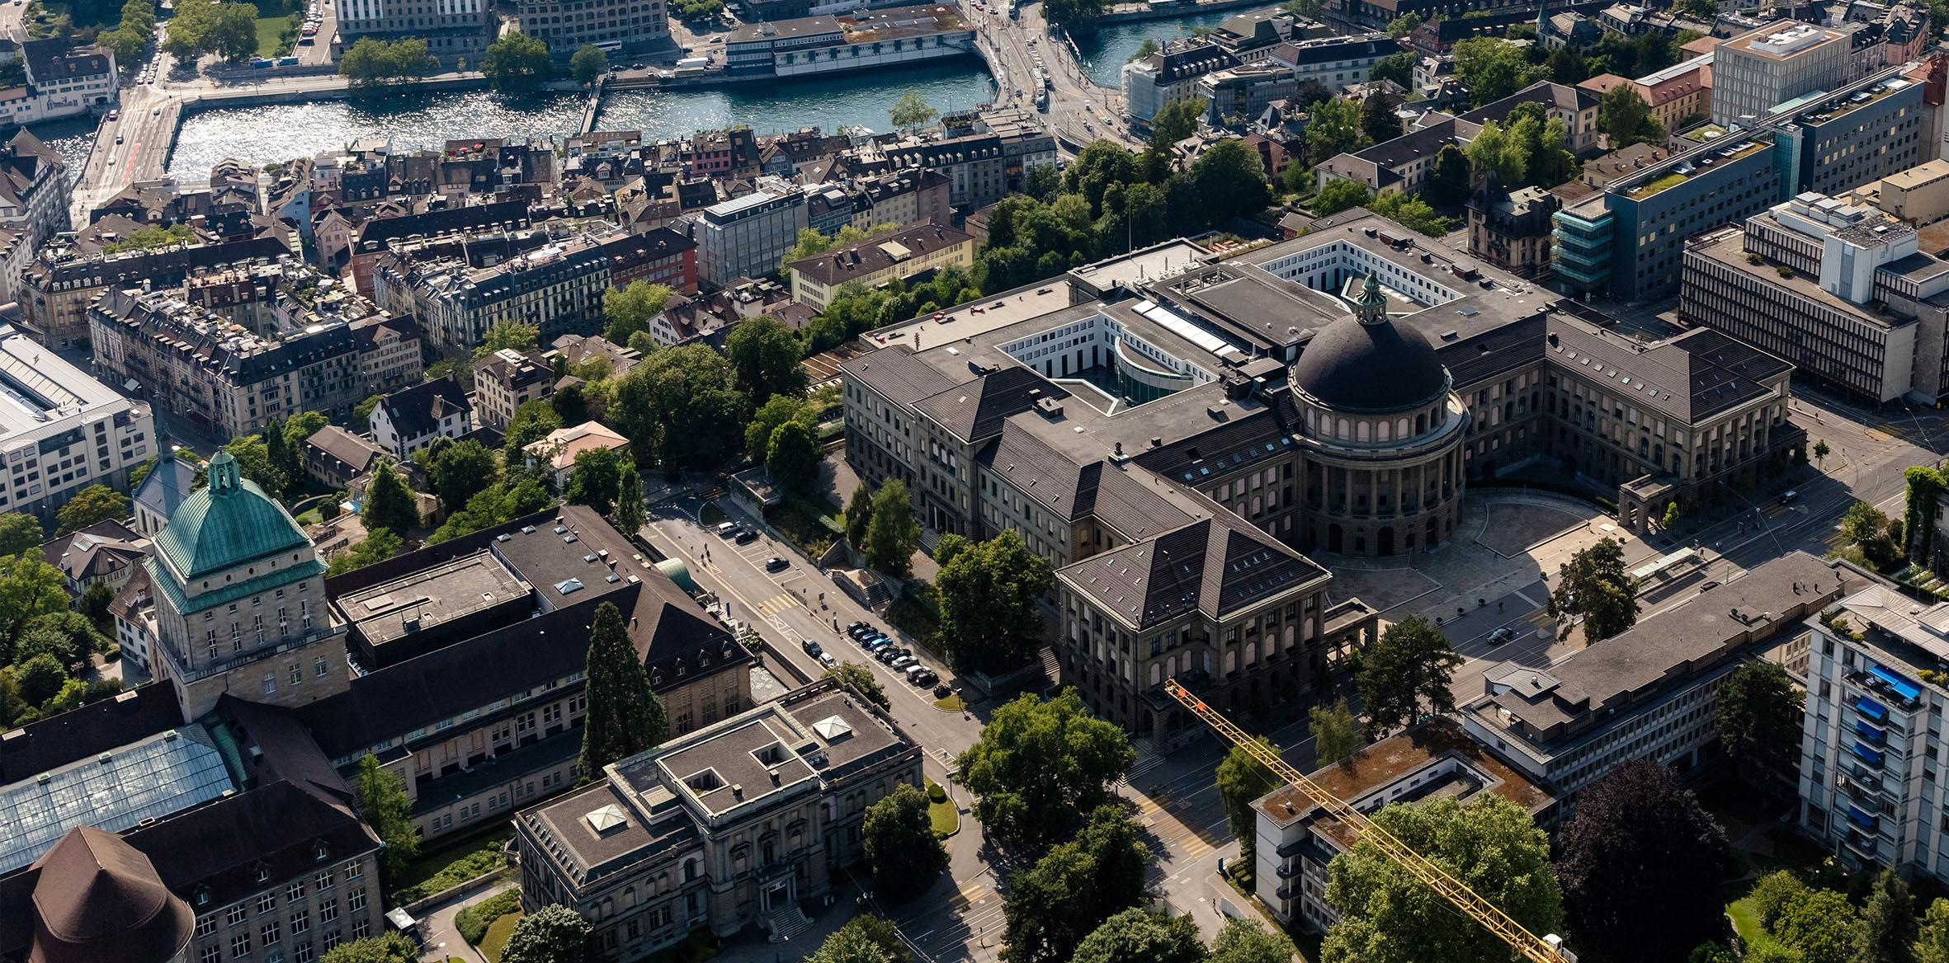
Decentralized Graph Processing for Reachability Queries
Distributed Computing Group
Joël Mathys, Robin Fritsch, Roger Wattenhofer
ETH Zürich
28. November 2022, ADMA, Brisbane, Australia

Slide 2
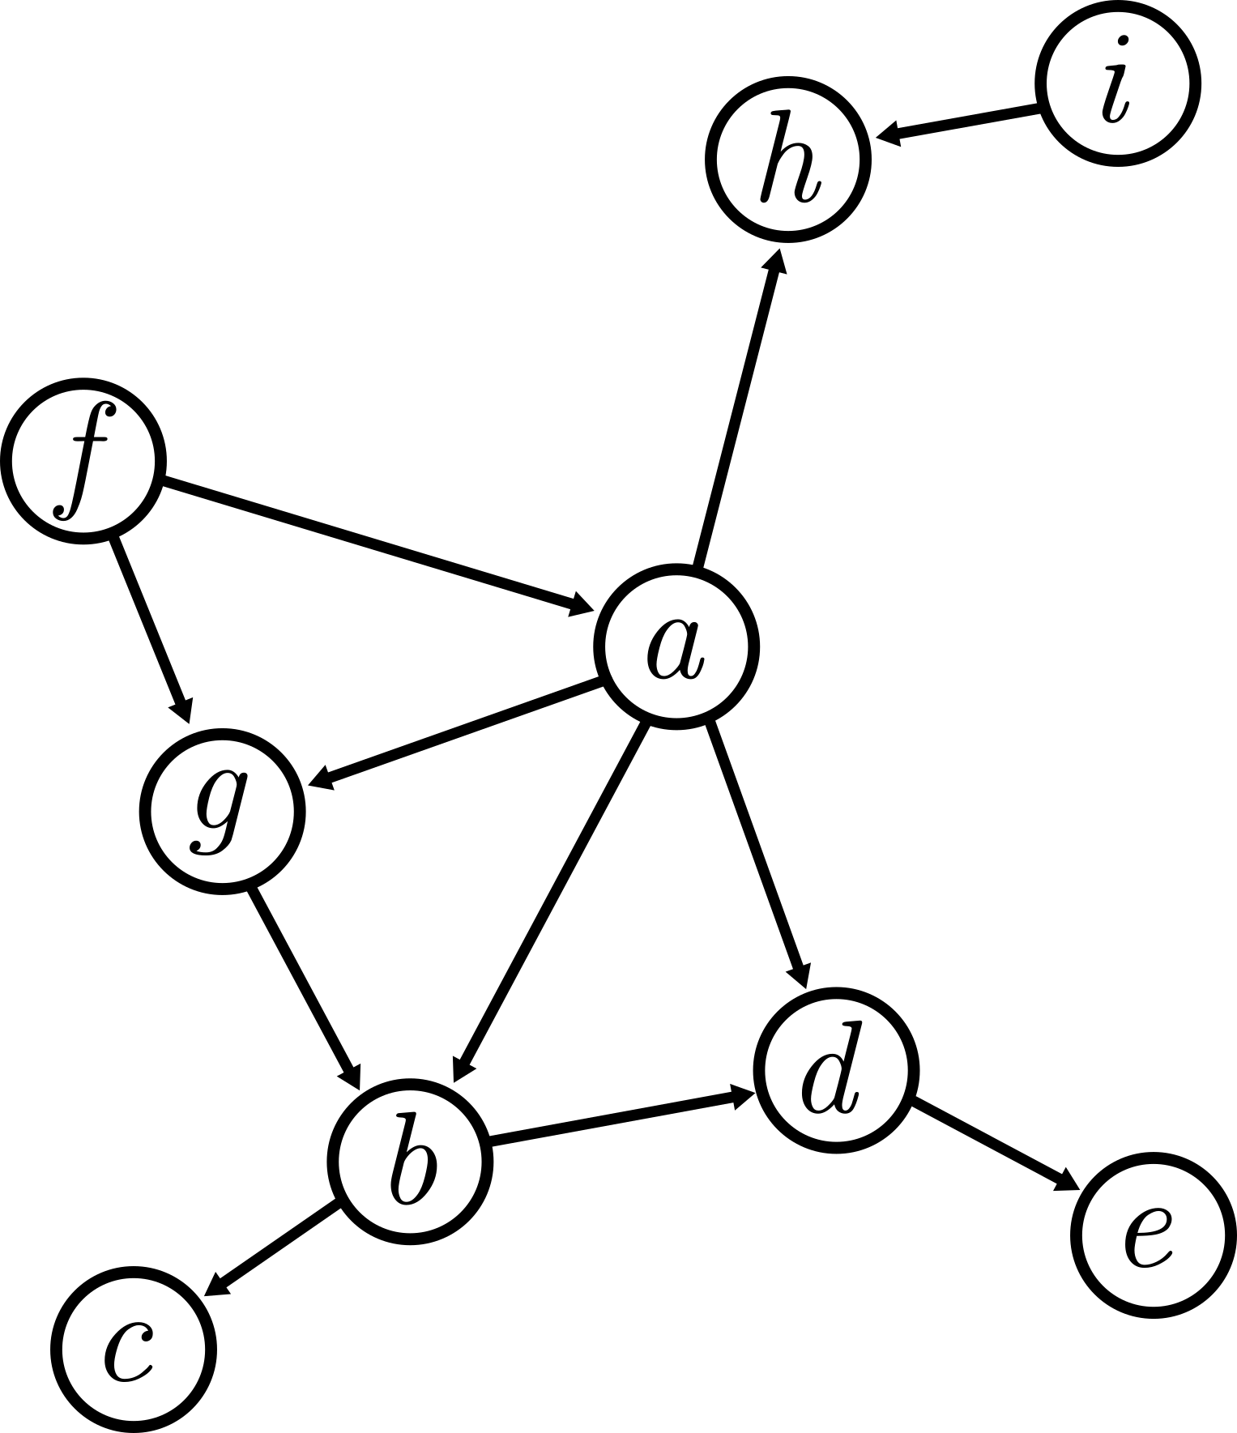
Introduction

Slide 3
Labeling Scheme
Given a Graph G, want to answer queries Q

Slide 4
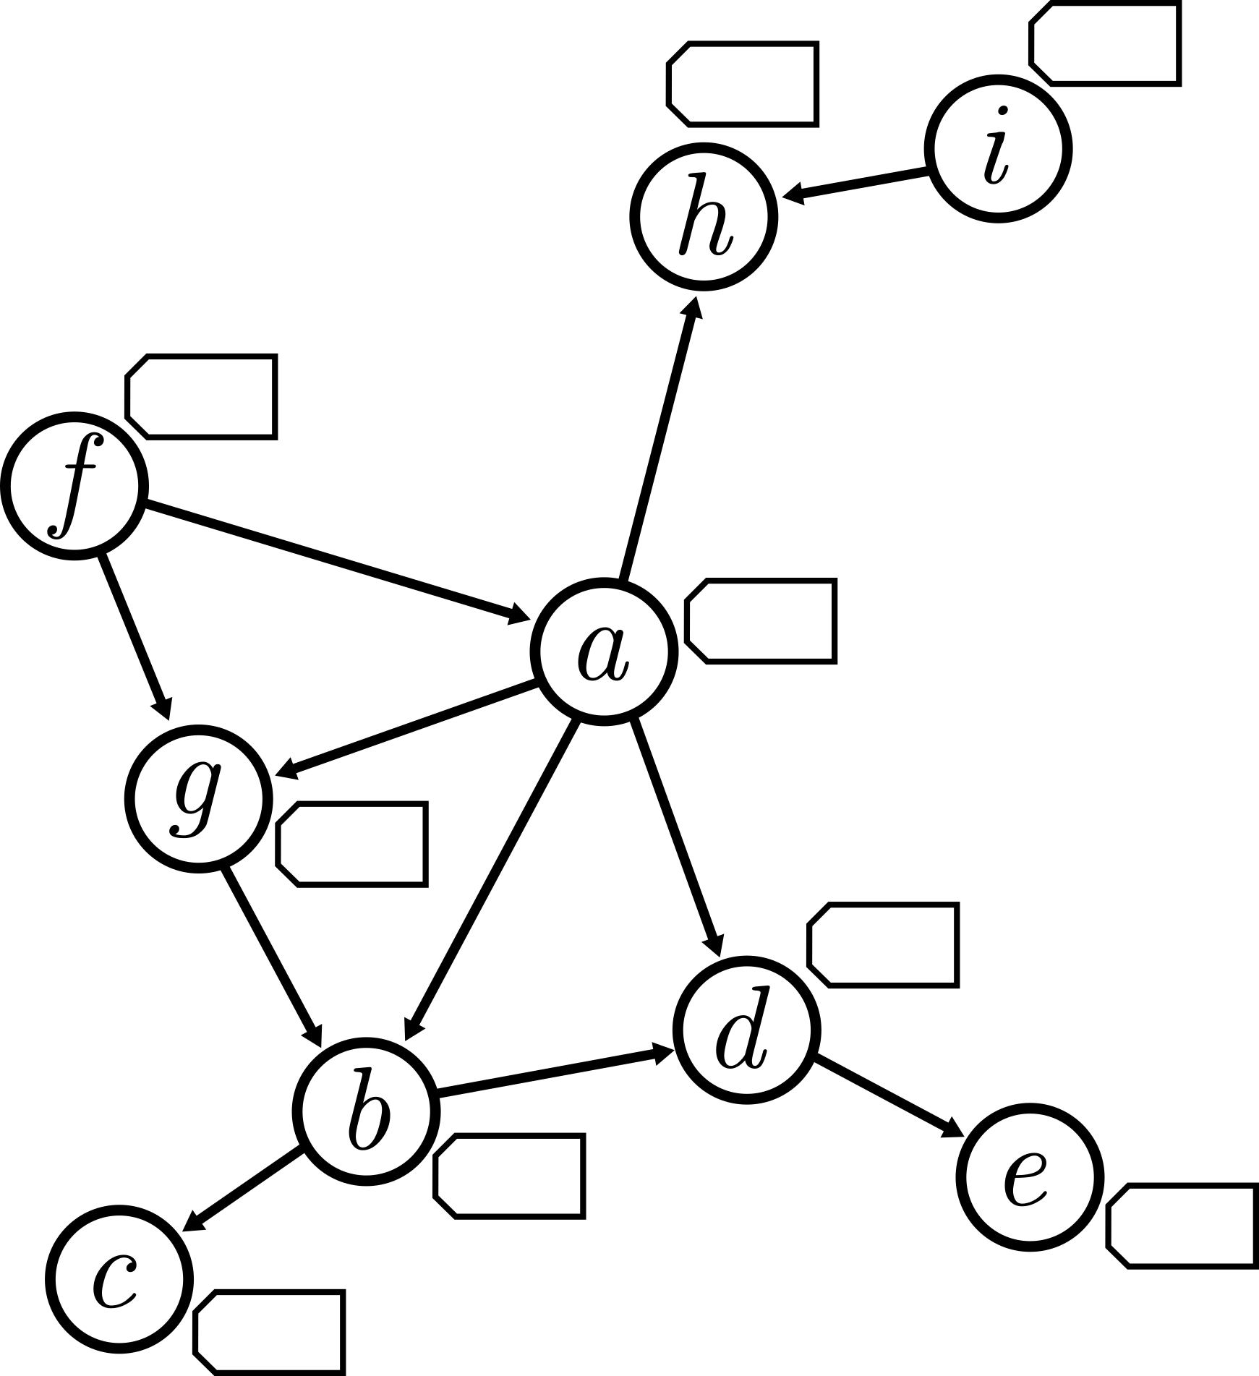
Labeling Scheme
Given a Graph G, want to answer queries Q
Encoder l, Decoder d
Q(u, v) = d(l(u), l(v))

Slide 5
Labeling Scheme
Given a Graph G, want to answer queries Q
Encoder l, Decoder d
Q(u, v) = d(l(u), l(v))
Minimize max. label size [bits]

Slide 6
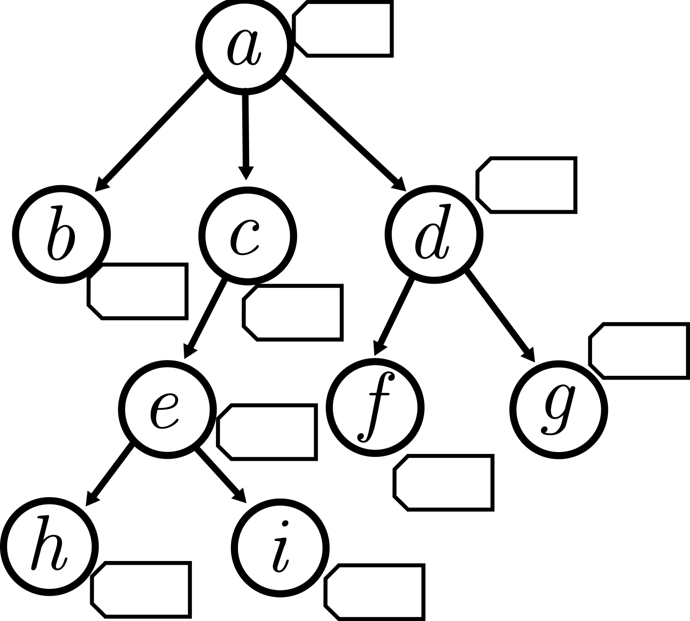
Warmup Tree
Tree T, answer reachability queries Q

Slide 7
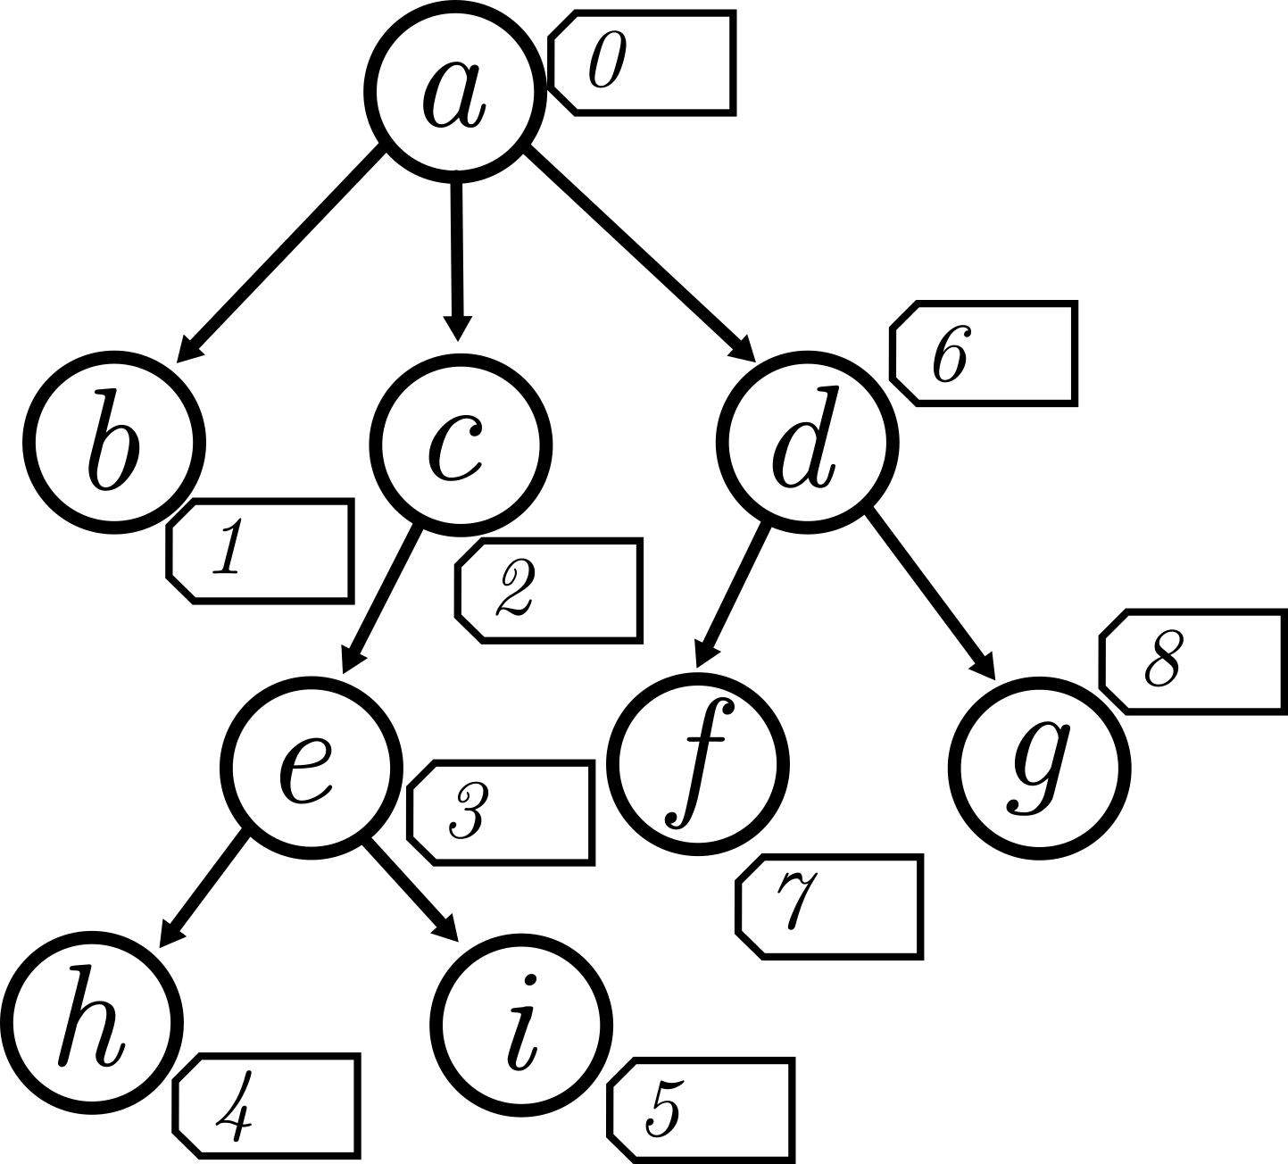
Warmup Tree
Tree T, answer reachability queries Q
DFS enumeration

Slide 8
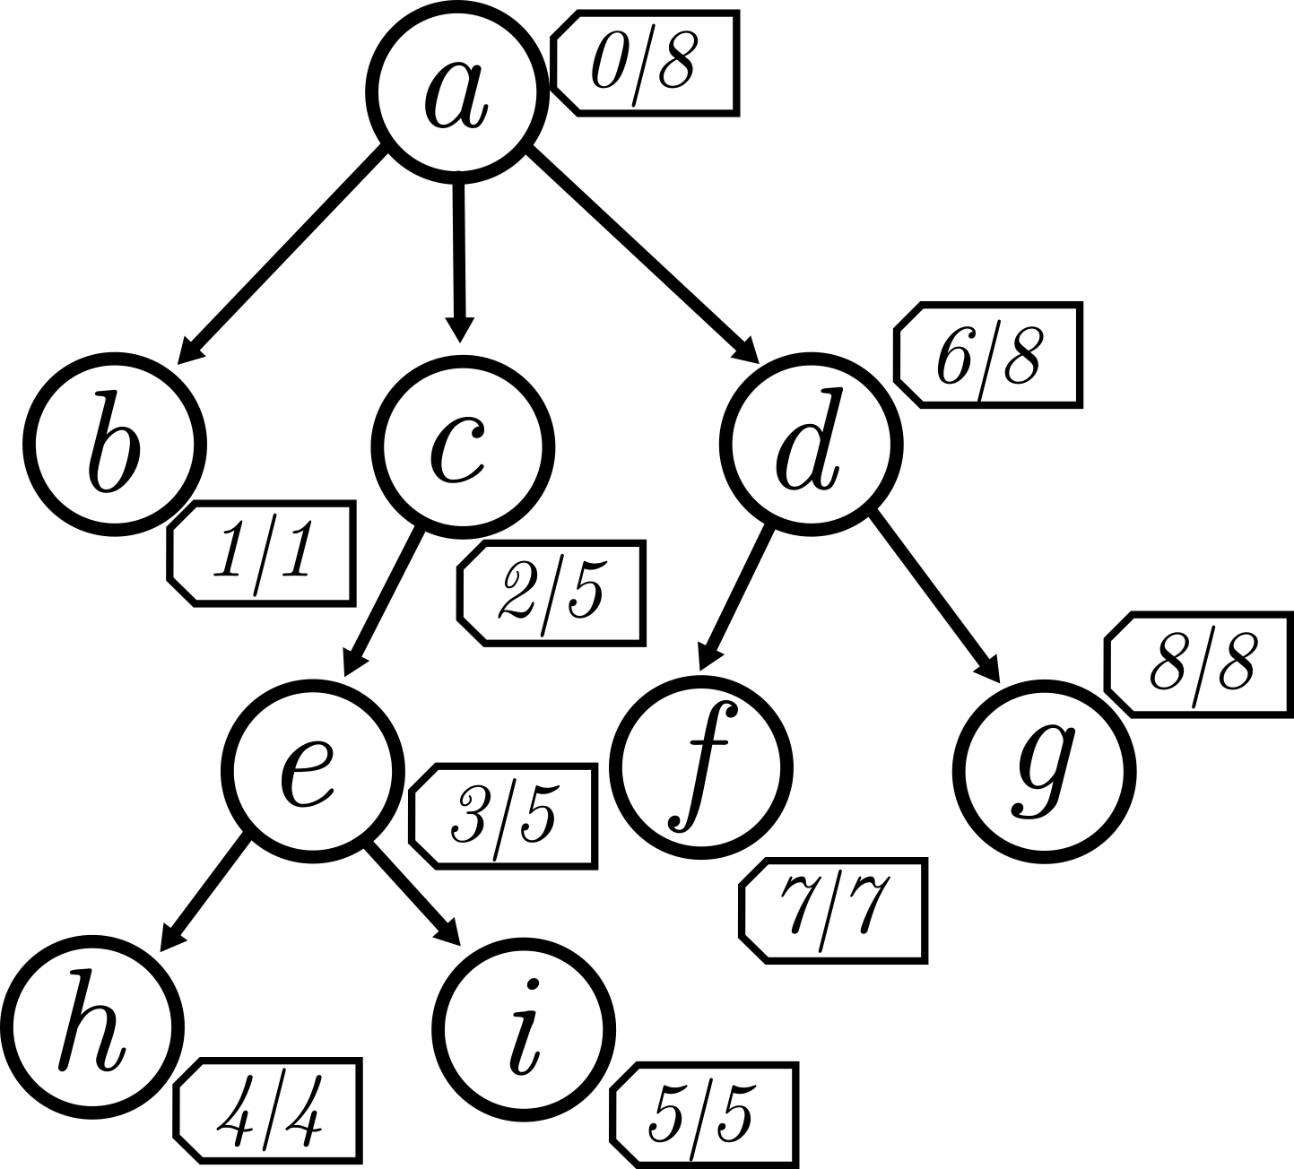
Warmup Tree
Tree T, answer reachability queries Q
DFS enumeration
Reachable range, log(n)

Slide 9
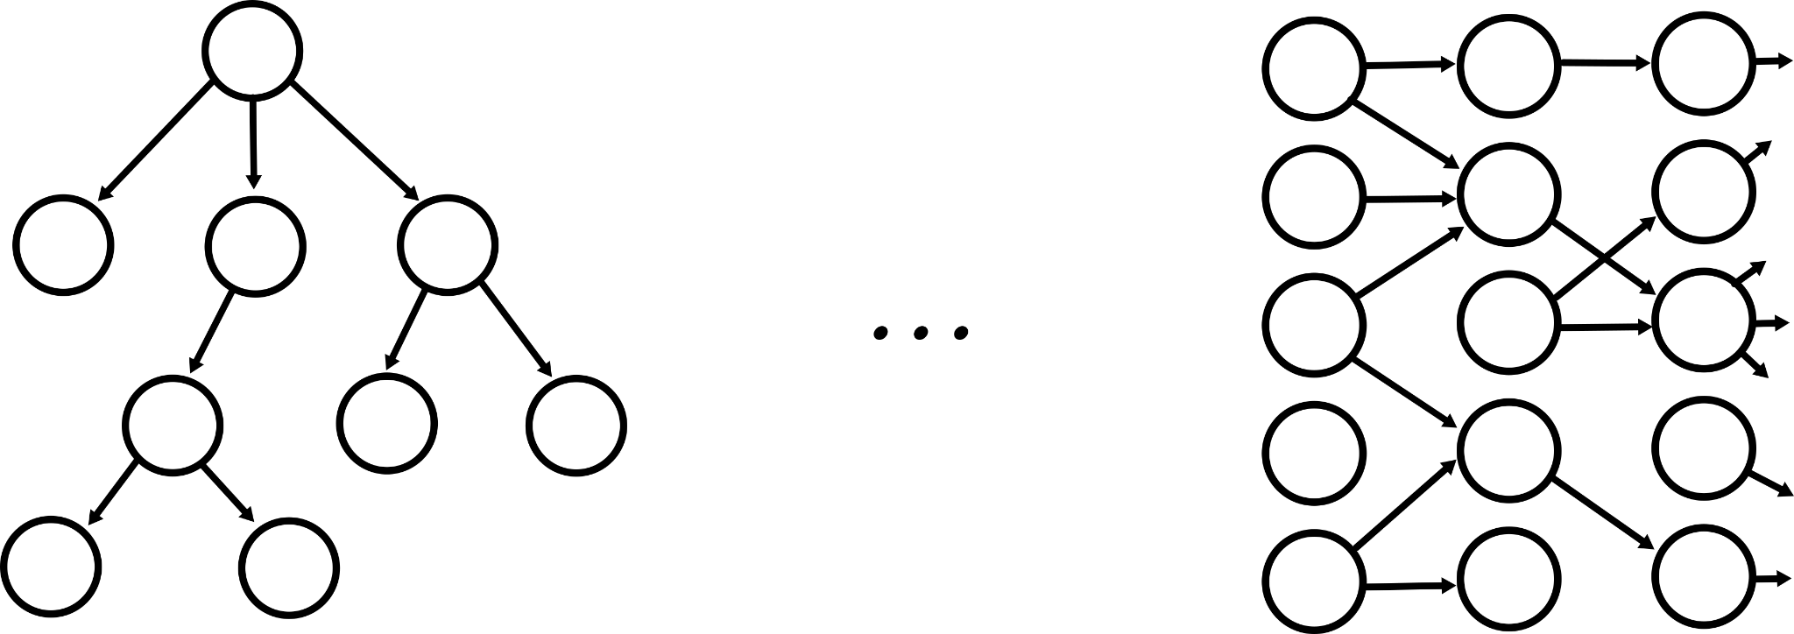
Our Goal
Given DAG G, answer reachability queries Q

Slide 10
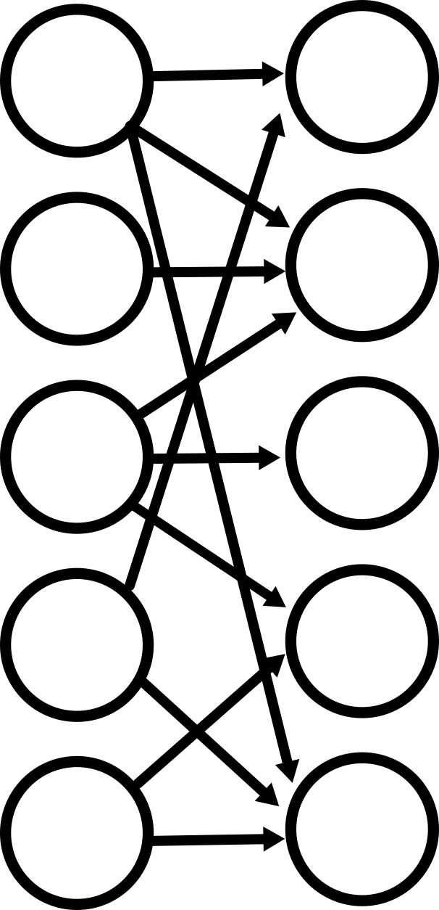
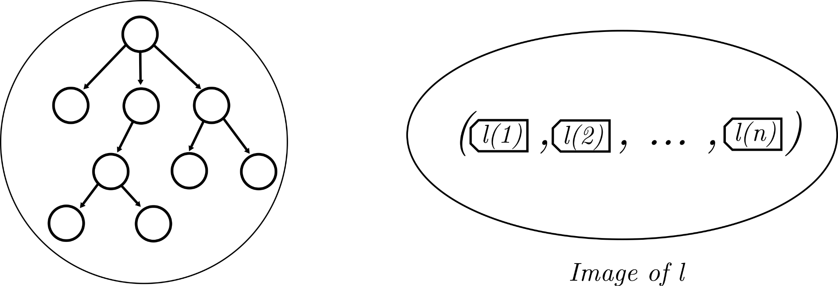
General Graphs
Given DAG G, answer reachability queries Q → L ≥ 𝛀(n)

Slide 11
Graphs of Bounded Degree

Slide 12
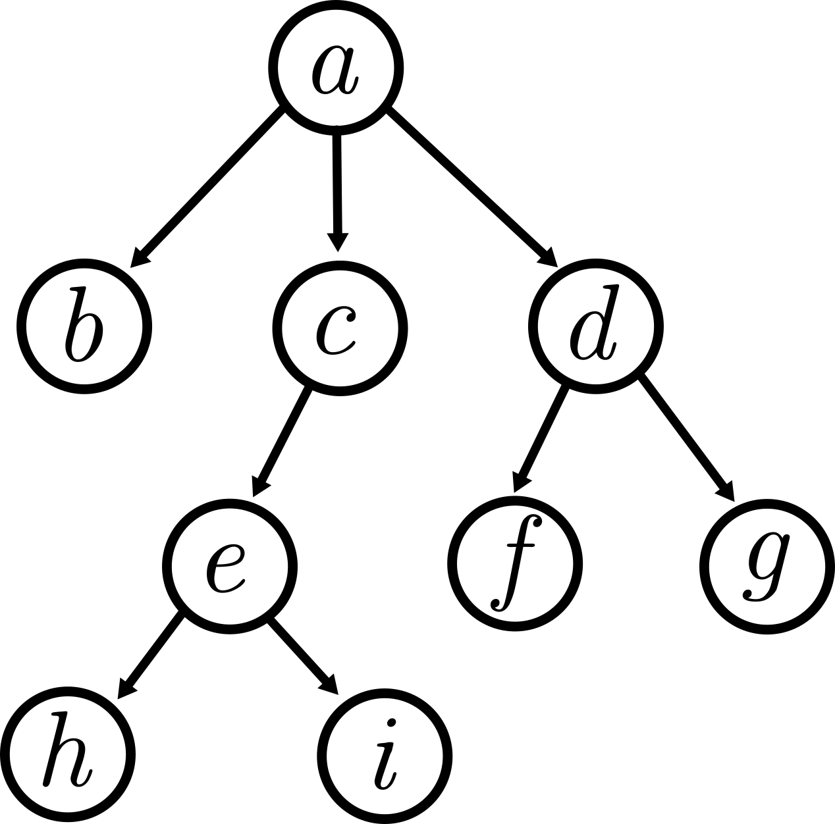
Bounded Degree Graphs
Δ at most 1

Slide 13
Bounded Degree Graphs
Δ at most 2

Slide 14
Bounded Degree Graphs
Δ at most 2
𝛙 Graph Transformation

Slide 15
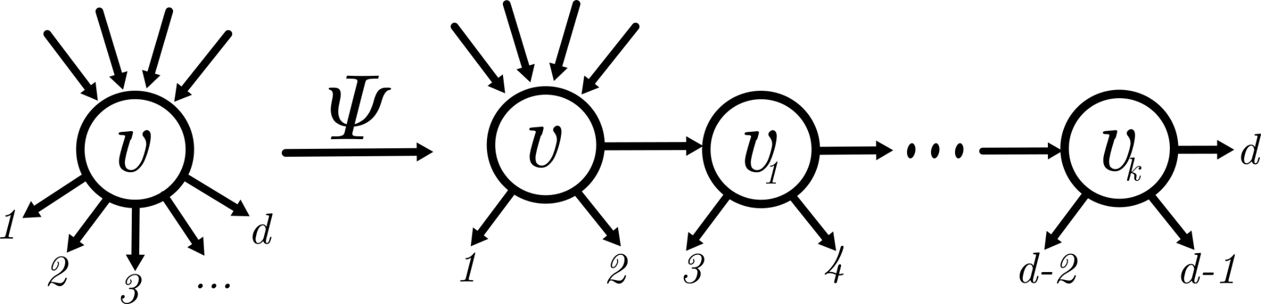
Bounded Degree Graphs
Δ at most 2
𝛙 Graph Transformation, preserves reachability, adds at most n / Δ nodes

Slide 16
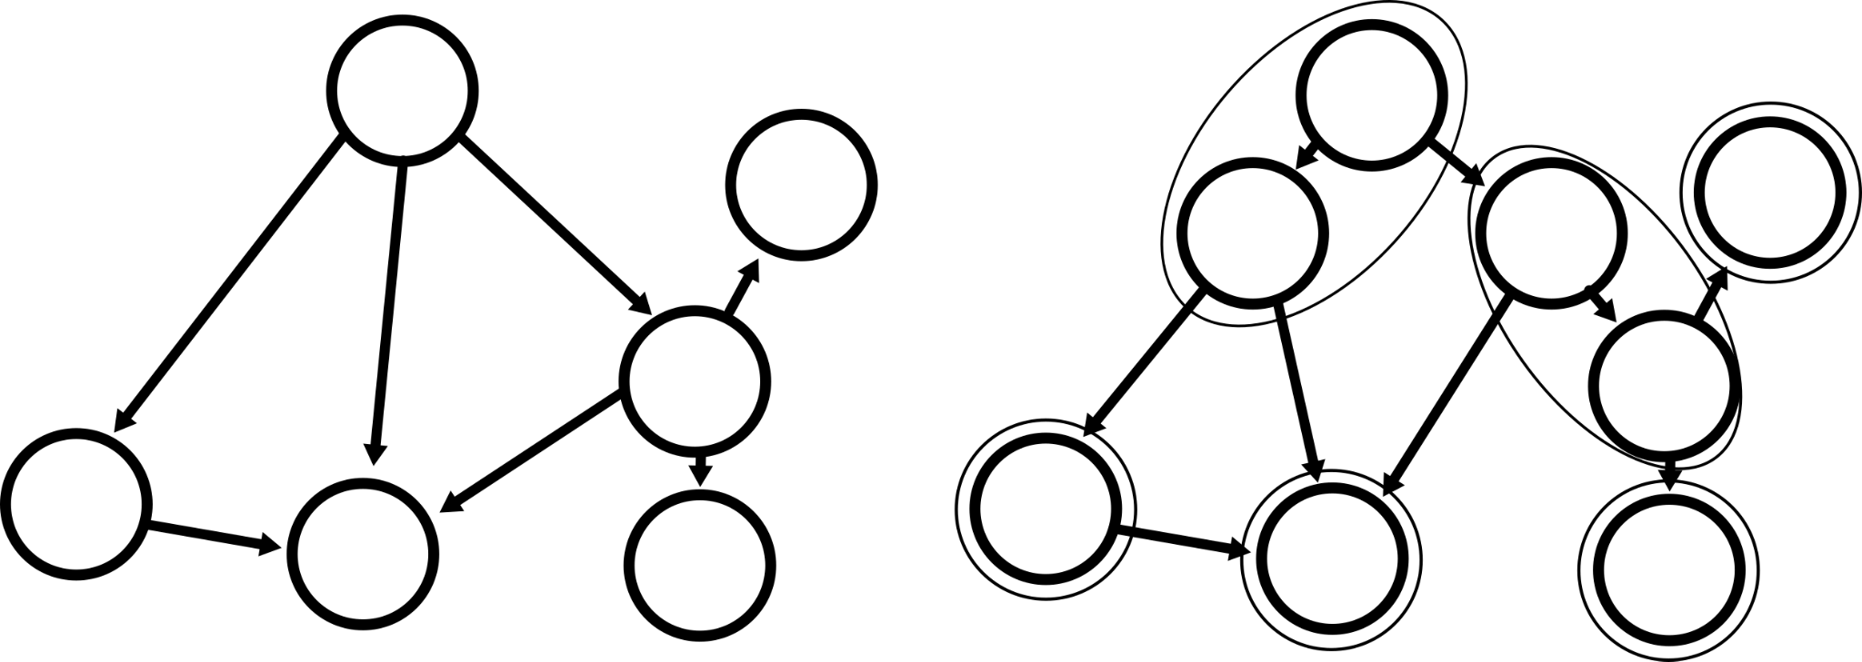
Bounded Degree Graphs
Δ at most 2
𝛙 Graph Transformation, preserves reachability, adds at most n / Δ nodes

Slide 17

Bounded Degree Graphs
Δ at most 2
𝛙 Graph Transformation, preserves reachability, adds at most n / Δ nodes

Slide 18
Graphs of Bounded Genus

Slide 19

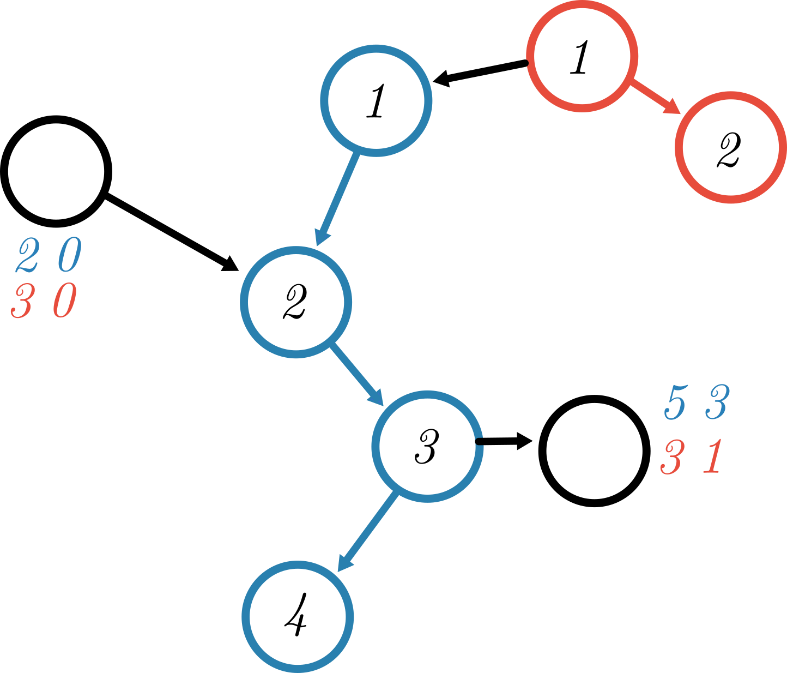
Tool I: Path removal
A directed path p, store log(n) bits per path

Slide 20
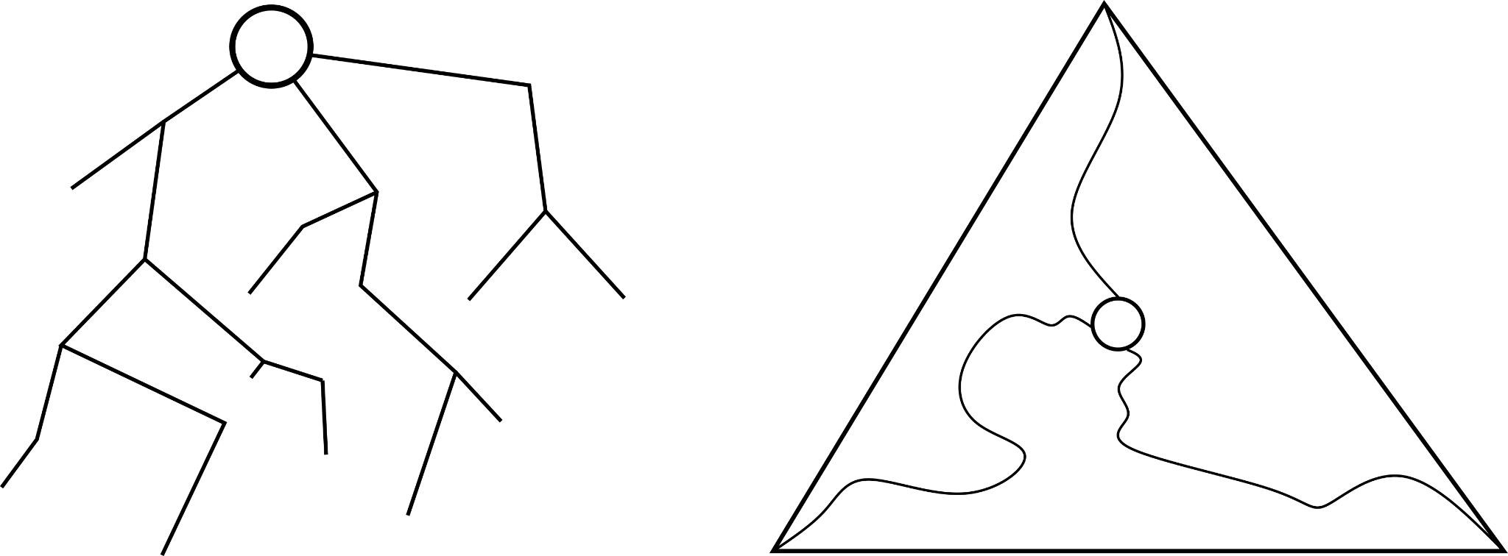
Tool II: Planar Graphs
Construct a special tree T
Remove 6 paths to half the graph size, log²(n) scheme

Slide 21
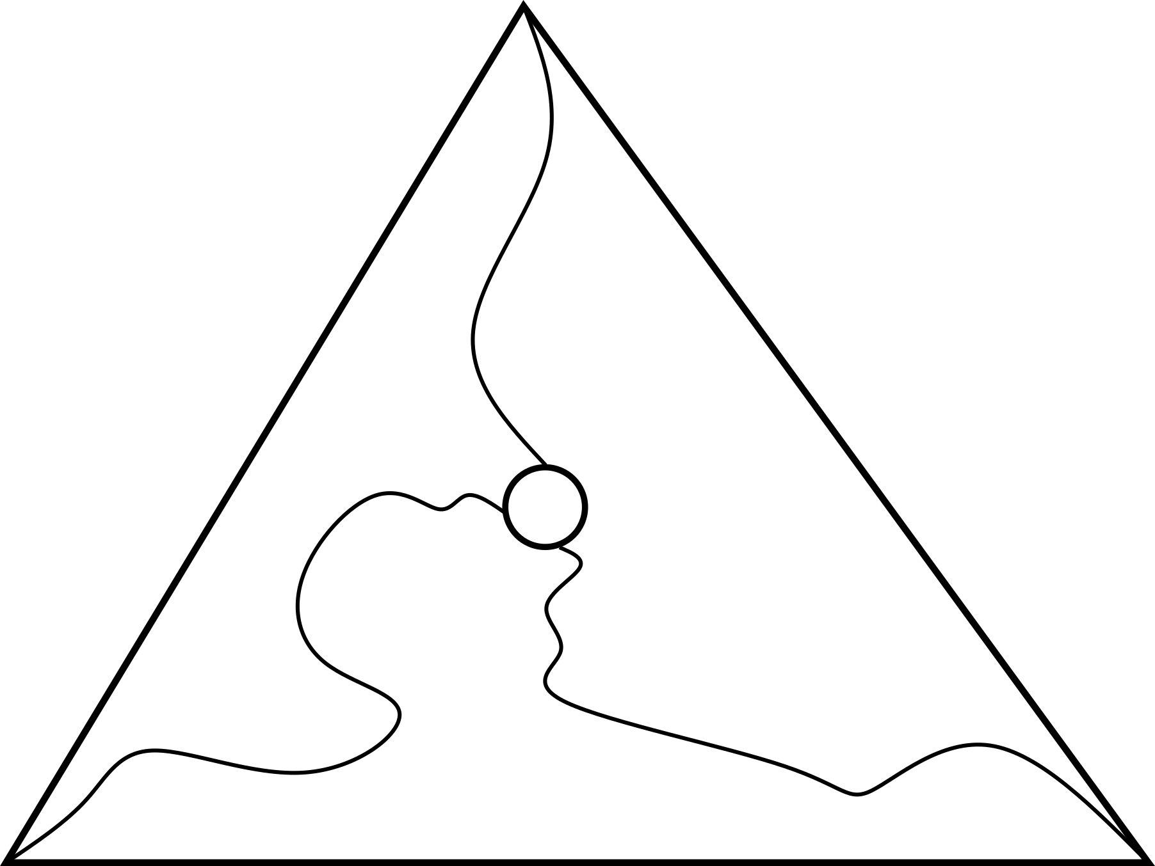

Graphs of Bounded Genus: Intuition
General Planar Bounded Genus

Slide 22
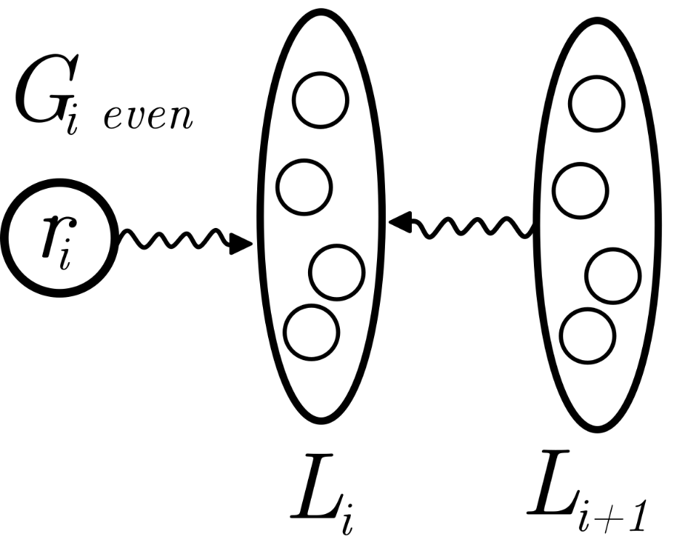
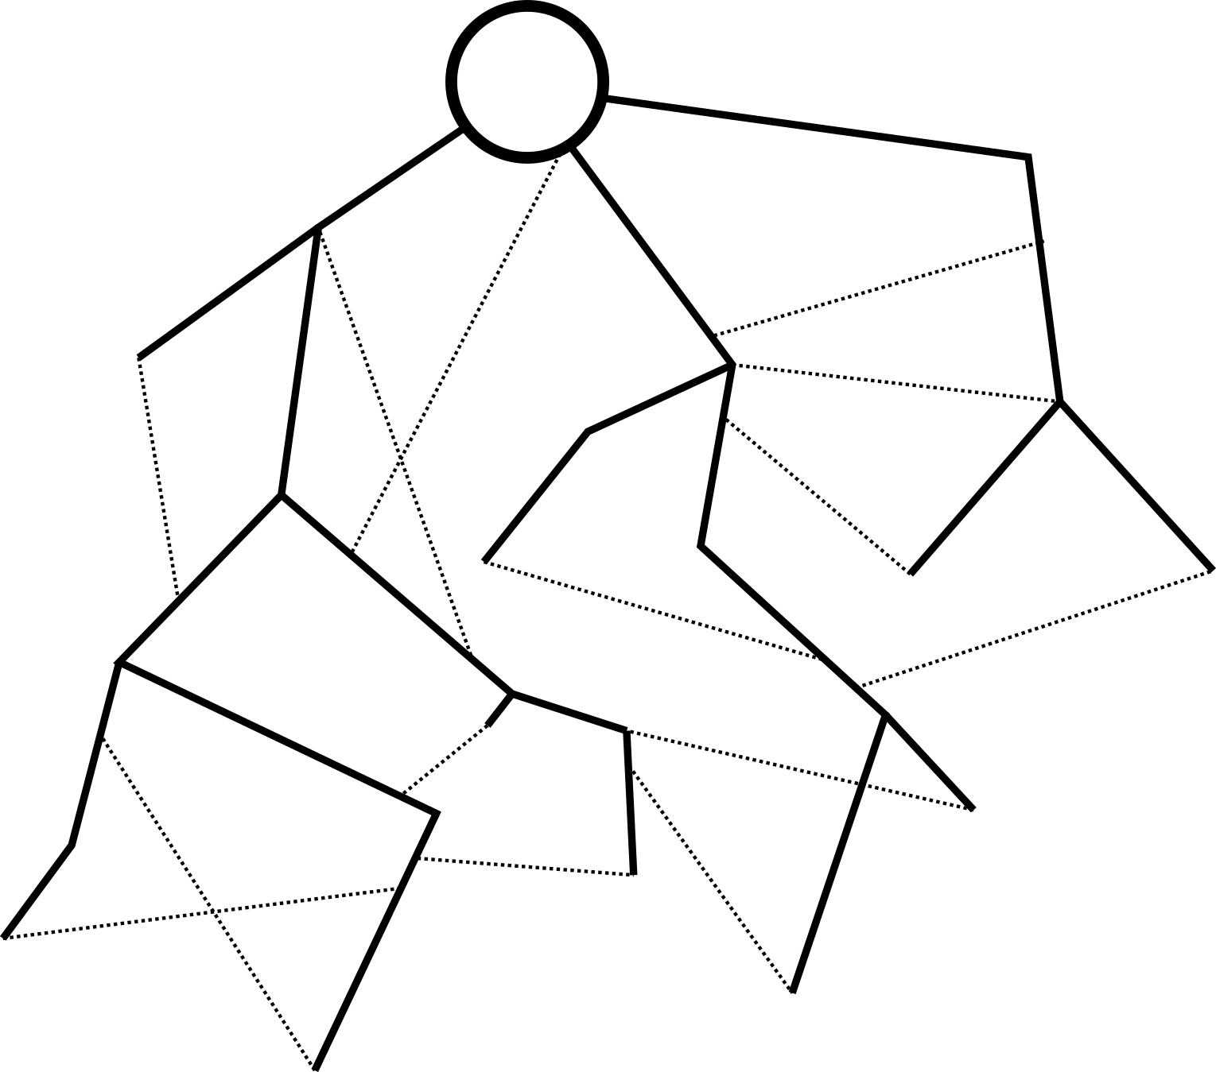
Graphs of Bounded Genus: Outline
Layering Planarizing Planar Graphs

Slide 23
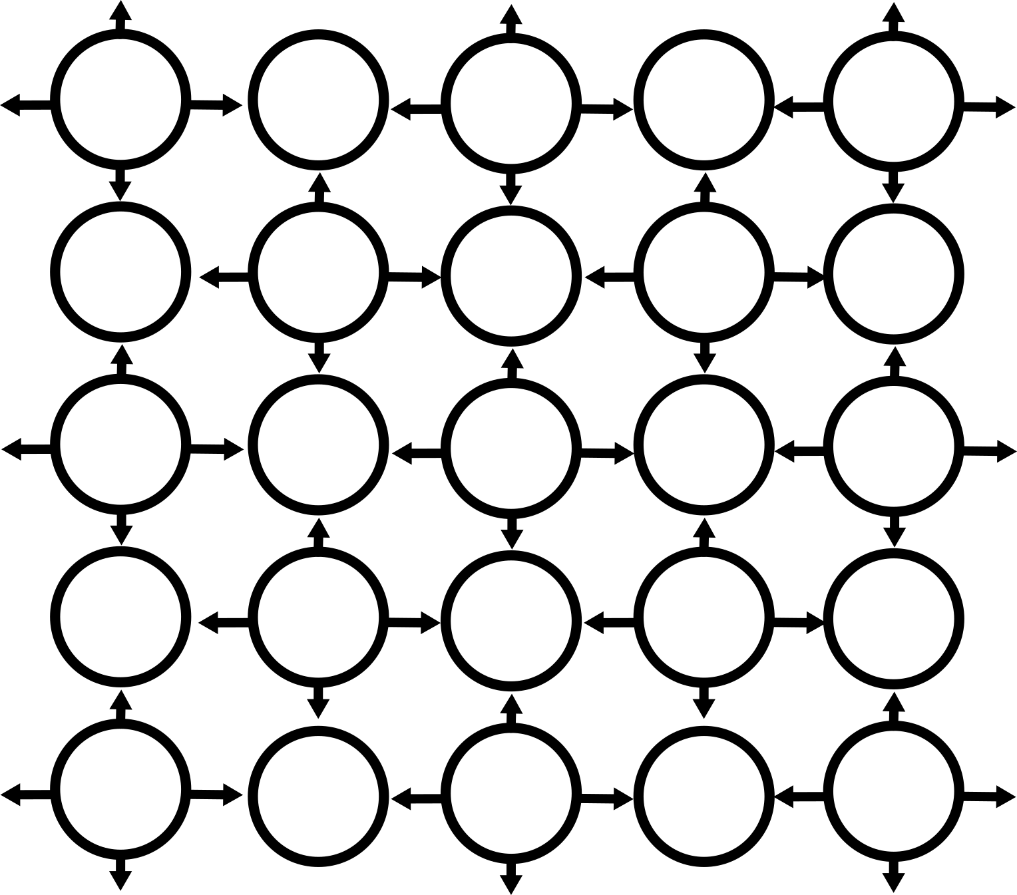
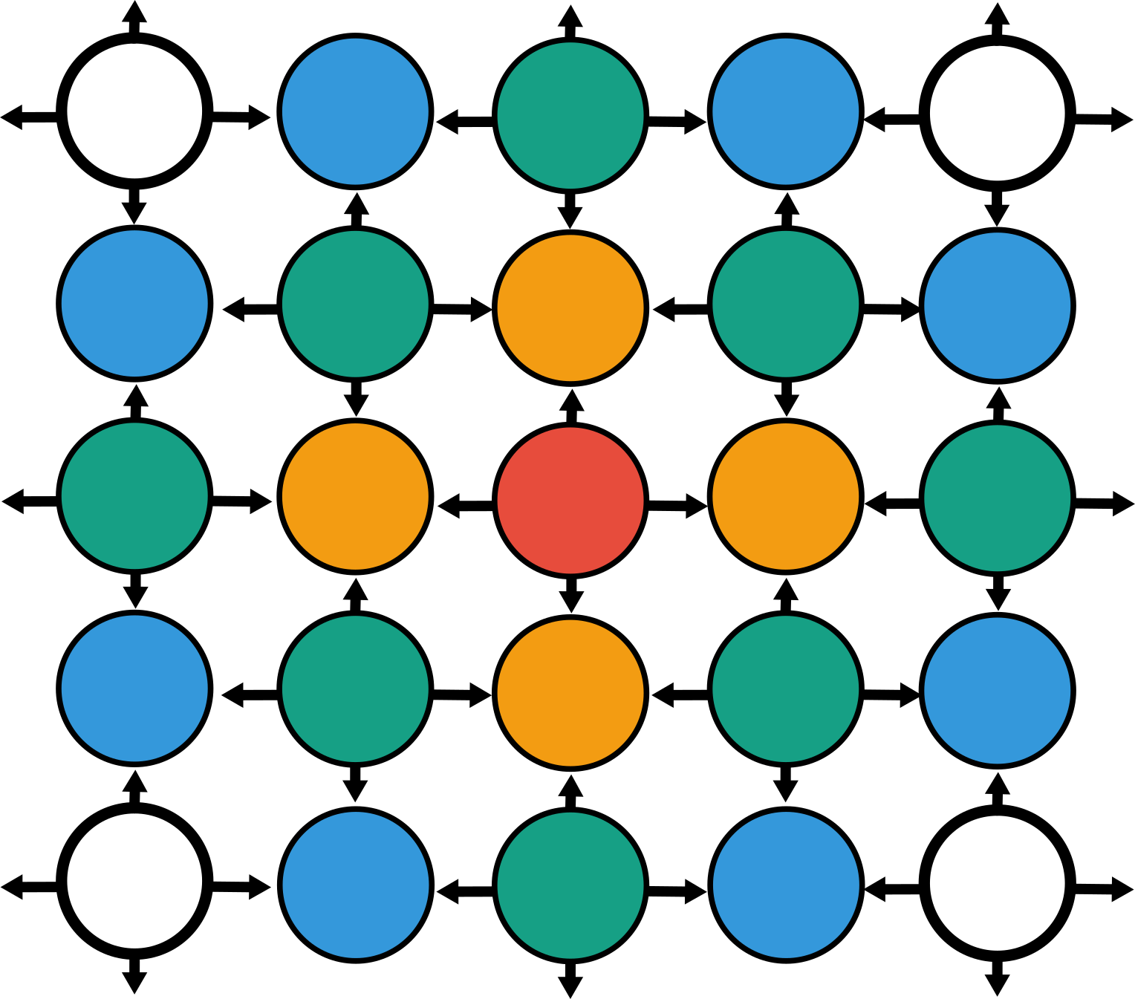
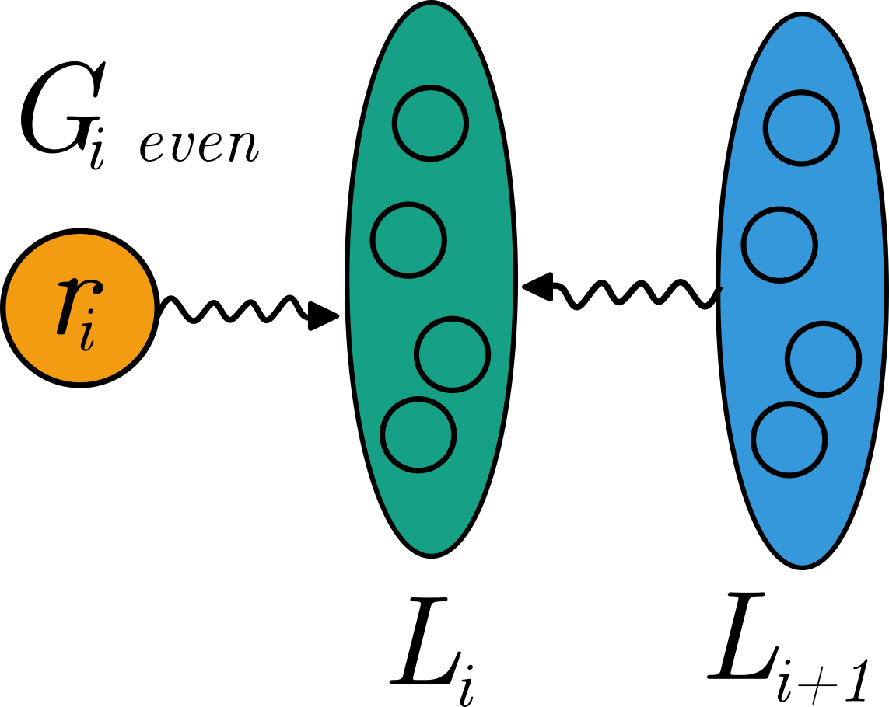
Graphs of Bounded Genus: Layering
Local Parts Layer Partition Digraph Sequence

Slide 24
Graphs of Bounded Genus: Planarizing
Layering preserves genus, now reduce genus to planar

Slide 25
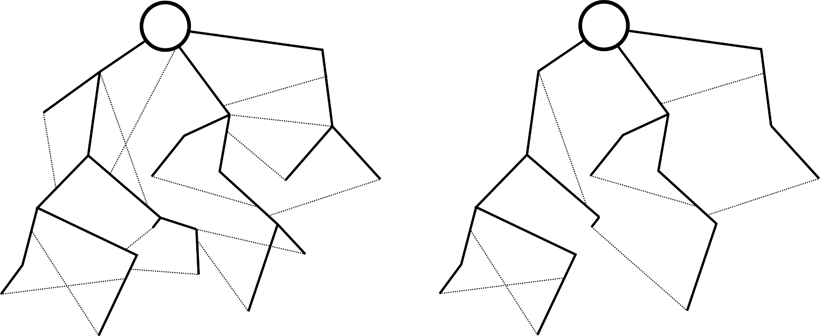
Graphs of Bounded Genus: Planarizing
Find rooted subgraph with at most 4g leaves, remove through paths

Slide 26

Graphs of Bounded Genus
Layering Remove g paths Planar Scheme

Slide 27

Conclusion
Bounded Degree Bounded Genus

Slide 28
Decentralized Graph Processing for Reachability Queries
Distributed Computing Group
Joël Mathys, Robin Fritsch, Roger Wattenhofer
ETH Zürich
28. November 2022, ADMA, Brisbane, Australia

