Slide 1
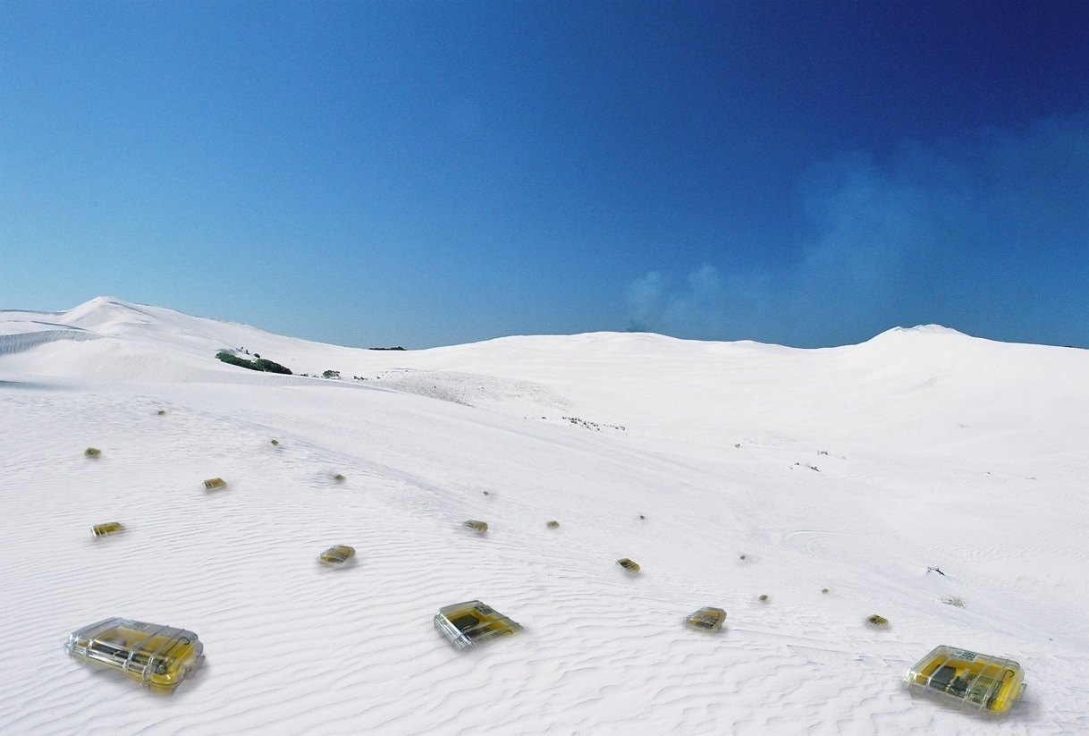

Tight Bounds for
Clock Synchronization
Christoph Lenzen, Thomas Locher, and Roger Wattenhofer
Notes:
Disclaimer: (again) no dynamic communication networks, sorry.
But: we have communication networks, and even if the nodes are not dynamic, the clock

Slide 2
Time in Networks
Common time is essential for many applications:
  Assigning a timestamp to a globally sensed event (e.g. earthquake)
  Precise event localization (e.g. shooter detection, multiplayer games)
  TDMA-based MAC layer in wireless networks
  Generating clock pulses driving a CPU or chip
Global
Local
Local
Local

Slide 3
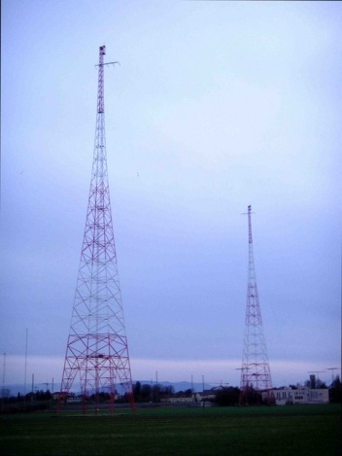

Clock Synchronization in Practice?
Radio Clock Signal:
  Clock signal from a reference source (atomic clock) is transmitted over a long wave radio signal
  DCF77 station near Frankfurt, Germany transmits at 77.5 kHz with a transmission range of up to 2000 km
  Accuracy limited by the distance to the sender, Frankfurt-Zurich is about 1 ms.
  Special antenna/receiver hardware required
Global Positioning System (GPS):
  Satellites continuously transmit own position and time code
  Line of sight between satellite and receiver required
  Special antenna/receiver hardware required
) (At least one) motivation to study the problem in multi-hop environments

Slide 4
Clock Synchronization in Theory?
...is a surprisingly versatile and persistent topic
some facets:
1970
one-shot, single-hop
1980
failures, drifting clocks, multi-hop
1990
varying drifts and delays
2000
gradient property
now
...?
We can have this and more!

Slide 5
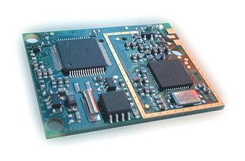
Error sources
Inaccurate hardware clocks
  Clock drift: both systematic and random deviations from the nominal rate dependent on power supply, temperature, etc.
  Drift is typically small
  E.g. TinyNodes have a maximum drift of ² < 10⁻⁵ at room temperature
Unknown message delays
  Asymmetric packet delays due to non-determinism
  Simplification: Assume messages take between 0 and 1 time unit
We analyze the worst-case
  Drifts and delays vary arbitrarily within these bounds
rate
1+²
1
1-²
t
Oscillator

Slide 6
Problem Summary
Given a communication network
  Nodes are equipped with drifting hardware clocks
  Message delays vary
Goal: Synchronize Clocks
  Both global and local synchronization!

Slide 7



Problem Summary (continued)
1. Global property: Minimize clock skew between any two nodes.
2. Local (gradient) property: Small clock skew between neighbors.
Clocks should not be allowed to stand still or jump.
...but let's be more careful (and ambitious):
3. Clocks shall behave similar to real clocks:
  Sometimes running a bit faster or slower is OK.
  But there should be a minimum and a maximum speed.
  As close to correct time as possible!

Slide 8
A Lower Bound on the Global Skew (5-second-proof)
Messages between two neighboring nodes may be fast in one direction and slow in the other, or vice versa.
A constant skew between neighbors may be „hidden“.
Create skew by manipulating clock drifts.
) Global skew of Ω(D).
u
2
3
4
5
6
7
v
2
3
4
5
6
7
vs
2
3
4
5
6
7
2
3
4
5
6
7
2
3
4
5
6
7
2
3
4
5
6
7
Notes:
8

Slide 9


Synchronization Algorithms: A^{max}
How to update logical clocks based on the neighbors' messages?
First idea: Minimize skew to fastest neighbor
  Set the clock to the maximum clock value received from any neighbor
  (if greater than local clock value)
  forward new values immediatly
) Optimal global skew of ¼D
Poor local property: Fast propagation of the largest clock value could lead to a large skew between two neighboring nodes
  First all messages take 1 time unit, then we have a fast message!
New time is D+x
New time is D+x
skew D!
Time is D+x
Time is D+x
Time is D+x
…
Clock value:
D+x
Old clock value:
D+x-1
Old clock value:
x+1
Old clock value:
x

Slide 10
Local Skew: Result Overview
Everybody‘s expectation, five years ago
(„obviously constant“)
“Kappa algorithm”
[FOCS'08]
Blocking algorithm
[DISC'06]
1 log D √D D …
Many natural algorithms
[DISC'06]
Many natural algorithms
[DISC'06]
Tight lower bound
Lower bound of log D / log log D
[Fan & Lynch, PODC'04]
Dynamic Networks
[Kuhn et al., SPAA'09]

Slide 11
Local Skew: Lower Bound
There's more to it: The bound depends also on the maximum logical clock rate ¯ !
We get the following picture:
Can these bounds be matched with clock rates · ¯ ?
  Yes, up to small constants!
max rate ¯ | 1+² | 1+£(²) | 1+√² | 2 | large
local skew | 1 | Ω(log D) | Ω(log_{1/²} D) | Ω(log_{1/²} D) | Ω(log_{1/²} D)
Can we have both smooth and accurate clocks?
...because too large clock rates will amplify the clock drift ².
Notes:
11

Slide 12
Some Simplifications
Ok when considering "reasonable" algorithms!
On a general graph, the clocks most ahead and behind take these roles
In order to keep things easy, we make a few simplifications:
  Permit logical clock rates of (1+²)¯
  Abstract communication: at any time t, node i has an estimate
  E_{i,j}(t) 2 (L_{j}(t-1),L_{j}(t)] of neighbor j's clock value
  The graph is a list of D nodes
  L₁(t) ¸ L₂(t) ¸ ... ¸ L_{D}(t) at any time t
node D "removes" skew, node 1 "creates" it, other nodes "move" it
) node i struggles to keep up with L_{i-1} while not outrunning L_{i+1}

Slide 13
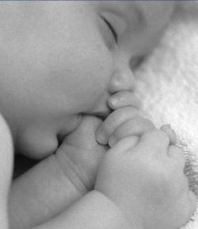
Synchronization Algorithms: A^{avg}
Time is 9
Time is 4
Time is 1
Time is 4
Time is 1
Time is 0
L_{i-2} = 10
L_{i-1} = 5
L_{i} = 2
L_{i+1} = 1
A^{max} failed because it locally accumulated clock skews
) Idea: Locally balance them!
) Increase L_{i} at rate h_{i} ¢ ¯ whenever E_{i,i-1} - L_{i} > L_{i} - E_{i,i+1}
) Skew to clock behind is only increased if skew to clock ahead is worse
Problem: delays prevent nodes from acting
) catastrophic failure: Ω(D²) global and Ω(D) local skew
[DISC'06]

Slide 14

Synchronization Algorithms: A^{agg}
Time is 4
Time is 3
Time is 2
Time is 3
Time is 2
Time is 1
L_{i-2} = 4
L_{i-1} = 3
L_{i} = 2
L_{i+1} = 1
Apparently we need to be more aggressive
) Increase L_{i} at rate h_{i}¢¯ whenever E_{i,i-1} - L_{i} + ¯ > L_{i} - E_{i,i+1} - ¯
) Nodes will always react if left neighbor is further ahead than right neighbor is behind
Problem: Nodes may run faster even if skew is well-balanced
) Ω(D) local skew

Slide 15
Synchronization Algorithms: A^{opt}
...totally lost?!?
No, but we need to combine the advantages of both algorithms.
) Idea: Run fast whenever d(E_{i,i-1}-L_{i})/(2¯)e > b(L_{i}-E_{i,i+1})/(2¯)c
Acts like A^{avg} if differences are even multiples of ¯:
d(E_{i,i-1}-L_{i})/(2¯)e = (E_{i,i-1}-L_{i})/(2¯) and b(L_{i}-E_{i,i+1})/(2¯)c = (L_{i}-E_{i,i+1})/(2¯)
...but like A^{agg} if they are odd multiples of ¯:
d(E_{i,i-1}-L_{i})/(2¯)e = (E_{i,i-1}-L_{i})/(2¯) + ¯ and b(L_{i}-E_{i,i+1})/(2¯)c = (L_{i}-E_{i,i+1})/(2¯) - ¯
) In some "skew ranges" A^{opt} moves skew quickly, in others it plays defensively in order to buy time
...it's that simple?
  Yes and no. It works, but the proof gets quite involved.

Slide 16
A^{opt} – Trivia
Message frequency? O(1/(¯-1))
Message size? O(1)
Approximation ratio? asymptotically 2
Memory required? roughly #neighbors
Must max. delay be known? no
Fault tolerance? crash failures ok

Slide 17
Summary/Contributions
Lower bounds taking into account hardware clock drifts, message delays, and constraints on logical clock rates
Matching upper bounds attained by a simple, oblivous algorithm
) Local skew of O(1) can be achieved in spite of smooth progress of logical clocks for any practical diameters
Bounds proving optimality of global skew
Algorithm is efficient and adaptable to quite a few other models
Some questions remain open, e.g.:
  What if delays are random?
  What about dynamic networks?
  How to cope with Byzantine failures?

Slide 18

Thank You!
Questions & Comments?

