Slide 1
Approximating Fault-Tolerant Domination in General Graphs

Slide 2

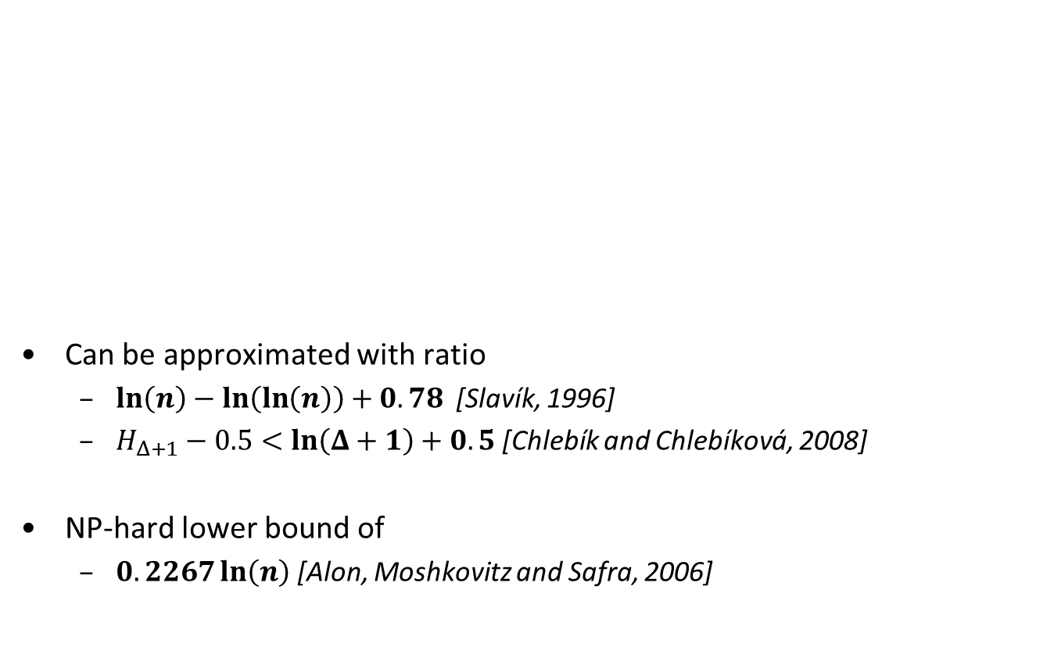
Minimum Dominating Set
Can be approximated with ratio
  $\ln\left(n\right)−\ln\left(\ln\left(n\right)\right)+0.78$[Slavík, 1996]
  $H_{Δ+1}−0.5<ln\left(Δ+1\right)+0.5$ [Chlebík and Chlebíková, 2008]
NP-hard lower bound of
  $0.2267\ln\left(n\right)$ [Alon, Moshkovitz and Safra, 2006]

Slide 3

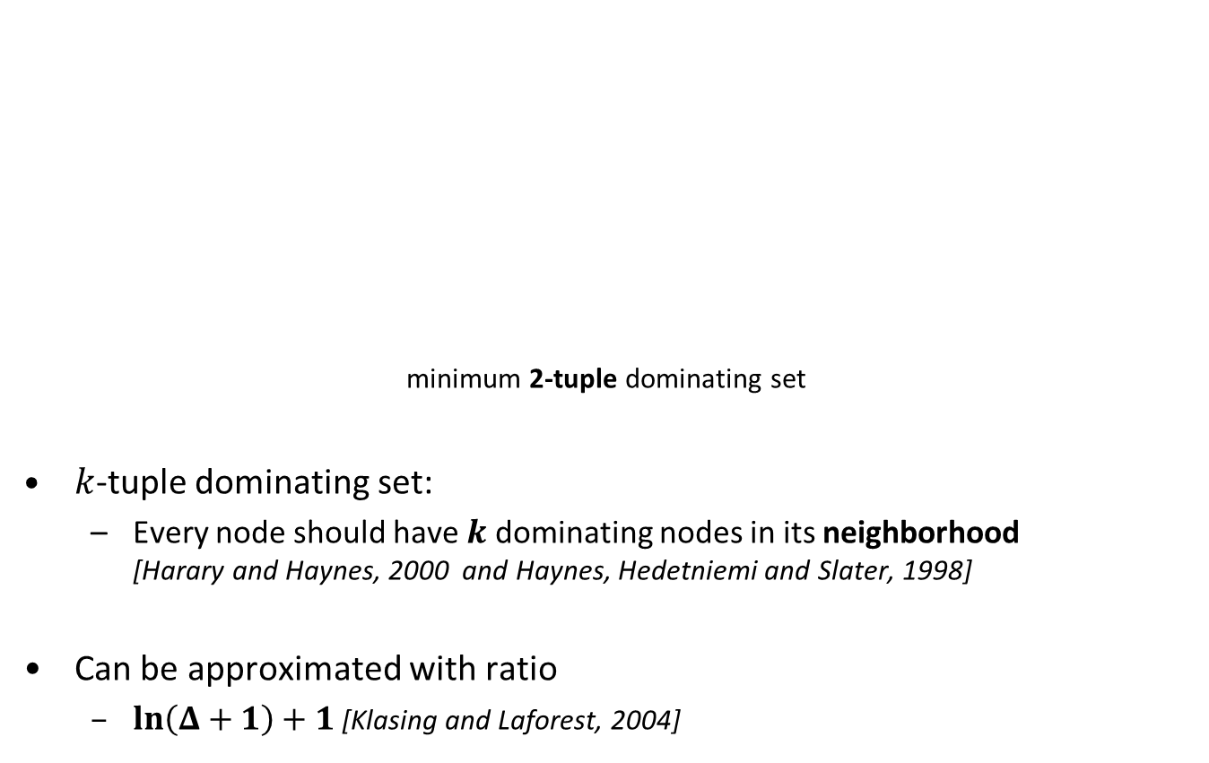
Minimum $k$-tuple Dominating Set
    minimum 2-tuple dominating set
$k$-tuple dominating set:
  Every node should have $k$ dominating nodes in its neighborhood
  [Harary and Haynes, 2000 and Haynes, Hedetniemi and Slater, 1998]
Can be approximated with ratio
  $\ln\left(Δ+1\right)+1$[Klasing and Laforest, 2004]

Slide 4
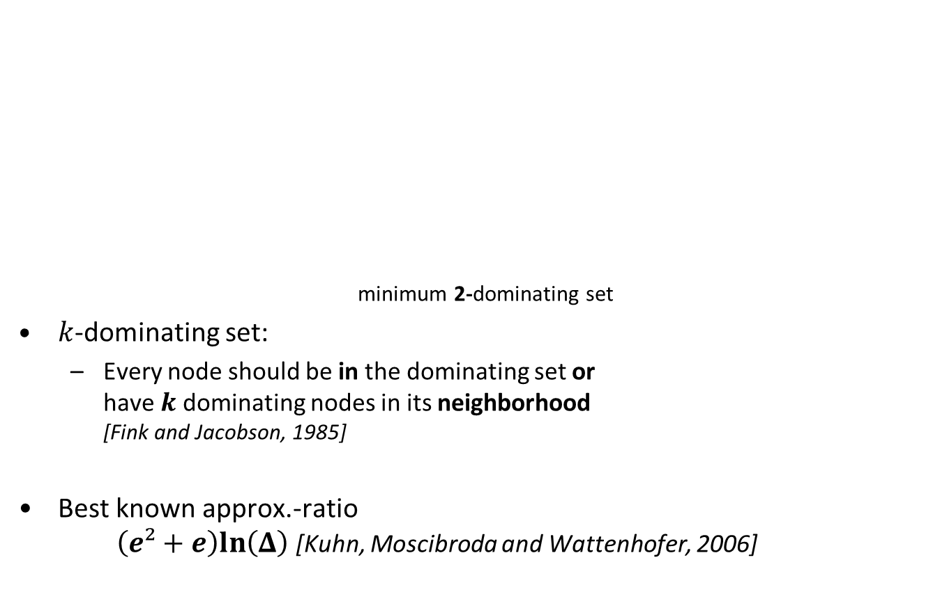
Minimum $k$-Dominating Set
    minimum 2-dominating set
$k$-dominating set:
  Every node should be in the dominating set or
  have $k$ dominating nodes in its neighborhood
  [Fink and Jacobson, 1985]
Best known approx.-ratio
$\left(e²+e\right)ln\left(Δ\right)$[Kuhn, Moscibroda and Wattenhofer, 2006]

Slide 5
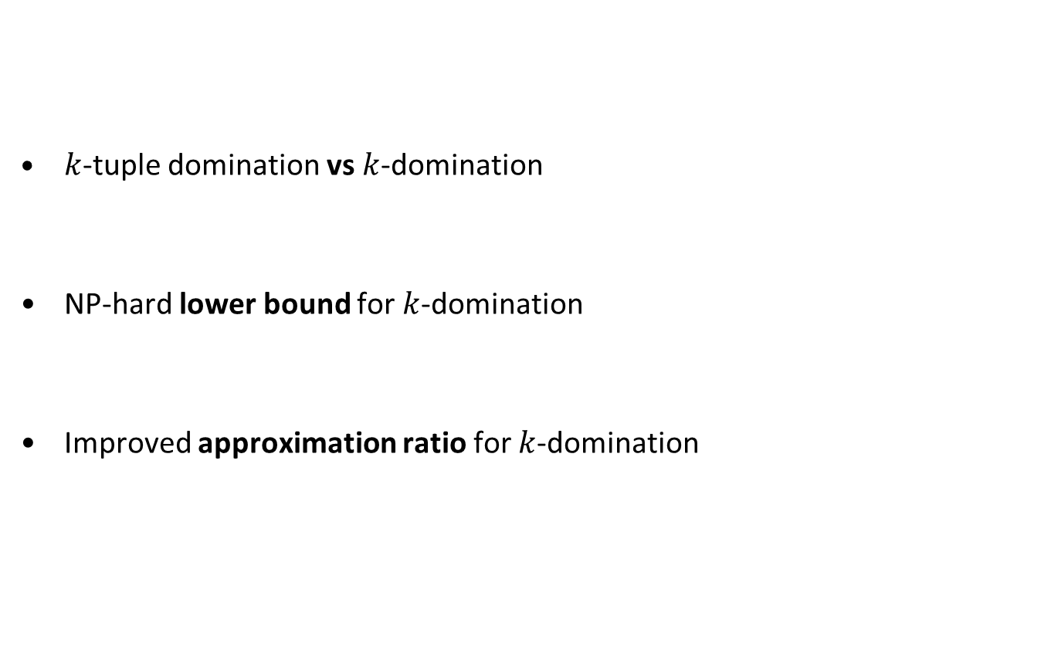
Overview of the remaining Talk
$k$-tuple domination vs $k$-domination
NP-hard lower bound for $k$-domination
Improved approximation ratio for $k$-domination

Slide 6
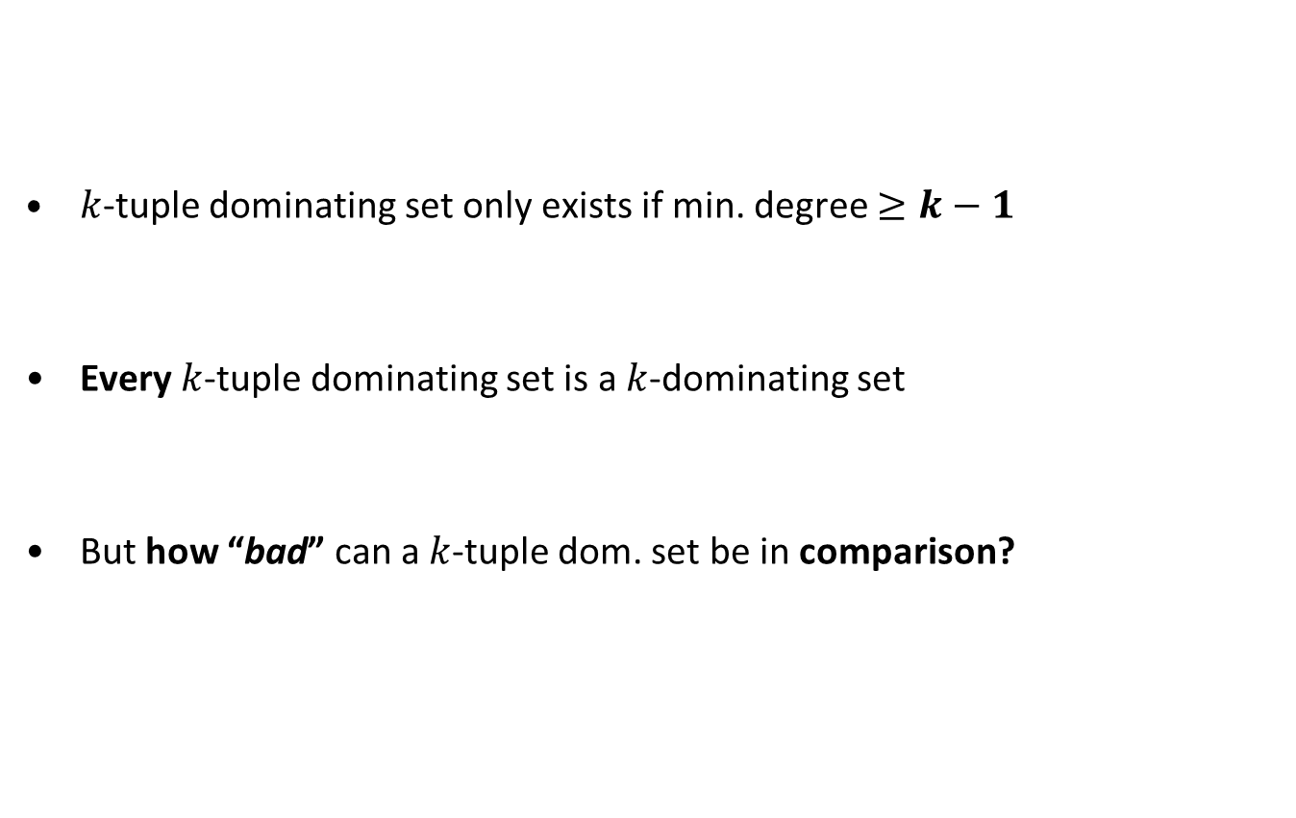
$k$-tuple Domination versus $k$-Domination
$k$-tuple dominating set only exists if min. degree $≥k−1$
Every $k$-tuple dominating set is a $k$-dominating set
But how “bad” can a $k$-tuple dom. set be in comparison?

Slide 7
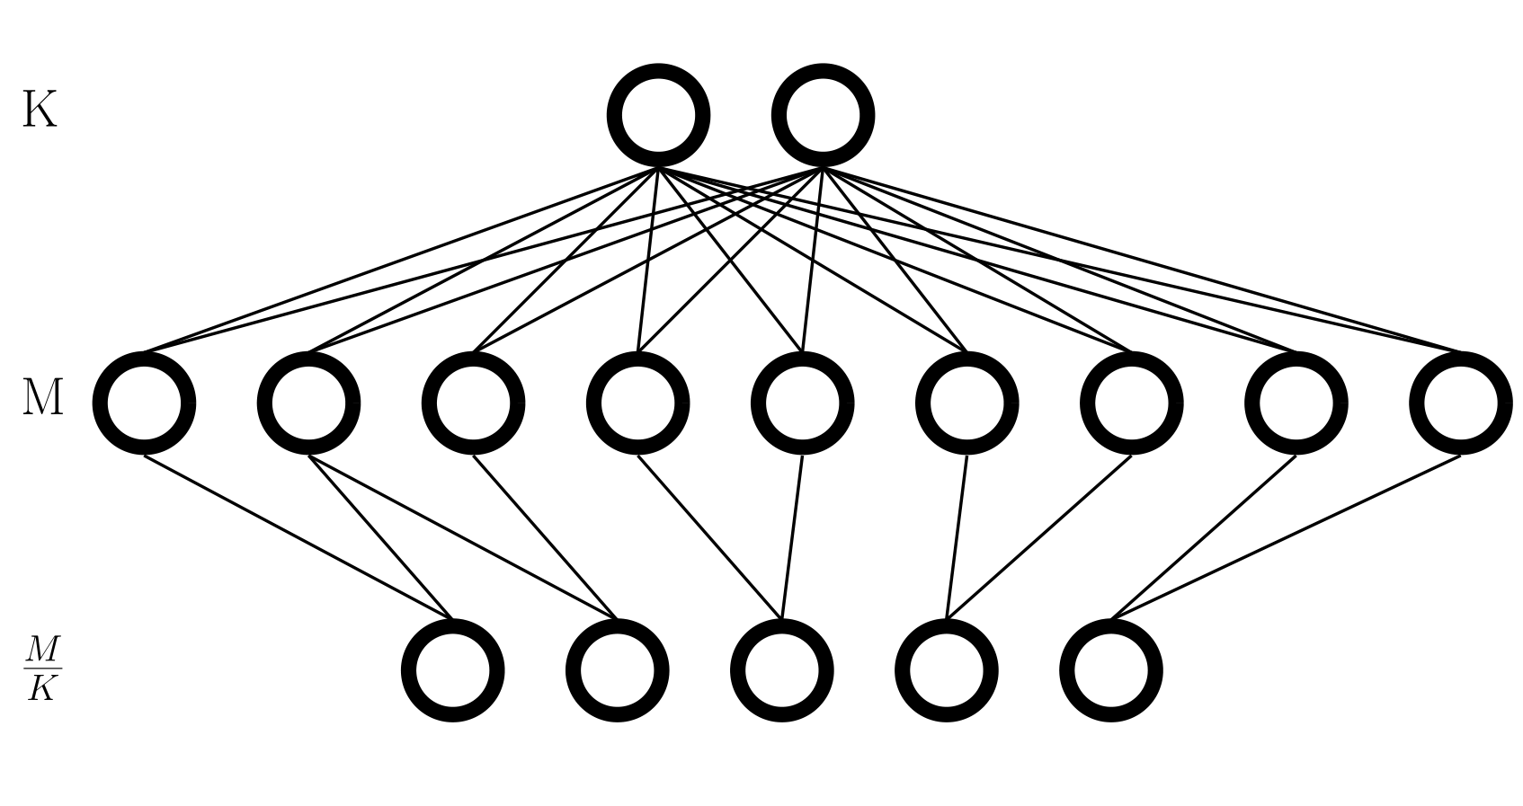
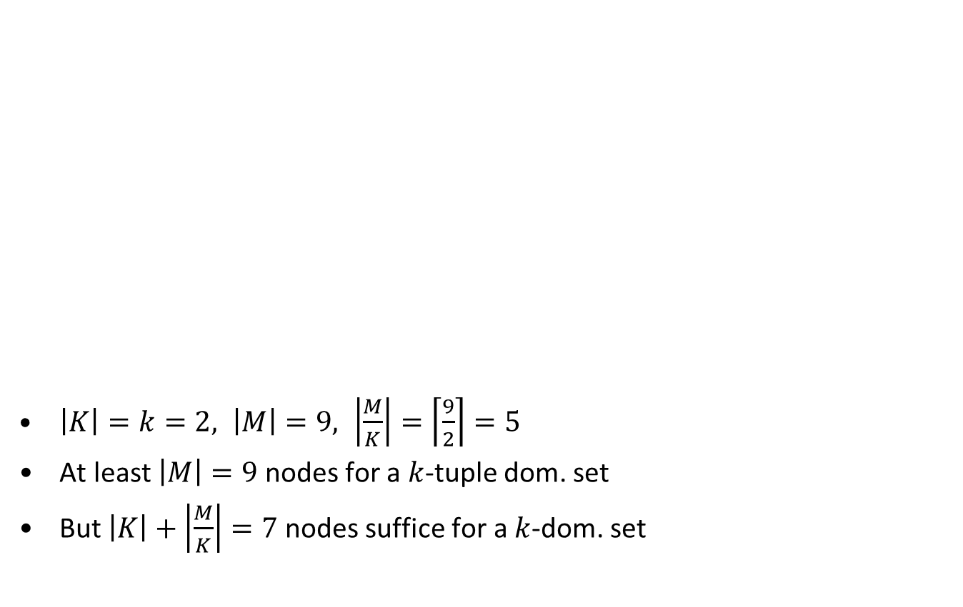
$k$-tuple Domination versus $k$-Domination: With $k$= 2
$\left|K\right|=k=2, \left|M\right|=9, \left|\frac{M}{K}\right|=\left\lceil \frac{9}{2}\right\rceil =5$
At least $\left|M\right|=9$ nodes for a $k$-tuple dom. set
But $\left|K\right|+\left|\frac{M}{K}\right|=7$ nodes suffice for a $k$-dom. set

Slide 8
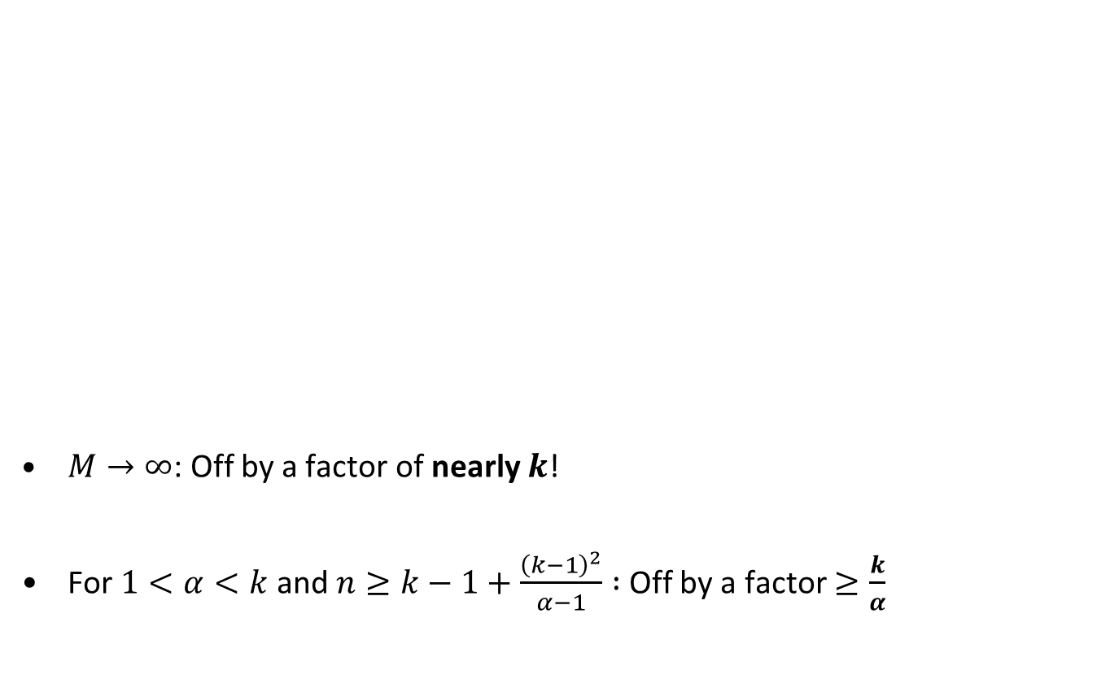
$k$-tuple Domination versus $k$-Domination
$M→∞$: Off by a factor of nearly $k$!
For $1<α<k$ and $n≥k−1+\frac{{\left(k−1\right)}^{2}}{α−1} :$Off by a factor $≥\frac{k}{α}$
(tight)

Slide 9
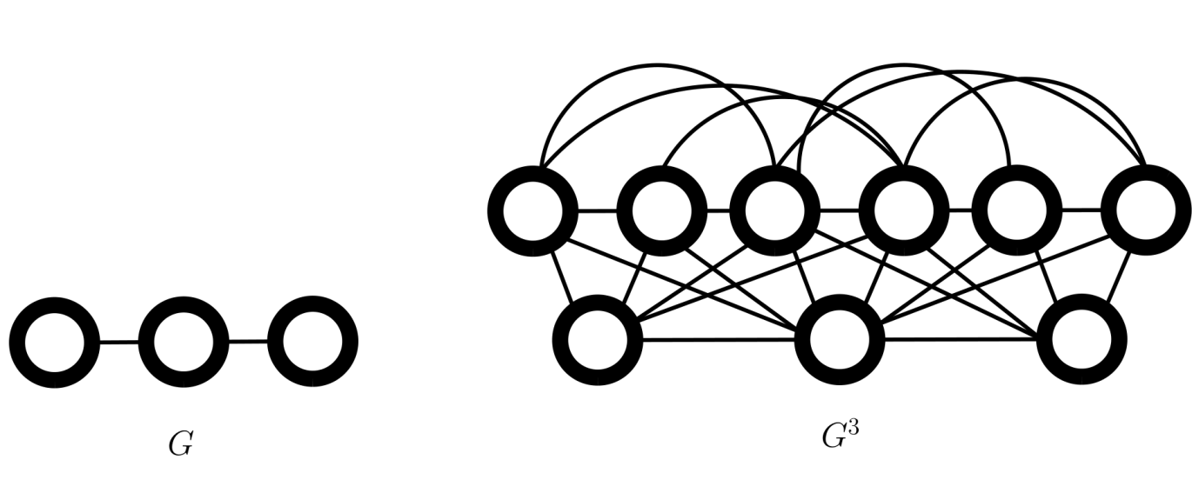
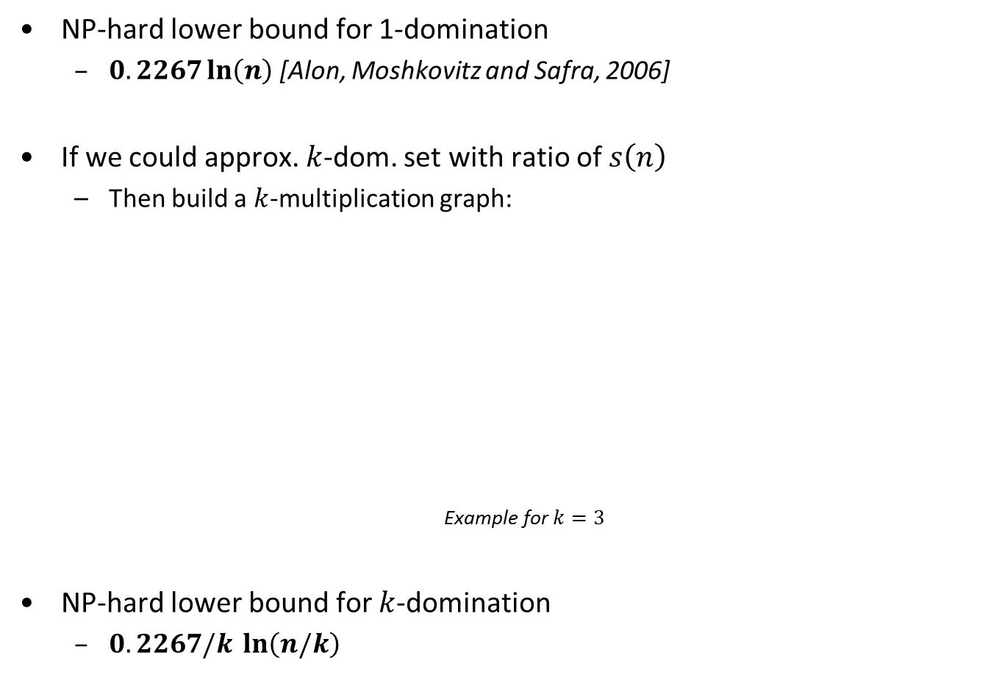
$$\text{NP}\text{−}\text{hard} \text{lower} \text{bound} \text{for} k\text{−}\text{domination}$$
NP-hard lower bound for 1-domination
  $0.2267\ln\left(n\right)$ [Alon, Moshkovitz and Safra, 2006]
If we could approx. $k$-dom. set with ratio of $s\left(n\right)$
  Then build a $k$-multiplication graph:
  Example for $k=3$
NP-hard lower bound for $k$-domination
  $0.2267/k\ln\left(n/k\right)$

Slide 10
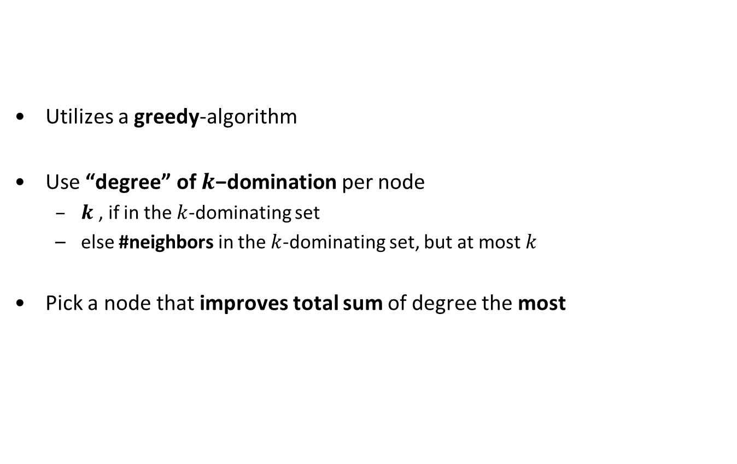
$$\text{Improved} \text{approximation} \text{ratio} \text{for} k\text{−}\text{domination}$$
Utilizes a greedy-algorithm
Use “degree” of $k\text{−}\text{domination}$ per node
  $k$ , if in the $k$-dominating set
  else #neighbors in the $k$-dominating set, but at most $k$
Pick a node that improves total sum of degree the most

Slide 11
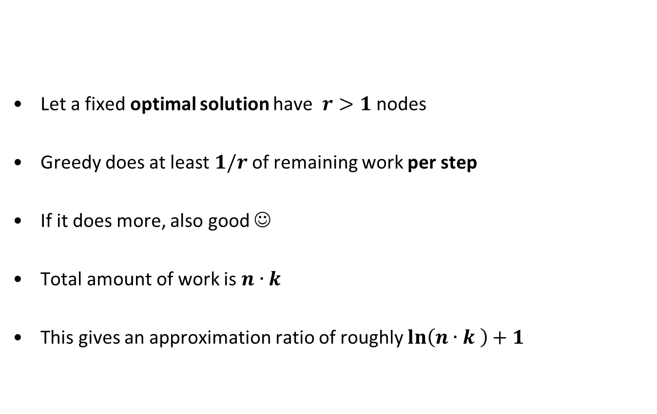
When does the Greedy Algorithm finish?
Let a fixed optimal solution have $r>1$ nodes
Greedy does at least $1/r$ of remaining work per step
If it does more, also good ☺
Total amount of work is $n∙k$
This gives an approximation ratio of roughly $\ln\left(n∙k \right)+1$

Slide 12
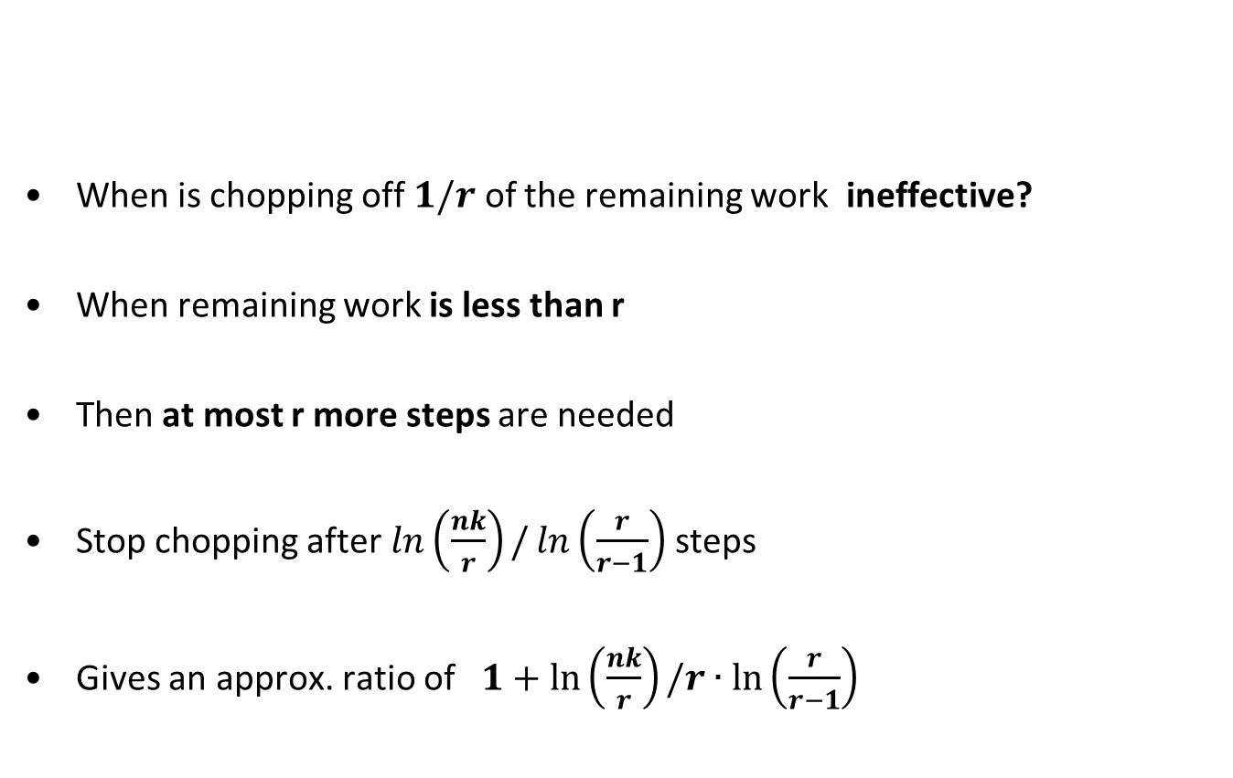
When to stop when chopping off…
When is chopping off $1/r$ of the remaining work ineffective?
When remaining work is less than r
Then at most r more steps are needed
Stop chopping after $\ln\left(\frac{nk}{r}\right)/\ln\left(\frac{r}{r−1}\right)$ steps
Gives an approx. ratio of$1+ln\left(\frac{nk}{r}\right)/r∙\ln\left(\frac{r}{r−1}\right)$

Slide 13
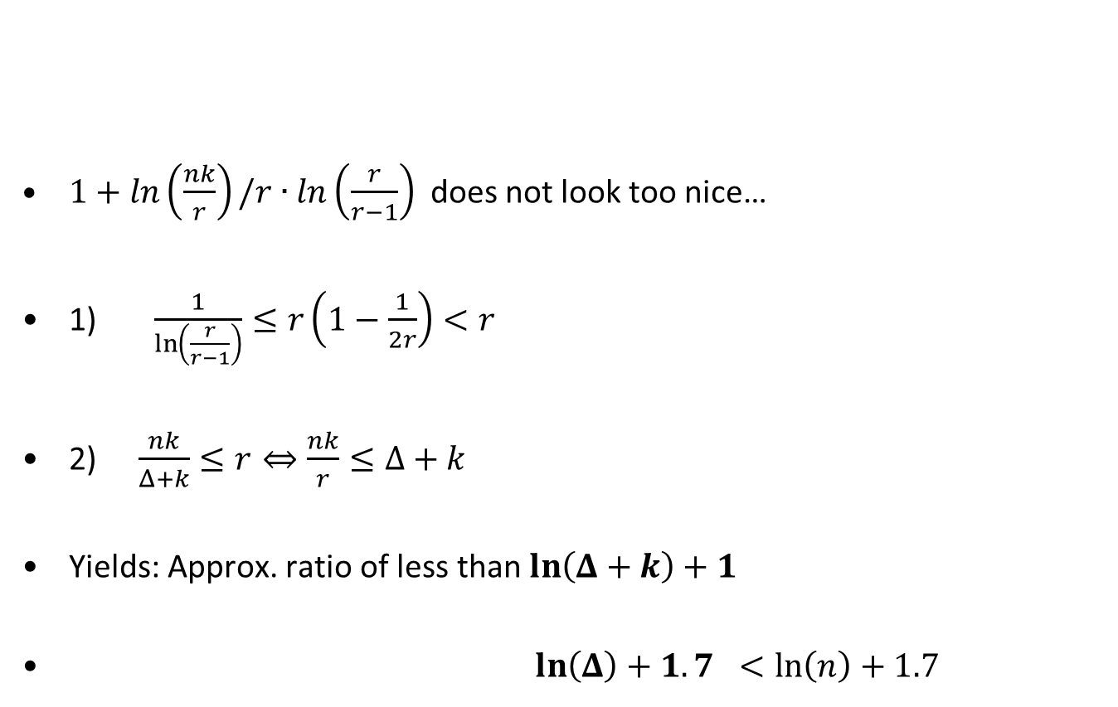
Calculating the approximation ratio
$1+ln\left(\frac{nk}{r}\right)/r∙\ln\left(\frac{r}{r−1}\right)$ does not look too nice…
1) $\frac{1}{\ln\left(\frac{r}{r−1}\right)}≤r\left(1−\frac{1}{2r}\right)<r$
2) $\frac{nk}{Δ+k}≤r⇔\frac{nk}{r}≤Δ+k$
Yields: Approx. ratio of less than $\ln\left(Δ+k\right)+1$
$\ln\left(Δ\right)+1.7 <\ln\left(n\right)+1.7$

Slide 14
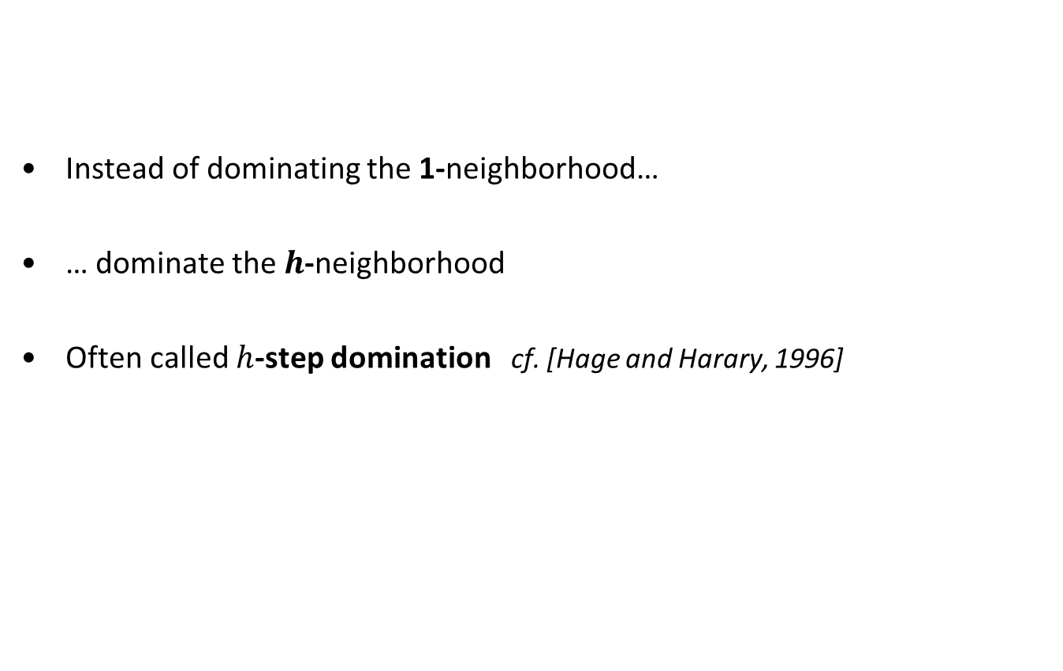
Extending the Domination Range
Instead of dominating the 1-neighborhood…
… dominate the $h$-neighborhood
Often called $h$-step domination cf. [Hage and Harary, 1996]

Slide 15
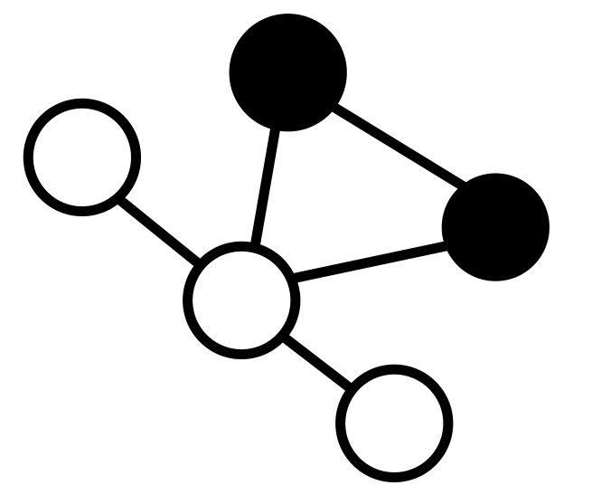
Extending the Domination Range
The black nodes form a 2-step dominating set
But not a 2-step 2-dominating set !

Slide 16
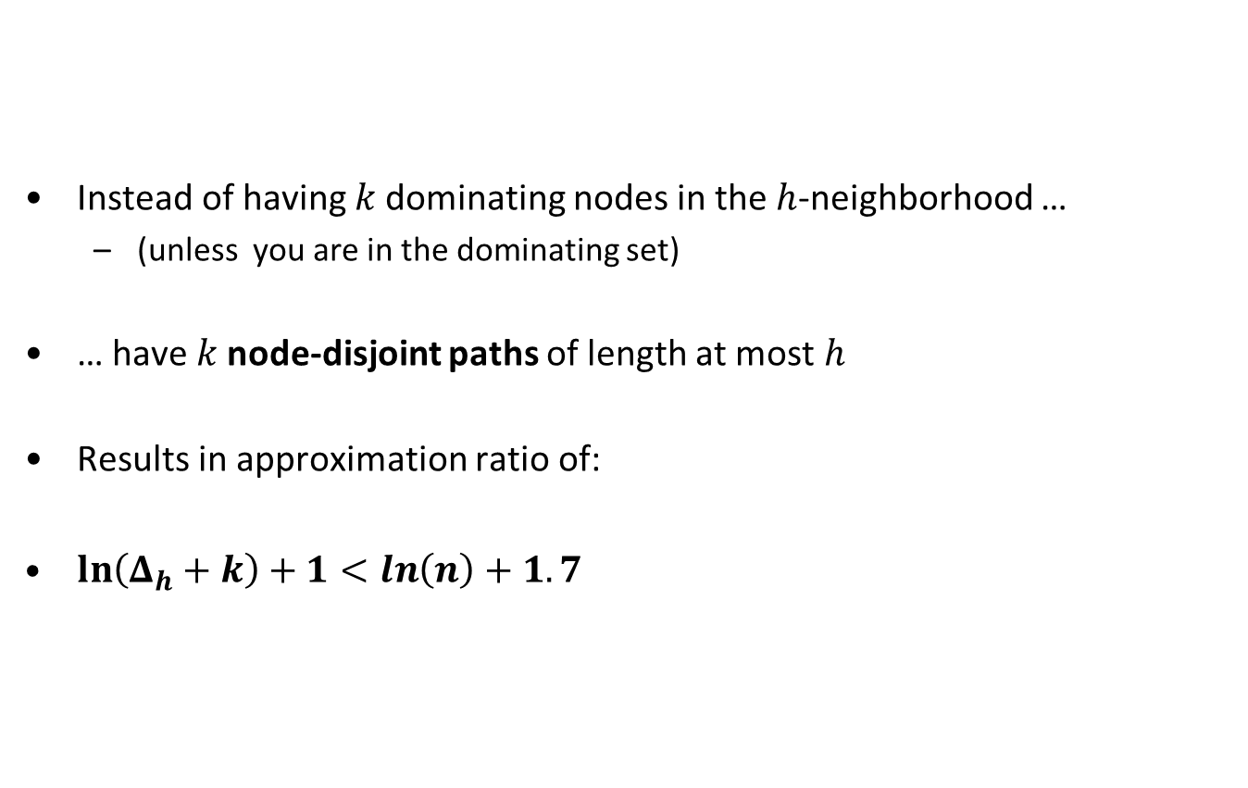
Extending the Domination Range
Instead of having $k$ dominating nodes in the $h$-neighborhood …
  (unless you are in the dominating set)
… have $k$ node-disjoint paths of length at most $h$
Results in approximation ratio of:
$\ln\left(Δ_{h}+k\right)+1<\ln\left(n\right)+1.7$

Slide 17
Thank you

