Slide 1
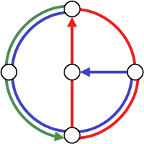
Manipulation in Games
Raphael Eidenbenz
Yvonne Anne Oswald
Stefan Schmid
Roger Wattenhofer
Distributed
Computing
Group
ISAAC 2007
Sendai, Japan
December 2007
Notes:
Hi. This talk is on how to manipulate players in economic games.
It is joint work with...

Slide 2
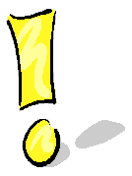
Manipulation in Games
Raphael Eidenbenz
Yvonne Anne Oswald
Stefan Schmid
Roger Wattenhofer
also present
at the conference
Distributed
Computing
Group
ISAAC 2007
Sendai, Japan
December 2007

Slide 3
Manipulation in Games
Raphael Eidenbenz
Yvonne Anne Oswald
Stefan Schmid
Roger Wattenhofer
also present
at the conference
Distributed
Computing
Group
ISAAC 2007
Sendai, Japan
December 2007

Slide 4
Extended Prisoners’ Dilemma (1)
A bimatrix game with two bank robbers
- A bank robbery (unsure, video tape) and a minor crime (sure, DNA)
- Players are interrogated independently
Robber 2
silent
testify
confess
silent
3 3
0 4
0 0
Robber 1
testify
4 0
1 1
0 0
confess
0 0
0 0
0 0

Slide 5
Extended Prisoners’ Dilemma (2)
A bimatrix game with two bank robbers
Robber 2
silent
testify
confess
silent
3 3
0 4
0 0
Payoff = number of saved
years in prison
Robber 1
testify
4 0
1 1
0 0
confess
0 0
0 0
0 0
Silent = Deny bank robbery
Testify = Betray other player (provide evidence of other player‘s bankrobbery)
Confess = Confess bank robbery (prove that they acted together)

Slide 6
Extended Prisoners’ Dilemma (3)
Concept of non-dominated strategies
Robber 2
silent
testify
confess
silent
3 3
0 4
0 0
dominated by „testify“
Robber 1
testify
4 0
1 1
0 0
non-dominated strategy
confess
0 0
0 0
0 0
dominated by „silent“ and „testify“
non-dominated strategy profile
Non-dominated strategy may not be unique!
In this talk, we use weakest assumption that players choose any
non-dominated strategy. (here: both will testify)
Notes:
Assumptions:
- Players do not know other player‘s payoff!!
- Gives lower bound for potential of manipulation: e.g., considering only (non-appropriate!) Nash equilibria gives only better potentials!

Slide 7
Mechanism Design by Al Capone (1)
Hence: both players testify = go 3 years to prison each.
Robber 2
silent
testify
confess
silent
3 3
0 4
0 0
Robber 1
testify
4 0
1 1
0 0
confess
0 0
0 0
0 0
Not good for gangsters‘ boss Al Capone!
- Reason: Employees in prison!
- Goal: Influence their decisions
- Means: Promising certain payments for certain outcomes!

Slide 8
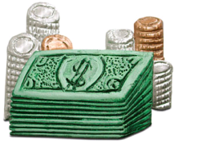
Mechanism Design by Al Capone (2)
s
t
c
s
3 3
0 4
0 0
New non-dominated
strategy profile!
Al Capone has to pay money
worth 2 years in prison, but saves
4 years for his employees!
Net gain: 2 years!
t
4 0
1 1
0 0
Original game G...
c
0 0
0 0
0 0
s
t
c
+
s
1 1
2 0
... plus Al Capone‘s
monetary promises V ...
t
0 2
c
s
t
c
s
4 4
2 4
0 0
=
... yields new game G(V)!
t
4 2
1 1
0 0
c
0 0
0 0
0 0

Slide 9
Al Capone can save his employees 4 years in prison
at low costs!
Can the police do a similar trick to increase the total
number of years the employees spend in prison?

Slide 10
Mechanism Design by the Police
s
t
c
s
3 3
0 4
0 0
New non-dominated
strategy profile!
Both robbers will confess
and go to jail for four years
each! Police does not have to
pay anything at all!
Net gain: 2
t
4 0
1 1
0 0
Original game G...
c
0 0
0 0
0 0
s
t
c
+
s
0 5
... plus the police‘
monetary promises V ...
t
0 2
c
5 0
2 0
s
t
c
s
3 3
0 4
0 5
=
... yields new game G(V)!
t
4 0
1 1
0 2
c
5 0
2 0
0 0

Slide 11


Definition:
Strategy profile implemented by Al Capone has
leverage (potential) of two: at the cost of money
worth 2 years in prison, the players in the game
are better off by 4 years in prison.
Strategy profile implemented by the police has a
malicious leverage of two: at no costs, the players
are worse off by 2 years.
Notes:
So the total game‘s potential is at least these values!!

Slide 12
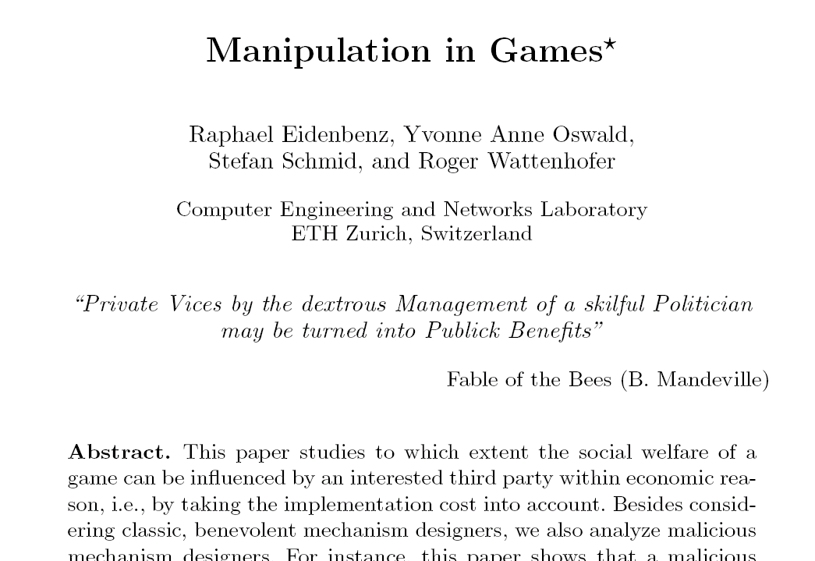

Paper studies the leverage in games = extent to which the players‘ decisions can be manipulated by creditability
  Creditability = the promise of money
For both benevolent as well as malicous mechanism designers
  - Benevolent = improve players‘ situation (i.e., increase social welfare)
  Malicious = make their situation worse!

Slide 13
Talk Overview
Definitions and Models
Overview of Results
Sample result: NP-hardness
Discussion

Slide 14
Talk Overview
Definitions and Models
Overview of Results
Sample result: NP-hardness
Discussion

Slide 15
Exact vs Non-Exact (1)
Goal of a mechanism designer: implement a certain set of strategy profiles at low costs
- I.e., make this set of profiles the (newly) non-dominated set of strategies
Two options: Exact implementation and non-exact implementation
- Exact implementation: All strategy profiles in the target region O are non-dominated
- Non-exact implementation: Only a subset of profiles in the target region O are non-dominated

Slide 16
Exact vs Non-Exact (2)
Player 2
Game G
X* = non-dominated strategies
before manipulation
X*(V) = non-dominated strategies
after manipulation
X*
Player 1
Exact implementation:
X*(V) = O
Non-exact implementation:
X*(V) ½ O
X*(V)
Non-exact implementations can yield larger gains,
as the mechanism designer can
choose which subsets to implement!

Slide 17
Worst-Case vs Uniform Cost
What is the cost of implementing a target region O?
Two different cost models: worst-case implementation cost and uniform implementation cost
- Worst-case implementation cost: Assumes that players end up in the worst (most expensive) non-dominated strategy profile.
- Uniform implementation costs: The implementation costs is the average of the cost over all non-dominated strategy profiles. (All profiles are equally likely.)

Slide 18
Talk Overview
Definitions and Models
Overview of Results
Sample result: NP-hardness
Discussion

Slide 19
Talk Overview
Definitions and Models
Overview of Results
Sample result: NP-hardness
Discussion

Slide 20
Overview of Results
Worst-case leverage
  Polynomial time algorithm for computing leverage of singletons
  Leverage for special games (e.g., zero-sum games)
  Algorithms for general leverage (super polynomial time)
Uniform leverage
  Computing minimal implementation cost is NP-hard (for both exact and non-exact implementations); it cannot be approximated better than Ω(n¢log(|X_{i}*\O_{i}|))
  Computing leverage is also NP-hard and also hard to approximate.
  Polynomial time algorithm for singletons and super-polynomial time algorithms for the general case.

Slide 21
Talk Overview
Definitions and Models
Overview of Results
Sample result: NP-hardness
Discussion

Slide 22
Talk Overview
Definitions and Models
Overview of Results
Sample result: NP-hardness
Discussion

Slide 23
Sample Result: NP-hardness (1)
Theorem: Computing exact uniform
implementation cost is NP-hard.
Reduction from Set Cover: Given a set cover problem instance, we can efficiently construct a game whose minimal exact implementation cost yields a solution to the minimal set cover problem.
As set cover is NP-hard, the uniform implementation cost must also be NP-hard to compute.

Slide 24
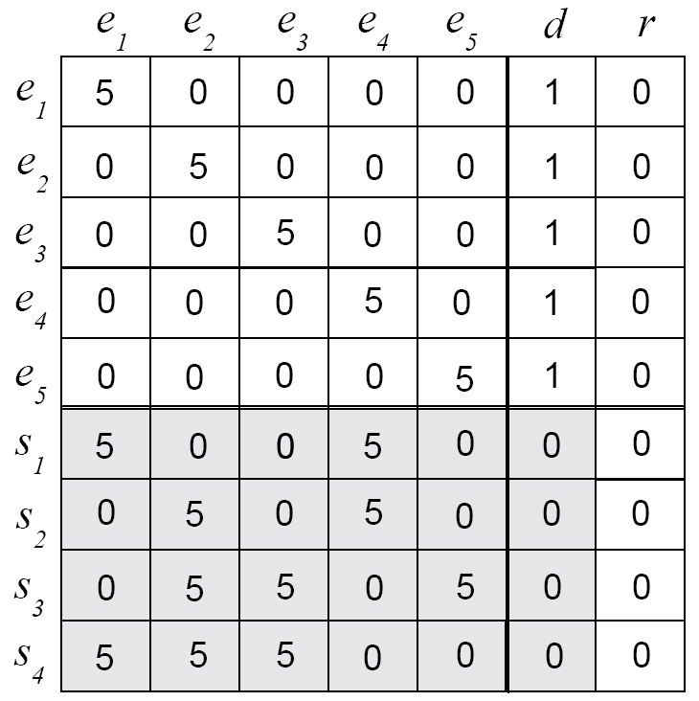
Sample Result: NP-hardness (2)
Sample set cover instance:
universe of elements U = {e₁,e₂,e₃,e₄,e₅}
universe of sets S = {S₁, S₂, S₃,S₄}
where S₁ = {e₁,e₄}, S₂={e₂,e₄}, S₃={e₂,e₃,e₅}, S₄={e₁,e₂,e₃}
elements
Gives game...:
helper cols
Player 2: payoff 1
everywhere except
for column r (payoff 0)
elements
Also works for
more than
two players!
sets

Slide 25
Sample Result: NP-hardness (3)
All 5s (=number of
elements) in diagonal...

Slide 26
Sample Result: NP-hardness (3)
Set has a 5 for
each element it
contains...
(e.g., S₁ = {e₁,e₄})

Slide 27
Sample Result: NP-hardness (3)
Goal: implementing
this region O
exactly at minimal
cost
O

Slide 28
Sample Result: NP-hardness (3)
Originally, all these
strategy profiles are
non-dominated...
X*

Slide 29

Sample Result: NP-hardness (3)
It can be shown that
the minimal cost
implementation only
makes 1-payments
here...
In order to dominate
strategies above, we
have to select minimal
number of sets which
covers all elements!
(minimal set cover)

Slide 30
Sample Result: NP-hardness (3)
A possible solution:
S₂, S₃, S₄
„dominates“ or
„covers“ all
elements above!
Implementation
costs: 3
1
1
1

Slide 31
Sample Result: NP-hardness (3)
A better solution:
cost 2!
1
1

Slide 32
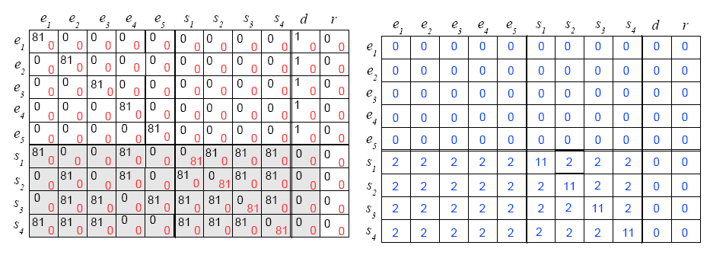
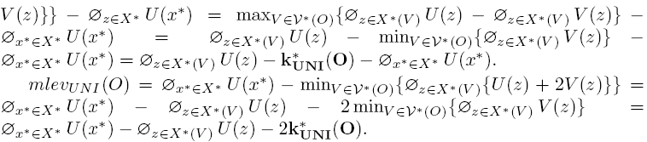
Sample Result: NP-hardness (4)
A similar thing works for non-exact implementations!
From hardness of costs follows hardness of leverage!
Notes:
Exact result does not hold for non-exact cost! Because non-exact cost might be different, it might become cheaper to implement only subset. That‘s why we need another game to show this claim!!

Slide 33
Talk Overview
Definitions and Models
Overview of Results
Sample result: NP-hardness
Discussion

Slide 34
Talk Overview
Definitions and Models
Overview of Results
Sample result: NP-hardness
Discussion

Slide 35
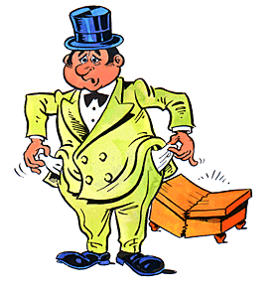
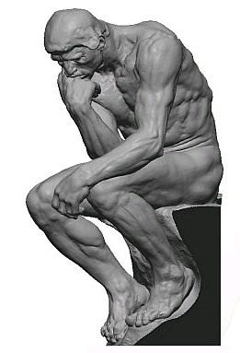
Discussion
Both benevolent and malicious mechanism designers can influence the outcome of games at low costs (sometimes even if they are bankrupt!)
Finding the leverage (or potential) of desired regions is often computationally hard.
Many interesting threads for future research!
  NP-hardness for worst-case implementation cost?
  Approximation algorithms for costs and leverage?
  Mixed (randomized) strategies?
  Test in practice? ☺

Slide 36
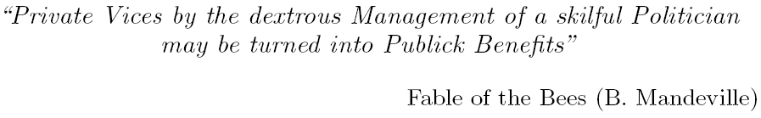
Thank you for
your interest!
Notes:
ASSUMPTIONS:
- Players do not know other player‘s payoff!!
- Gives lower bound for potential of manipulation: e.g., considering only (non-appropriate!) Nash equilibria gives only better potentials!
- Another reasonable assumption would be to consider only dominant strategies. Nash makes less sense. But there are not always dominant strategies!
WHY NP-HARDNESS OF EXACT CASE DOES NOT IMPLY NON-EXACT HARDNESS?
Exact result does not hold for non-exact cost! Because non-exact cost might be different, it might become cheaper to implement only subset. That‘s why we need another game to show this claim!!
WORST-CASE HARDER?
The difficulty of worst-case hardness is that we only have one field where the cost occurs, unlike in the uniform case. So SETCOVER reduction does not work. However, actually, it has been tried to use reduction from SATISFIABILITY. However, the proof by Monderer and Tennenholtz is wrong, and we could not fix it. We conjecture that it is also NP-hard!!
POTENTIAL OF ENTIRE GAMES?
No matter what they will play, goal is just to maximize social welfare at low costs or so? Our results also apply here, just make O the entire game. However, exact case needs additional assumptions and so we cannot say much (-> future research!). But why should exact be interesting? Non-exact should work – the algorithms, but maybe not NP-hardness as we have only subset of profiles in O. We need to think about that in more detail.

Slide 37
Extra Slides…

Slide 38
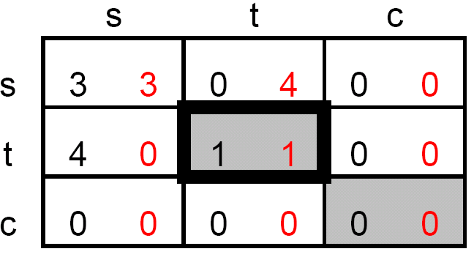
Q&A (1)
Assumptions
Players do not know about other players‘ payoffs.
Choice of non-dominated strategies: weakest reasonable assumption
Alternatives: Nash equilibria (NEs can be outside „non-dominated region“, but not a meaningful solution concept for „one shot games“ => implementing a good NE could be a goal for the designer as players will remain with their choices!), dominant strategies (do not always exist? => could be goal of mechanism though!!), etc.
Worst-case leverage?
Hardness more difficult: Only one profile counts! No easy reduction from Set Cover.
But maybe SAT? -> See Monderer and Tennenholtz!
Related Work?
Monderer and Tennenholtz: „k-Implementation“. EC 2003
Eidenbenz, Oswald, Schmid, Wattenhofer: „Mechanism Design by Creditability“. COCOA 2007
Nash Equlibria

Slide 39
Q&A (2)
Exact hardness -> non-exact hardness?
Non-exact implementation might be cheaper and look different! (cannot prove that payments are only „1“s in that column)
Need other game!
Potential of Entire Games
I.e.: No goal of what the players do, just maximize / minimize overall efficiency / potential
Our algorithms also applicable! Exact case however needs extra column. Exact interesting?
NP-hardness proof may not hold for these special Os! (In our reduction, O is only subset!)
Malicious Mechanism Designer?
- Initial motivation: Monderer et al. only gave „positive example“, kind of „insurance“; but also works here!
COCOA Results
No notion of potential: Only implementation cost, does not consider gain!
Characterization of 0-implementable games (e.g., Nash equilibria)
Algorithms for cost (exact ones and heuristics)
Error in Monderer et al.‘s hardness proof
Other models of players‘ rationality, e.g., risk-averse
Dynamic games

Slide 40
Q&A (3)
Monderer and Tennenholtz, EC 2003
K-implementation
Complete information and incomplete information games (combinatorial auction / VCG games), including study of mixed strategies
Complete information (our model!): Polynomial time algo for exact costs, and NP-hardness proof for non-exact case (wrong)
Incomplete information = Mechanism designer does not see players‘ types!

Slide 41
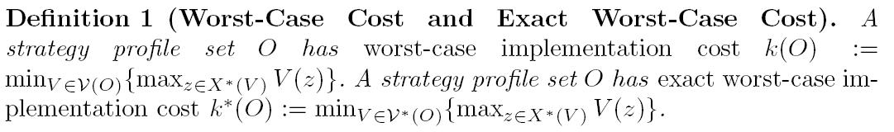
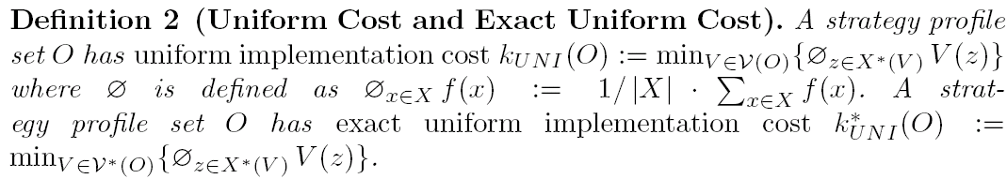
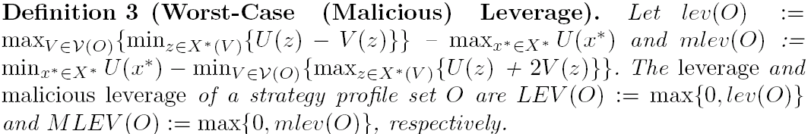
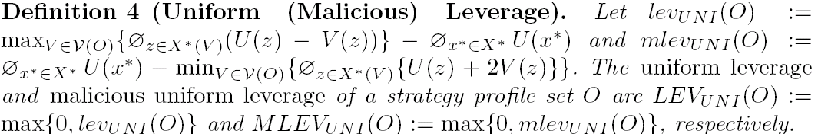
Definitions
Subtracted twice, as money spent
on players is considered a loss!

Slide 42
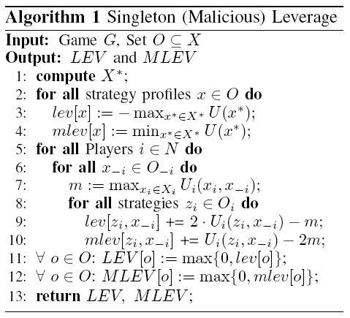
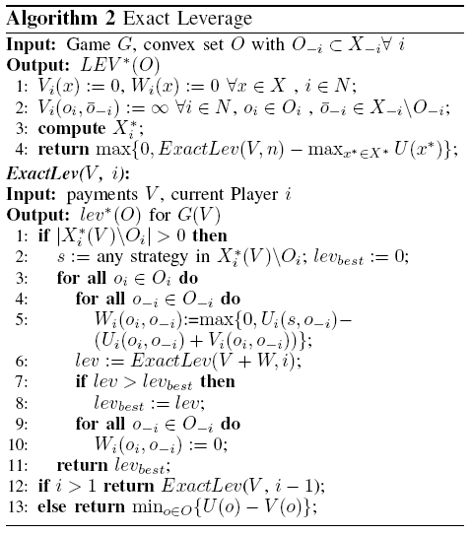
Algorithms

Slide 43
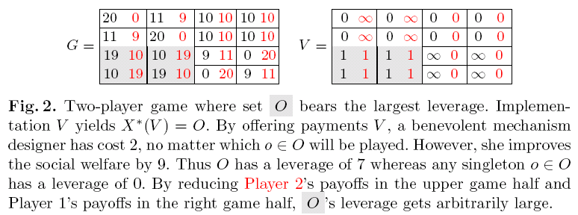
O Wins (Worst-case Cost)
Sometimes implementing a singleton is not optimal!
- Exact implementation costs 2, for all possible outcomes
- Singleton is more expensive: e.g., profile (3,1) costs
1 (Player 1) + 10 (Player 2), but new social welfare is the same as in exact case!

Slide 44
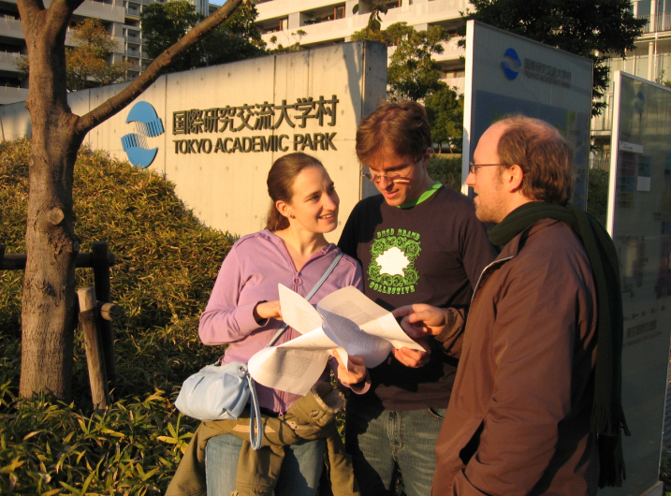
Authors at Conference...
Yvonne Anne Oswald
Raphael
Eidenbenz
Stefan
Schmid

