Slide 1
Cyclic Arbitrage in Decentralized Exchange Markets
Ye Wang, Yan Chen, Shuiguang Deng, Roger Wattenhofer
ETH Zurich
Zhejiang University

Slide 2
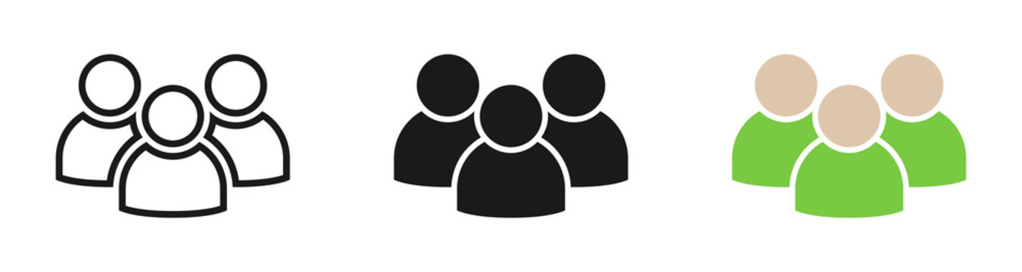
Decentralized Exchanges
DEX
Smart
Contracts
On-chain Exchanges
Between Accounts
Buy/Sell
Orders
Buy/Sell
Orders
Buy/Sell
Orders

Slide 3


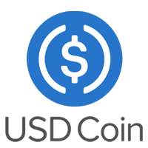

Decentralized Exchanges
Uniswap V1
Uniswap V2

Slide 4




Cyclic Arbitrage
283.709…
USDT
285.71 USDC
0xfea39…
303.68… USDC
2.13…
Seal
1.55…
KP3R
Transaction 0xcf70944a…

Slide 5
Cyclic Arbitrage
Why there exist cyclic arbitrage opportunities?
How frequently cyclic arbitrage happens?
What are the revenue and cost of cyclic arbitrage?

Slide 6
Cyclic Arbitrage
Why there exist cyclic arbitrage opportunities?
How frequently cyclic arbitrage happens?
What are the revenue and cost of cyclic arbitrage?

Slide 7
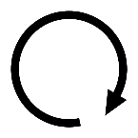
Cyclic Arbitrage
3,720 WBTC
13.396 WBTC
3,720 WBTC
13.396 WBTC
118,107 ETH
658,796 USDT
118,107 ETH
658,796 USDT
57,374 ETH
88,638,132 USDT
57,374 ETH
88,638,132 USDT
ETH→WBTC →USDT →ETH
ETH→ USDT → WBTC →ETH

Slide 8
Unbalanced Exchange Rates
3,720 WBTC
13.396 WBTC
3,720 WBTC
13.396 WBTC
118,107 ETH
658,796 USDT
118,107 ETH
658,796 USDT
57,374 ETH
88,638,132 USDT
57,374 ETH
88,638,132 USDT
ETH→WBTC →USDT →ETH
ETH→ USDT → WBTC →ETH
$$Exchange rate=\frac{3720}{118107}×\frac{658796}{13.396}×\frac{57374}{88638132}=1.0026$$
$$Exchange rate=\frac{88638132}{57374}×\frac{13.396}{658796}×\frac{118107}{3720}=0.9974$$

Slide 9
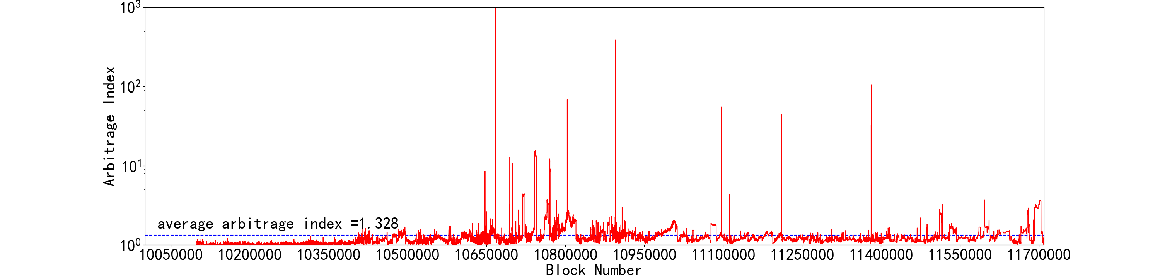
Unbalanced Exchange Rates

Slide 10
Transaction Fees
3,720 WBTC
13.396 WBTC
118,107 ETH
658,796 USDT
57,374 ETH
88,638,132 USDT
$$Exchange rate=\frac{3720}{118107}×\frac{658796}{13.396}×\frac{57374}{88638132}=1.0026≤{1.003}^{3}$$

Slide 11
Cyclic Arbitrage
Why there exist cyclic arbitrage opportunities?
How frequently cyclic arbitrage happens?
What are the revenue and cost of cyclic arbitrage?

Slide 12
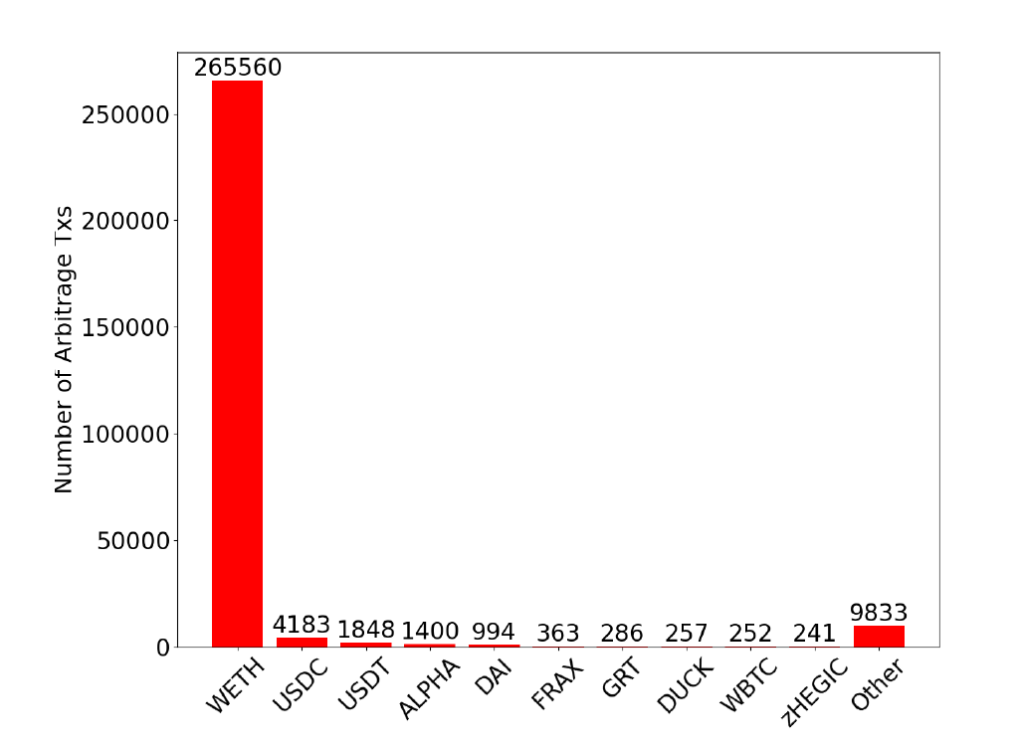
Cyclic Arbitrage

Slide 13
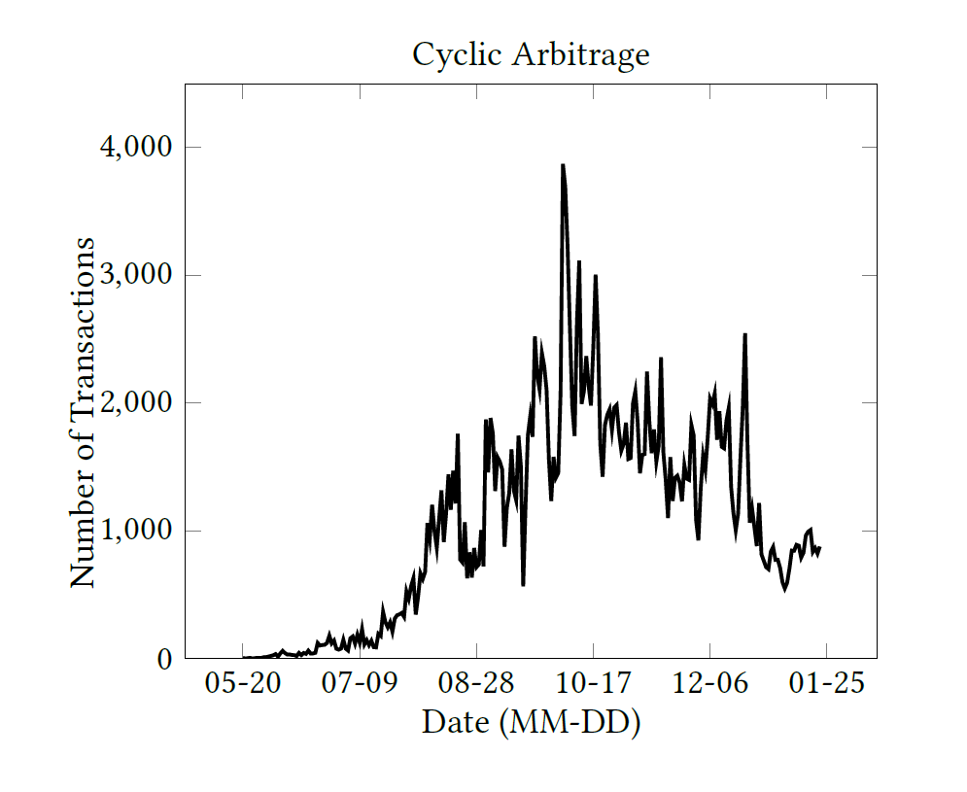
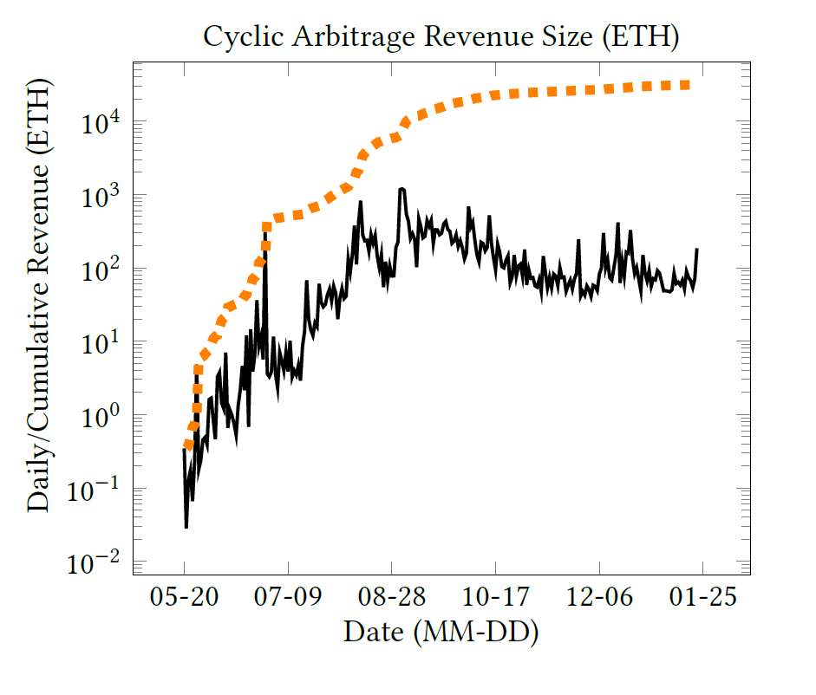
Cyclic Arbitrage – Market Size

Slide 14
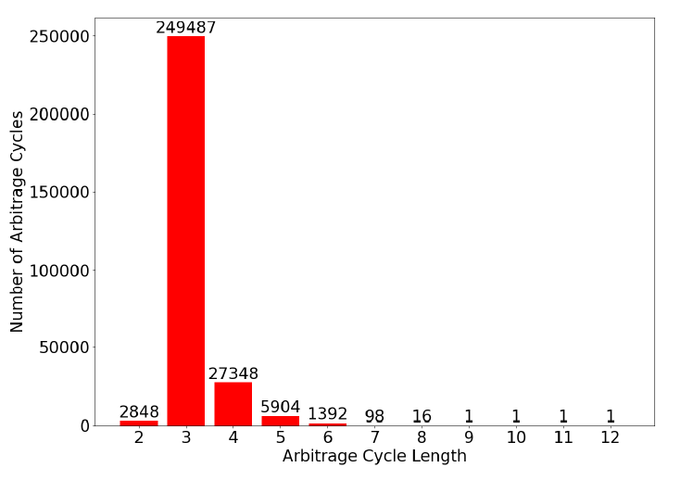
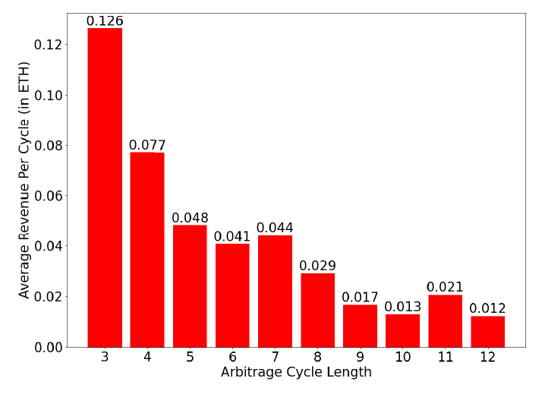
Cyclic Arbitrage – Single Cycle

Slide 15
Cyclic Arbitrage
Why there exist cyclic arbitrage opportunities?
How frequently cyclic arbitrage happens?
What are the revenue and cost of cyclic arbitrage?

Slide 16
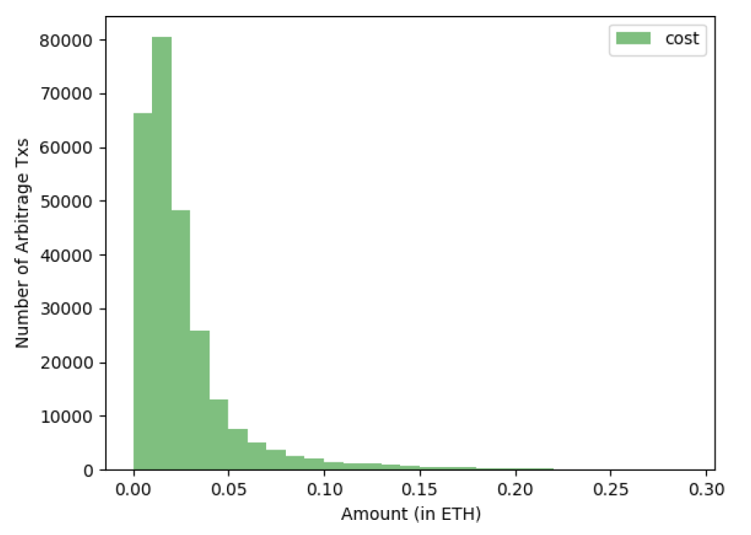
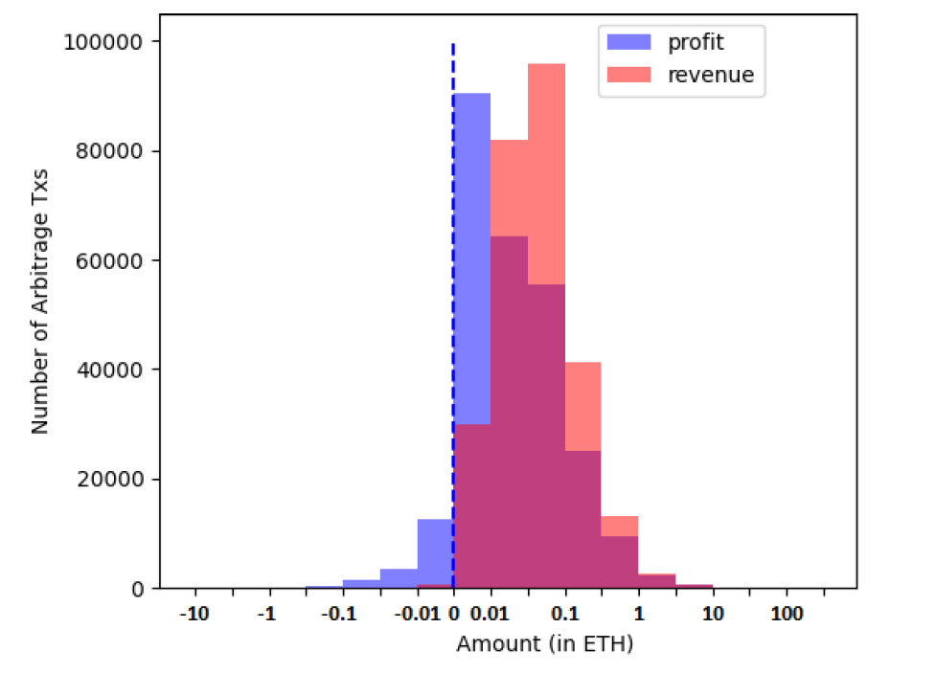
Revenue, Cost, and Profit

Slide 17
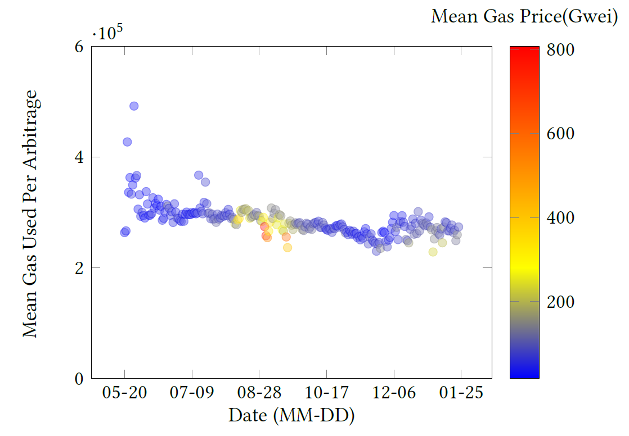
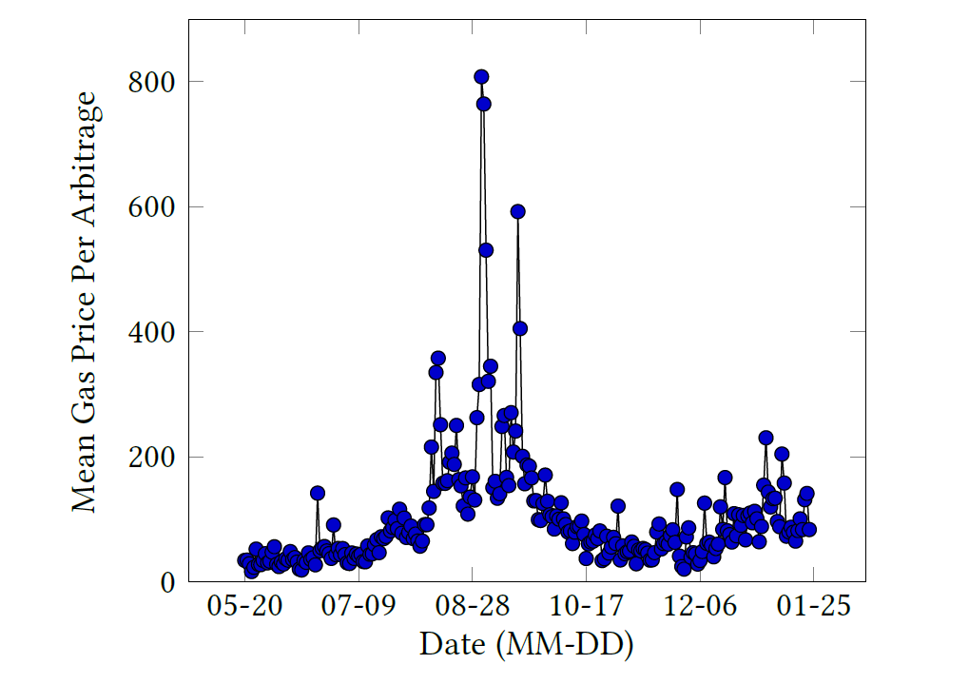
Gas Fee

Slide 18
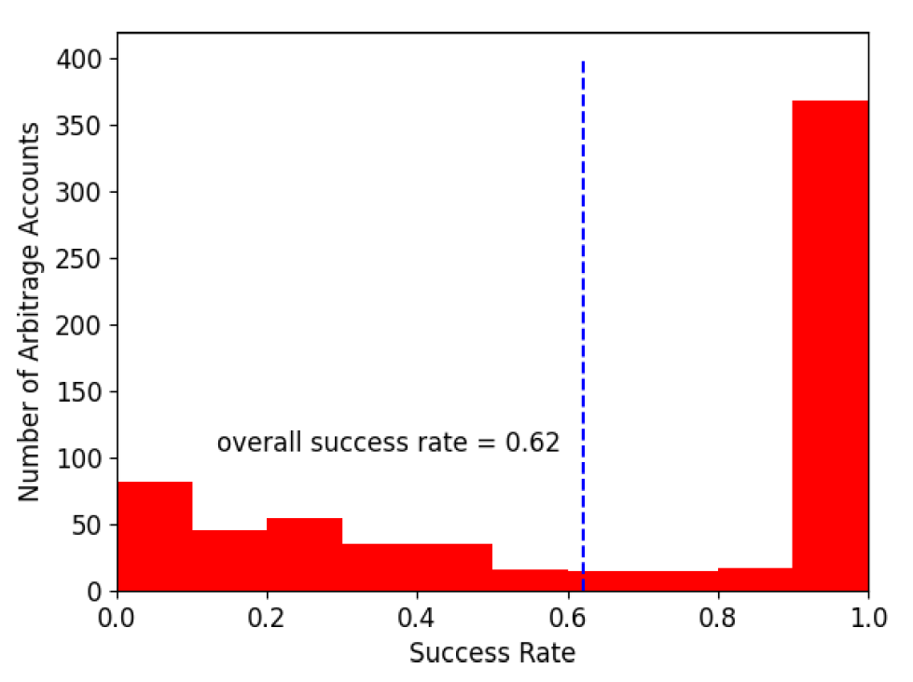
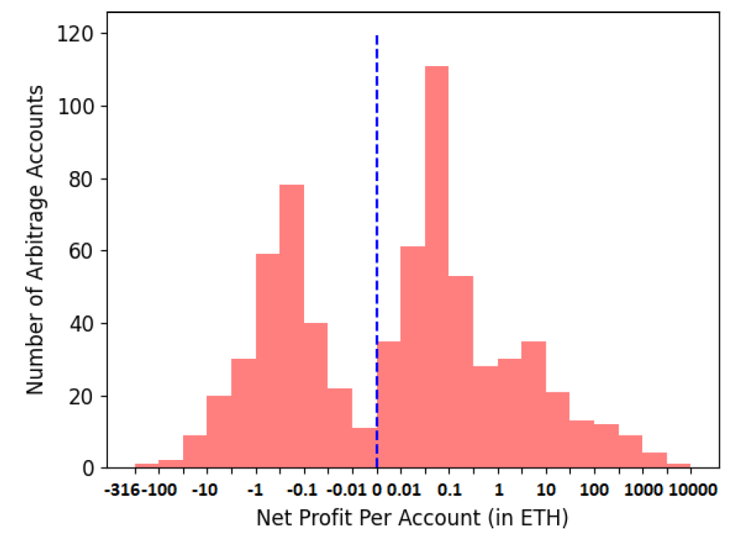
Failed Transactions

Slide 19
Thanks!
Questions & Comments?
Speaker: Ye Wang
ETH Zurich

