Slide 1
Augmenting Anycast Network Flows
Sebastian Brandt, Klaus-Tycho Förster, Roger Wattenhofer
January 06, 2016 @ ICDCN 2016 - Singapore

Slide 2
Motivation
t
size of each flow: 1
capacity of links: 1

Slide 3
Motivation
t
size of each flow: 1
capacity of links: 1

Slide 4

Motivation
t
size of each flow: 1
capacity of links: 1

Slide 5
Network Updates
The Internet: Designed for selfish participants
  Often inefficient (low utilization of links), but robust
But what happens if the WAN is controlled by a single entity?
  Examples: Microsoft & Amazon & Google …
  They spend hundreds of millions of dollars per year
General Idea: Separate data & control plane in a network
Centralized controller updates networks rules for optimization
  Controller (control plane) updates the switches/routers (data plane)

Slide 6
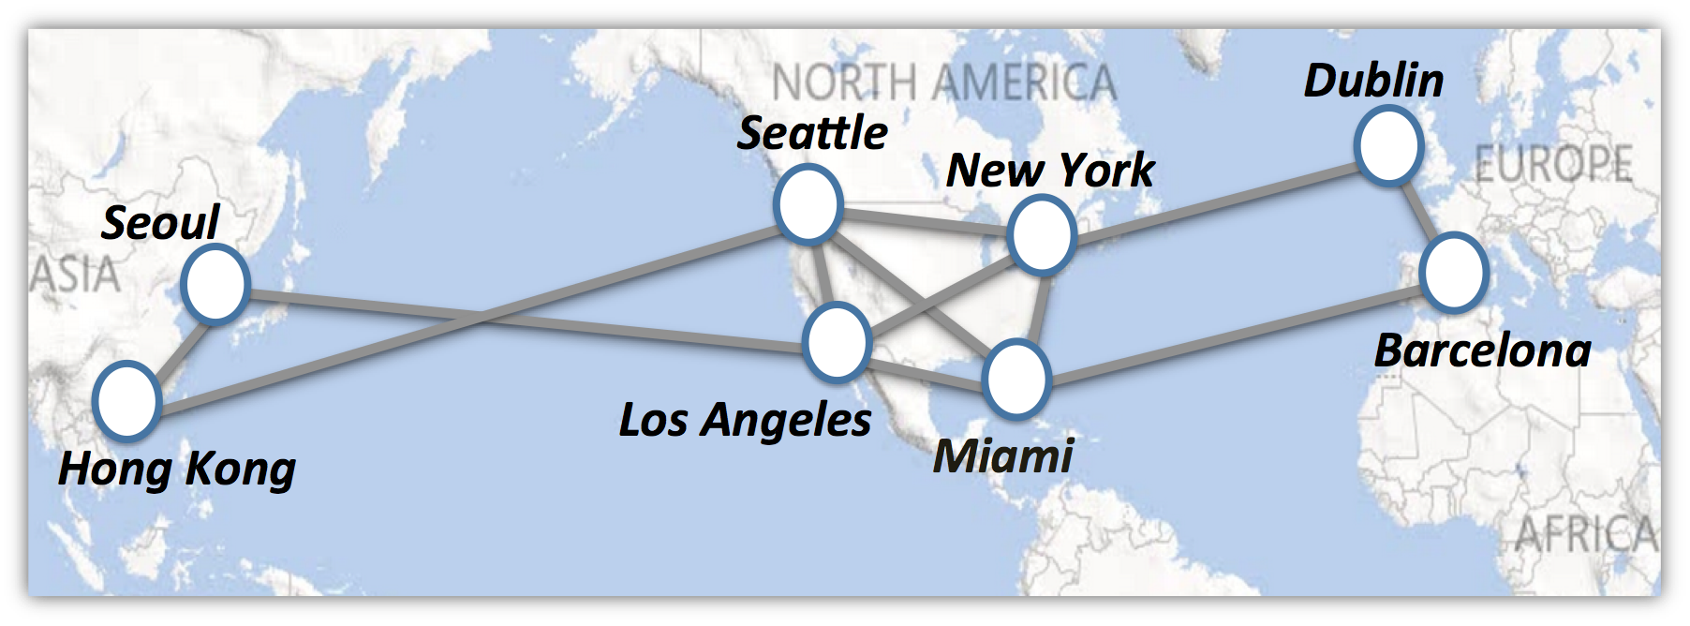

Network Updates
Think: Google, Amazon, Microsoft

Slide 7



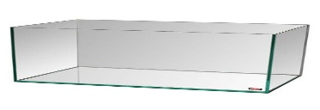

Network Updates
The Internet: Designed for selfish participants
  Often inefficient (low utilization of links), but robust
But what happens if the WAN is controlled by a single entity?
  Examples: Microsoft & Amazon & Google …
  They spend hundreds of millions of dollars per year
Possible solution: Software Defined Networking (SDN)
General Idea: Separate data & control plane in a network
Centralized controller updates networks rules for optimization
  Controller (control plane) updates the switches/routers (data plane)

Slide 8

Motivation
t
size of each flow: 1
capacity of links: 1

Slide 9
Motivation
network updates
t
size of each flow: 1
capacity of links: 1

Slide 10

Motivation
network updates
t
size of each flow: 1
capacity of links: 1

Slide 11
Motivation
network updates
t
size of each flow: 1
capacity of links: 1

Slide 12
Motivation
network updates
t
size of each flow: 1
capacity of links: 1

Slide 13
Motivation
network updates
t
size of each flow: 1
capacity of links: 1

Slide 14
Motivation
network updates
t
size of each flow: 1
capacity of links: 1

Slide 15
Structure of the Talk
Motivation & Software Defined Networking
Related Work & Splittable Flows
Our Approach
Extension beyond Anycast Flows

Slide 16
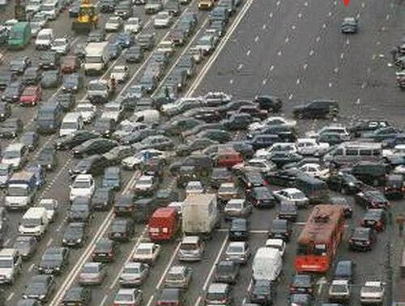

Network Updates of Flows without Congestion
old network
rules
network updates
new network
rules
State of the art: (Partial) moves of flows using linear programming (LPs), e.g.,
  SWAN [Hong et al., SIGCOMM 2013], zUPDATE [Liu et al., SIGCOMM 2013]
  Dionysus [Jin et al., SIGCOMM 2014]
Open problems:
  When are network updates without congestion possible?
  How can we do them fast?
This paper: Addresses the case of one (logical) destination for splittable flows

Slide 17
Swapping of Flows
network updates
t
t
size of each flow: 2
capacity of links: 3

Slide 18
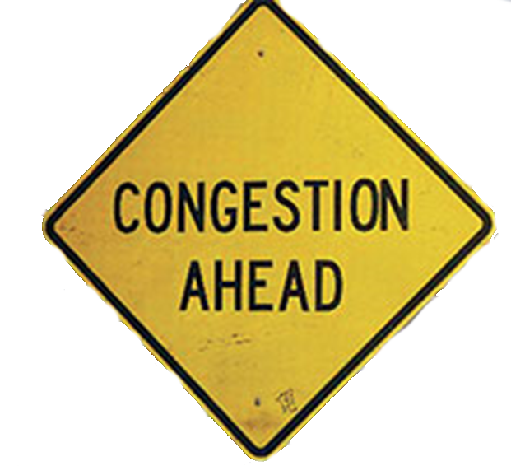
Just Switch? Congestion!
size of each flow: 2
capacity of links: 3

Slide 19
Migrate only parts of the flow
50%
50%
size of each flow: 2
capacity of links: 3

Slide 20
Can even do both flows at once
50%
V₁
V₂
50%
50%
V₃
V₄
50%
size of each flow: 2
capacity of links: 3

Slide 21
Done in two steps
V₁
V₂
V₃
V₄
size of each flow: 2
capacity of links: 3

Slide 22
But not always possible!
V₁
V₂
V₃
V₄
size of each flow: 2
capacity of links: 2

Slide 23

How about other paths?
V₁
V₂
Number of steps can be unbounded
$ε$ capacity
V₃
V₄
size of each flow: 2
capacity of links: 2

Slide 24
How about other paths?
V₁
V₂
Number of steps can be unbounded
$ε$ capacity
Binary search with LPs
ineffective
V₃
V₄
size of each flow: 2
capacity of links: 2

Slide 25
Structure of the Talk
Motivation & Software Defined Networking
Related Work & Splittable Flows
Our Approach
Extension beyond Anycast Flows

Slide 26
Our Approach
Compute our own new rules
  Based off the new demands
Deviate from linear programming binary search
  Go combinatorial with augmenting flows
    “Push back” flows for migration

Slide 27
Augmenting Flows
s₁
t
s₂
size of each flow: 1
capacity of links: 1

Slide 28
Consider Residual Network
s₁
t
s₂
size of each flow: 1
capacity of links: 1

Slide 29
Find a Way in the Residual Network
s₁
t
s₂
size of each flow: 1
capacity of links: 1

Slide 30
Push back the old Flow
s₁
t
s₂
size of each flow: 1
capacity of links: 1

Slide 31
Insert the new Flow
s₁
t
s₂
size of each flow: 1
capacity of links: 1

Slide 32
Migrated without Congestion
s₁
t
s₂
size of each flow: 1
capacity of links: 1

Slide 33
Similar to “Addition”
s₁
s₁
s₁
t
+
t
=
t
s₂
s₂
s₂
size of each flow: 1
capacity of links: 1

Slide 34
Also works as “Subtraction”
s₁
s₁
s₁
t
-
t
=
t
s₂
s₂
s₂
size of each flow: 1
capacity of links: 1

Slide 35
High-level Mechanism Idea
For all commodities (iteratively):
  Increase demand and calculate new flow with LP
    offline calculation
  Apply augmenting flow from the difference
    linear # re-routing in the network

Slide 36
High-level Mechanism Idea
For all commodities (iteratively):
  Increase demand and calculate new flow with LP
    offline calculation
  Apply augmenting flow from the difference
    linear # re-routing in the network
OLD | CURRENT | NEW
1 | 1 | 5
1 | 1 | 2
2 | 2 | 6
3 | 3 | 3
2 | 2 | 8

Slide 37
High-level Mechanism Idea
For all commodities (iteratively):
  Increase demand and calculate new flow with LP
    offline calculation
  Apply augmenting flow from the difference
    linear # re-routing in the network
OLD | CURRENT | NEW
1 | 5 | 5
1 | 1 | 2
2 | 2 | 6
3 | 3 | 3
4 | 2 | 8

Slide 38
High-level Mechanism Idea
For all commodities (iteratively):
  Increase demand and calculate new flow with LP
    offline calculation
  Apply augmenting flow from the difference
    linear # re-routing in the network
OLD | CURRENT | NEW
1 | 5 | 5
1 | 2 | 2
2 | 2 | 6
3 | 3 | 3
4 | 2 | 8

Slide 39
High-level Mechanism Idea
For all commodities (iteratively):
  Increase demand and calculate new flow with LP
    offline calculation
  Apply augmenting flow from the difference
    linear # re-routing in the network
OLD | CURRENT | NEW
1 | 5 | 5
1 | 2 | 2
2 | 6 | 6
3 | 3 | 3
4 | 2 | 8

Slide 40
High-level Mechanism Idea
For all commodities (iteratively):
  Increase demand and calculate new flow with LP
    offline calculation
  Apply augmenting flow from the difference
    linear # re-routing in the network
OLD | CURRENT | NEW
1 | 5 | 5
1 | 2 | 2
2 | 6 | 6
3 | 3 | 3
4 | 2 | 8

Slide 41
High-level Mechanism Idea
For all commodities (iteratively):
  Increase demand and calculate new flow with LP
    offline calculation
  Apply augmenting flow from the difference
    linear # re-routing in the network
OLD | CURRENT | NEW
1 | 5 | 5
1 | 2 | 2
2 | 6 | 6
3 | 3 | 3
4 | 8 | 8

Slide 42
Number of “Push Back”- Links decreases
2
2
s₁
w
2
x
y
2
2
2
s₃
2
v
u
z
t
4
2
2
2
s₄
3
2
s₂
size of flows: 1, 2, 1, 1
capacity of links: 1 (or marked)

Slide 43
Number of “Push Back”- Links decreases
2
2
s₁
w
2
x
y
2
2
2
s₃
2
v
u
z
t
4
2
2
2
s₄
3
2
s₂
size of flows: 1, 2, 1, 1
capacity of links: 1 (or marked)

Slide 44
Number of “Push Back”- Links decreases
2
2
s₁
w
2
x
y
2
2
2
s₃
2
v
u
z
t
4
2
2
2
s₄
3
2
s₂
size of flows: 1, 2, 1, 1
capacity of links: 1 (or marked)

Slide 45
Number of “Push Back”- Links decreases
2
2
s₁
w
2
x
y
2
2
2
s₃
2
v
u
z
t
4
2
2
2
s₄
3
2
s₂
size of flows: 1, 2, 1, 1
capacity of links: 1 (or marked)

Slide 46
Number of “Push Back”- Links decreases
2
2
s₁
w
2
x
y
2
2
2
s₃
2
v
u
z
t
4
2
2
2
s₄
3
2
s₂
size of flows: 1, 2, 1, 1
capacity of links: 1 (or marked)

Slide 47
Number of “Push Back”- Links decreases
2
2
s₁
w
2
x
y
2
2
2
s₃
2
v
u
z
t
4
2
2
2
s₄
3
2
s₂
size of flows: 1+3=4, 2, 1, 1
capacity of links: 1 (or marked)

Slide 48
Structure of the Talk
Motivation & Software Defined Networking
Related Work & Splittable Flows
Our Approach
Extension beyond Anycast Flows

Slide 49

Flow Augmentation for many Destinations
Flows end up at the wrong destination!
So let’s stick with augmenting flows that don’t mix destinations
s₁
t₂
s₁
t₂
s₁
t₂
s₂
t₁
s₂
t₁
s₂
t₁

Slide 50
Extension beyond one logical destination?
s₁
t₁
s₂
t₂
s₃
t₃
size of each flow: 1
capacity of each links: 1

Slide 51
Augmenting flows that don’t mix up the destinations?
s₁
t₁
s₂
t₂
s₃
t₃
size of each flow: 1
capacity of each links: 1

Slide 52
Augmenting flows that don’t mix up the destinations?
s₁
t₁
s₂
t₂
s₃
t₃
size of each flow: 1
capacity of each links: 1

Slide 53
But impossible to migrate!
s₁
t₁
s₂
t₂
s₃
t₃
size of each flow: 1
capacity of each links: 1

Slide 54
But impossible to migrate!
s₁
t₁
s₂
t₂
s₃
t₃
“it is unlikely that similar techniques can be developed
for constructing multicommodity flows”
[Hu, 1963]
size of each flow: 1
capacity of each links: 1

Slide 55
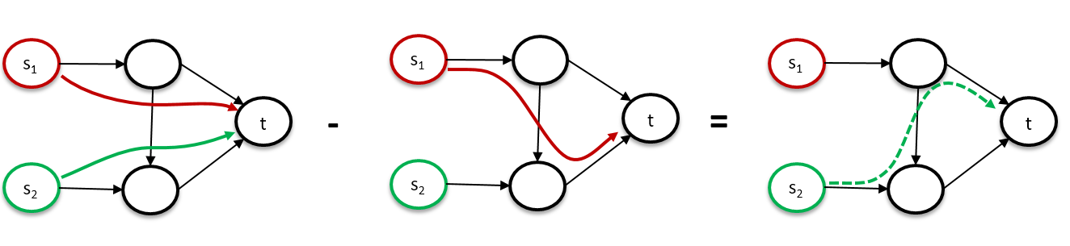
Summary
We studied how to migrate flows with one logical destination in SDNs without congestion
  We can decide fast if demands can be met
  We can migrate with linear # re-routings in the network
  using augmenting flows
Open question:
  How to extend beyond one logical destination?

Slide 56
Thank you
Sebastian Brandt, Klaus-Tycho Förster, Roger Wattenhofer
January 06, 2016 @ ICDCN 2016 - Singapore

