Slide 1

Slotted Programming
for Sensor Networks
Roland Flury
Roger Wattenhofer
Distributed Computing Group
ETH Zurich, Switzerland
DISTRIBUTED COMPUTING

Slide 2

Energy Efficient Communication
A
Radio on
Radio off
TX
Radio off
t_{A}
Close to optimal!
Radio on
Radio off
RX
Radio off
B
t_{B}
time
t₀

Slide 3
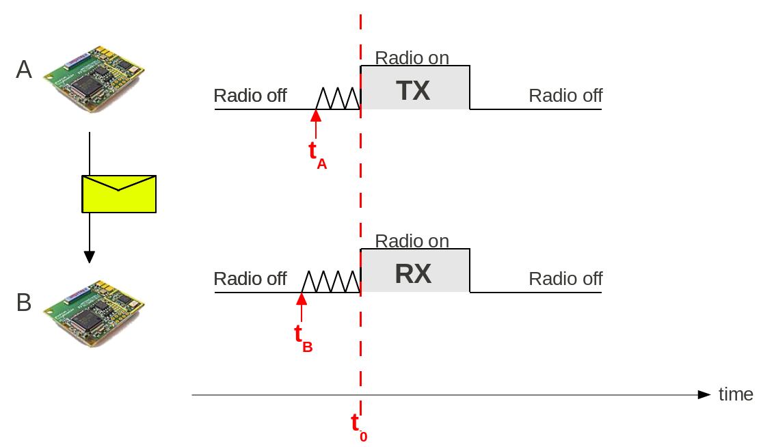
Requirements
Good Synchronization
Exact time execution
  No delay
  If B is too late, it misses the message
Radio must be free to use
  No other task may be using the radio
Slotted Programming can ensure these properties

Slide 4
Programming Sensor Nodes
What are the time critical sections?
  E.g. wake up the radio at t₀ to receive a message
Can they be delayed by another task?
Can we avoid it?
Check access to any device, not only radio
Need to analyze the entire application
Any part may interact with any other part

Slide 5


Traditional vs Slotted
Traditional Application
time
Slotted Application: Temporal separation of the tasks
time
No interference of other tasks
Can analyze each task separately

Slide 6

Slotted & Synchronized
A
B
time
All nodes need to be synchronized
Clock sync module does all the work
Transparent to the other modules

Slide 7


Slotted Programming
Easy case: repetitive schedule
time
Scheduling Window
Advanced schedules are possible

Slide 8
Slotted Programming
Scheduling Window

Slide 9
Slotted Programming
1) @boot: allocate slots
2) schedule slots:
startSlot() - stopSlot()
Scheduling Window
@boot
@runtime
Clock Sync
init()
startSlot()
stopSlot()
Sampling
init()
startSlot()
stopSlot()
Routing
init()
startSlot()
stopSlot()

Slide 10
Slotted Programming
startSlot() {
startRxTimer();
startTxTimer();
}
Scheduling Window
RX
TX
time
RX timer
TX timer

Slide 11
Slotted Programming
Very simple: Time division
No side effects
  Additional module does not disturb existing app
Guaranteed access to resources
Simplified software structure
  Step towards provably correct software
Energy efficient applications
Clock Sync is transparent
Too simplistic?

Slide 12
Examples
Goal
Synchronize all nodes of a network
A master node dictates its time
to the remaining nodes
Slotted Clock Synchronization
Energy Efficient Alarming
Data gathering

Slide 13
Slotted Clock Synchronization
Bootstrap procedure to get rough synchronization
A
B
C
time
RX
TX

Slide 14
Pipelining
time
root
TX
1 hop
RX
TX
2 hops
RX
TX
3 hops
RX
TX

Slide 15
Pipelining
time
root
TX
1 hop
RX
TX
2 hops
RX
TX
3 hops
RX
TX

Slide 16
Pipelining
time
root
TX
Best synchronization
we can have!
Lenzen, Sommer, Wattenhofer
@Sensys 2009
1 hop
RX
TX
2 hops
RX
TX
3 hops
RX
TX

Slide 17


Slotted Clock Sync
Timers not delayed
Access to radio not blocked
Transparent to remaining modules:
  All timers are relative to the time when the current slot started
time
startSlot()

Slide 18
Examples
Goal
a) Inform the root node about an event
b) Inform all nodes about an event
energy efficient and reliable
Slotted Clock Synchronization
Energy Efficient Alarming
Data gathering

Slide 19

Energy Efficient Alarming
Initial idea: Pipelined RSSI sniffs
  Send a message to transmit an alarm
  Measure the RSSI value to detect an alarm
  Several nodes may indicate an alarm in parallel

Slide 20
Alarm!
root
RSSI
TX
1 hop
RSSI
TX
RSSI
TX
2 hops
RSSI
TX
RSSI
TX
5ms
3 hops
RSSI
TX
RSSI
TX
any-to-root
root-to-all

Slide 21
False Alarm!
RSSI works fine – indoors
  Around 30% false alarms when deployed outdoors
TinyNode with Semtech XE1205 Radio
  FSK modulation:
  Announce an alarm: Send at f₀
  No alarm: be quiet
  Detection:
    No alarm: white noise (50% '1' and 50% '0')
    Alarm: > 75% '0'
  Several nodes may indicate an alarm in parallel
0
f₀
1
f₁

Slide 22


Signaling
root
RX
1 hop
RX
RX
2 hops
RX
RX
5ms
3 hops
RX
RX
any-to-root
root-to-all
Reuse same pipeline as for RSSI:

Slide 23


Slotted Programming
How to compare the RSSI and Signaling?
Slotted Programming = Modularity
  Easy reuse of software modules
Energy Efficient: Tight pipelining
  No delays for wakeup, guaranteed access to radio
False Alarms: 30% RSSI vs 1% Signaling
RSSI
RSSI
RSSI
RSSI
RSSI
RSSI

Slide 24
Examples
Goal
Collect sensor readings at a base station
Slotted Clock Synchronization
Energy Efficient Alarming
Data gathering

Slide 25

Slotted Data Gathering
root
RX
1 hop
RX
TX
2 hops
RX
TX
3 hops
RX
TX

Slide 26
Slotted Data Gathering
root
RX
1 hop
RX
TX
2 hops
RX
TX
3 hops
RX
TX

Slide 27

Slotted Programming - Recap
RX
TX
Simple time division
Modularity
No delays, guaranteed access to resources
Energy efficient applications
  Tight scheduling & wakeup patterns
Transparent Clock Sync
Simplified software structure
  Each module can be analyzed independently

Slide 28
Thank You!
slotos – an extension to TinyOS that
supports slotted programming will be
available online soon.

Slide 29
Slotted Programming For Everything?
Fast sensor sampling
time
External asynchronous events
Fast sampling
Multitasking required?

