Slide 1
On Consistent Migration of Flows in SDNs
Sebastian Brandt, Klaus-Tycho Förster, Roger Wattenhofer
April 12, 2016 @ INFOCOM 2016 – San Francisco

Slide 2


The Internet
General Idea: Separate data & control plane in a network
Centralized controller updates networks rules for optimization
  Controller (control plane) updates the switches/routers (data plane)

Slide 3

Central Control?
General Idea: Separate data & control plane in a network
Centralized controller updates networks rules for optimization
  Controller (control plane) updates the switches/routers (data plane)

Slide 4
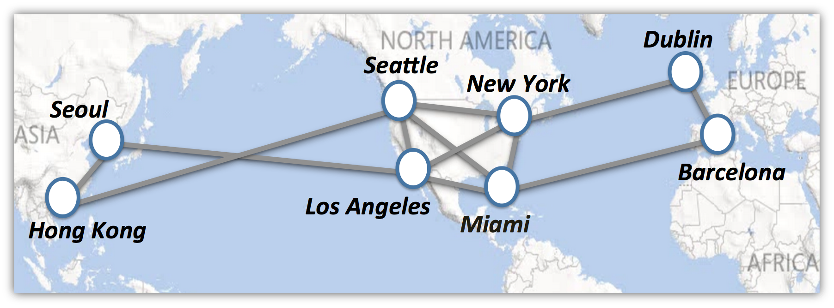

Own WAN = Expensive
Think: Google, Amazon, Microsoft

Slide 5




Software Defined Networking (SDN)
+

Slide 6
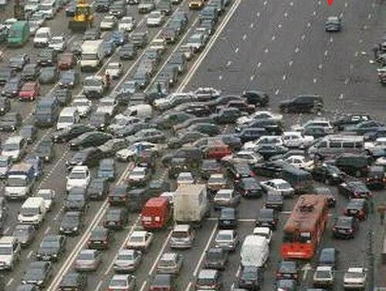


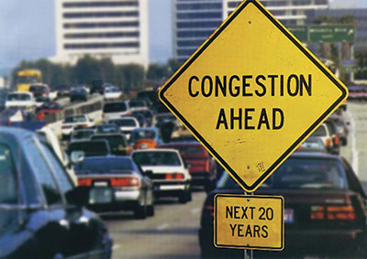
Network Updates
old network
rules
network updates
new network
rules

Slide 7
Network Updates
old network
rules
network updates
new network
rules
State of the art: (Partial) moves of flows using linear programming (LPs), e.g.,
  SWAN [Hong et al., SIGCOMM 2013], zUPDATE [Liu et al., SIGCOMM 2013]
  Dionysus [Jin et al., SIGCOMM 2014]

Slide 8
Network Updates
old network
rules
network updates
new network
rules
Open problems:
  When are network updates in a consistent manner possible?
  How can we decide fast?

Slide 9
Network Updates
old network
rules
network updates
new network
rules
This paper: Addresses the case of splittable multi-commodity flows

Slide 10
A Small Sample Network

Slide 11
Green wants to send as well

Slide 12

Congestion!

Slide 13
This would work

Slide 14
So lets go back

Slide 15

But Red is a bit Slow..

Slide 16
Congestion Again!

Slide 17
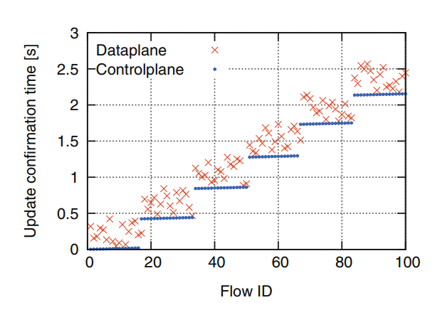
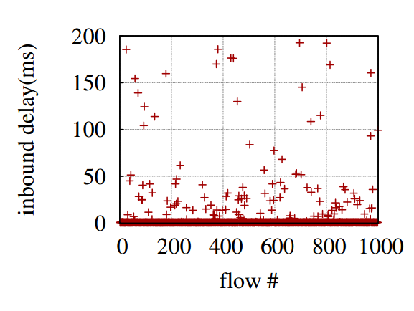
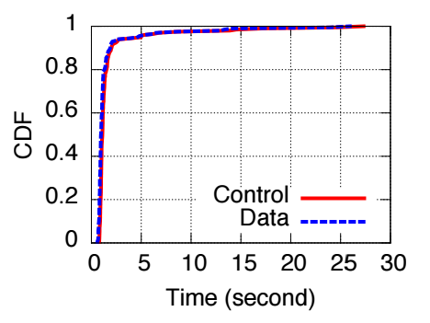
Appears in Practice
“Data plane updates may fall behind the control
plane acknowledgments and may be even reordered.”
Kuzniar et al., PAM 2015
“…the inbound latency is quite variable with a
[…] standard deviation of 31.34ms…”
He et al., SOSR 2015
“some switches can ‘straggle,’ taking substantially more time
than average (e.g., 10-100x) to apply an update”
Jin et al., SIGCOMM 2014

Slide 18
So lets go Back …

Slide 19
First, Red switches

Slide 20
Then, Blue …

Slide 21
And then, Green …

Slide 22
Done

Slide 23
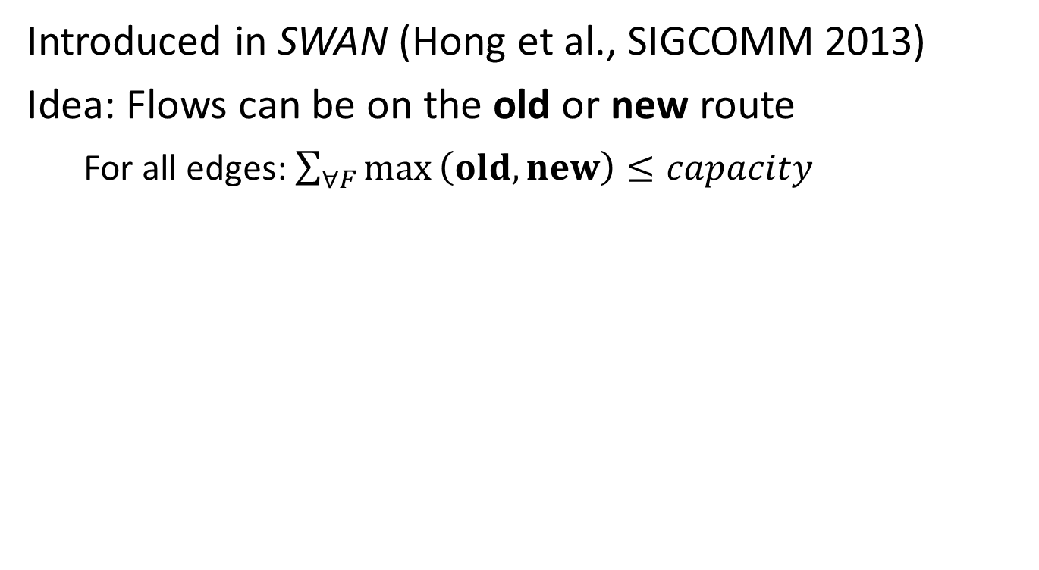
Consistent Migration of Flows
Introduced in SWAN (Hong et al., SIGCOMM 2013)
Idea: Flows can be on the old or new route
  For all edges: $\underset{}{\sum_{∀F}{max}\left(old,new\right)≤capacity}{}$

Slide 24
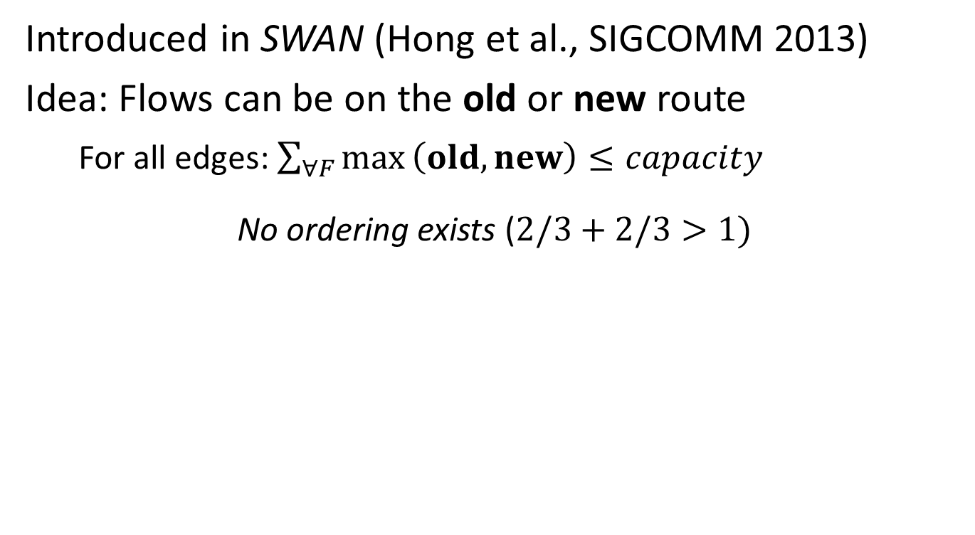
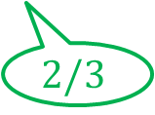

Consistent Migration of Flows
Introduced in SWAN (Hong et al., SIGCOMM 2013)
Idea: Flows can be on the old or new route
  For all edges: $\underset{}{\sum_{∀F}{max}\left(old,new\right)≤capacity}{}$
No ordering exists ($2/3+2/3>1)$
$$2/3$$
$$2/3$$

Slide 25
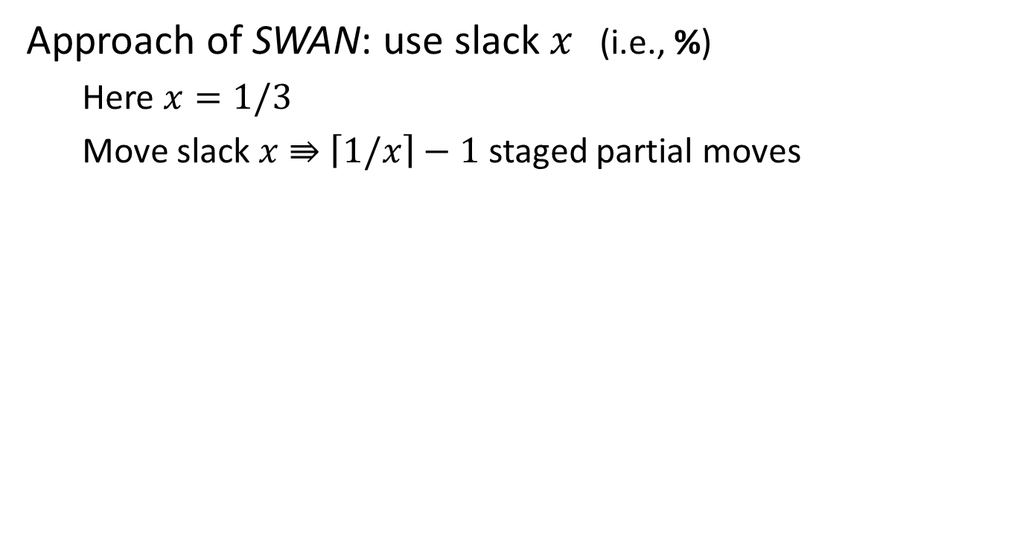
Consistent Migration of Flows
Approach of SWAN: use slack $x$ (i.e., %)
  Here $x=1/3$
  Move slack $x$ $⇛$ $\left\lceil 1/x\right\rceil −1$ staged partial moves
$$2/3$$
$$2/3$$

Slide 26

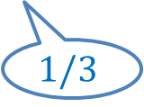
Consistent Migration of Flows
Approach of SWAN: use slack $x$ (i.e., %)
  Here $x=1/3$
  Move slack $x$ $⇛$ $\left\lceil 1/x\right\rceil −1$ staged partial moves
  Update 1 of 2
$$1/3$$
$$1/3$$

Slide 27
Consistent Migration of Flows
Approach of SWAN: use slack $x$ (i.e., %)
  Here $x=1/3$
  Move slack $x$ $⇛$ $\left\lceil 1/x\right\rceil −1$ staged partial moves
  Update 1 of 2
$$1/3$$
$$1/3$$

Slide 28
Consistent Migration of Flows
Approach of SWAN: use slack $x$ (i.e., %)
  Here $x=1/3$
  Move slack $x$ $⇛$ $\left\lceil 1/x\right\rceil −1$ staged partial moves
  Update 2 of 2
$$2/3$$
$$2/3$$

Slide 29


Consistent Migration of Flows
No slack on flow edges?
$$1$$
$$1$$

Slide 30
Consistent Migration of Flows
Alternate routes?

Slide 31
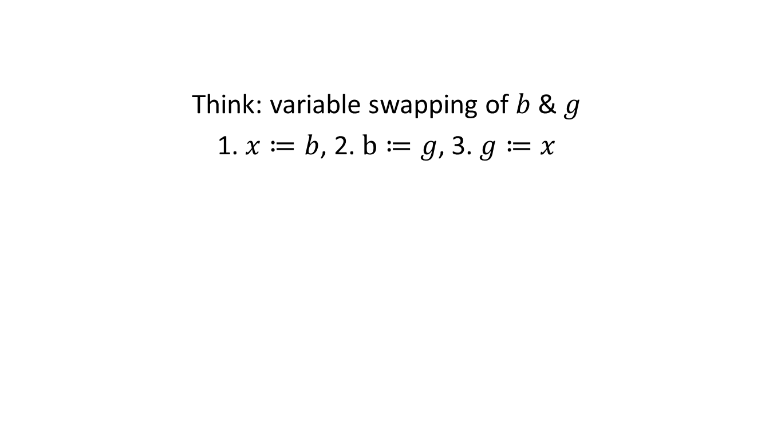
Consistent Migration of Flows
Think: variable swapping of $b$ & $g$
1. $x≔b$, 2. $b≔g$, 3. $g≔x$

Slide 32
Consistent Migration of Flows
Think: variable swapping of $b$ & $g$
1. $x≔b$, 2. $b≔g$, 3. $g≔x$

Slide 33
Consistent Migration of Flows
Think: variable swapping of $b$ & $g$
1. $x≔b$, 2. $b≔g$, 3. $g≔x$

Slide 34
Consistent Migration of Flows
SWAN: LP-approach with binary search
  1 update? 2 updates? 4 updates? …

Slide 35

Consistent Migration of Flows
SWAN: LP-approach with binary search
  1 update? 2 updates? 4 updates? …
$$ε$$

Slide 36
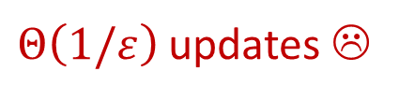
Consistent Migration of Flows
SWAN: LP-approach with binary search
$Θ\left(1/ε\right)$ updates ☹
$$ε$$

Slide 37
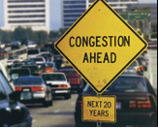
Consistent Migration of Flows
Open problem: Can we decide in (polynomial) time?
Flow migration
LP
“Halting Problem”
yes
no

Slide 38
Overview of the Remaining Talk
Yes, we can (decide in polynomial time)
What to do if we cannot migrate consistently?
Last: NP-hardness for unsplittable flows

Slide 39
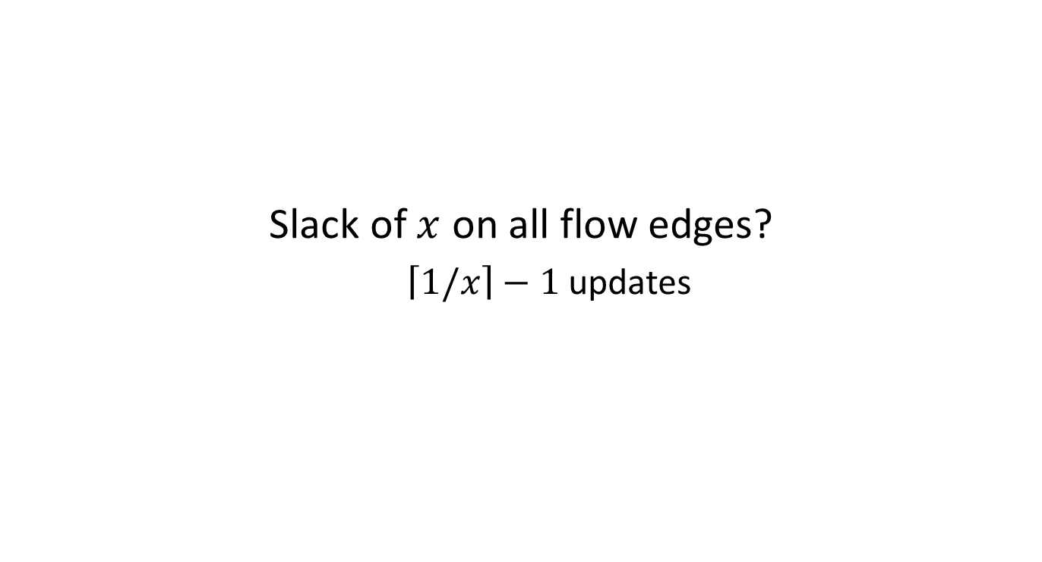
To Slack or not to Slack?
Slack of $x$ on all flow edges?
  $\left\lceil 1/x\right\rceil −1$ updates

Slide 40
To Slack or not to Slack?
What if not?
Try to create slack

Slide 41
To Slack or not to Slack?
Combinatorial approach
  Augmenting paths

Slide 42



Combinatorial Approach
Move single commodities at a time
$$1$$
$$1$$
u
v
$$e$$

Slide 43





Combinatorial Approach
Where to increase flow?
$$+$$
$$+$$
$$+$$
$$+$$
$$+$$
u
v
$$e$$

Slide 44







Combinatorial Approach
Where to push back flow?
$$−$$
$$−$$
$$−$$
$$−$$
$$−$$
$$−$$
$$−$$
u
v
$$e$$

Slide 45
Combinatorial Approach
Resulting residual network
u
v
$$e$$

Slide 46
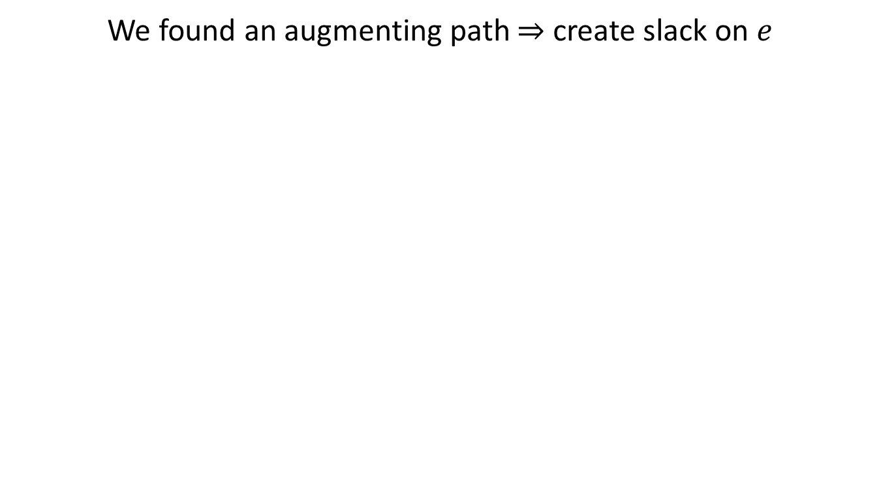
Combinatorial Approach
We found an augmenting path $⇒$ create slack on $e$
$$−$$
u
v
$$e$$

Slide 47
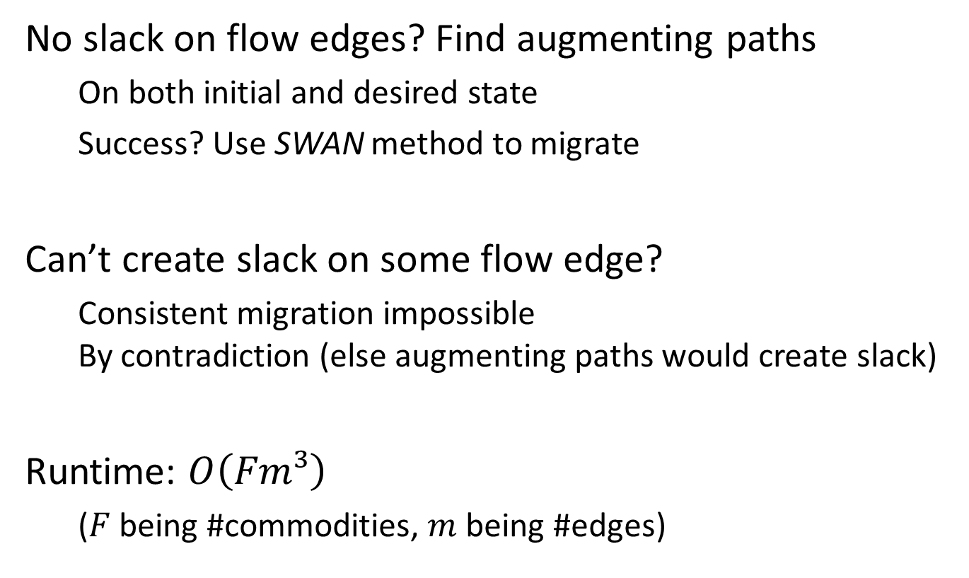
High-level Algorithm Idea
No slack on flow edges? Find augmenting paths
  On both initial and desired state
  Success? Use SWAN method to migrate
Can’t create slack on some flow edge?
  Consistent migration impossible
  By contradiction (else augmenting paths would create slack)
Runtime: $O\left(Fm³\right)$
  ($F$ being #commodities, $m$ being #edges)

Slide 48
Overview of the Remaining Talk
Yes, we can (decide in polynomial time)
What to do if we cannot migrate consistently?
Last: NP-hardness for unsplittable flows

Slide 49
What to do if we cannot Migrate Consistently?
    Option 1: Migrate, but reduce congestion
      B4: Optimize (Jain et al., SIGCOMM 13)
      Dionysus: Rate-limit some flows (Jin et al., SIGCOMM 14)
      Time-based updates (E.g., Mizrahi et al., INFOCOM 15/16)
      …

Slide 50
What to do if we cannot Migrate Consistently?
    Option 1: Migrate, but reduce congestion
      B4: Optimize (Jain et al., SIGCOMM 13)
      Dionysus: Rate-limit some flows (Jin et al., SIGCOMM 14)
      Time-based updates (E.g., Mizrahi et al., INFOCOM 15/16)
      …
Wed, 08:30: Grand Ballroom B

Slide 51
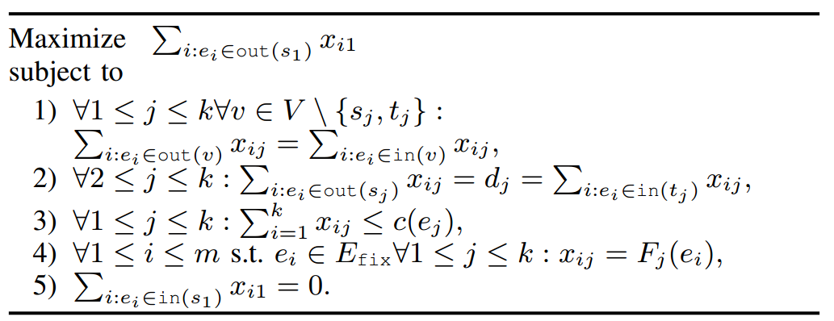
Option 2: Increase Demands Consistently
Idea: Don’t change where no slack is possible

Slide 52
Overview of the Remaining Talk
Yes, we can (decide in polynomial time)
What to do if we cannot migrate consistently?
Last: NP-hardness for unsplittable flows

Slide 53
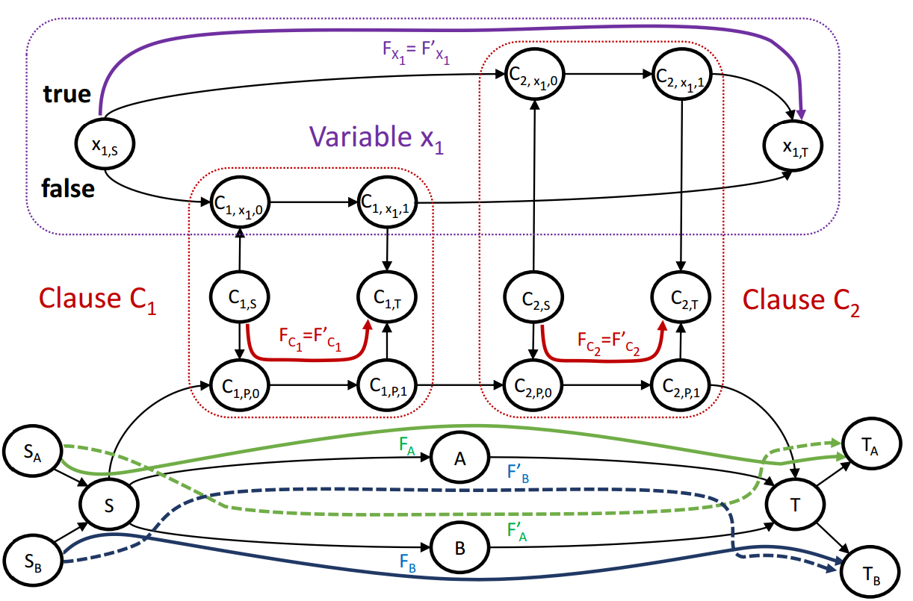
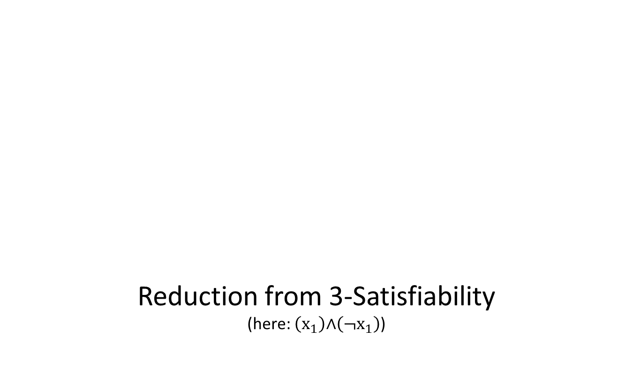
NP-Hardness for Unsplittable Flows
Reduction from 3-Satisfiability
(here: $\left(x_{1}\right)\text{∧}\left(¬x_{1}\right)$)

Slide 54
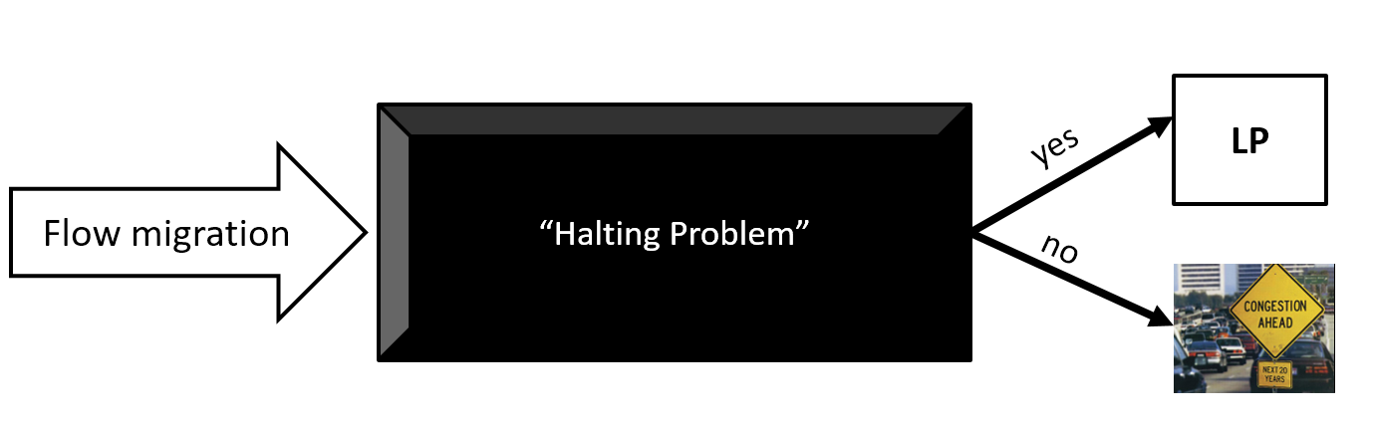
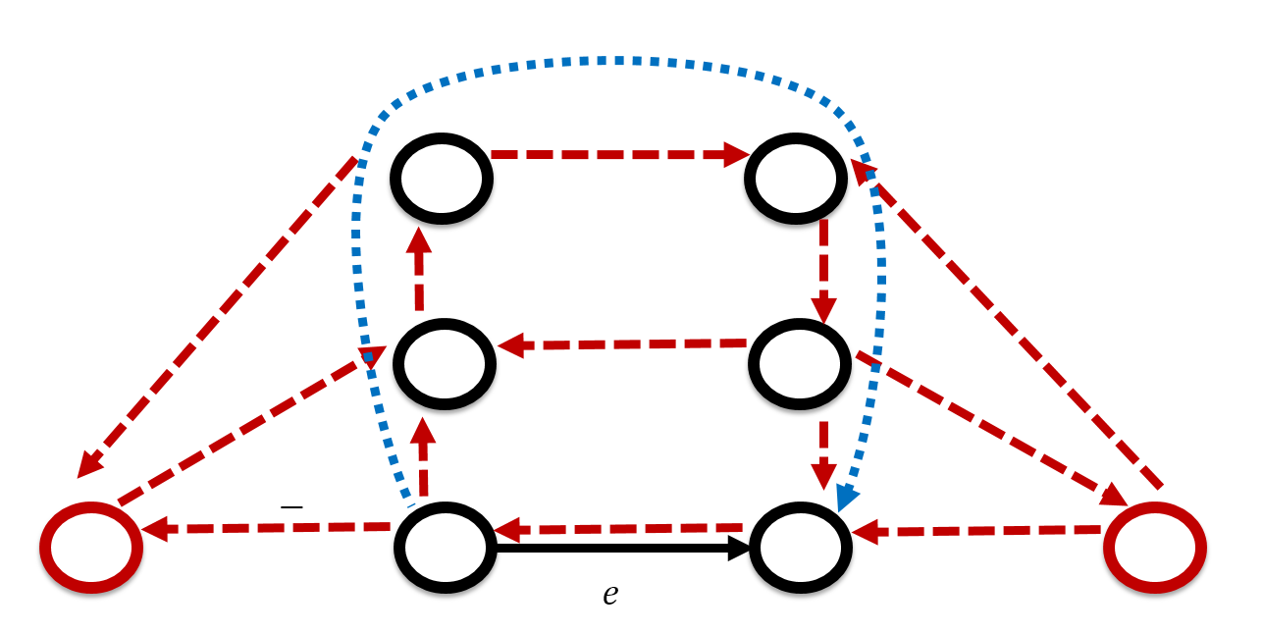
Summary
Consistent migration of flows
  Decidable in polynomial time
No consistent migration possible?
  Can use LP to maximize demands
Unsplittable flow migration
  NP-hard

Slide 55
On Consistent Migration of Flows in SDNs
Sebastian Brandt, Klaus-Tycho Förster, Roger Wattenhofer
April 12, 2016 @ INFOCOM 2016 – San Francisco

