Slide 1

Fast Shared Counting using O(n) Compare-and-Swap Registers
Pankaj Khanchandani, Roger Wattenhofer
ETH Zurich

Slide 2
Using LL/SC Registers
Faith Ellen and Philipp Woelfel, An Optimal Implementation of Fetch-and-Increment [2013]
Prasad Jayanti, f-arrays: implementation and applications [2002]

Slide 3
Using LL/SC Registers
Faith Ellen and Philipp Woelfel, An Optimal Implementation of Fetch-and-Increment [2013]
Prasad Jayanti, f-arrays: implementation and applications [2002]
Extra sequence number field
(Anderson and Moir, 1997)
LL/SC
LL/SC
CAS
O(n) space overhead
(Jayanti and Petrovic, 2005, 03)

Slide 4
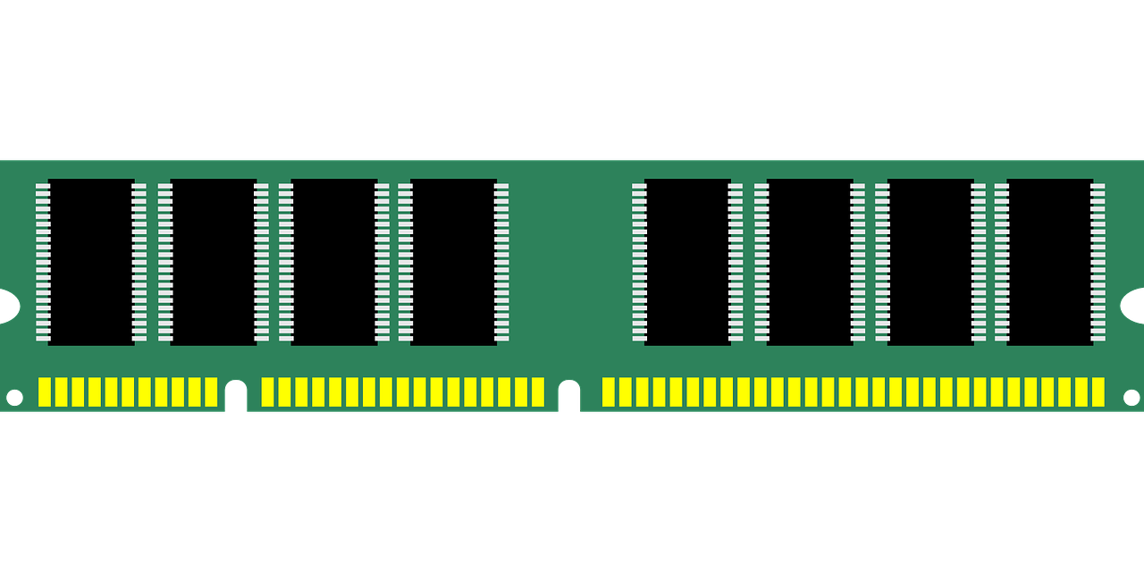

Slide 5
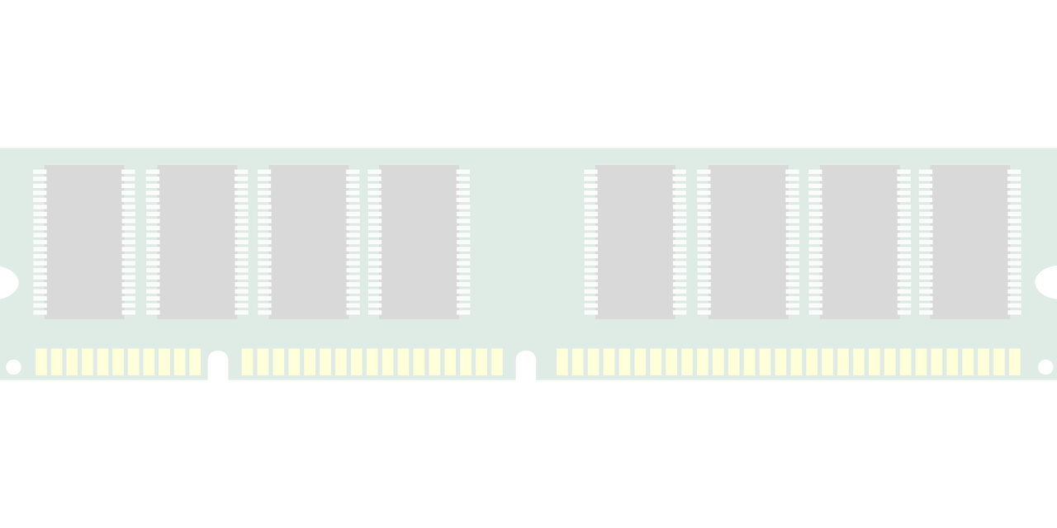
0
1
2
3
4

Slide 6
0
1
2
3
4
R₂.write(5)

Slide 7
0
1
2
3
4
5
R₂.write(5)

Slide 8
0
1
2
3
4
5
R₂.write(5)
v = R₂.read()

Slide 9
0
1
2
3
4
5
R₂.write(5)
v = R₂.read()

Slide 10
0
1
2
3
4
5
R₂.write(5)
v = R₂.read()
v’ = v + 1

Slide 11
0
1
2
3
4
5
R₂.write(5)
v = R₂.read()
v’ = v + 1

Slide 12
0
1
2
3
4
5
R₂.write(5)
v = R₂.read()
v’ = v + 1
success = R₂.CAS(v, v’)

Slide 13
0
1
2
3
4
6
R₂.write(5)
v = R₂.read()
v’ = v + 1
success = R₂.CAS(v, v’)

Slide 15
0
C

Slide 16
0
C
C.inc()

Slide 17
1
C
C.inc()

Slide 18
1
C
C.inc()
C.inc()

Slide 19
2
C
C.inc()
C.inc()

Slide 20
2
C
C.inc()
C.inc()
v = C.read()

Slide 21
2
C
C.inc()
C.inc()
v = C.read()

Slide 23
0
R

Slide 24
0
R
v = R.read()
R.write(v + 1)

Slide 25
0
R
v = R.read()
R.write(v + 1)
v = 0

Slide 26
0
R
v = R.read()
R.write(v + 1)
v = 0
v = 0

Slide 27
1
R
v = R.read()
R.write(v + 1)
v = 0
v = 0

Slide 28
1
R
v = R.read()
R.write(v + 1)
v = 0
v = 0

Slide 29
1
R
v = R.read()
R.write(v + 1)
v = 0
v = 0
NOT
LINEARIZABLE

Slide 31
0
R

Slide 32
0
R
while(true) {
v = R.read()
if(R.CAS(v, v + 1)){
break
}
}

Slide 33
0
R
while(true) {
v = R.read()
if(R.CAS(v, v + 1)){
break
}
}

Slide 34
0
R
while(true) {
v = R.read()
if(R.CAS(v, v + 1)){
break
}
}
v = 0

Slide 35
0
R
while(true) {
v = R.read()
if(R.CAS(v, v + 1)){
break
}
}
v = 0

Slide 36
0
R
while(true) {
v = R.read()
if(R.CAS(v, v + 1)){
break
}
}
v = 0
v = 0

Slide 37
1
R
while(true) {
v = R.read()
if(R.CAS(v, v + 1)){
break
}
}
v = 0
v = 0

Slide 38
1
R
while(true) {
v = R.read()
if(R.CAS(v, v + 1)){
break
}
}
v = 0
v = 0

Slide 39
1
R
while(true) {
v = R.read()
if(R.CAS(v, v + 1)){
break
}
}
v = 0
v = 0

Slide 40
1
R
while(true) {
v = R.read()
if(R.CAS(v, v + 1)){
break
}
}
v = 0
v = 0

Slide 41
1
R
while(true) {
v = R.read()
if(R.CAS(v, v + 1)){
break
}
}
v = 0
v = 0

Slide 42
1
R
while(true) {
v = R.read()
if(R.CAS(v, v + 1)){
break
}
}
v = 1
v = 0

Slide 43
1
R
while(true) {
v = R.read()
if(R.CAS(v, v + 1)){
break
}
}
v = 1
v = 0

Slide 44
1
R
while(true) {
v = R.read()
if(R.CAS(v, v + 1)){
break
}
}
v = 1
v = 0
NOT
WAIT-FREE

Slide 45
Linearizable
Wait-free
Shared Counter
using CAS Registers

Slide 46
S
0
R
B
0
0

Slide 47
S
0
R
B
0
0
if(“red”) {
R = R + 1
}else{
B = B + 1
}
sum = S.read()
sum’ = R.read() + B.read()
success = S.CAS(sum, sum’)

Slide 48
S
0
R
B
0
0
if(“red”) {
R = R + 1
}else{
B = B + 1
}
sum = S.read()
sum’ = R.read() + B.read()
success = S.CAS(sum, sum’)

Slide 49
S
0
R
B
1
0
if(“red”) {
R = R + 1
}else{
B = B + 1
}
sum = S.read()
sum’ = R.read() + B.read()
success = S.CAS(sum, sum’)

Slide 50
S
0
R
B
1
0
if(“red”) {
R = R + 1
}else{
B = B + 1
}
sum = S.read()
sum’ = R.read() + B.read()
success = S.CAS(sum, sum’)
sum = 0

Slide 51
S
0
R
B
1
0
if(“red”) {
R = R + 1
}else{
B = B + 1
}
sum = S.read()
sum’ = R.read() + B.read()
success = S.CAS(sum, sum’)
sum = 0
sum’ = 1

Slide 52
S
0
R
B
1
0
if(“red”) {
R = R + 1
}else{
B = B + 1
}
sum = S.read()
sum’ = R.read() + B.read()
success = S.CAS(sum, sum’)
sum = 0
sum’ = 1

Slide 53
S
0
R
B
1
1
if(“red”) {
R = R + 1
}else{
B = B + 1
}
sum = S.read()
sum’ = R.read() + B.read()
success = S.CAS(sum, sum’)
sum = 0
sum’ = 1

Slide 54
S
0
R
B
1
1
if(“red”) {
R = R + 1
}else{
B = B + 1
}
sum = S.read()
sum’ = R.read() + B.read()
success = S.CAS(sum, sum’)
sum = 0
sum’ = 1
sum = 0

Slide 55
S
0
R
B
1
1
if(“red”) {
R = R + 1
}else{
B = B + 1
}
sum = S.read()
sum’ = R.read() + B.read()
success = S.CAS(sum, sum’)
sum = 0
sum’ = 1
sum = 0
sum’ = 2

Slide 56
S
1
R
B
1
1
if(“red”) {
R = R + 1
}else{
B = B + 1
}
sum = S.read()
sum’ = R.read() + B.read()
success = S.CAS(sum, sum’)
sum = 0
sum’ = 1
sum = 0
sum’ = 2

Slide 57
S
1
R
B
1
1
if(“red”) {
R = R + 1
}else{
B = B + 1
}
sum = S.read()
sum’ = R.read() + B.read()
success = S.CAS(sum, sum’)
sum = 0
sum’ = 1
sum = 0
sum’ = 2

Slide 58
S
1
R
B
1
1
if(“red”) {
R = R + 1
}else{
B = B + 1
}
sum = S.read()
sum’ = R.read() + B.read()
success = S.CAS(sum, sum’)
sum = 0
sum’ = 1
sum = 0
sum’ = 2

Slide 59
S
1
R
B
1
1
if(“red”) {
R = R + 1
}else{
B = B + 1
}
sum = S.read()
sum’ = R.read() + B.read()
success = S.CAS(sum, sum’)
if(! success){
sum = S.read()
sum’ = R.read() + B.read()
success = S.CAS(sum, sum’)
}
sum = 0
sum’ = 1
sum = 0
sum’ = 2

Slide 60
S
1
R
B
1
1
if(“red”) {
R = R + 1
}else{
B = B + 1
}
sum = S.read()
sum’ = R.read() + B.read()
success = S.CAS(sum, sum’)
if(! success){
sum = S.read()
sum’ = R.read() + B.read()
success = S.CAS(sum, sum’)
}
sum = 0
sum’ = 1
sum = 0
sum’ = 2

Slide 61
S
1
R
B
1
1
if(“red”) {
R = R + 1
}else{
B = B + 1
}
sum = S.read()
sum’ = R.read() + B.read()
success = S.CAS(sum, sum’)
if(! success){
sum = S.read()
sum’ = R.read() + B.read()
success = S.CAS(sum, sum’)
}
sum = 0
sum’ = 1
sum = 1
sum’ = 2

Slide 62
S
1
R
B
1
1
if(“red”) {
R = R + 1
}else{
B = B + 1
}
sum = S.read()
sum’ = R.read() + B.read()
success = S.CAS(sum, sum’)
if(! success){
sum = S.read()
sum’ = R.read() + B.read()
success = S.CAS(sum, sum’)
}
sum = 0
sum’ = 1
sum = 1
sum’ = 2

Slide 63
S
2
R
B
1
1
if(“red”) {
R = R + 1
}else{
B = B + 1
}
sum = S.read()
sum’ = R.read() + B.read()
success = S.CAS(sum, sum’)
if(! success){
sum = S.read()
sum’ = R.read() + B.read()
success = S.CAS(sum, sum’)
}
sum = 0
sum’ = 1
sum = 1
sum’ = 2

Slide 66
inc()

Slide 67
read()
inc()

Slide 68
read()
inc()
O(log n) time, O(n) space

Slide 69
fetch-and-inc() in O(n) space?

Slide 70


