Slide 1

Convergence in (Social) Influence Networks
Silvio Frischknecht, Barbara Keller, Roger Wattenhofer
ETH Zurich – Distributed Computing – www.disco.ethz.ch

Slide 2
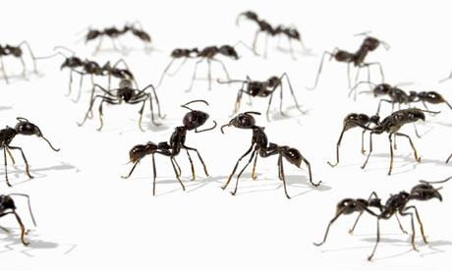
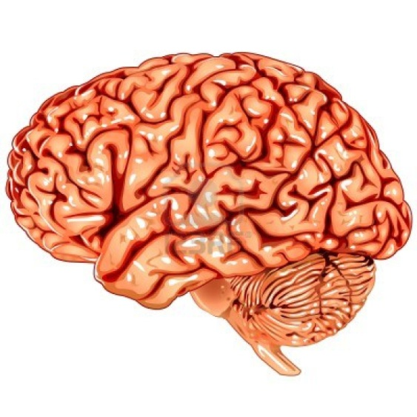
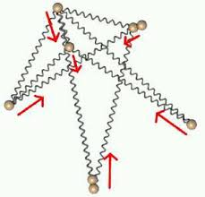
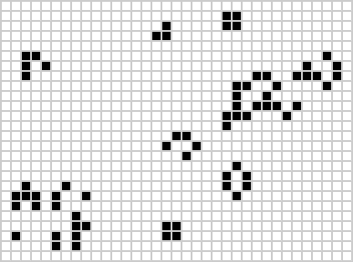
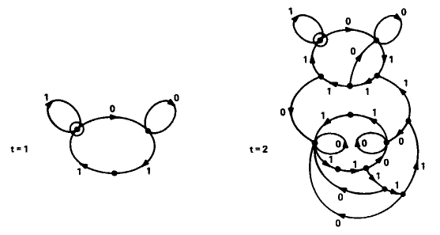
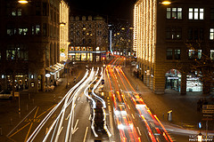
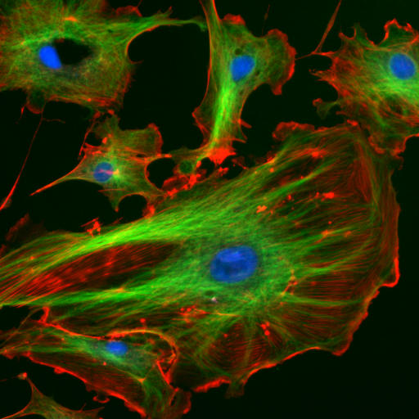

Slide 3
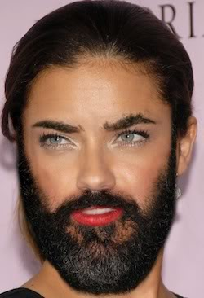
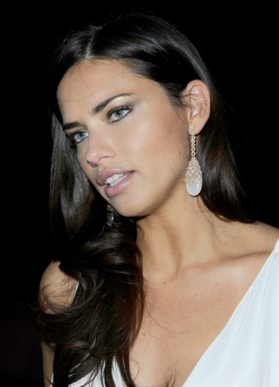
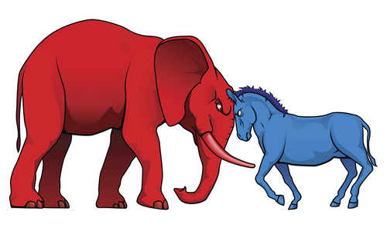
Simple World
2 Opinions:
Opinion changes: Whatever the majority of my friends think

Slide 4
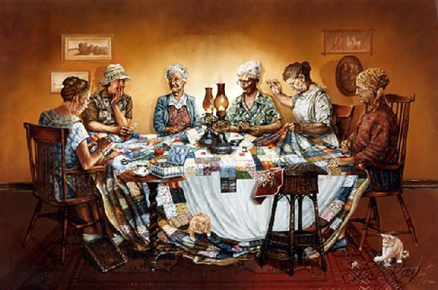
b

Slide 5
b

Slide 6
b

Slide 7
b

Slide 8
b

Slide 9
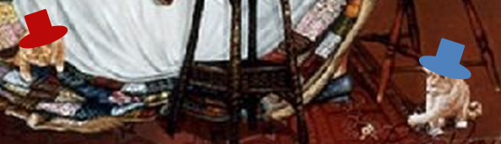
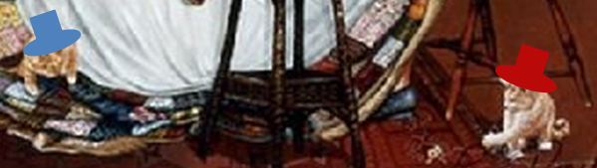
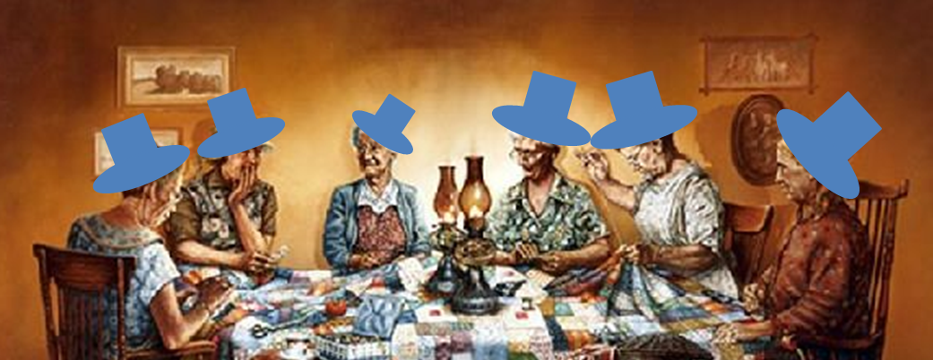
What Can Happen?
and/or
Goles and Olivios 1980

Slide 10
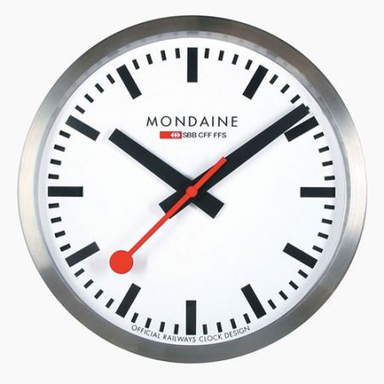

Slide 11
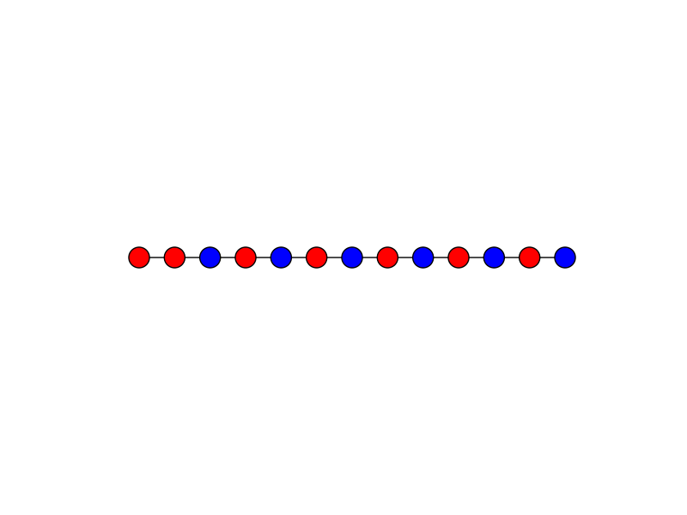
Easy Lower Bound: Ω(n)

Slide 12
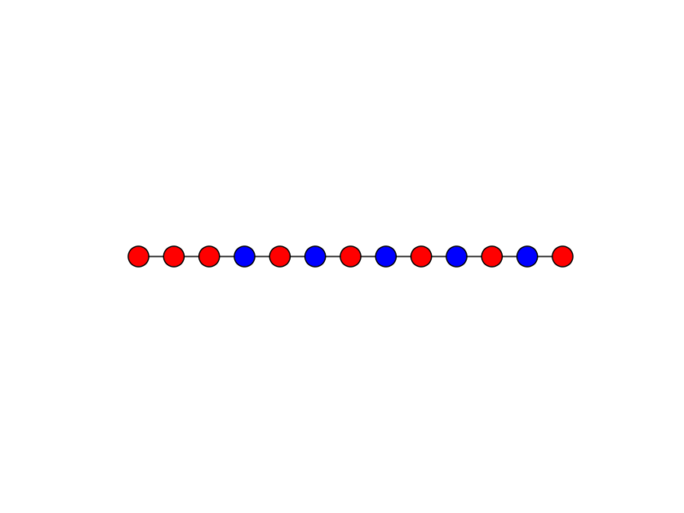
Easy Lower Bound: Ω(n)

Slide 13
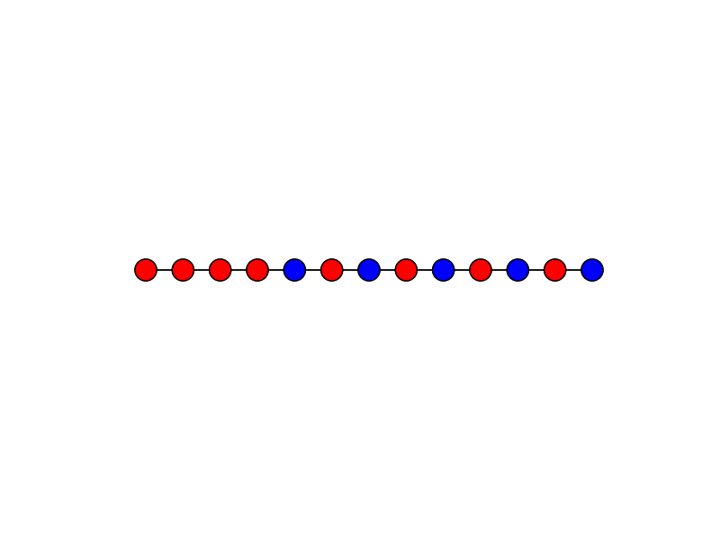
Easy Lower Bound: Ω(n)

Slide 14

Easy Lower Bound: Ω(n)

Slide 15
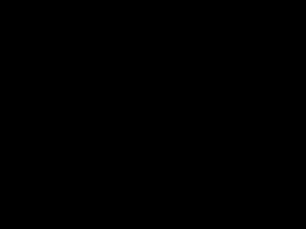
Easy Lower Bound: Ω(n)

Slide 16
Upper Bound:
v

Slide 17
Upper Bound:
v

Slide 18
Upper Bound:
v

Slide 19
Upper Bound:
Good edge: Friend takes advised opinion on next day
Bad edge: Friend does not take the proposed opinion
v

Slide 20
Upper Bound:
Good edge: Friend takes advised opinion on next day
Bad edge: Friend does not take the proposed opinion
t
t+1
t+2
g
g: Nr. of good edges
b: Nr. of bad edges
v
v
b
case g > b

Slide 21
Upper Bound:
Good edge: Friend takes advised opinion on next day
Bad edge: Friend does not take the proposed opinion
t
t+1
t+2
g
g: Nr. of good edges
b: Nr. of bad edges
v
v
b
case g > b

Slide 22
Upper Bound:
Good edge: Friend takes advised opinion on next day
Bad edge: Friend does not take the proposed opinion
t
t+1
t+2
g
g: Nr. of good edges
b: Nr. of bad edges
v
v
b
case g > b

Slide 23
Upper Bound:
t
t+1
t+2
g
g: Nr. of good edges
b: Nr. of bad edges
v
v
b
case b > g

Slide 24
Upper Bound:
t
t+1
t+2
g
g: Nr. of good edges
b: Nr. of bad edges
v
v
b
case b > g

Slide 25
Upper Bound:
t
t+1
t+2
g
g: Nr. of good edges
b: Nr. of bad edges
v
v
b
case b > g

Slide 26
Upper Bound:
t
t+1
t+2
g
g
g: Nr. of good edges
b: Nr. of bad edges
v
v
b
b
case b > g

Slide 27
Tight Bound?
Lower bound Upper bound
vs.

Slide 28

Let`s Vote
vs.

Slide 30
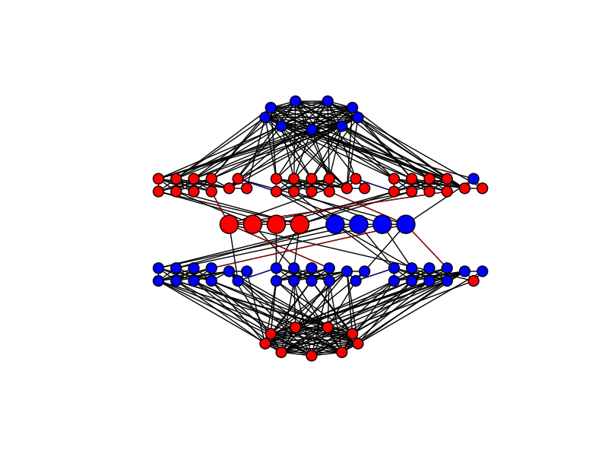
Simpler Example:

Slide 31
Simpler Example:

Slide 32
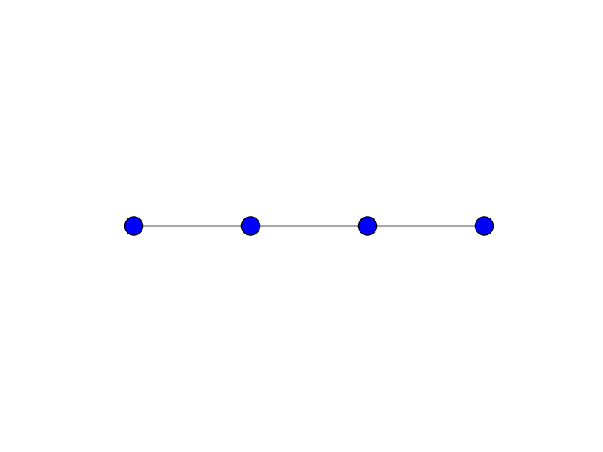

Slide 33
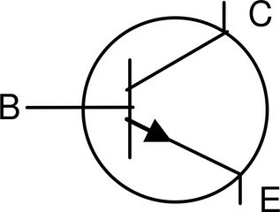
A Transistor

Slide 34
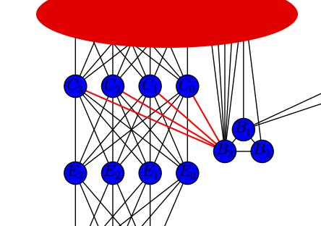
A Transistor

Slide 35
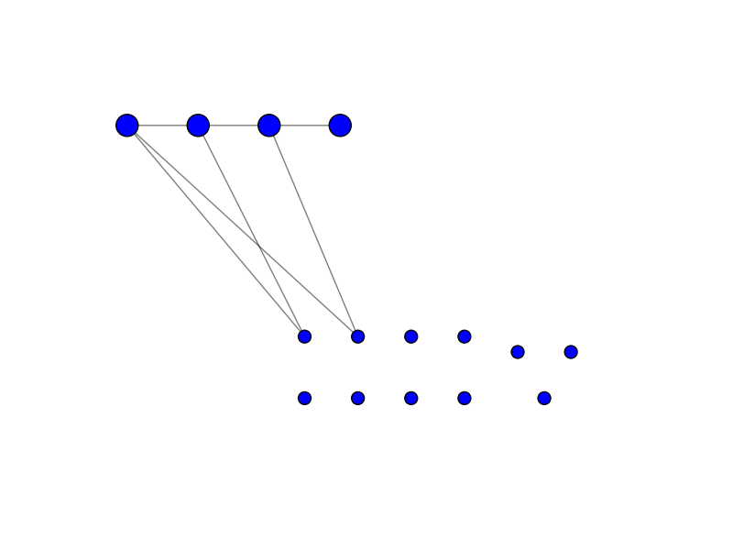
E
E
B
B
C
C

Slide 36
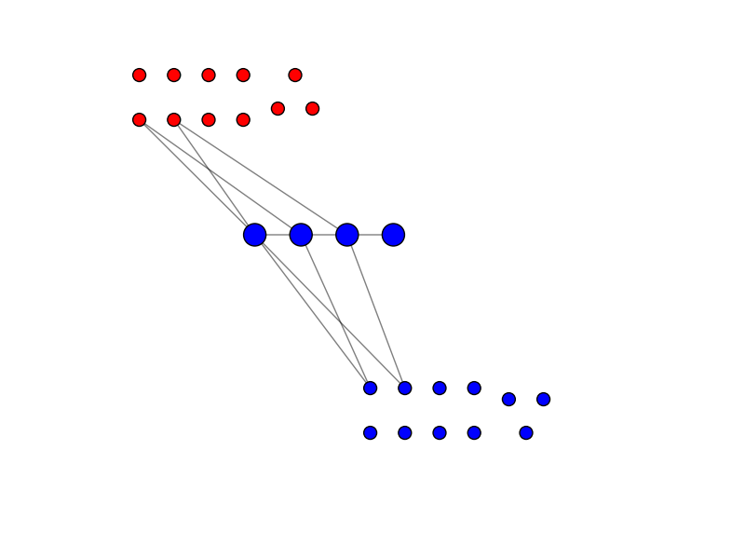
C
C
B
B
E
E
E
E
B
B
C
C

Slide 37
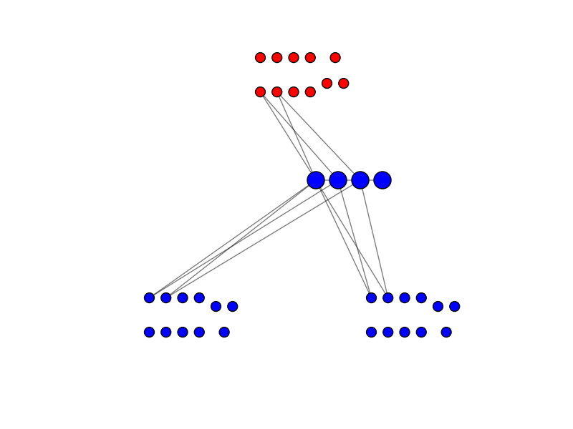
C
B
E
E
B
E
B
C
C

Slide 38
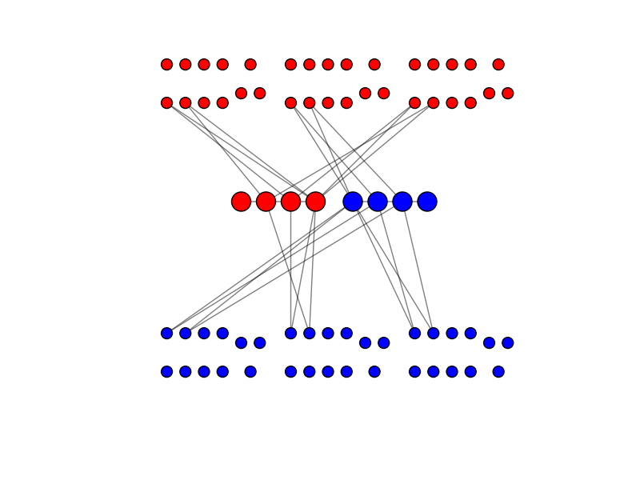
C
B
C
B
C
B
E
E
E
E
B
E
B
E
B
C
C
C

Slide 39
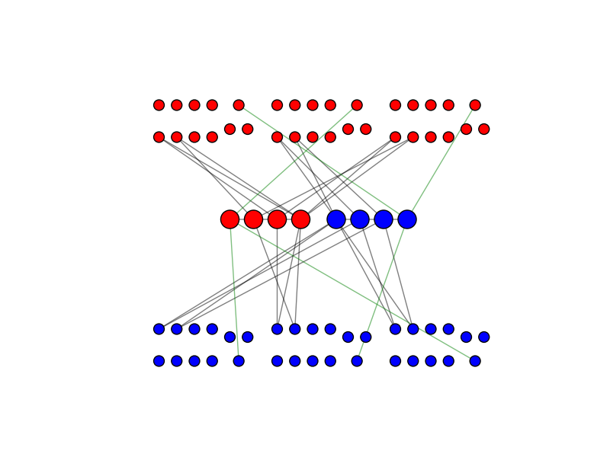

Slide 40


Slide 41


Slide 44
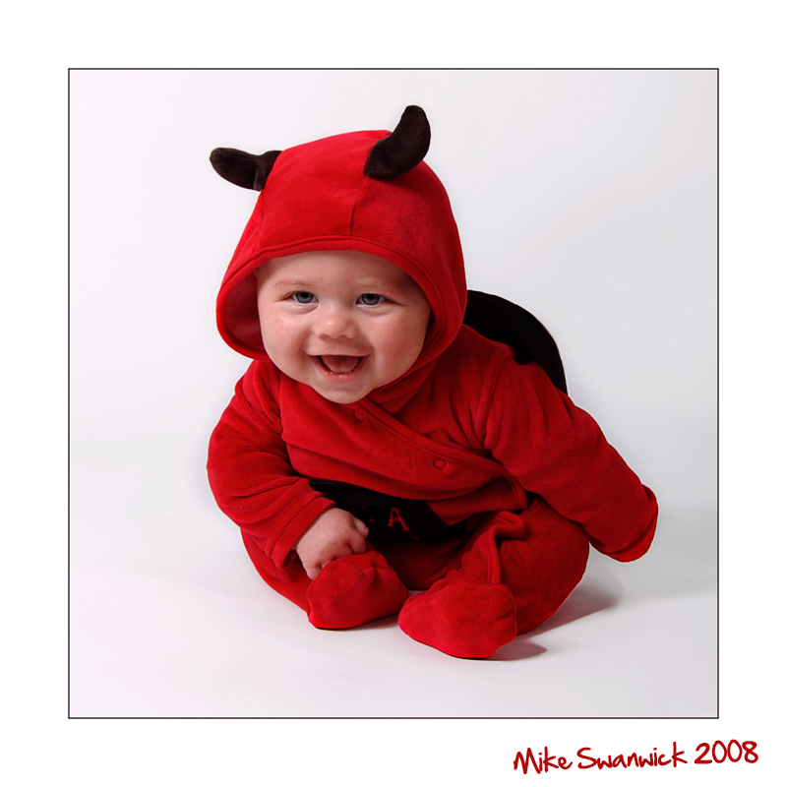
Other Results
Iterative model: Adversary picks nodes instead of synchronous rounds:
1 Step = 1 node change its opinion

Slide 45
Convergence Time: θ(n²)

Slide 46
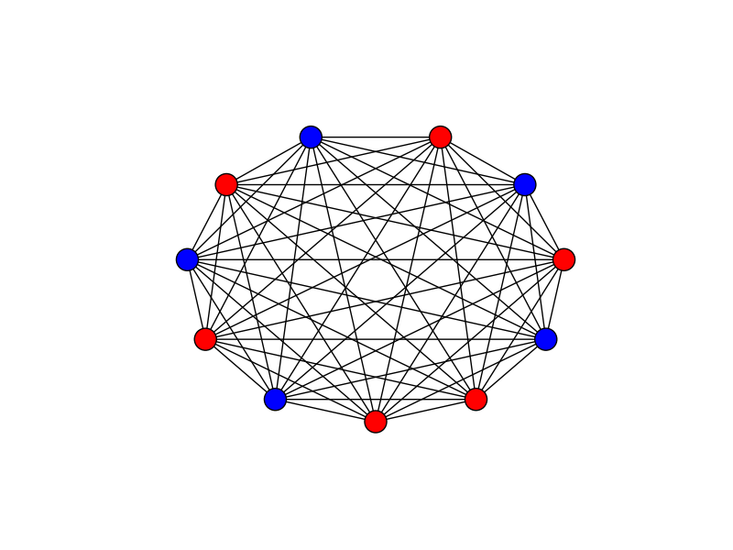
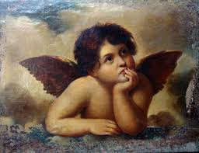
Iterative Model
Benevolent algorithm: θ(n)

Slide 47

תודה רבה

