Slide 1
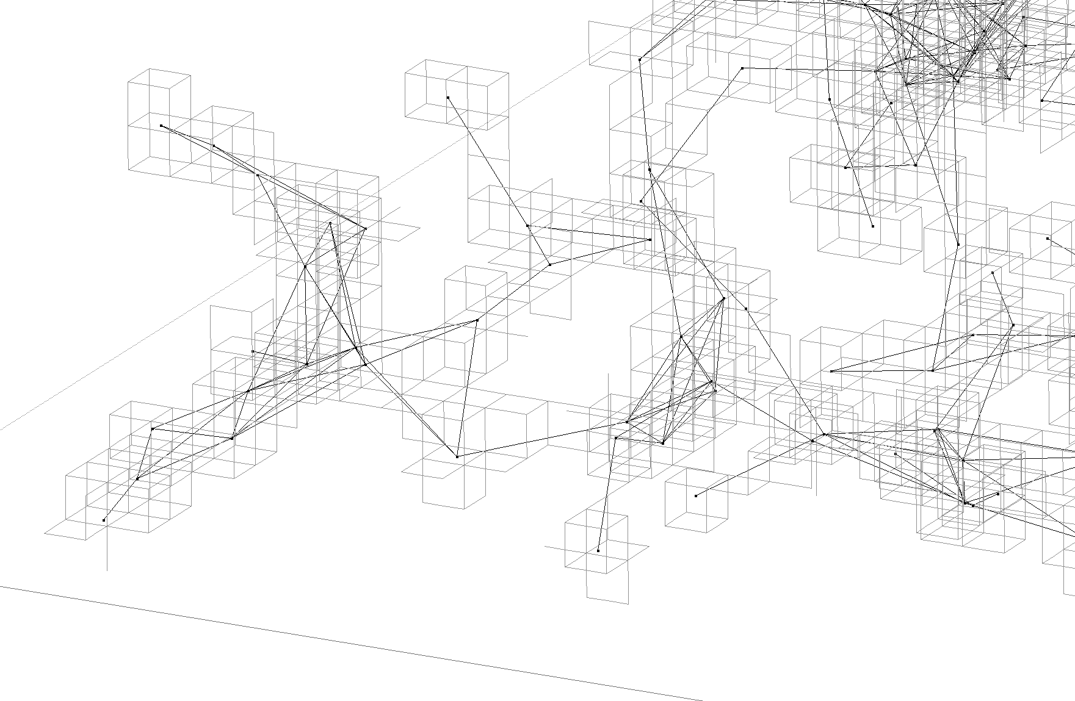
Randomized
3D Geographic Routing
Roland Flury
Roger Wattenhofer
Distributed
Computing Group

Slide 2
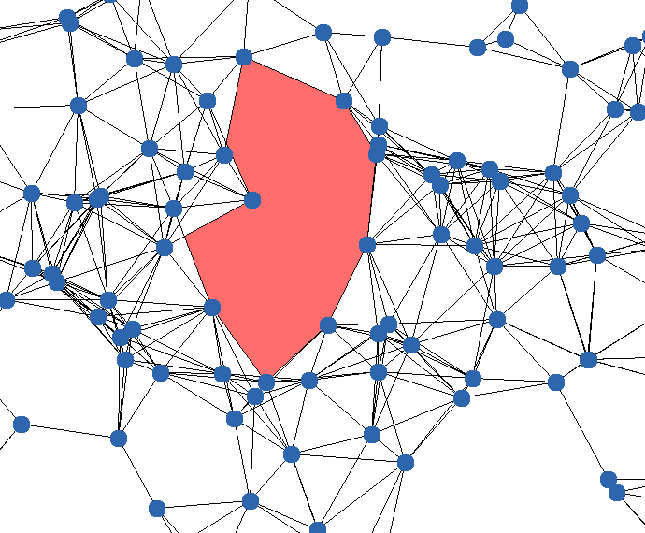
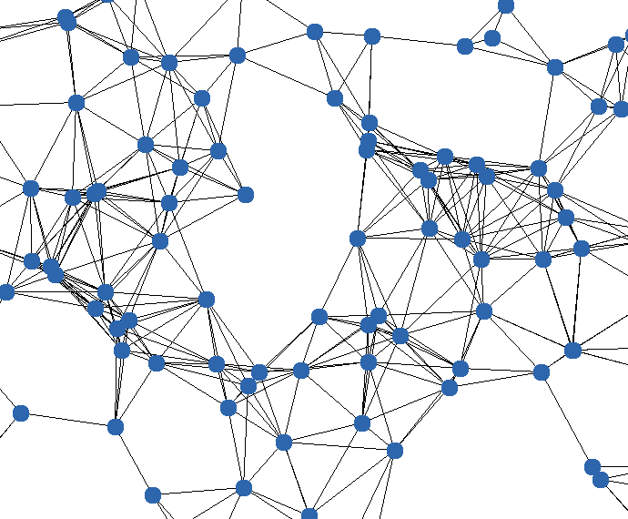
Geographic Routing in 2D
Nodes are aware of their position (coordinates)
Sender knows position of destination (how?)
  Location server, even for dynamic networks
Memoryless: Nodes store no info about transmitted messages
Highly desirable for dynamic networks

Slide 3
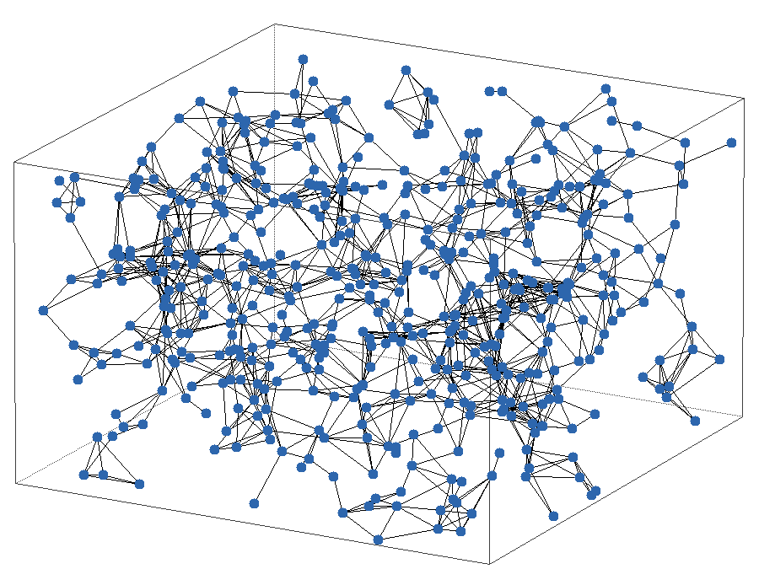
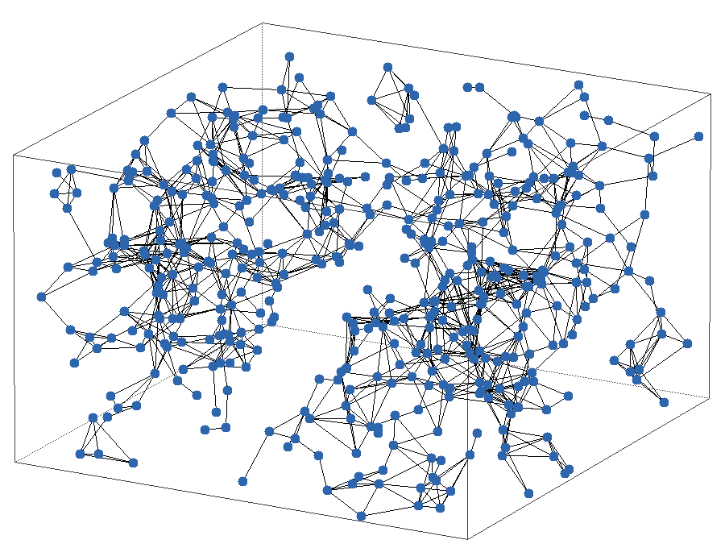
Geographic Routing in 3D
Is it really different?
Greedy routing is still possible
Local minima are now delimited by 2-dim surfaces (before: 1-dim line)
All we need to is to explore
2-dim surfaces…

Slide 4
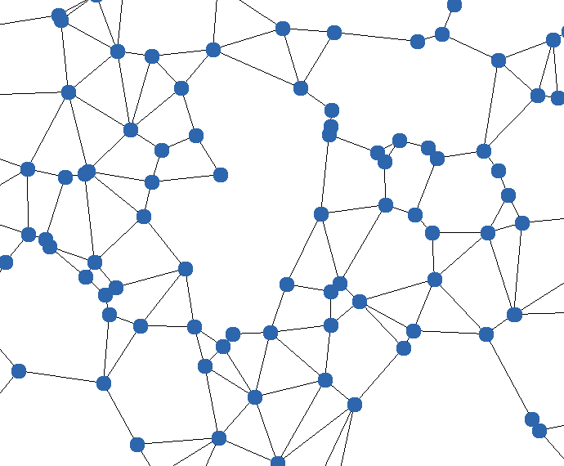
2D vs 3D
In 2D, we use a planar graph to capture the boundary of a routing void
In 3D, there is no standard way to do this…
We examine the simplistic UBG network model for 3D: Two nodes are connected iff their distance is below 1
Gabriel Graph

Slide 5
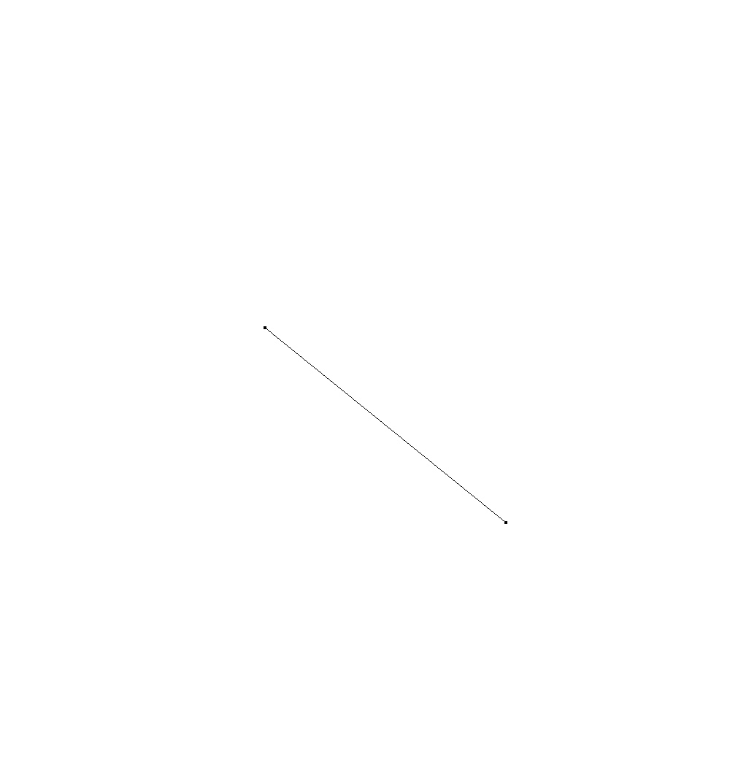
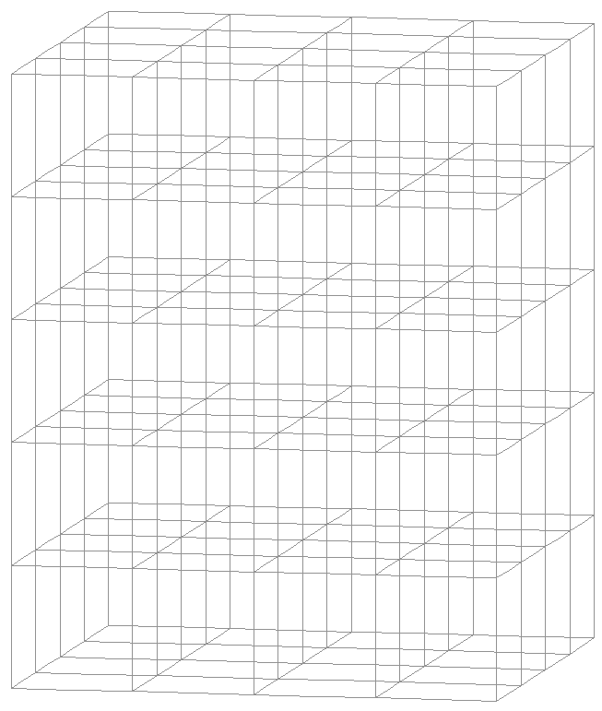
Surfaces in 3D
Regular, virtual 3D-grid
Side Length η = 0.258
We consider UBG, with a transmission range normalized to 1
η

Slide 6
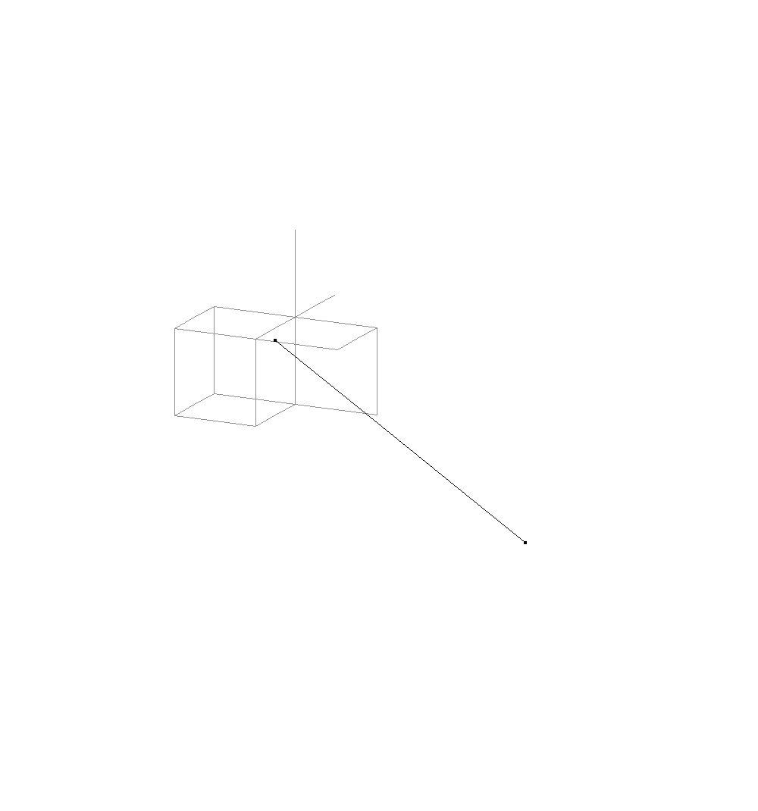
Surfaces in 3D
ρ
u
v
u
A node owns the grid nodes at most ρ away
ρ = 0.37
Virtual nodes are at the intersection point of 3D grid
v

Slide 7
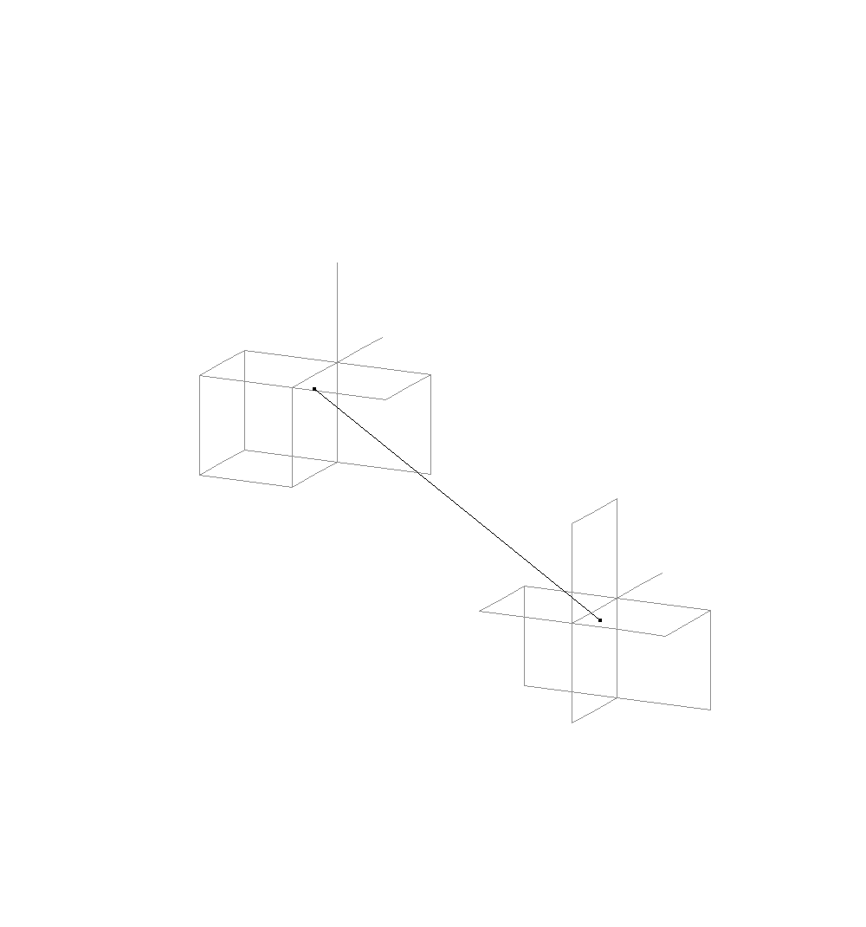
Surfaces in 3D
ρ
u
v
u
A node owns the grid nodes at most ρ away
ρ = 0.37
Virtual nodes are at the intersection point of 3D grid
v

Slide 8
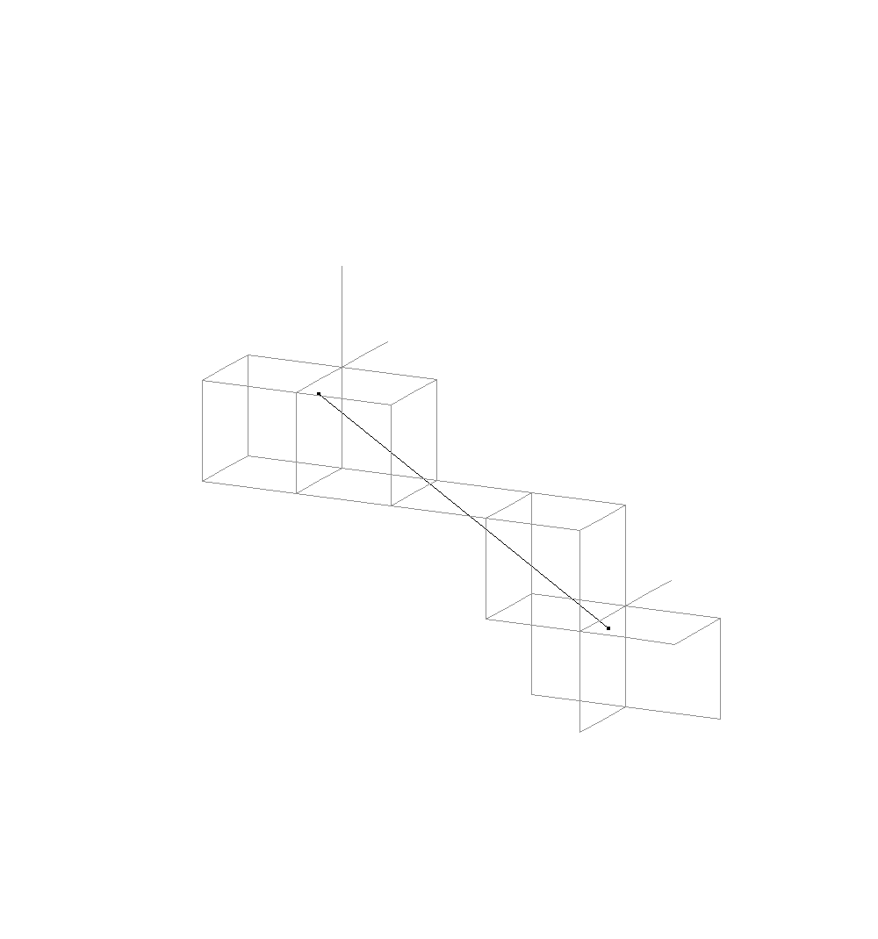
Surfaces in 3D
ρ
u
h
v
u
η
To ensure connectivity on the grid, add grid nodes in the cone
h = 0.223
ρ = 0.37
η = 0.258
v
h, ρ, η are chosen such that
Connectivity on the network
↨
Connectivity on the virtual grid

Slide 9
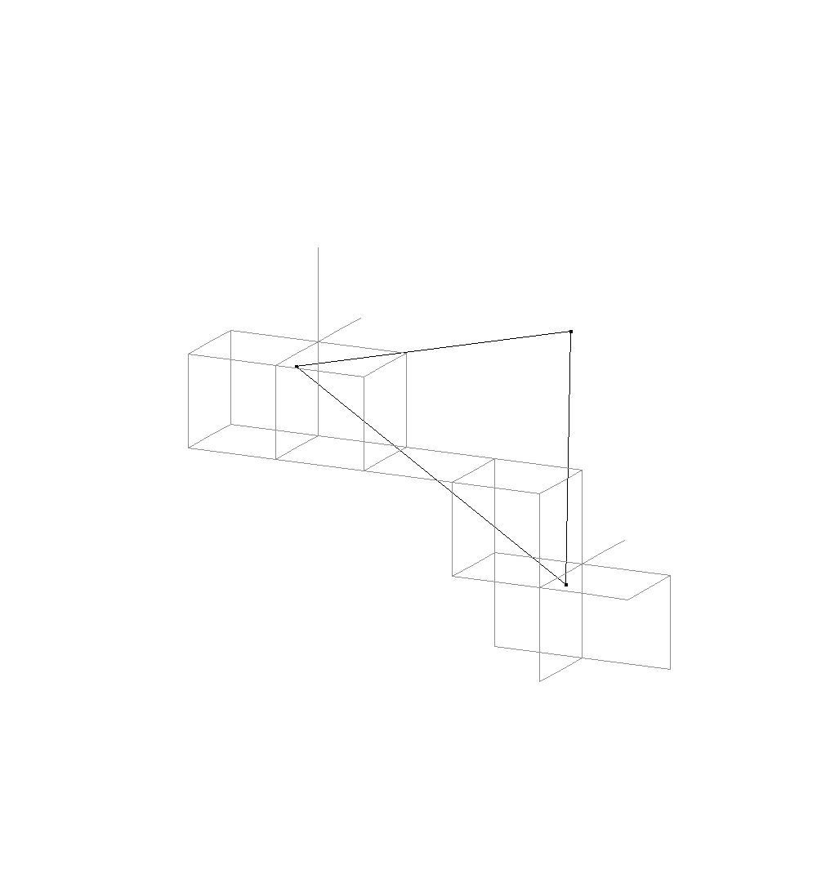
Surfaces in 3D
u
Adding further nodes…
v

Slide 10
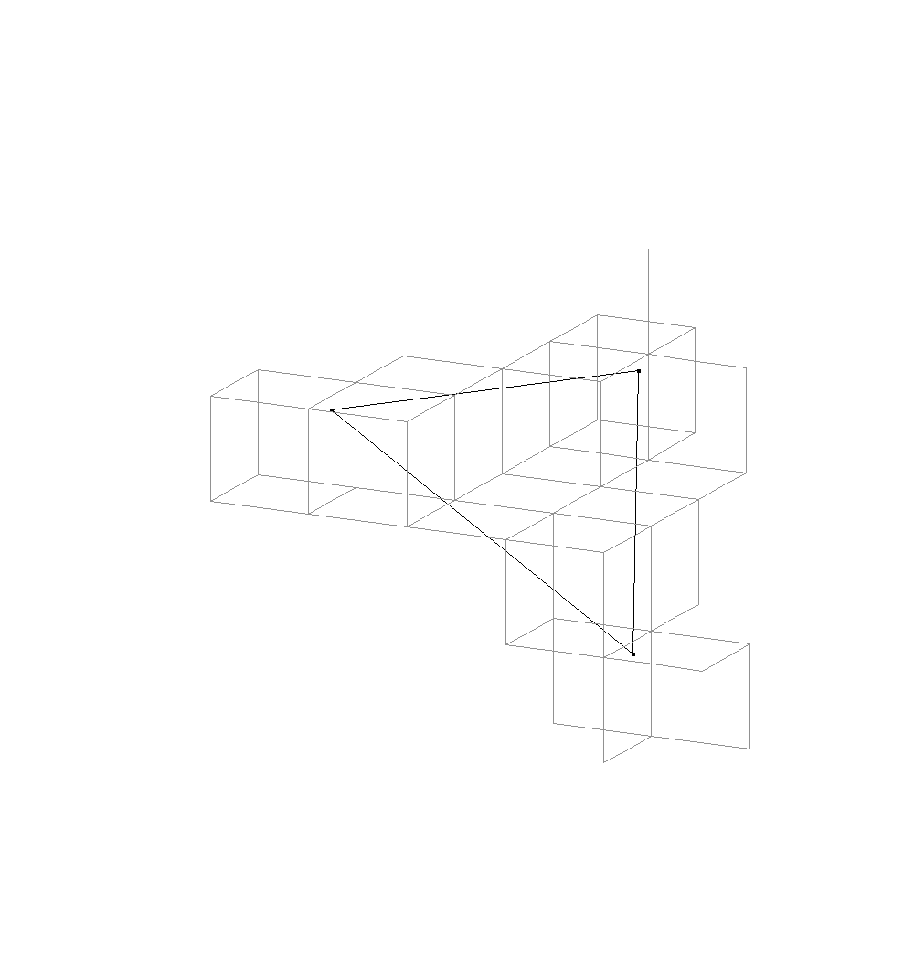
Surfaces in 3D
Adding further nodes…
Each virtual node belongs to
exactly one network node
The decision is strictly local (2 hops)

Slide 11
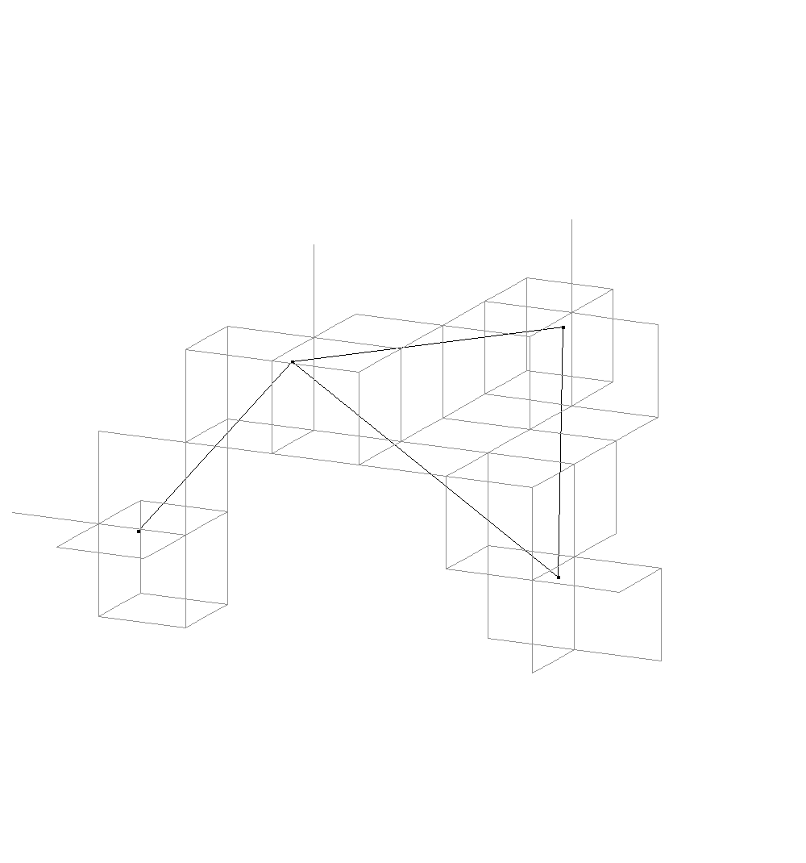
Surfaces in 3D
Adding further nodes…

Slide 12
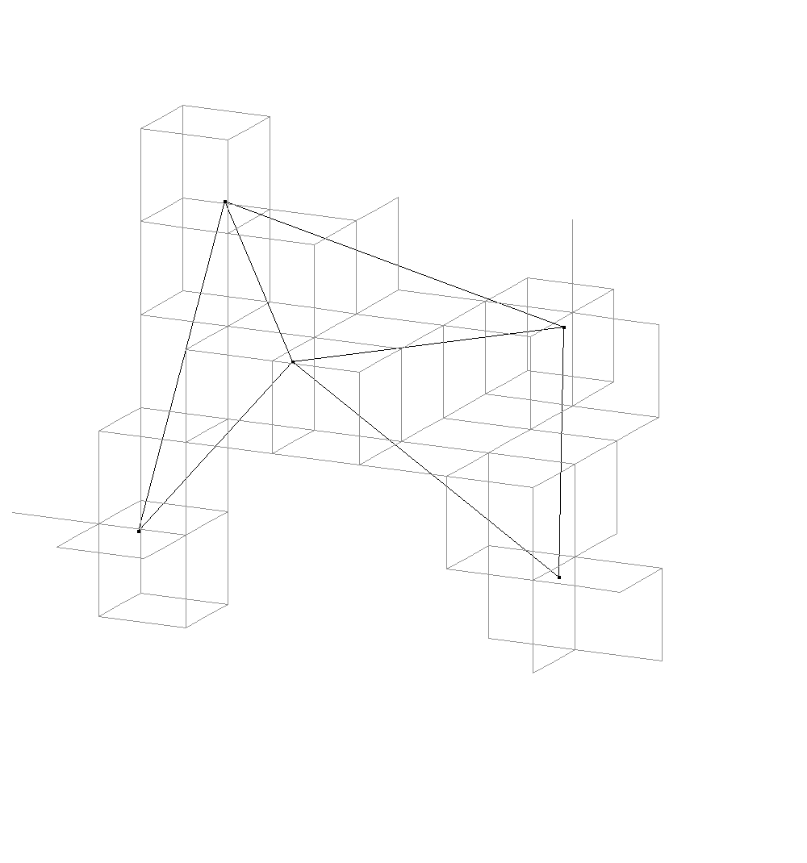
Surfaces in 3D
Adding further nodes…

Slide 13
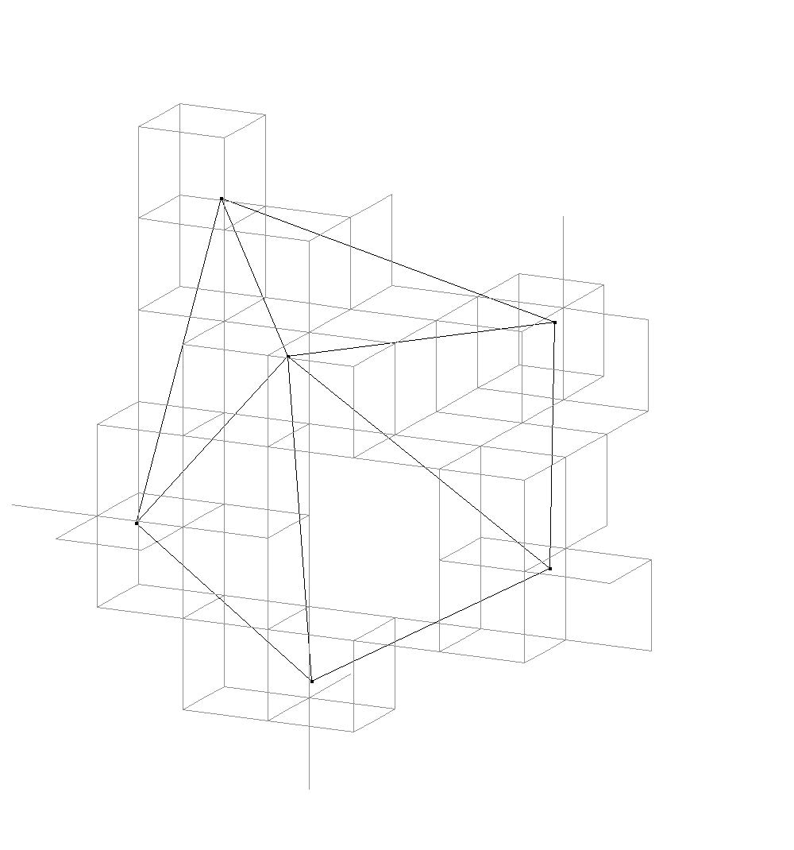
Surfaces in 3D
Adding further nodes…

Slide 14
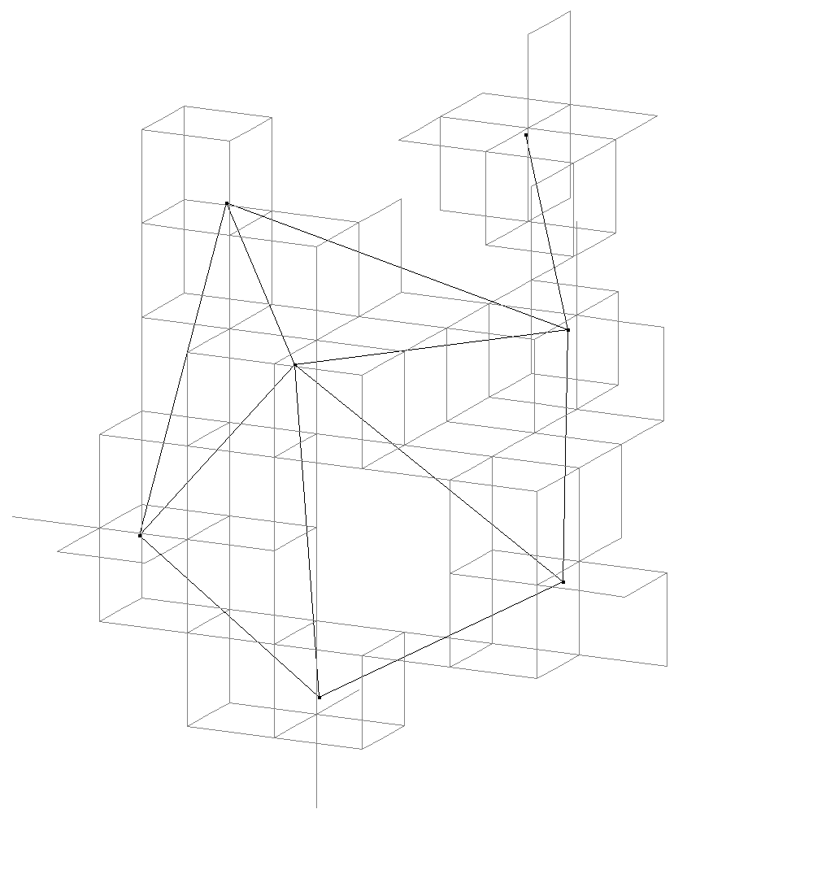
Surfaces in 3D
Adding further nodes…

Slide 15
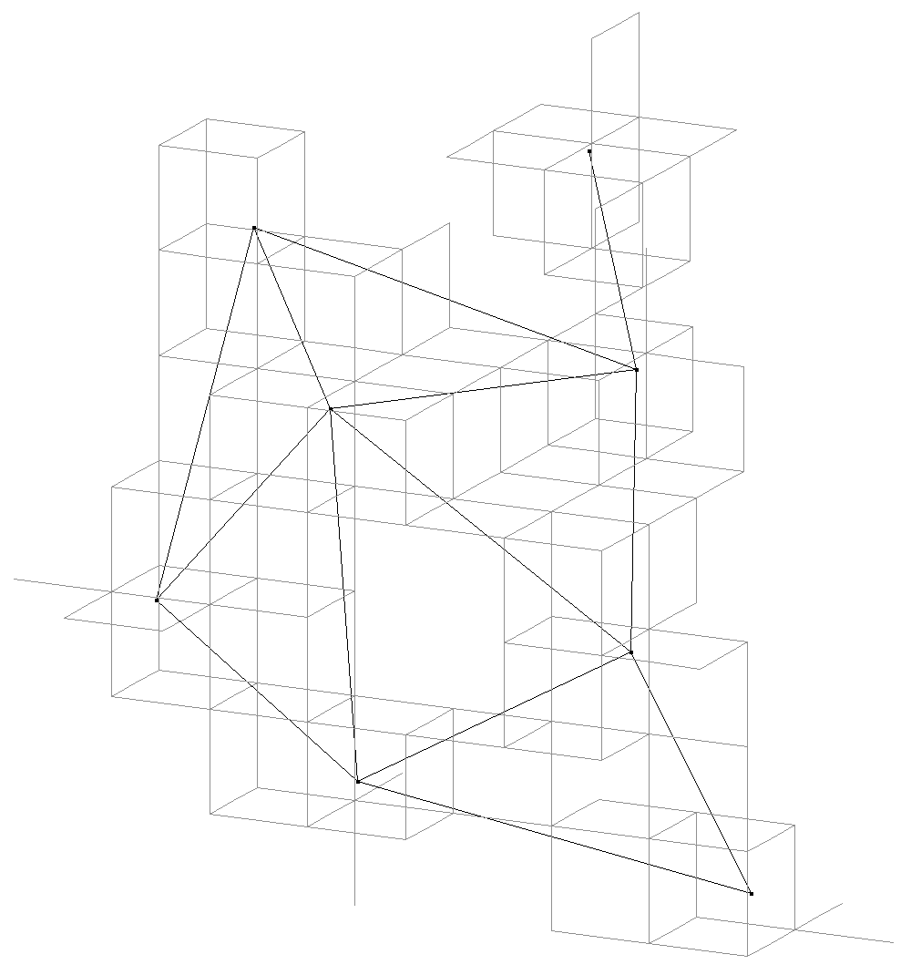
Surfaces in 3D
Adding further nodes…

Slide 16
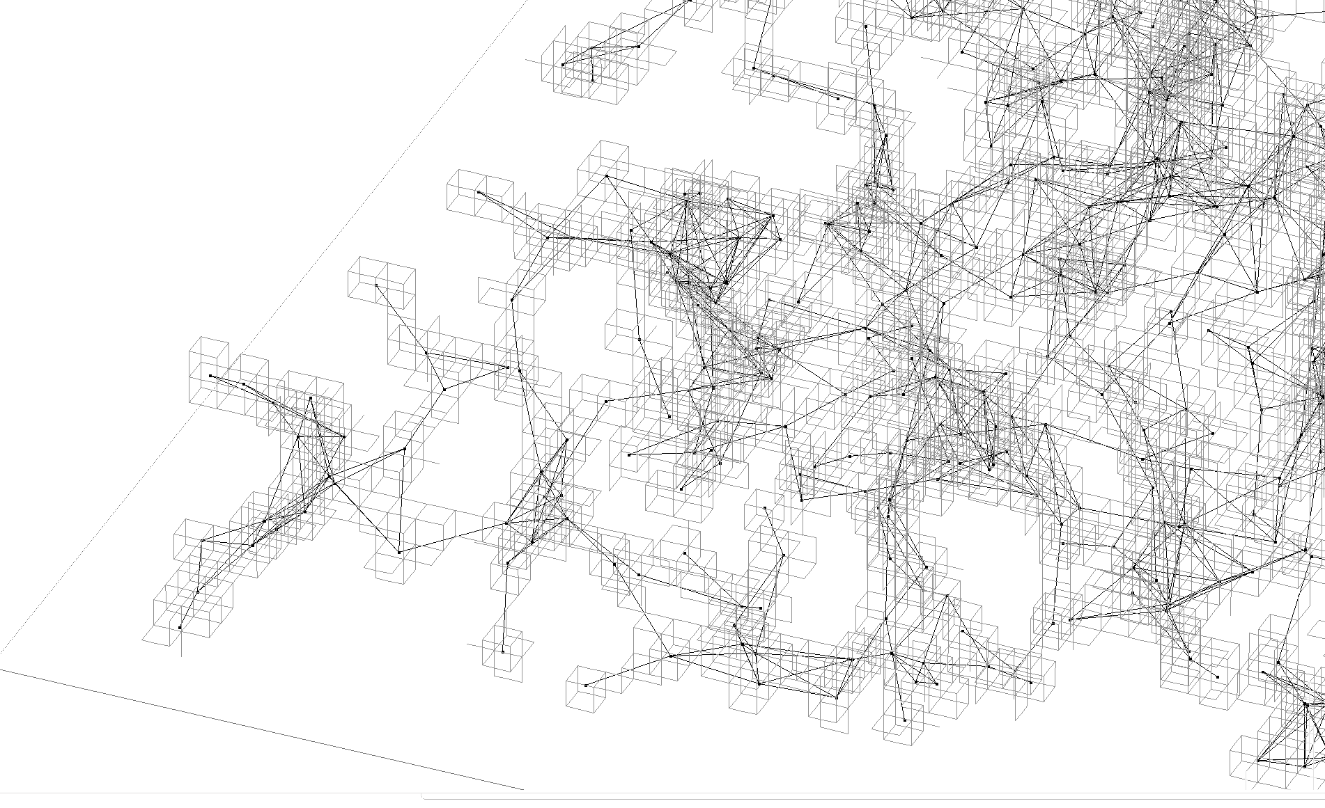
Surfaces in 3D

Slide 17
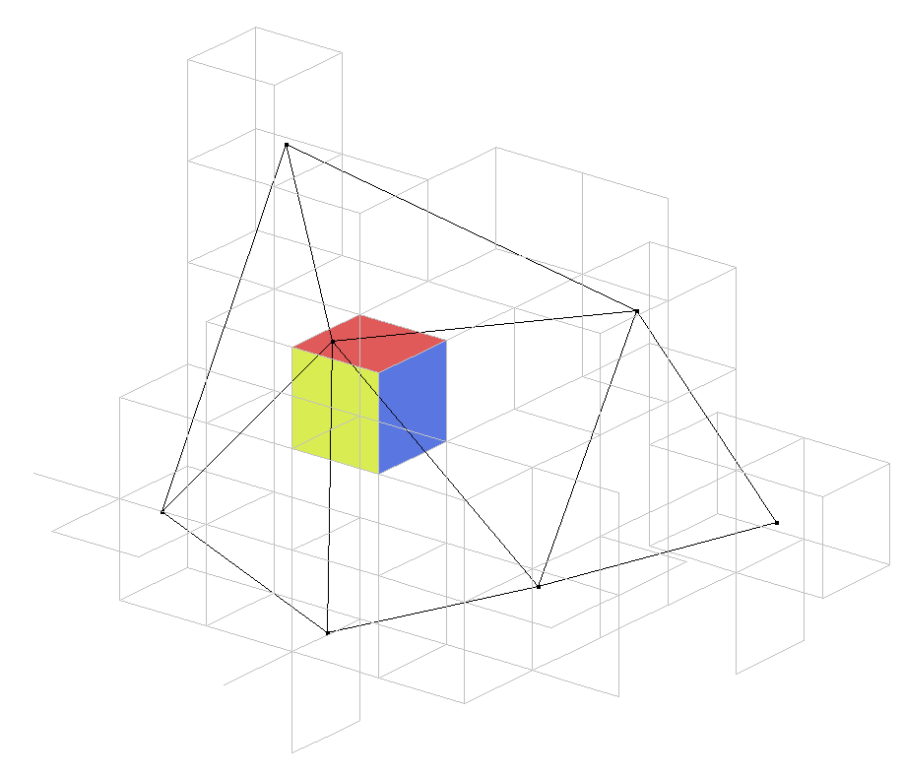
Local Capture of Surfaces in 3D
Missing virtual points define the surface
Local operation to determine surface

Slide 18
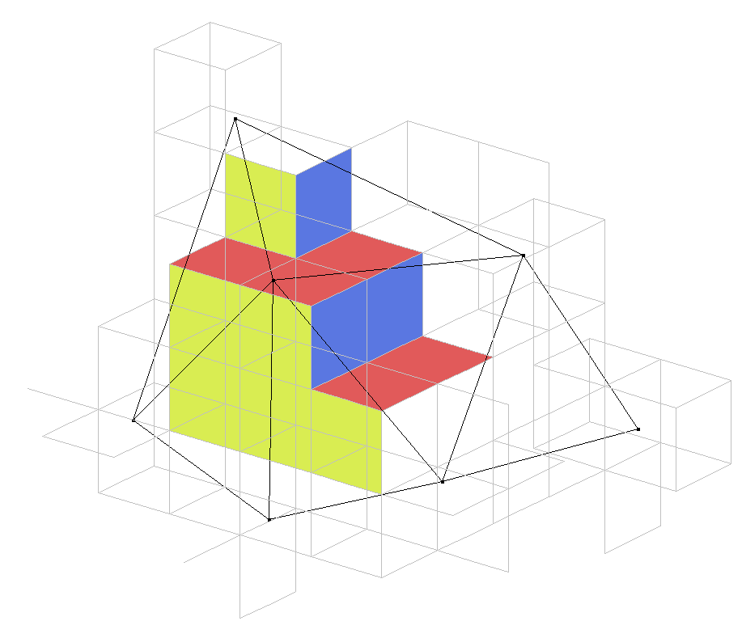
Local Capture of Surfaces in 3D
Missing virtual points define the surface
Local operation to determine surface

Slide 19
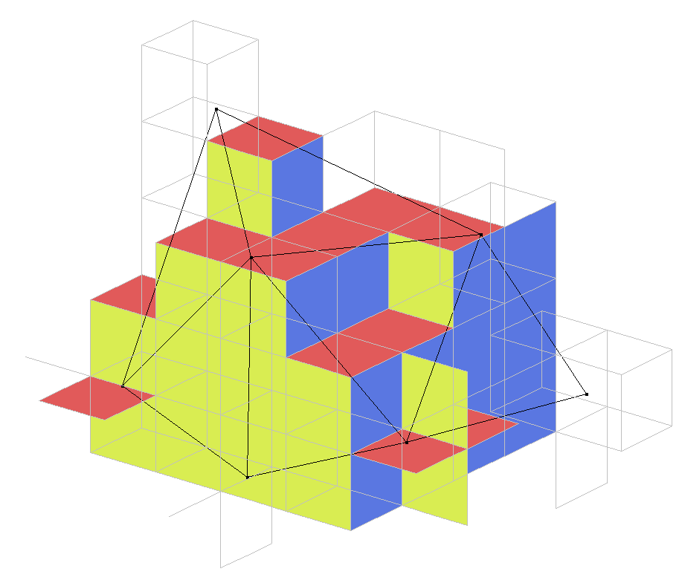
Local Capture of Surfaces in 3D
Missing virtual points define the surface
Local operation to determine surface
Connectivity on the network ↔ Connectivity on the virtual graph
Simulate routing on the virtual graph

Slide 20
GSG for 3D
The routing algorithm looks as following
  Greedy until local minimum is encountered
  Explore surface of local minimum
  Continue with Greedy
But how exactly do we explore the surface?
  Knowing the position of the current node, its neighbors and the destination
  Memoryless
  Only with local information
Right-hand rule from 2D cannot be applied anymore…

Slide 21
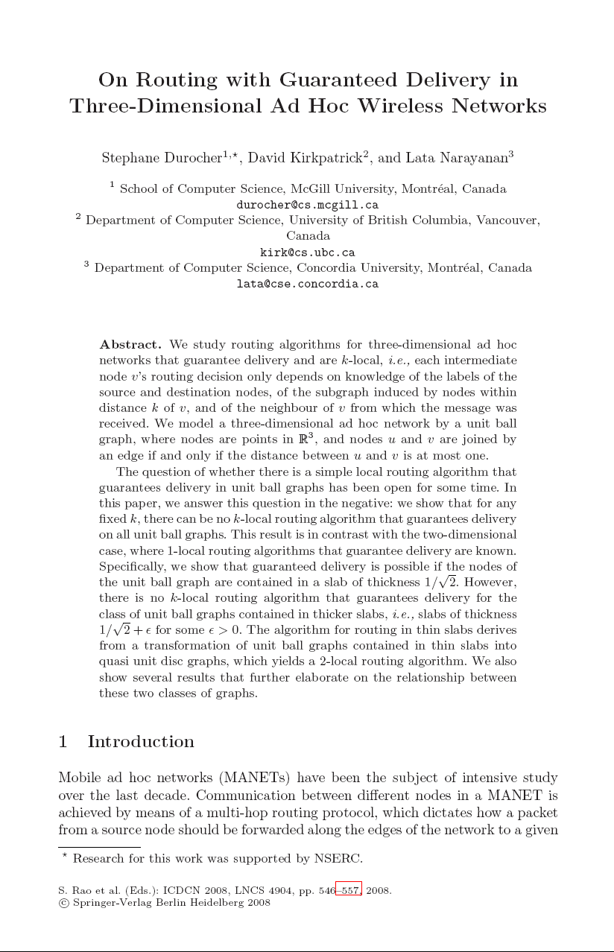
Deterministic Geographic Routing in 3D
Impossibility result by S. Durocher, D. Kirkpatrick and L. Narayanan
(ICDCN 2008, LNCS 4904/2008)
“There is no deterministic memoryless geographic
routing algorithm for 3D Networks.”

Slide 22

Deterministic Geographic Routing in 3D
“There is no deterministic memoryless geographic routing algorithm for 3D Networks.”
Proof by contradiction:
Any graph can be translated to a 3D UBG:
Assume k-local det. routing algo for UBG
1-local det. routing algo for UBG
1-local det. routing algo for arbitrary graphs
does not exist (derangements)
by S. Durocher, D. Kirkpatrick and L. Narayanan (ICDCN 2008, LNCS 4904/2008)
E
E
E

Slide 23
So what?
No deterministic algorithm to route in 3D
No deterministic exploration of the surfaces
How good can a local routing algorithm in 3D be at all?

Slide 24
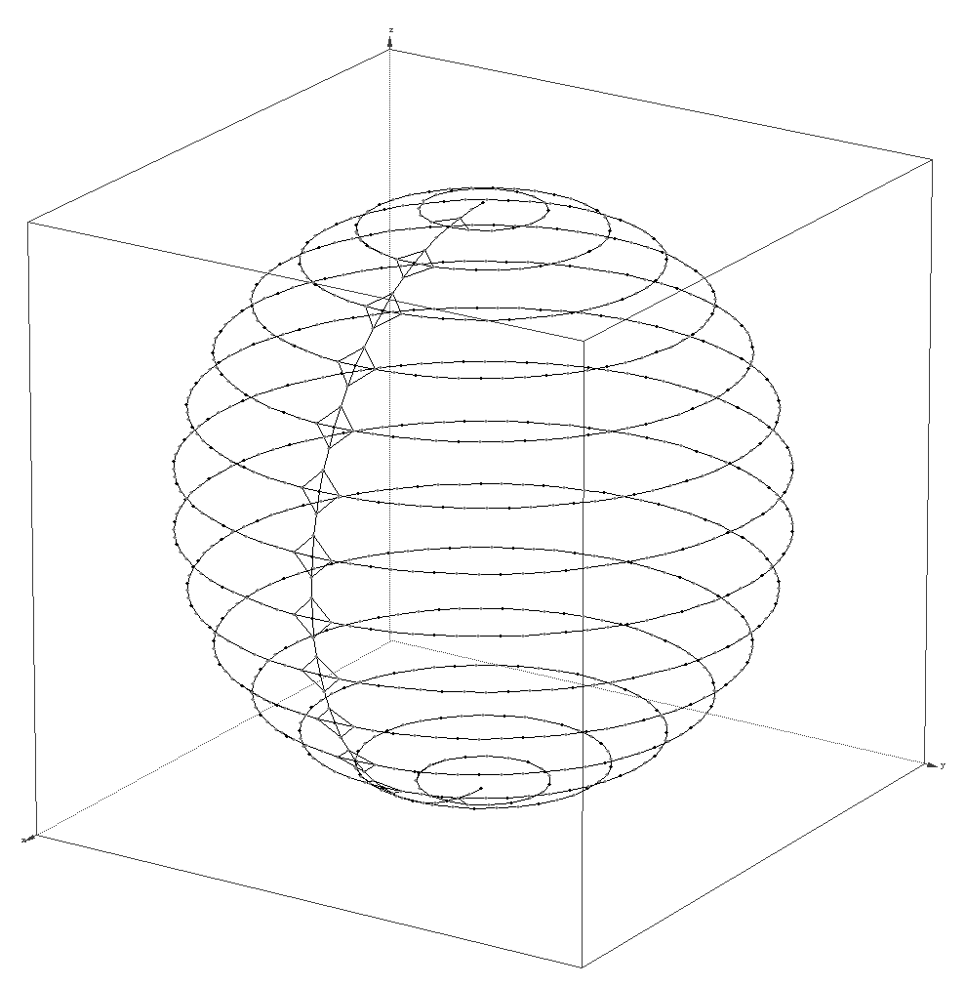
3D Georouting Lower Bound
Take a sphere of radius r
Add circular node chains on the surface
r

Slide 25
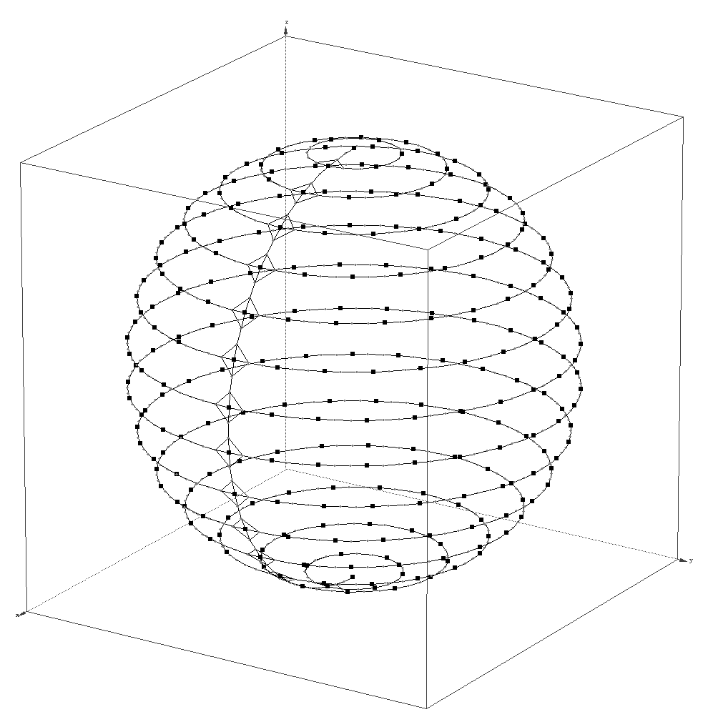
3D Georouting Lower Bound
Take a sphere of radius r
Add circular node chains on the surface
Select subset of the nodes s.t. no two nodes in the subset are connected

Slide 26
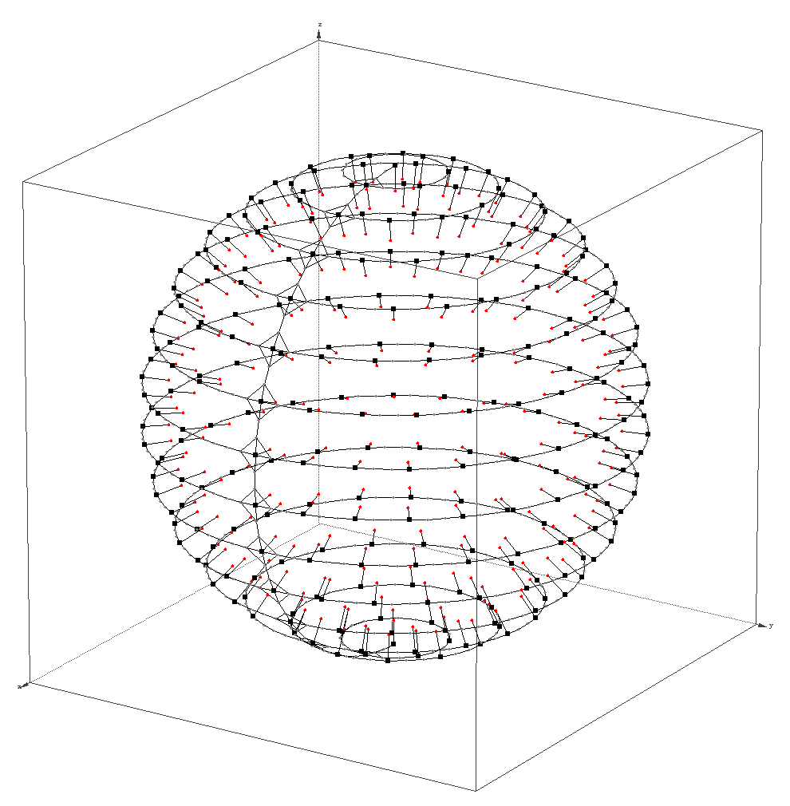
3D Georouting Lower Bound
Take a sphere of radius r
Add circular node chains on the surface
Select subset of the nodes s.t. no two nodes in the subset are connected
Grow strings of nodes towards the center…

Slide 27
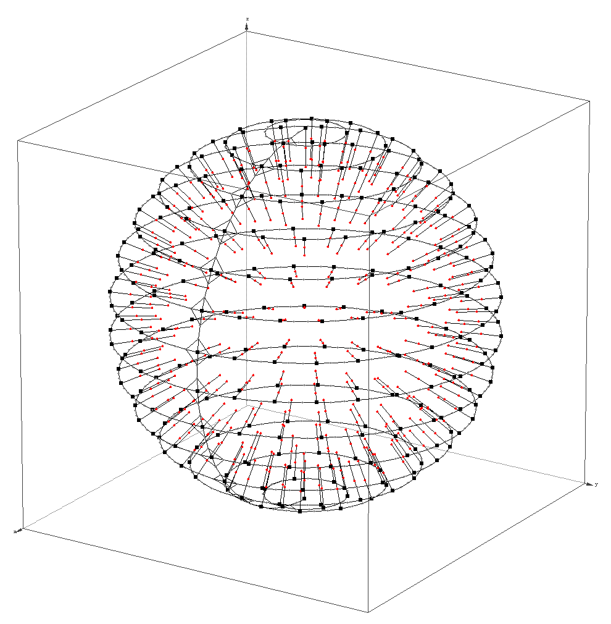
3D Georouting Lower Bound
Take a sphere of radius r
Add circular node chains on the surface
Select subset of the nodes s.t. no two nodes in the subset are connected
Grow strings of nodes towards the center…

Slide 28
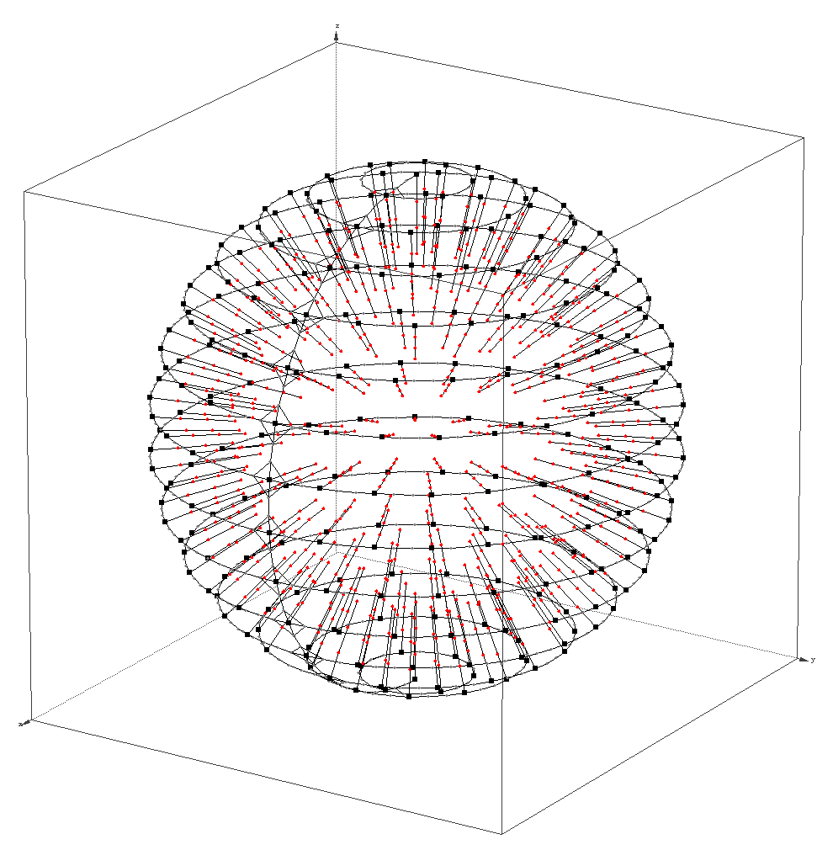
3D Georouting Lower Bound
Take a sphere of radius r
Add circular node chains on the surface
Select subset of the nodes s.t. no two nodes in the subset are connected
Grow strings of nodes towards the center…

Slide 29
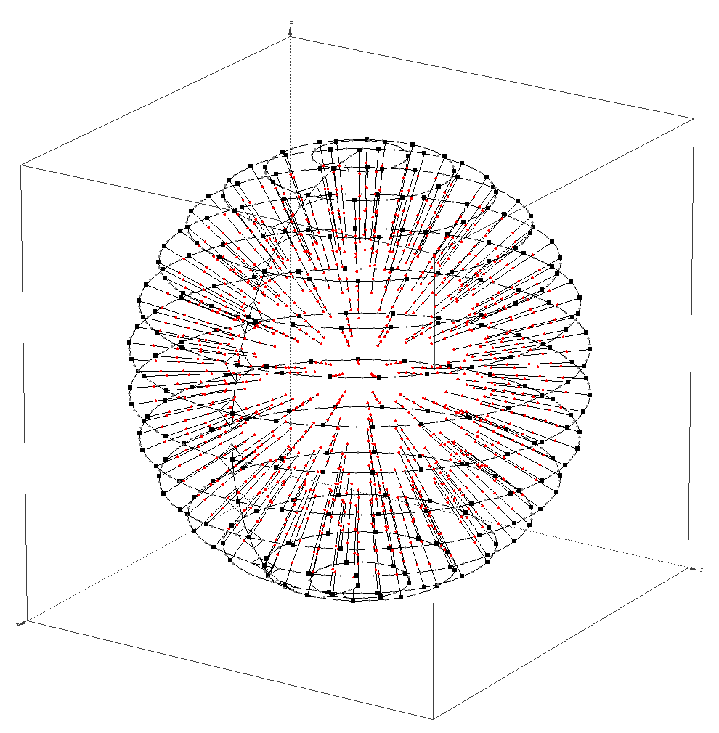
3D Georouting Lower Bound
Take a sphere of radius r
Add circular node chains on the surface
Select subset of the nodes s.t. no two nodes in the subset are connected
Grow strings of nodes towards the center…
…but only as long as they don’t contact

Slide 30

3D Georouting Lower Bound
Take a sphere of radius r
Add circular node chains on the surface
Select subset of the nodes s.t. no two nodes in the subset are connected
Grow strings of nodes towards the center…
…but only as long as they don’t contact
Connect one surface node to center

Slide 31
3D Georouting Lower Bound
The optimal route from the surface to the center is at most O(r) hops
A local routing algo does not know the entry point and must to guess
In average, it tries O(r²) entry points, visiting O(r) nodes on each string, resulting in O(r³) hops.
Any local routing algorithm for 3D has a cubic worst case stretch.

Slide 32
Randomized Surface Exploration
No deterministic geographic routing → randomization
GRG: Greedy – Random – Greedy
  Good performance in smooth networks when greedy succeeds
  Randomized recovery from local minima
Random walk to escape local minima

Slide 33
Randomized Surface Exploration
Expected search time in a general graph is O( |V| · |E| ) = O( |V|³ )
On a sparse graph, |E| = O( |V| ), reducing the search time to O( |V|² )
No deterministic geographic routing → randomization
GRG: Greedy – Random – Greedy
  Good performance in smooth networks when greedy succeeds
  Randomized recovery from local minima
Random walk to escape local minima
  Walk on sparse sub-graph, e.g. virtual graph

Slide 34
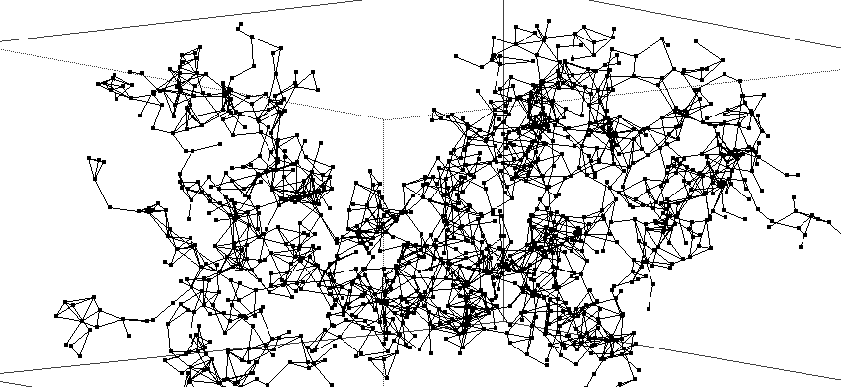
Randomized Surface Exploration
No need to explore entire network!
Use exponentially growing search areas
No deterministic geographic routing → randomization
GRG: Greedy – Random – Greedy
  Good performance in smooth networks when greedy succeeds
  Randomized recovery from local minima
Random walk to escape local minima
  Walk on sparse sub-graph, e.g. virtual graph
  Walk limited to area around local minimum

Slide 35
Randomized Surface Exploration
Walk on the surface of the network hole
No need to visit other nodes
No deterministic geographic routing → randomization
GRG: Greedy – Random – Greedy
  Good performance in smooth networks when greedy succeeds
  Randomized recovery from local minima
Random walk to escape local minima
  Walk on sparse sub-graph, e.g. virtual graph
  Walk limited to area around local minimum
  Walk on surface of the network hole

Slide 36
Randomized Surface Exploration
No deterministic geographic routing → randomization
GRG: Greedy – Random – Greedy
  Good performance in smooth networks when greedy succeeds
  Randomized recovery from local minima
Random walk to escape local minima
  Walk on sparse sub-graph, e.g. virtual graph
  Walk limited to area around local minimum
  Walk on surface of the network hole
If the optimal distance of the route is d, we need up to O(d⁶) hops…
… compared to a cubic worst case stretch…
… still many open questions

Slide 37
Simulation
GRG: Greedy – Random – Greedy geographic routing
Recovery algorithms:
  Bounded random walk on the graph
  Bounded random walk on the (sparse) virtual graph
  Bounded random walk on the surface
  Comparing to
  Bounded Flooding (not memoryless)
Simulation on quite large network (diameter around 40 hops)
Different densities of network
Ensured holes in the network: 200 randomly rotated cubic holes

Slide 38
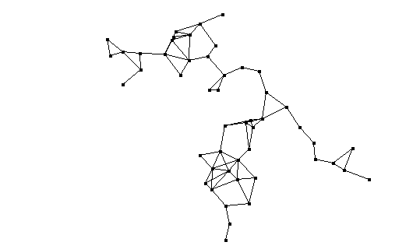
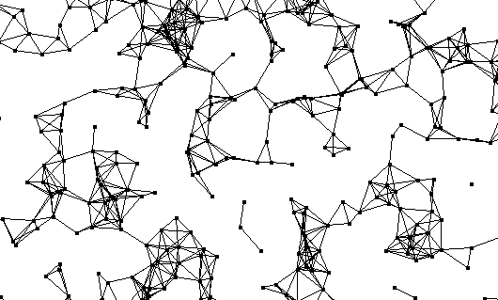
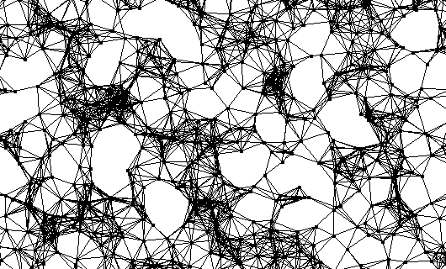
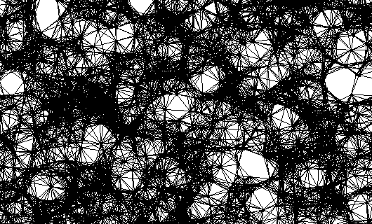
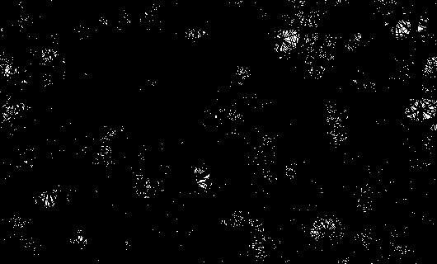
Simulation
Number of hops for flooding
(not memoryless)

Slide 39
Simulation
Number of hops for flooding
(not memoryless)

Slide 40
Simulation
Sparse
Number of hops for flooding
(not memoryless)

Slide 41
Simulation
Sparse
Conclusion
Geographic routing in 3D still not really satisfactory
Random walk on surface is not worth the overhead
Number of hops for flooding
(not memoryless)

Slide 42
Thank you!
Questions / Comments?
Roland Flury
Roger Wattenhofer
PS: simulation & images by sinalgo
http://sourceforge.net/projects/sinalgo

Slide 43
BACKUP SLIDES

Slide 44
Simulation

Slide 45
BACKUP

Slide 46
Deterministic Routing in 3-Dimensional Networks
We will prove that
There is no deterministic k-local routing algorithm for 3D UDGs
Deterministic: Whenever a node n receives a message from node m, n determines the next hop as a function of (n,m,s,t,N(n)), where s and t are the sender and the target nodes and N(n) the neighborhood of n
k-local: A node only knows its k-hop neighborhood
Proof Outline:
We show that an arbitrary graph G can be translated to a 3D UDG G’
Assume for contradiction that there is a k-local algorithm A_{k} for 3D UDGs,
We show that there must also be a 1-local algorithm A₁ for 3D UDGs
The translation from G to G’ is strictly local, therefore, we could simulate A₁ on G and obtain a 1-local routing for arbitrary graphs
We show that there is no such algorithm, disproving the existence of A_{k}.

Slide 47

Transforming a general graph to a 3D UDG (1/2)
Main idea: Build the 3D UDG similar to an electronic circuit on three layers, and add chains of virtual nodes (the conductors)
1
3
4
2
1
4
3
2
1
1

Slide 48
Transforming a general graph to a 3D UDG (2/2)
1
3
4
2
4
3
2
1

Slide 49
1-local Routing for 3D UDGs
Assume that there is a k-local routing algorithm A_{k} for 3D UDG
Adapt the transformation s.t. the connecting lines contain at least 2k virtual nodes
As a result, A_{k} cannot see more than 1 hop of the original graph
The stretching of the paths introduces ‘dummy’ information of no use, but the algorithm A_{k} still has to work
Therefore, there must also be a 1-local algorithm A₁ for 3D UDG
≥2k
≥2k

Slide 50
1-local Routing for Arbitrary Graphs
The transformation to the 3D UDG G’ can be determined strictly locally from any graph G
The nodes of any graph G can simulate A₁ by simulating G’
Therefore, A₁ can be used to build a 1-local routing algorithm for arbitrary graphs
1
3
4
2
2
How node 2 sees the virtual graph G’

Slide 51
1-local Routing for Arbitrary Graphs is impossible (1/2)
A deterministic routing algorithm can be described as a function f(n,m,s,t,N(n)), which returns the next hop
n: current node, m: previous node, s: sender, t: target, N(n): neighborhood of n
Node n has no means to determine locally which of its neighbors has a connection to t → n must try all of them before returning to m
Even the position of t or s can’t help
The function f must be a cycle over the i+1 neighbors
If not, we miss some neighbors of n, which may connect to t
p | f_{n}(p)
m | 1
1 | 2
2 | 3
… | …
i | m
1
m
n
2
s
i
t

Slide 52
1-local Routing for Arbitrary Graphs is impossible (2/2)
Node 2 and 7 have to decide on one forwarding function
There are 4 combinations possible. For all of them, forwarding fails either in the left or the right network
Conclusion 1: 1-local routing algorithms do not exist
Conclusion 2: There is no k-local routing algorithm for 3D UDG
Conclusion 3: There is no k-local routing algorithm for 3D graphs
3
5
3
6
s
1
2
7
8
t
s
1
2
7
8
t
4
6
4
5
x | f₂(x)
1 | 3
3 | 4
4 | 1
x | f₂(x)
1 | 4
4 | 3
3 | 1
x | f₇(x)
5 | 8
8 | 6
6 | 5
x | f₇(x)
5 | 6
6 | 8
8 | 5
xor
xor

Slide 53
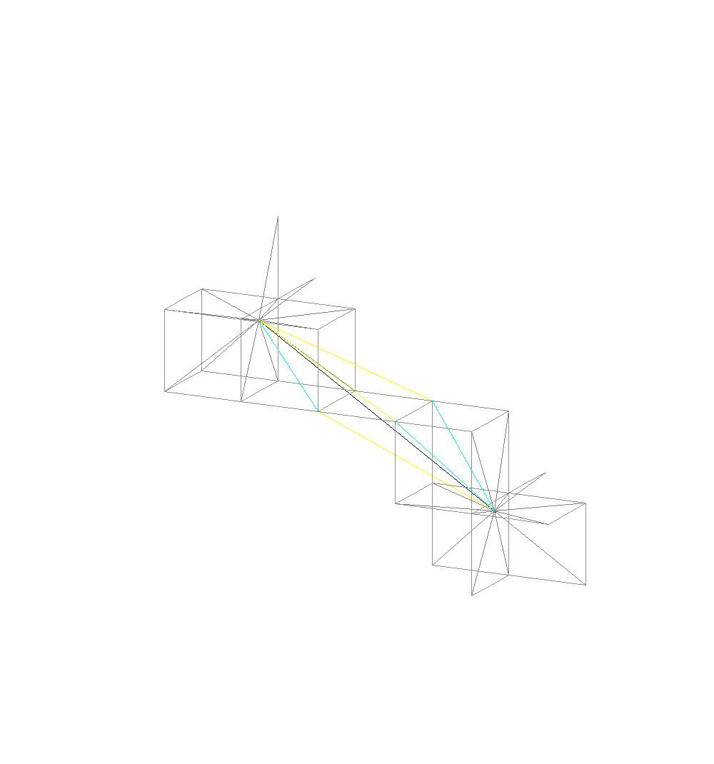
Surfaces in 3D
ρ
u
h
v
u
The virtual nodes are owned by exactly one network node
Arbitration by proximity, then node ID
v

