Slide 1
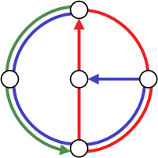
Selfishness in Transactional Memory
Game Theory meets Multicore Architecture
Raphael Eidenbenz,
Roger Wattenhofer
Distributed
Computing
Group
Notes:
Good morning, thanks for coming.
This talk is about non-cooperative behavior in p2p systems. The catchy title is…

Slide 2
Transactional Memory
Multicore Architecture
  Parallel concurrent threads
  Communication through shared memory
  Traditionally explicit locking of shared resources
    Hard task for software developers
[Herlihy et al. 1993]: Transactional Memory
  Wrap critical code into transactions
  The system then guarantees exclusive execution

Slide 3






Contention Management
When threads interfere, a contention manager (CM) resolves conflict
  Let one transaction continue
  Abort the others
But which transaction to abort?

Slide 4
Contention Managers
Timestamp
  Oldest transaction wins
Polite
  Exponential backoff
Karma
  Transaction with most locked resources wins
  Priority is carried over to next attempt when aborted
Polka
  Karma with exponential backoff
Randomized
  Pick a random winner
priority based
non-priority based

Slide 5
Good Programming Incentives
What code is beneficial for a TM system?
  Transactions as short as semantically possible
    No unnecessary locks
    Commit as early as possible
Assumptions
  Developers are selfish
  Competition among thread developers
Do TM systems offer good programming incentives (GPIs)?
  A CM is GPI compatible iff it rewards partitioning and punishes unnecessary locking
  Theorem: Polite, Greedy, Karma, Timestamp and Polka are not GPI compatible. Randomized is GPI compatible.

Slide 6
Simulation Setup
Implement „free-riding“ threads in DSTM2 using coarse transaction granularity
  ¸ 20 accesses per transaction
Let them compete against collaborative threads with granularity 1
Polite, Karma, Polka, Timestamp, Randomized
16 threads on 16 cores do random updates on shared ordered list or red-black tree during 10 s.
  Test runs with 1 or 8 free-riders
  High contention

Slide 7
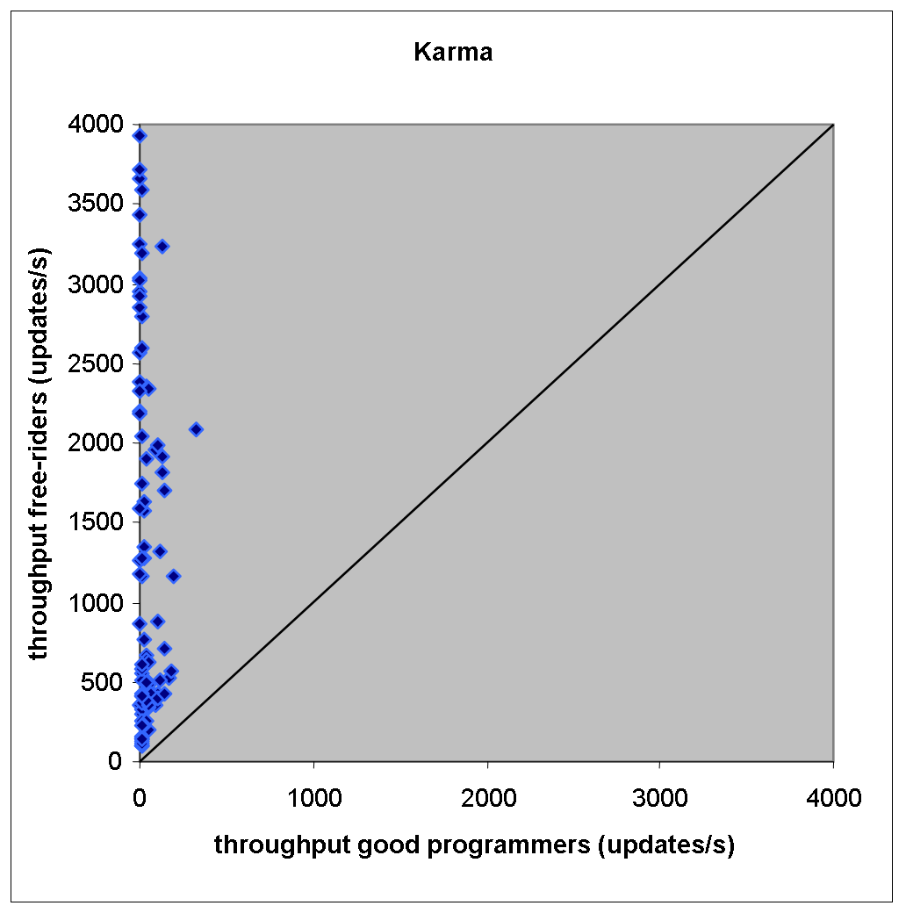
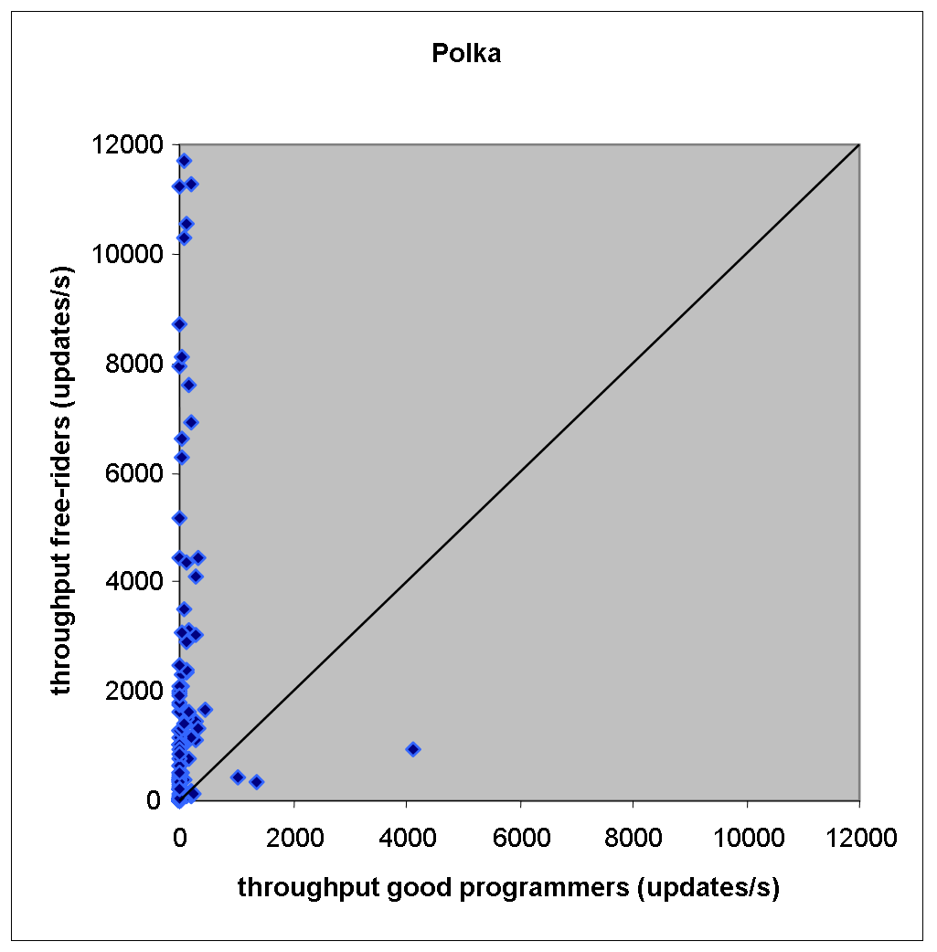
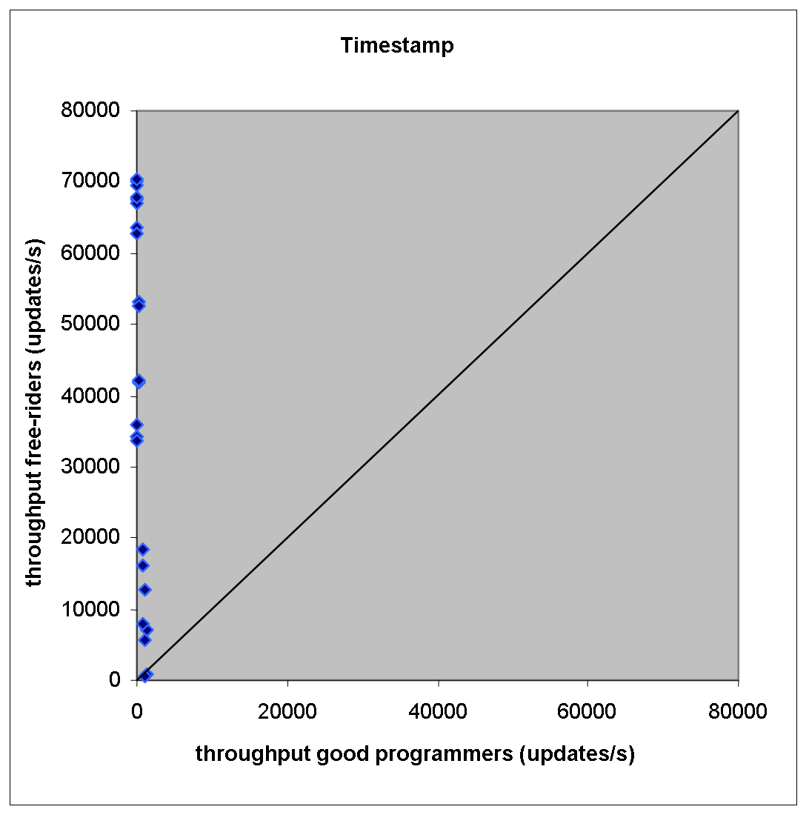
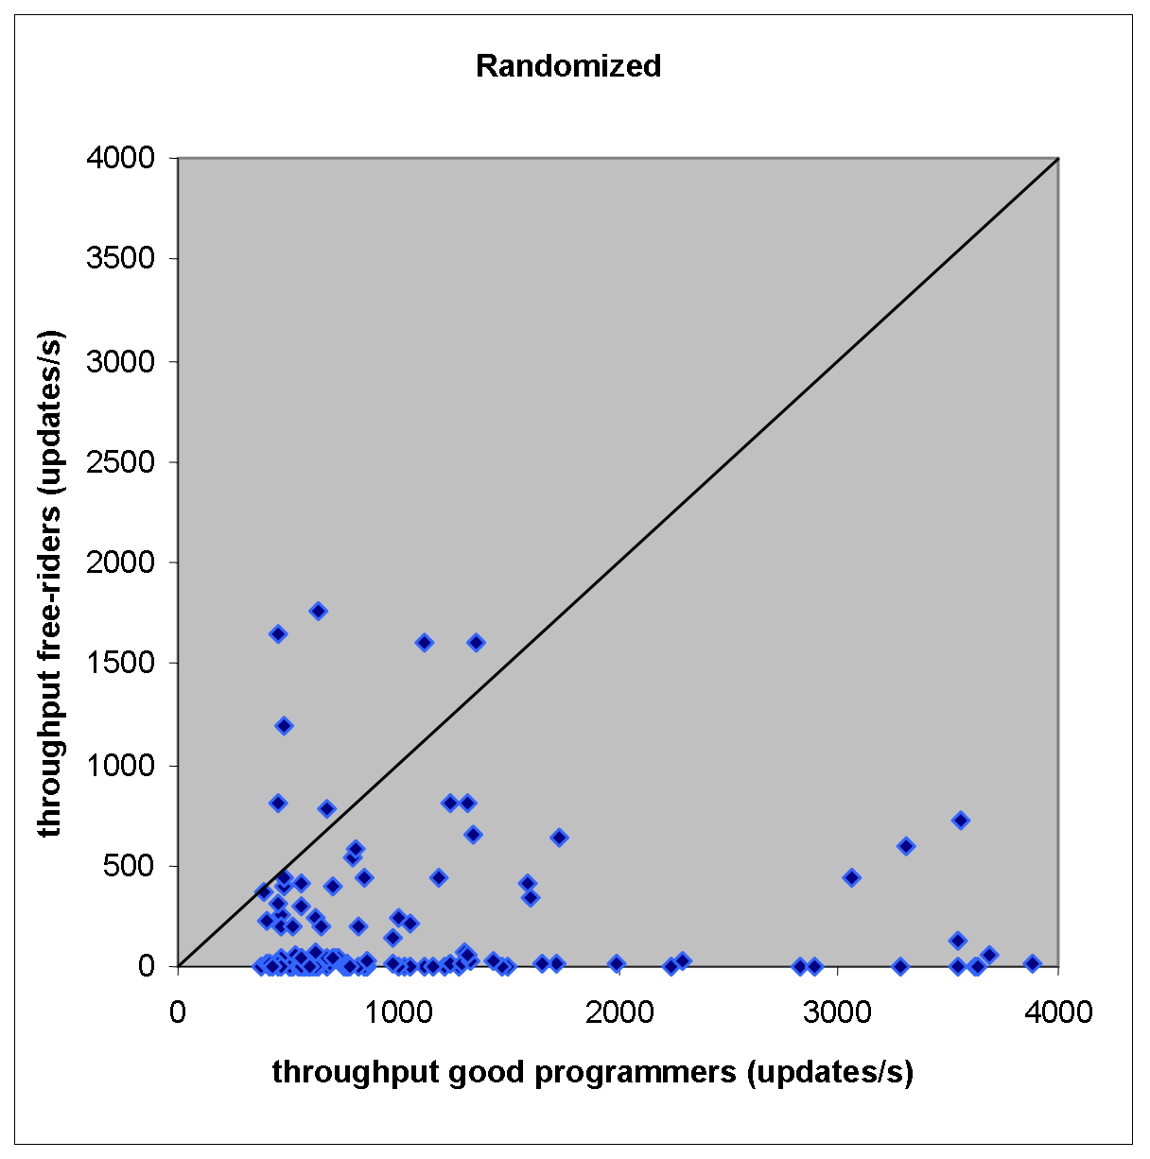
Simulation Results I

Slide 8
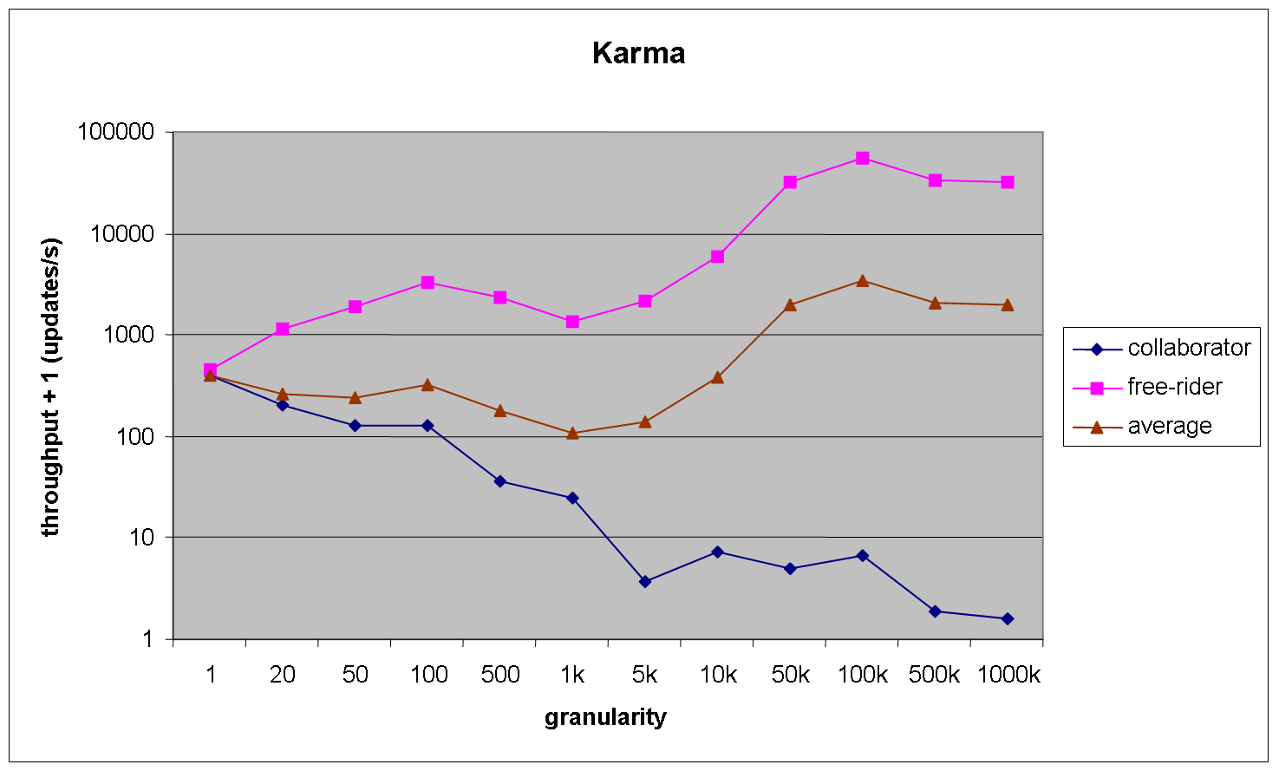
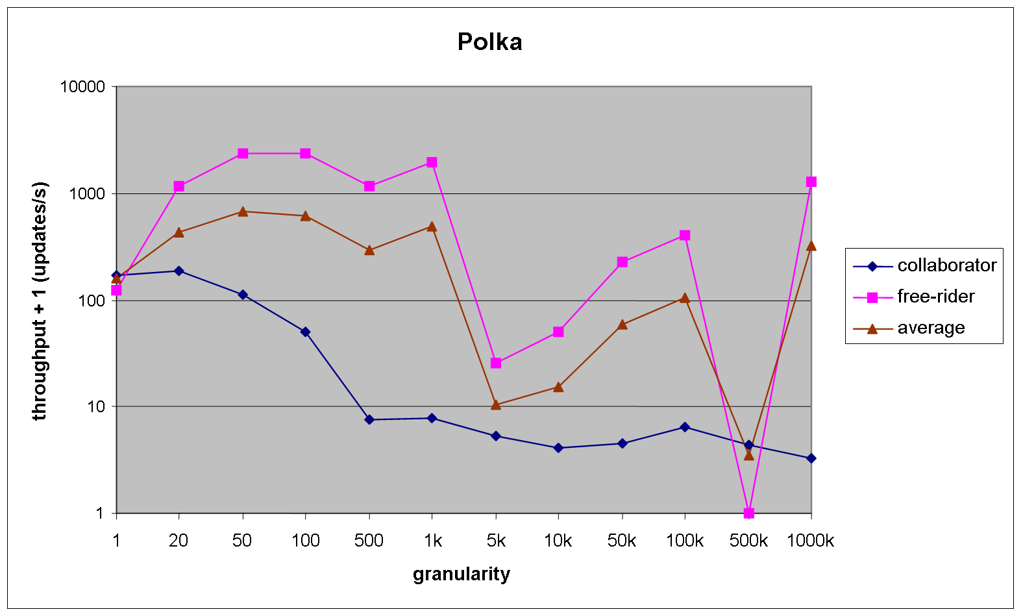
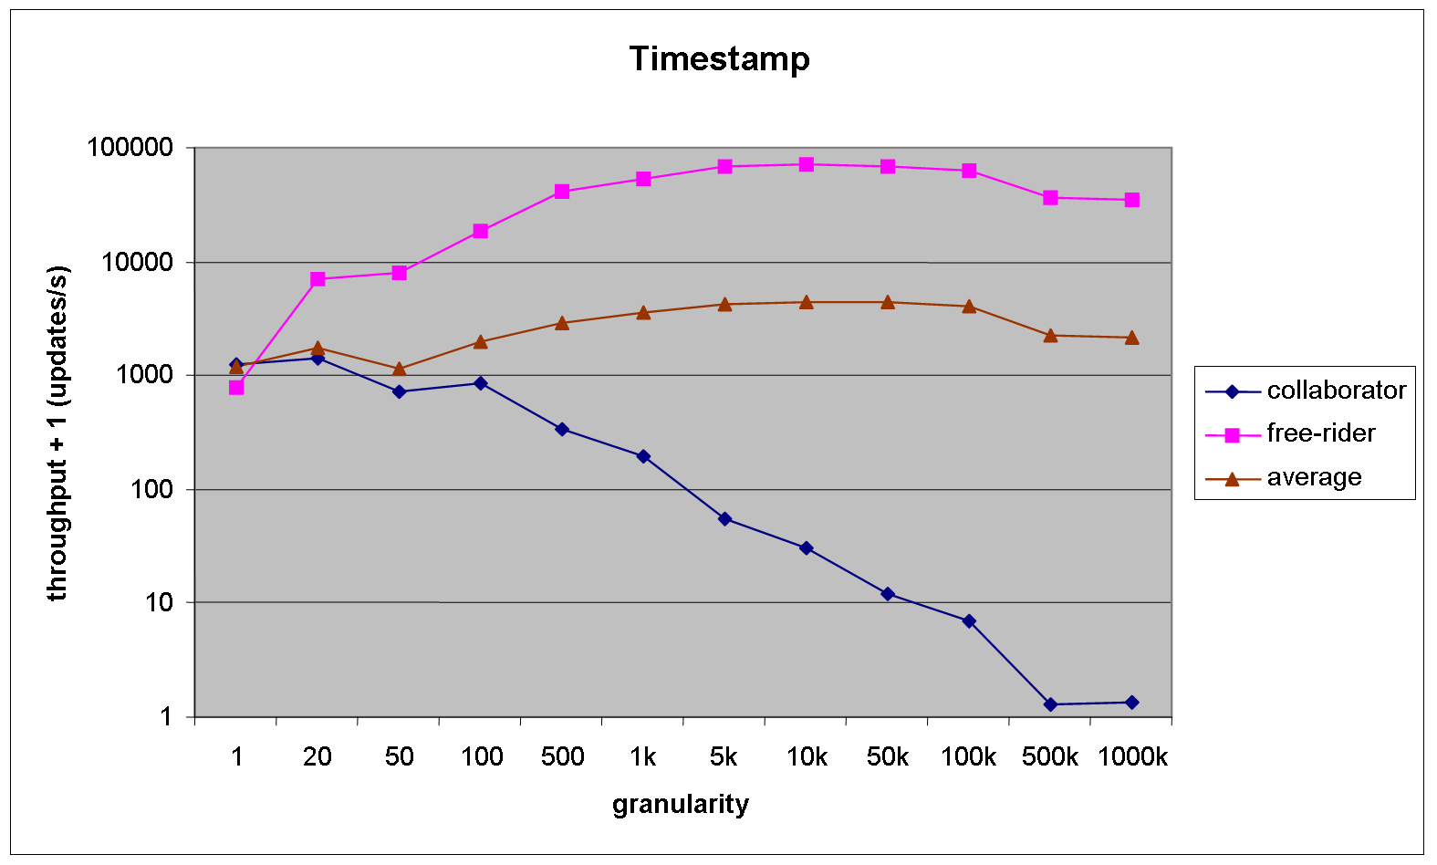
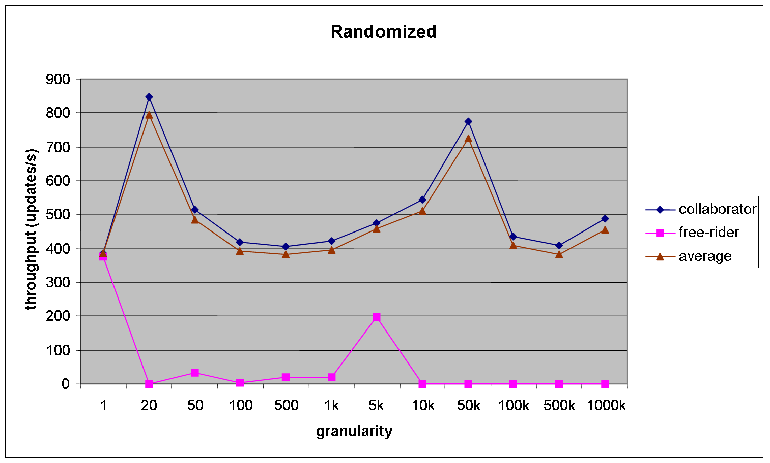
Simulation Results II

Slide 9
Conclusion
Current priority based CMs do not offer the right incentives to software developers
  Tuning one thread potentially slows down the system
Non-priority based CMs seem to be GPI compatible more naturally
Further work:
  Design GPI compatible CM
  Classification framework
  Relax GPI compatibility
  Trace effect in „real“ software
  Assess importance of incentive compatibility
Thank you!
Notes:
So in order to demonstrate how easy the BitTorrents fairness mechanism can be cheated we have implemented a BitTorrent client which does not upload anything at all and still achieves fast downloads.

