Slide 1
Maintaining Constructive Interference Using Well-Synchronized Sensor Nodes
Michael König
Roger Wattenhofer

Slide 2
Constructive Interference (CI)
+
=
+
=

Slide 3
Traditional Approaches to Transmission Synchronization
Use an external clock.
Don’t send complicated data.
  SlotOS [Flury et al., 2010]
  Black Burst Synchronization [Gotzhein et al., 2011]
Use triggering packets.
  Glossy [Ferrari et al., 2011]

Slide 4
CI for Broadcasting: Glossy

Slide 5
Traditional Approaches to Transmission Synchronization
Use an external clock.
Don’t send complicated data.
Use triggering packets.
Can we do it …
… without an external clock,
… with normal data packets,
… and without triggering packets?

Slide 6
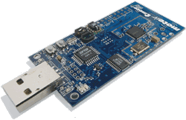


Our Work
General case CI
TelosB
Minimizing error sources:
  Clock synchronization
  Transmission timing
  Travel time
=
S_{A}
S_{B}
S
S_{A}
R
S_{B}

Slide 7
CI Timing Requirements (IEEE 802.15.4)
250,000 bit/s
4-bit symbols
32 chips/symbol, on I and Q phases in parallel
→ 1 µs per chip
1 chip
error

Slide 8
Error Sources
=
Clock synchronization e_{clock} = clock_{A} – clock_{B}
Transmission Timing e_{transmit} = delay_{B} – delay_{A}
Travel Time e_{travel} = traveltime_{B} – traveltime_{A}
Total Error e_{total} = e_{clock} + e_{transmit} + e_{travel}
Goal |e_{total}| << 0.5 µs
S
S
S
S
R
S

Slide 9
Travel Time (e_{travel})
S_{B}
S_{A}
R
30 meters = 0.1 µs travel time
Workaround: negligible for senders of similar distance
  |e_{travel}| < 0.033 µs
Recent work
  “Time-of-Flight Aware Time Synchronization” (TATS)
  [Lim et al., 2016]

Slide 10
Clock Synchronization (e_{clock})
=
S_{A}
S_{B}
MAC layer timestamping
Averaging out errors
Drift compensation
Combining clocks
Extended precision timestamps

Slide 11
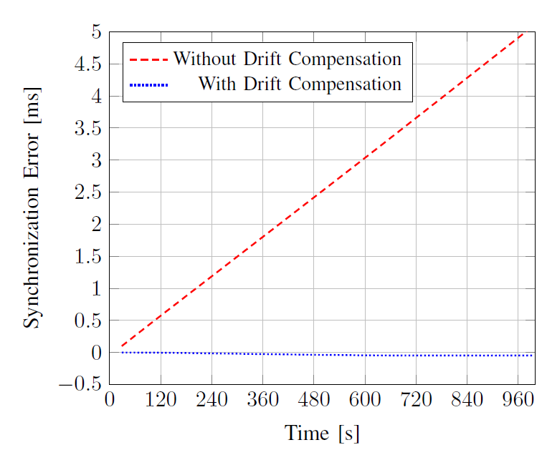
Drift Compensation

Slide 12
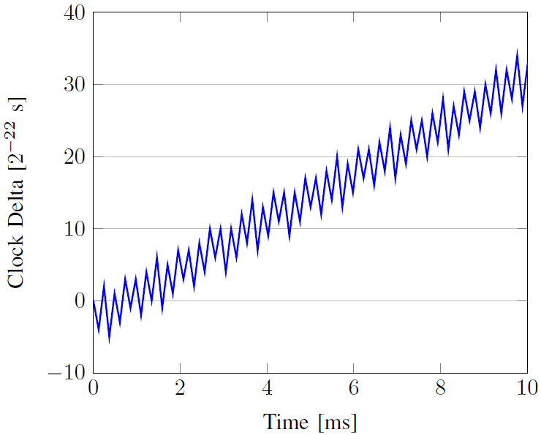
Combining Clocks
2 clocks:
32 kHz quartz
4 MHz DCO (digitally controlled oscillator)

Slide 13
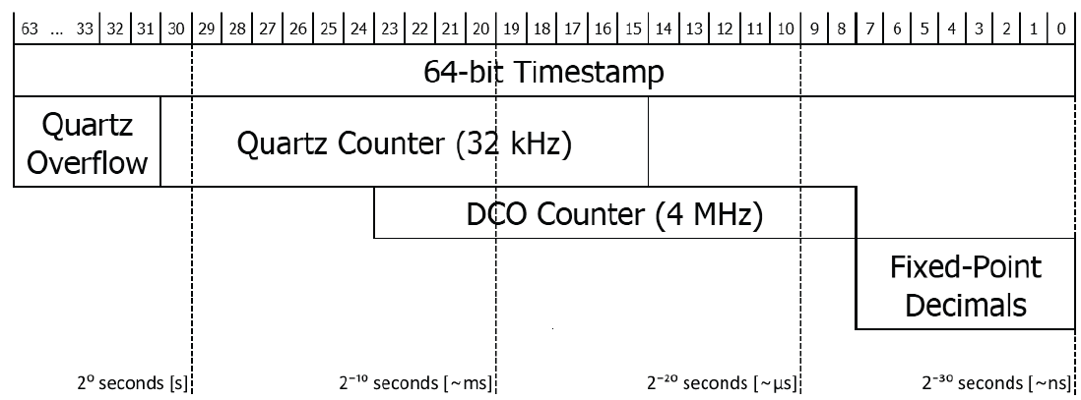
Combined Timestamp
Virtual High-Resolution Time [Schmid et al., 2010]

Slide 14
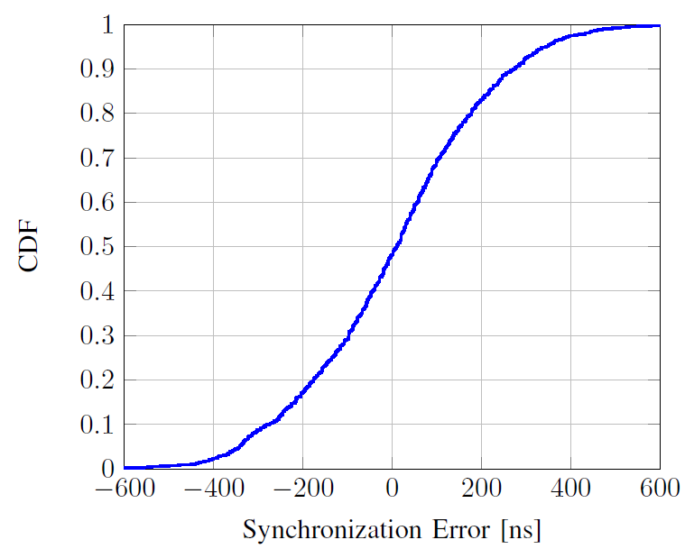
Clock Synchronization Result
|e_{clock}| < 0.05 µs in 20% of cases
|e_{clock}| < 0.25 µs in 75% of cases

Slide 15
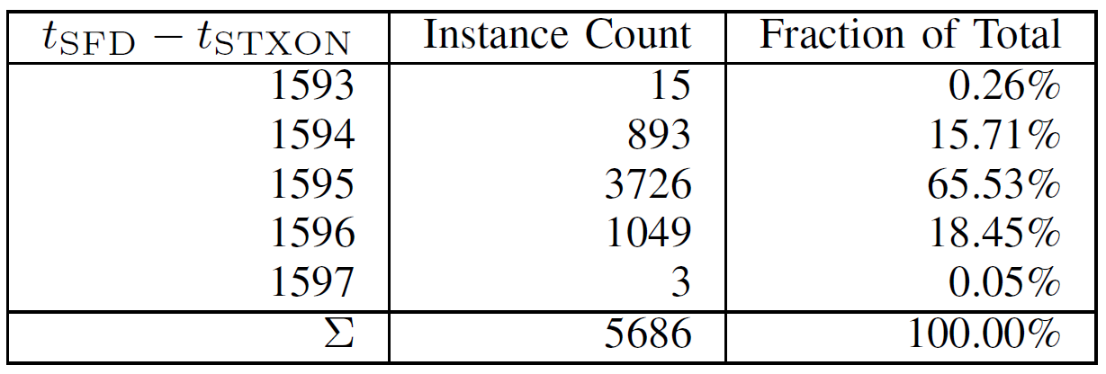
Transmission Timing (e_{transmit})
S
Measure: TXON command → SFD pin (“start of frame delimiter”)
(DCO ticks)

Slide 16
Naïve Transmission Timing
if (TargetTime - GetGlobalTime() < 10 ms) {
while (TargetTime > GetGlobalTime())
; // do nothing
cc2420_driver.transmit();
}
165 instructions
22 instructions

Slide 17
Split Clock Transmission Timing
void await(uint64_t local_target) {
uint16_t target_tarof = (local_target >> 23) & 0xFFFF;
uint16_t target_tar = (local_target >> 7) & 0xFFFF;
while (TAR_overflows < target_tarof)
;
while (TAR < target_tar)
;
uint16_t target_tbr = (local_target & 0x007F) + TBCCR6;
while (TBR < target_tbr)
;
}
await(GetLocalTime(TargetTime));

Slide 18
New Loop Size
.L24:
mov &__TBR, r15
cmp r12, r15
jlo .L24
; 3 cycles
; 1 cycle
; 2 cycles
New maximum error: 6 cycles

Slide 19
Loop Alignment
the jump table (omitted)
switch ((target_tbr - TBR) % 8) {
case 7:
_NOP();
case 6:
_NOP();
case 5:
_NOP();
case 4:
_NOP();
case 3:
_NOP();
case 2:
_NOP();
case 1:
_NOP();
case 0:
default:
;
}
while (TBR < target_tbr) {
_NOP();
_NOP();
}
and #7, r15
rla r15
br .L34(r15)
.L33:
nop ; 1 cycle
.L32:
nop ; 1 cycle
.L31:
nop ; 1 cycle
.L30:
nop ; 1 cycle
.L29:
nop ; 1 cycle
.L37:
nop ; 1 cycle
.L47:
nop ; 1 cycle
.L45:
mov &__TBR, r15 ; 3 cycles
cmp r12, r15 ; 1 cycle
jlo .L37 ; 2 cycles
New maximum error: 1 cycle!

Slide 20
Summary of Error Sources
|e_{clock}| < 0.25 µs (in 75% of cases)
|e_{transmit}| < 0.25 µs = 1 cycle
|e_{travel}| < 0.033 µs = 10 m/c
|e_{total}| = |e_{clock} + e_{transmit} + e_{travel}| << 0.5 µs
!

Slide 21
Excursion: The Capture Effect

Slide 22
Excursion: The Capture Effect

Slide 23
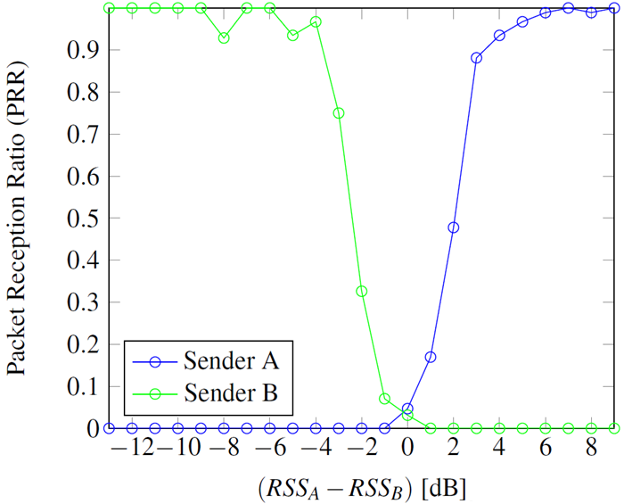
The Capture Effect – Power Difference
[“Sharing a Medium Between Concurrent Protocols Without Overhead Using the Capture Effect”, 2016]

Slide 24
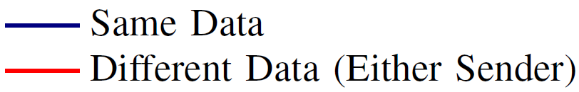
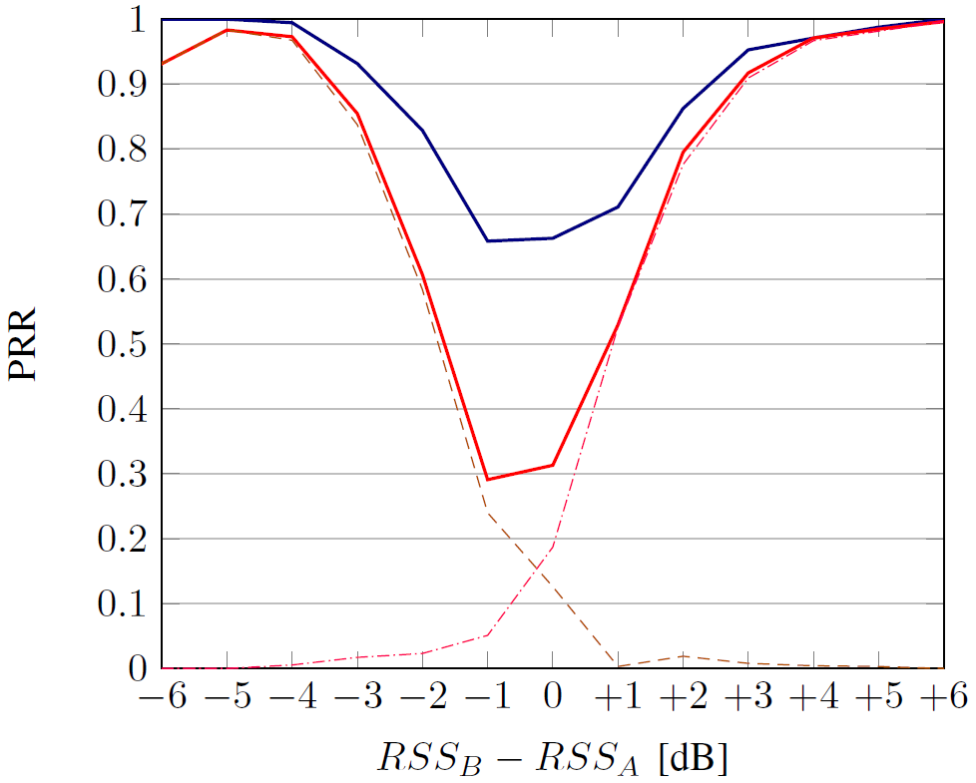
Results: Example A

Slide 25
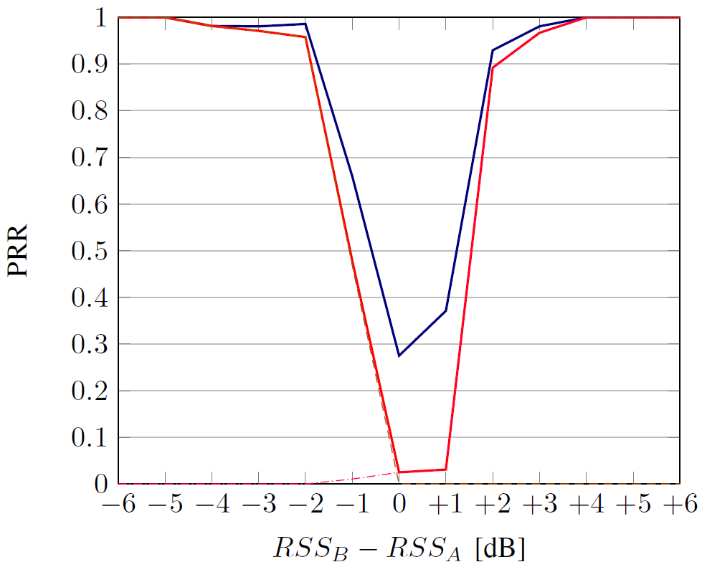
Results: Example B

Slide 26
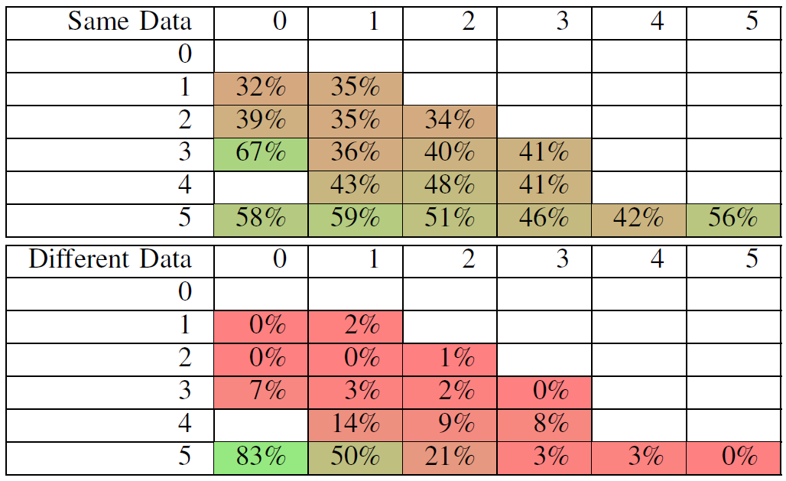
Results with 3 Senders
RSS₂ – RSS₃ [dB]
RSS₁ – RSS₃ [dB]

Slide 27
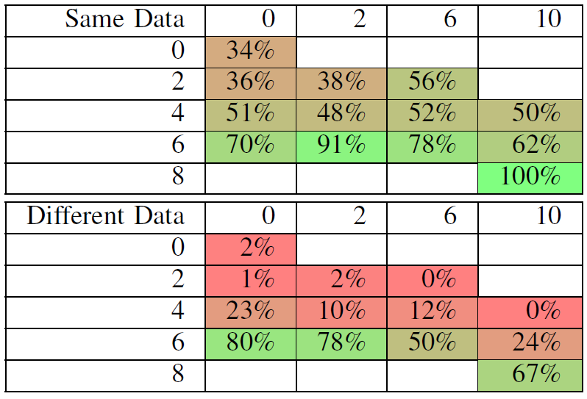
Results with 3 Senders
Var(RSS_{>1}) [dB]
RSS₁ – RSS_{avg} [dB]

Slide 28
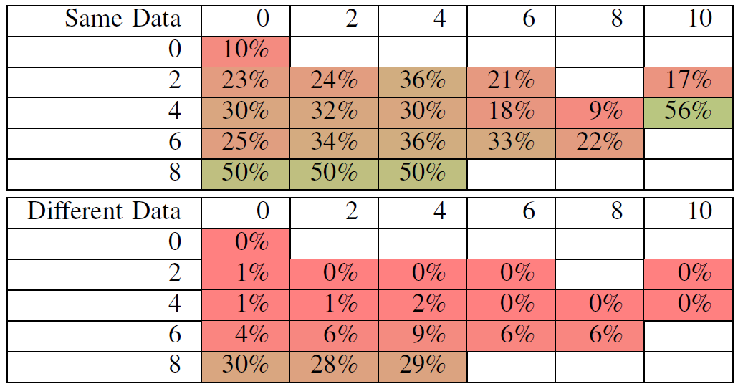
Results with 4 Senders
Var(RSS_{>1}) [dB]
RSS₁ – RSS_{avg} [dB]

Slide 29
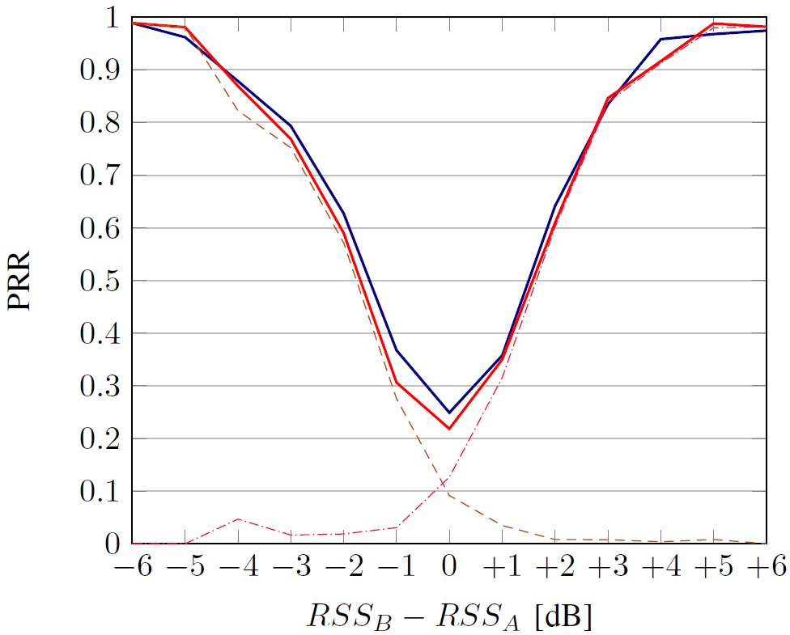
Results: Ground Truth

Slide 30
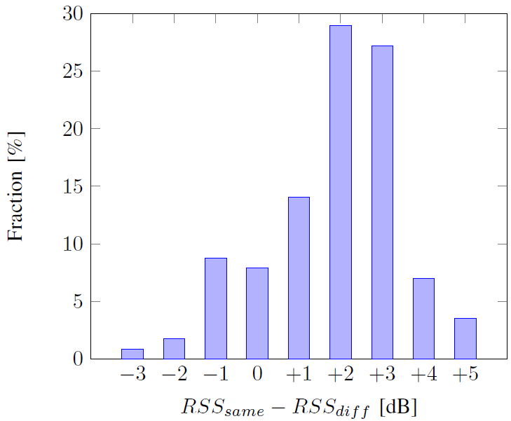
RSS Gain

Slide 31
Summary
+
=
!
|e_{total}| = |e_{clock} + e_{transmit} + e_{travel}| << 0.5 µs
.L24:
mov &__TBR, r15
cmp r12, r15
jlo .L24
; 3 cycles
; 1 cycle
; 2 cycles

Slide 32
Questions
Michael König

