Slide 1
Theory Meets Practice
…it's about TIME!
TexPoint fonts used in EMF.
Read the TexPoint manual before you delete this box.: AAAAAAA

Slide 2
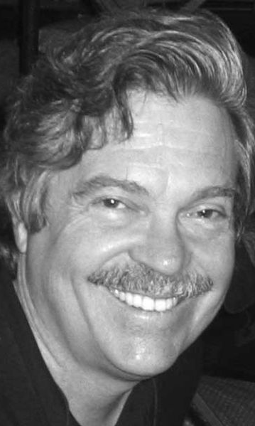
„People who are really serious about software should make their own hardware.”
  Alan Kay

Slide 3
„People who are
really serious
about algorithms
should make their
own software.”
  … or wait a long time for
  algorithms to be discovered.

Slide 4


Slide 5
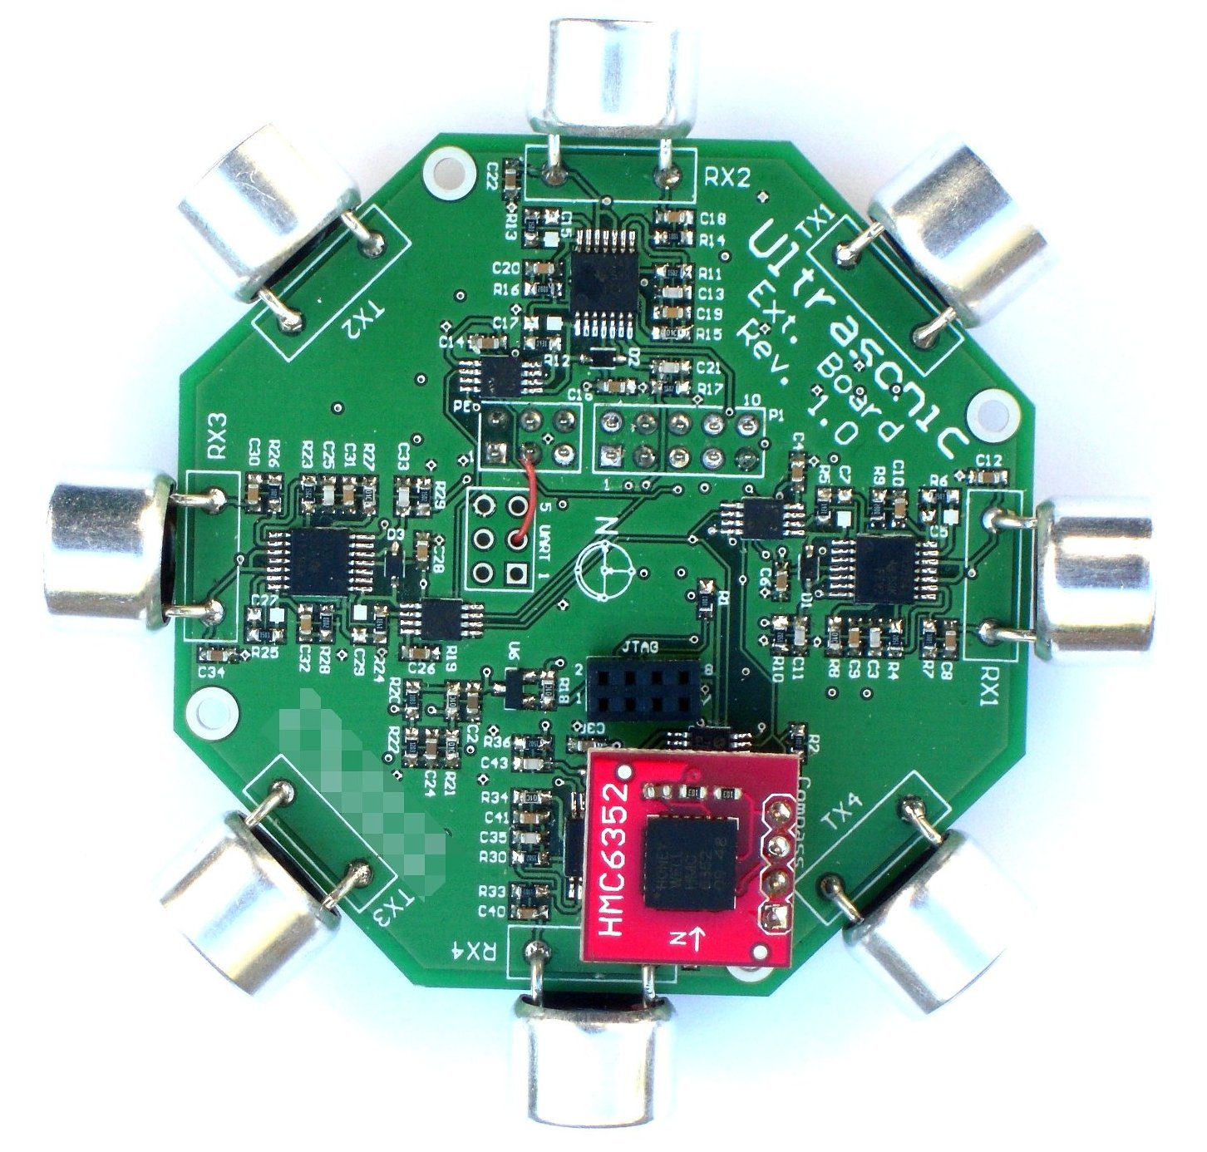

Slide 6
Theory Meets Practice?

Slide 7
Practice: Sensor Networks

Slide 8
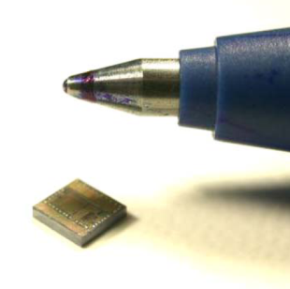

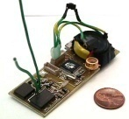






Today, we look much cuter!
And we’re usually carefully deployed
Radio
Power
Processor
Sensors
Memory

Slide 9
A Sensor Network After Deployment
multi-hop
communication

Slide 10
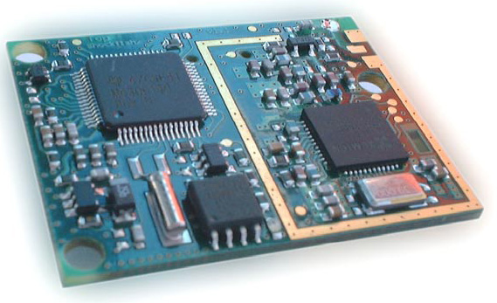
A Typical Sensor Node: TinyNode 584
TI MSP430F1611 microcontroller @ 8 MHz
10k SRAM, 48k flash (code), 512k serial storage
868 MHz Xemics XE1205 multi channel radio
Up to 115 kbps data rate, 200m outdoor range
 | Current Draw | Power Consumption
uC sleep with timer on | 6.5 uA | 0.0195 mW
uC active, radio off | 2.1 mA | 6.3 mW
uC active, radio idle listening | 16 mA | 48 mW
uC active, radio TX/RX at +12dBm | 62 mA | 186 mW
Max. Power (uC active, radio TX/RX at +12dBm + flash write) | 76.9 mA | 230.7mW
Notes:
3V layout
Light bulb: 13W
Standby of (some) stereos: 20W
TV: 250W

Slide 11

Environmental Monitoring (PermaSense)
Understand global warming in alpine environment
Harsh environmental conditions
Swiss made (Basel, Zurich)
Go
Notes:
Environmental monitoring (permasense)
http://www.swiss-experiment.ch/index.php/PermaSense:Home
http://tik42x.ee.ethz.ch:22001/topology.html#topology
More: IP.01, common-sense water monitoring, water meter reading
About
The main objective of the PermaSense project is to build and customize a set of wireless measurement units for use in remote areas with harsh environmental monitoring conditions. The second goal is the gathering of environmental data that helps to understand the processes that connect climate change and rock fall in permafrost areas. To this end, two sensor fields will be deployed in the Swiss alps and be operated over several years.
Wireless sensors contribute to permafrost science. They will enable to easily monitor larger permafrost areas with denser sampling, leading to better predictions on the consequences of global warming for alpine regions.
Beyond helping the modelling of permafrost processes, this research is also applicable to natural hazard surveillance. Currently, there is lack of easy to deploy geo-monitoring systems that are low-cost, cheap in maintenance, and easily reconfigurable when deployed. With better wireless sensor solutions, larger hazard areas can be permanently monitored and linked to warning system that help to protect human lives.
What has been achieved so far? The consequences of global warming due to permafrost degradation cannot be predicted yet in an appropriate manner. Furthermore, there is an urgent need for continuous environmental monitoring at various time scales. Finally, there is still a lack of cheap and easy to deploy stand-alone monitoring and warning systems.
Where does the project stand now? The project begins in the fall of 2005. The first generation of sensors shall be ready early summer 2006 where climatic conditions permit to deploy them. After that, access is more or less impossible for the span of a year, during which continuous measurements will be done.

Slide 12
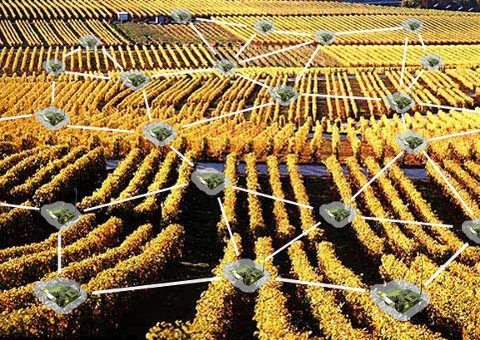
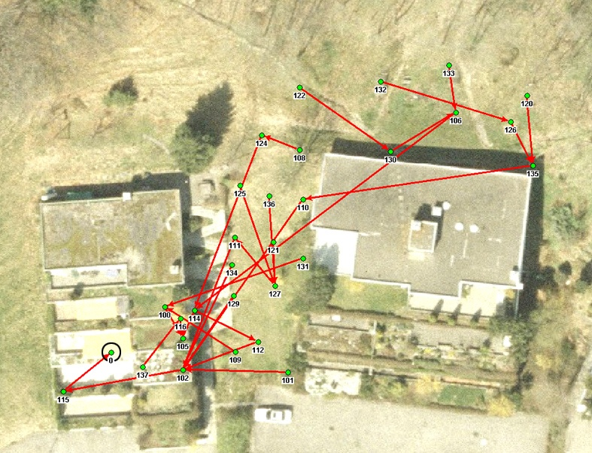
Example: Dozer
Up to 10 years of network life-time
Mean energy consumption: 0.066 mW
Operational network in use > 3 years
High availability, reliability (99.999%)
[Burri et al., IPSN 2007]
Notes:
12

Slide 13
Is Dozer a theory-meets-practice success story?
Good news
  Theory people can develop good systems!
  Sensor network (systems) people write that Dozer is one of the “best sensor network systems papers”, or: “In some sense this is the first paper I'd give someone working on communication in sensor nets, since it nails down how to do it right.”
Bad news: Dozer does not have an awful lot of theory inside
Ugly news: Dozer v2 has even less theory than Dozer v1
Hope: Still subliminal theory ideas in Dozer?

Slide 14
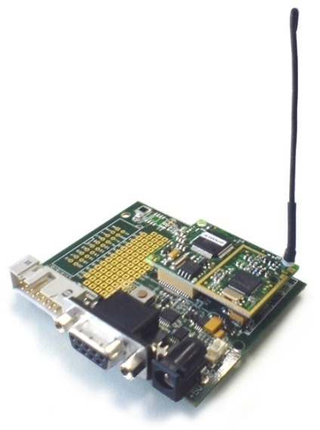
Energy-Efficient Protocol Design
Communication subsystem is the main energy consumer
  Power down radio as much as possible
Issue is tackled at various layers
  MAC
  Topology control / clustering
  Routing
TinyNode | Power Consumption
uC sleep, radio off | 0.015 mW
Radio idle, RX, TX | 30 – 40 mW
Orchestration of the whole network stack
to achieve duty cycles of ~ 0.1%
Notes:
It is well known that the radio of currently used sensor nodes is a very power hungry component. For example,
The TinyNode platform we used in our experiments consumes 30-40 mW if the radio is turned on no matter if we
Are sending, receiving, or doing nothing with it. However, if we switched the node to sleep mode we only consume
0.015 mW.
There are a lot of protocols on various layers that try to minimize the radio uptime. At the MAC layer duty cycling as
It is done in BMac or SMac can be applied. In the realm of topology control or clustering dominating sets may be used
To let the cluster heads do the work while all other nodes can go to sleep. And finally if the routing layer is considered
a lot of algorithms were proposed resulting in energy efficient routes.
It is our strong believe that if we want to achieve the goal of gathering measured data with very low power spent by
the nodes we have to coordinate all layers the network stack.
Radio -> power hungry component
MAC -> duty cycles b-mac s-mac
Topology control -> energy reduction through sending power reduction
Clustering -> Synchronized Sleep/Awake schedules
within a cluster, only cluster-leader needs to remain awake
Routing -> find energy-efficient routes
Application -> tailored systems such as for data gathering or event dissemination

Slide 15
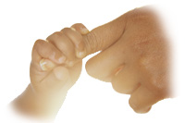
Dozer System
Tree based routing towards data sink
  No energy wastage due to multiple paths
  Current strategy: SPT
TDMA based link scheduling
  Each node has two independent schedules
  No global time synchronization
The parent initiates each TDMA round with a beacon
  Enables integration of disconnected nodes
  Children tune in to their parent’s schedule
parent
child
activation frame
beacon
contention window
beacon
time
Notes:
The Dozer system not only incorporates topology control and a simple routing scheme but also
Schedules the sleep and awake times of individual nodes und manages their access to the wireless medium.
In fact, Dozer establishes a routing tree rooted at the data sink. This prevents data packets from being
Sent over more than one path which would unnecessarily drain battery power at the involved nodes.
In the current version dozer uses a hop based shortest path tree to convey the measurements back towards
The base station.
We have built a TDMA based link scheduling scheme into Dozer. That is dozer determines when data
Is transferred over which link of the routing tree. Therefore each node in the network has two independent
Schedules. One in its role as a parent and one in its child role. With this trick we do not need to globally synchronize
network but break up the synchronization at each link. This is far more easy to achieve than global time sync.
In its role as a parent each node broadcasts a beacon message at the outset of every TDMA round. This
Allows the integration of yet not already connected nodes into the data gathering tree. A node therefore
Listens right after the beacon message if new children want to hook up with it. Once a child has managed
To establish a link to its parent it listens to all parent beacons to stay synchronized with it.
Since a node has to listen for the whole duration of the contention window to detect new connection
Attempts, and these events are quite rare in a running system we incorporated a so called activation frame.
Now the parent sniffs the channel for activity right after the beacon and goes to sleep if no activity is detected.
To keep the parent awake a new child now has to send a few bytes after the overheard beacon to attract the parents attention.
We found that with this simple trick we are able to saves a huge amount of energy.

Slide 16
Dozer System
Parent decides on its children data upload times
  Each interval is divided into upload slots of equal length
  Upon connecting each child gets its own slot
  Data transmissions are always ack’ed
No traditional MAC layer
  Transmissions happen at exactly predetermined point in time
  Collisions are explicitly accepted
  Random jitter resolves schedule collisions
Clock drift, queuing, bootstrap, etc.
data transfer
jitter
slot 1
slot 2
slot n
time
Notes:
The data upload time for a child is determined by its parent. For that a parent allocates a distinct upload
Slot for each of its children. In such a slot a child tries to upload as much data as possible. To convey the data
Reliably towards the sink data traffic is ack’ed on each hop. Note that the beacon frequency of a node is normally
higher than the actual data sampling.
Since Dozer relies heavily on exact timings, we got rid of any kind of collision avoidance in the MAC layer that might
delay message transmission. With that a receiver is able to wake up right at the moment the sender is starting its
transmission.
In doing so we explicitly accept occasional message collisions. However since we assume the application to produce
Only light traffic collisions are rare. To prevent two schedules to collide over and over each TMDA interval is extended
With a randomly chosen jitter at the end. This allows colliding schedules to drift apart quickly.

Slide 17
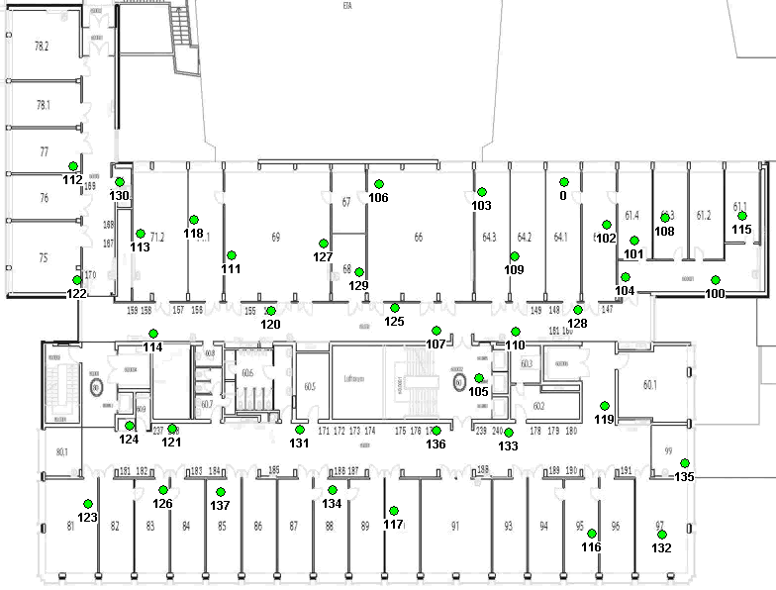
Dozer in Action
Notes:
Here we see a time-lapse recording of the topology established by dozer.
You can see that Dozer has to cope with quite some network dynamics. The
Maximum tree depth we observed was 7.

Slide 18
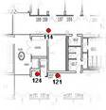
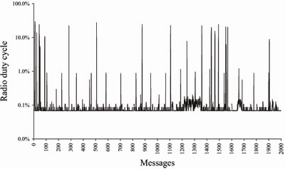
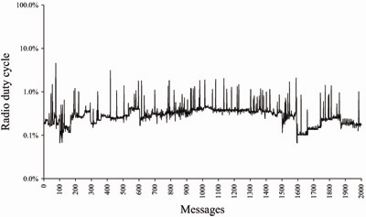
Energy Consumption
0.32% duty cycle
0.28% duty cycle
scanning
overhearing
updating
#children
Leaf node
Few neighbors
Short disruptions
Relay node
No scanning
Notes:
~2 days and 18 hours
0.7promille

Slide 19
no theory ☹

Slide 20
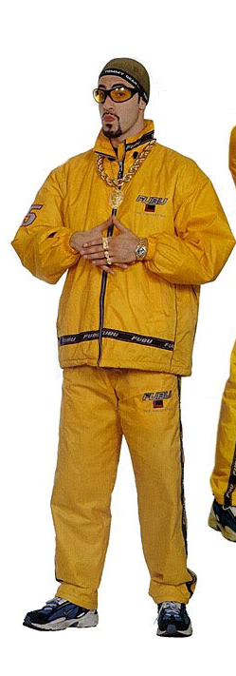
Theory for sensor networks, what is it good for?!
How many lines of pseudo code //
Can you implement on a sensor node?
The best algorithm is often complex //
And will not do what one expects.
Theory models made lots of progress //
Reality, however, they still don’t address.
My advice: invest your research £££s //
in ... impossibility results and lower bounds!

Slide 21
Theory Meets Practice
Example: Clock Synchronization
…it's about TIME!

Slide 22
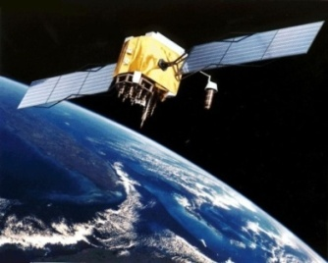
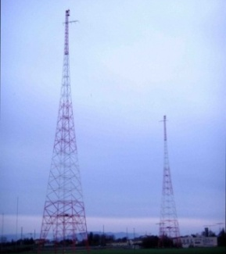
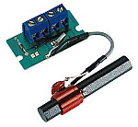




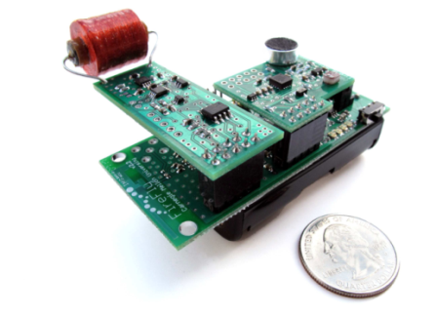
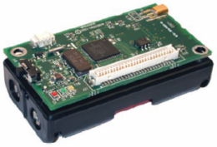


Clock Synchronization in Practice
Many different approaches for clock synchronization
Global Positioning
System (GPS)
Radio Clock Signal
AC-power line
radiation
Synchronization
messages

Slide 23
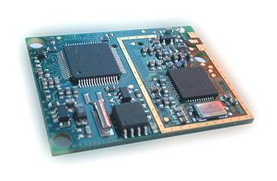

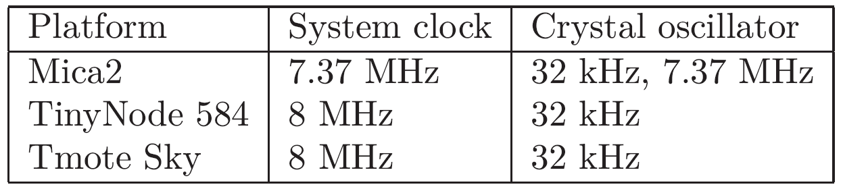
Oscillators
Clock Devices in Sensor Nodes
Structure
  External oscillator with a nominal frequency (e.g. 32 kHz or 7.37 MHz)
  Counter register which is incremented with oscillator pulses
  Works also when CPU is in sleep state
7.37 MHz quartz
32 kHz quartz
TinyNode
Mica2
32 kHz quartz
Notes:
1 tick = 1s/32000
Some processors (Mica2) allow to access system clock (7 to 8Mhz)
Some other processors (TinyNode) do have system clock as well, but it’s very inaccurate
(oscillating circuit), and will reset if CPU is turned off.
50ppm, parts per million
50ppm → 1.6 ticks per second.
And the result of 50microseconds follows (surprising that it’s exactly the same
as the ppm? Probably not)

Slide 24
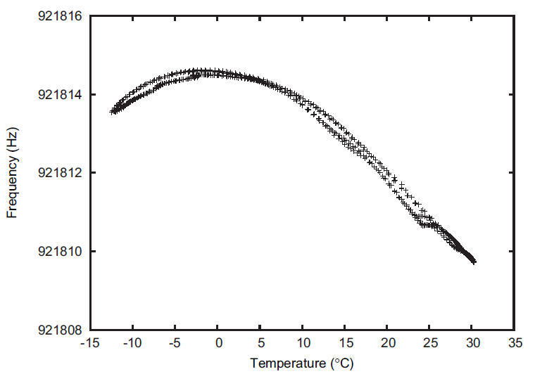
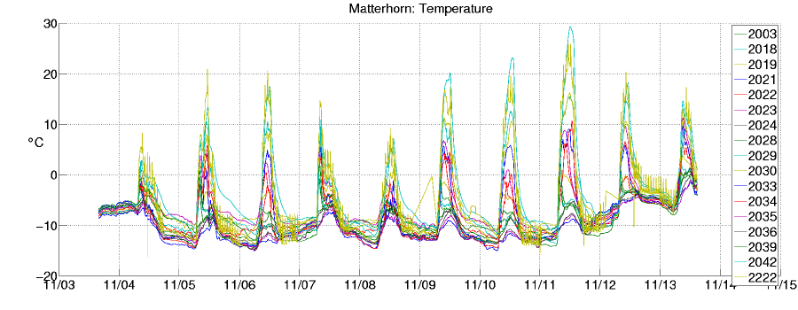
Clocks Experience Drift
Clock Drift
Accuracy
  Clock drift: random deviation from the nominal rate dependent on power supply, temperature, etc.
  E.g. TinyNodes have a maximum drift of 30-50 ppm at room temperature
rate
1+²
This is a drift of up to 50 μs per second
or 0.18s per hour
1
1-²
t
Notes:
1 tick = 1s/32000
Some processors (Mica2) allow to access system clock (7 to 8Mhz)
Some other processors (TinyNode) do have system clock as well, but it’s very inaccurate
(oscillating circuit), and will reset if CPU is turned off.
50ppm, parts per million
50ppm → 1.6 ticks per second.
And the result of 50microseconds follows (surprising that it’s exactly the same
as the ppm? Probably not)

Slide 25

Messages Experience Jitter in the Delay
Problem: Jitter in the message delay
  Various sources of errors (deterministic and non-deterministic)
Solution: Timestamping packets at the MAC layer [Maróti et al.]
  → Jitter in the message delay is reduced to a few clock ticks
0-100 ms
0-500 ms
1-10 ms
timestamp
SendCmd
Access
Transmission
Reception
Callback
timestamp
0-100 ms
t

Slide 26
Clock Synchronization in Networks?
Time, Clocks, and the Ordering of Events in a Distributed System
L. Lamport, Communications of the ACM, 1978.
Internet Time Synchronization: The Network Time Protocol (NTP)
D. Mills, IEEE Transactions on Communications, 1991
Reference Broadcast Synchronization (RBS)
J. Elson, L. Girod and D. Estrin, OSDI 2002
Timing-sync Protocol for Sensor Networks (TPSN)
S. Ganeriwal, R. Kumar and M. Srivastava, SenSys 2003
Flooding Time Synchronization Protocol (FTSP)
M. Maróti, B. Kusy, G. Simon and Á. Lédeczi, SenSys 2004
and many more ...
FTSP: State of the art clock sync protocol for networks.

Slide 27
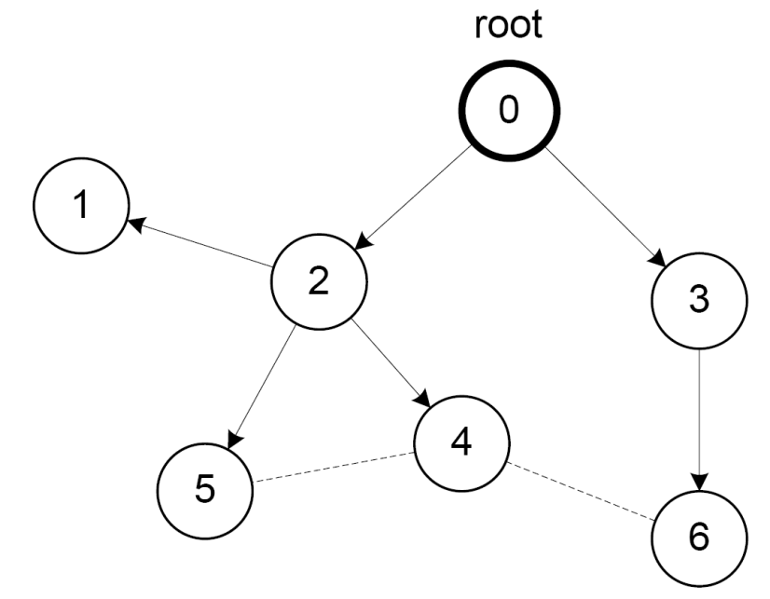
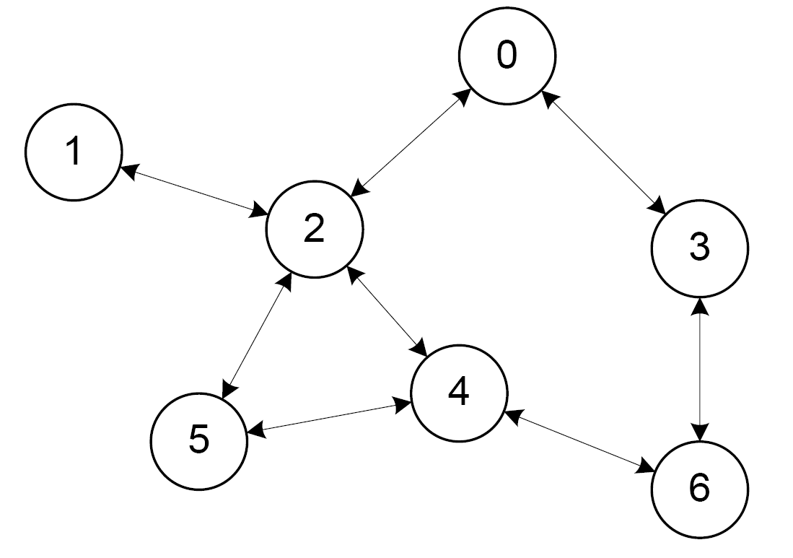
Variants of Clock Synchronization Algorithms
Tree-like Algorithms Distributed Algorithms
e.g. FTSP e.g. GTSP
[Sommer et al., IPSN 2009]
Bad local skew
All nodes consistently average errors to all neighbors

Slide 28
FTSP vs. GTSP: Global Skew
Network synchronization error (global skew)
  Pair-wise synchronization error between any two nodes in the network
FTSP (avg: 7.7 μs)
GTSP (avg: 14.0 μs)

Slide 29
FTSP vs. GTSP: Local Skew
Neighbor Synchronization error (local skew)
  Pair-wise synchronization error between neighboring nodes
Synchronization error between two direct neighbors:
FTSP (avg: 15.0 μs)
GTSP (avg: 2.8 μs)

Slide 30
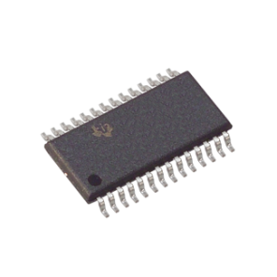
Time in (Sensor) Networks
Localization
Sensing
Global
Global
Local
Local
TDMA
Local
Duty-Cycling
Local
Clock Synchronization Protocol
Hardware Clock

Slide 31
Clock Synchronization in Theory?
Clock Synchronization in Theory?
Given a communication network
  Each node equipped with hardware clock with drift
  Message delays with jitter
Goal: Synchronize Clocks (“Logical Clocks”)
  Both global and local synchronization!
worst-case (but constant)

Slide 32
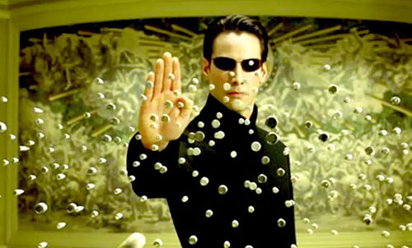
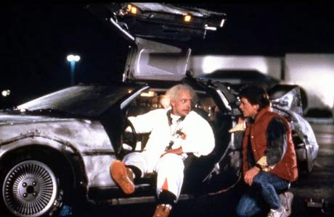
Time Must Behave!
Time Must Behave!
Time (logical clocks) should not be allowed to stand still or jump
Let’s be more careful (and ambitious):
Logical clocks should always move forward
  Sometimes faster, sometimes slower is OK.
  But there should be a minimum and a maximum speed.
  As close to correct time as possible!

Slide 33

Formal Model
Hardware clock H_{v}(t) = s_{[0,t]} h_{v}(¿) d¿
with clock rate h_{v}(t) 2 [1-²,1+²]
Logical clock L_{v}(∙) which increases
at rate at least 1 and at most ¯
Message delays 2 [0,1]
Employ a synchronization algorithm
to update the logical clock according
to hardware clock and
messages from
neighbors
Clock drift ² is typically small, e.g.
² ¼10⁻⁴ for a cheap quartz oscillator
Logical clocks with rate much less than 1 behave differently...
Neglect fixed share of delay, normalize jitter
H_{v}
Time is 152
Time is 140
Time is 150
L_{v}?

Slide 34
Local Skew
Tree-like Algorithms Distributed Algorithms
e.g. FTSP e.g. GTSP
Bad local skew

Slide 35
Synchronization Algorithms: An Example (“A^{max}”)
Question: How to update the logical clock based on the messages from the neighbors?
Idea: Minimizing the skew to the fastest neighbor
  Set clock to maximum clock value you know, forward new values immediately
First all messages are slow (1), then suddenly all messages are fast (0)!
Fastest Hardware Clock
Time is T
Time is T
Time is T
…
Clock value:
T
Clock value:
T-1
Clock value:
T-D+1
Clock value:
T-D
T
T
skew D

Slide 36
Local Skew: Overview of Results
Everybody‘s expectation, 10 years ago („solved“)
Blocking algorithm
All natural algorithms
[Locher et al., DISC 2006]
Lower bound of logD / loglogD
[Fan & Lynch, PODC 2004]
1 logD √D D …
Dynamic Networks!
[Kuhn et al., SPAA 2009]
Kappa algorithm
[Lenzen et al., FOCS 2008]
Tight lower bound
[Lenzen et al., PODC 2009]
together
[JACM 2010]

Slide 37



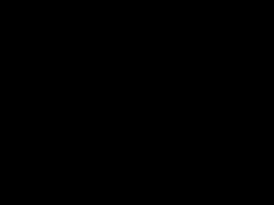
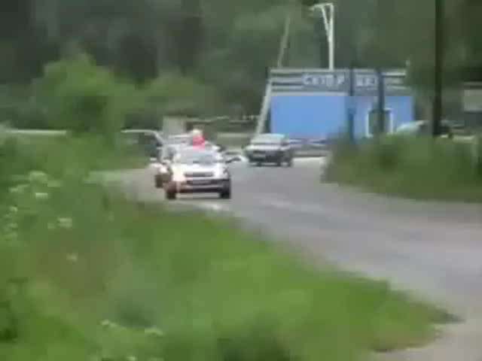
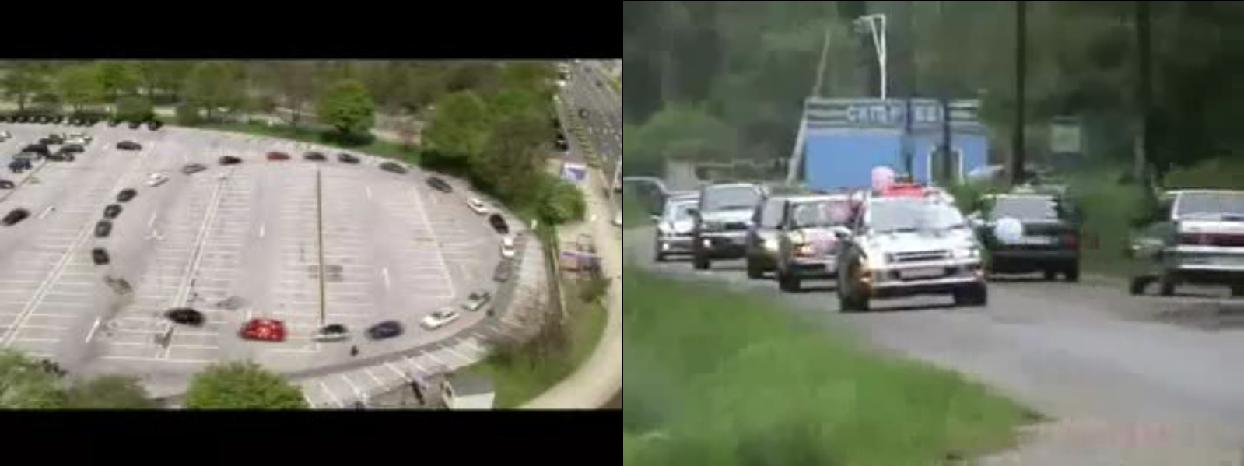
Clock Synchronization vs. Car Coordination
In the future cars may travel at high speed despite a tiny safety distance, thanks to advanced sensors and communication

Slide 38
Clock Synchronization vs. Car Coordination
In the future cars may travel at high speed despite a tiny safety distance, thanks to advanced sensors and communication
How fast & close can you drive?
Answer possibly related to clock synchronization
  clock drift ↔ cars cannot control speed perfectly
  message jitter ↔ sensors or communication between cars not perfect

Slide 39
Is the Theory Practical?!?
Example: Clock Synchronization
…it's about TIME!

Slide 40


One Big Difference Between Theory and Practice, Usually!
Worst Case Analysis!
Physical Reality...
Practice
Theory

Slide 41
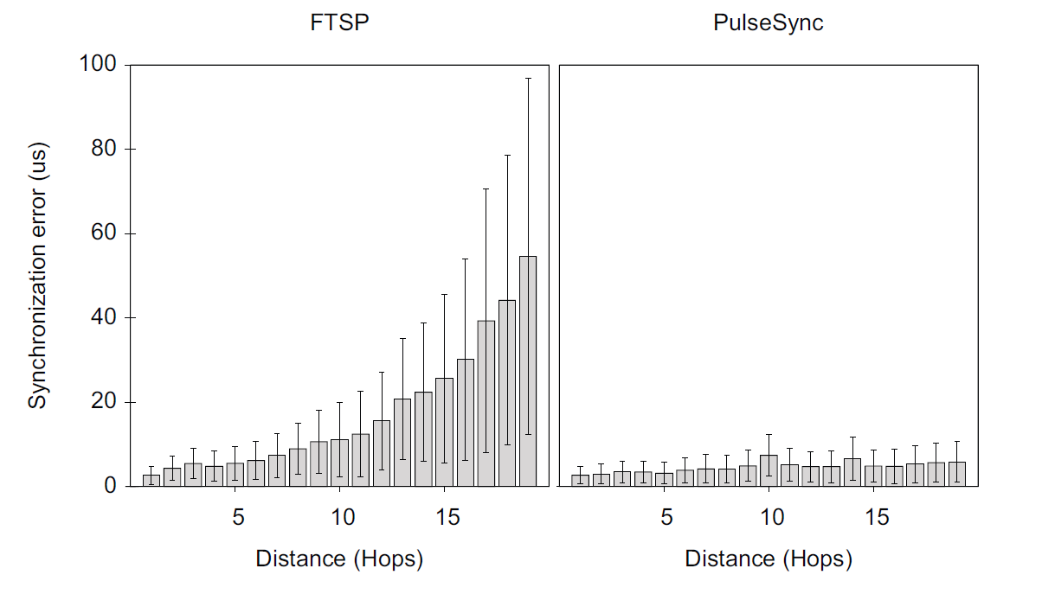
„Industry Standard“ FTSP in Practice
As we have seen FTSP
does have a local skew problem
But it’s not all that bad…
However, tests revealed
another (severe!) problem:
FTSP does not scale: Global
skew grows exponentially
with network size…
FTSP (avg: 15.0 μs)

Slide 42
The PulseSync Protocol
[Lenzen et al., SenSys 2009]
1) Remove self-amplifying of synchronization error
2) Send fast synchronization pulses through the network
  Speed-up the initialization phase
  Faster adaptation to changes in temperature or network topology
FTSP
Expected time
= D·B/2
0
1
2
3
4
t
PulseSync
Expected time
= D·t_{pulse}
0
1
2
3
4
t

Slide 43
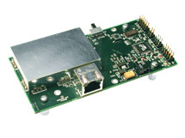

Evaluation
Testbed setup
  20 Crossbow Mica2 sensor nodes
  PulseSync implemented in TinyOS 2.1
  FTSP from TinyOS 2.1
Network topology
  Single-hop setup, basestation
  Virtual network topology (white-list)
  Acknowledgments for time sync beacons
0
1
2
3
4
...
20
Probe beacon

Slide 44
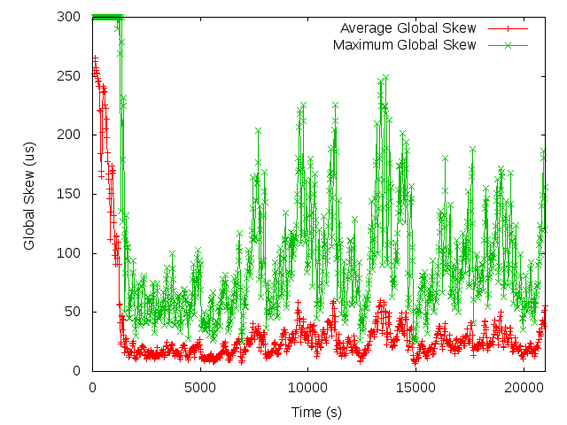
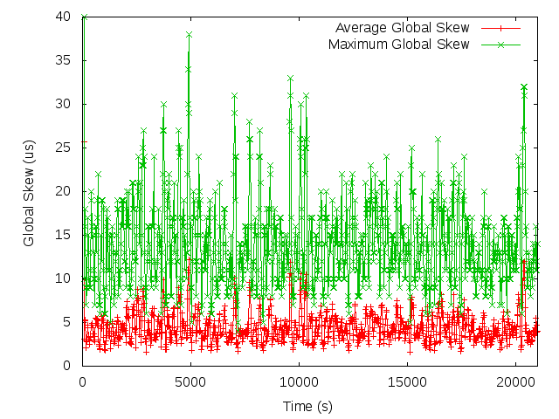
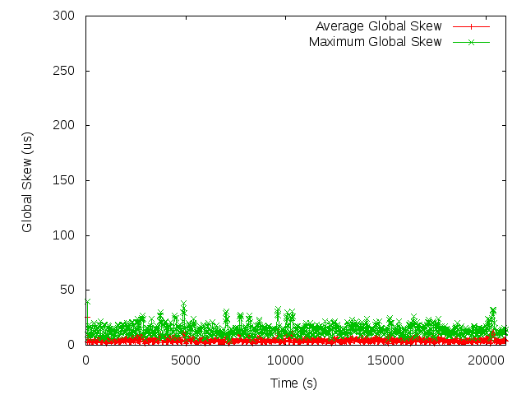
Experimental Results
Global Clock Skew
  Maximum synchronization error between any two nodes
FTSP
PulseSync
Synchronization Error | FTSP | PulseSync
Average (t>2000s) | 23.96 µs | 4.44 µs
Maximum (t>2000s) | 249 µs | 38 µs

Slide 45
Experimental Results
Synchronization error vs. hop distance
FTSP
PulseSync

Slide 46
Summary
Everybody‘s expectation, five years ago („solved“)
Blocking algorithm
All natural algorithms
[Locher et al., DISC 2006]
Lower bound of logD / loglogD
[Fan & Lynch, PODC 2004]
…
Kappa algorithm
[Lenzen et al., FOCS 2008]
Dynamic Networks!
[Kuhn et al., SPAA 2009]
FTSP
PulseSync
Tight lower bound
[Lenzen et al., PODC 2009]

Slide 47
Merci!
Questions & Comments?
Thanks to my co-authors
Nicolas Burri
Christoph Lenzen
Thomas Locher
Philipp Sommer
Pascal von Rickenbach
TexPoint fonts used in EMF.
Read the TexPoint manual before you delete this box.: AAAAAAA

Slide 48

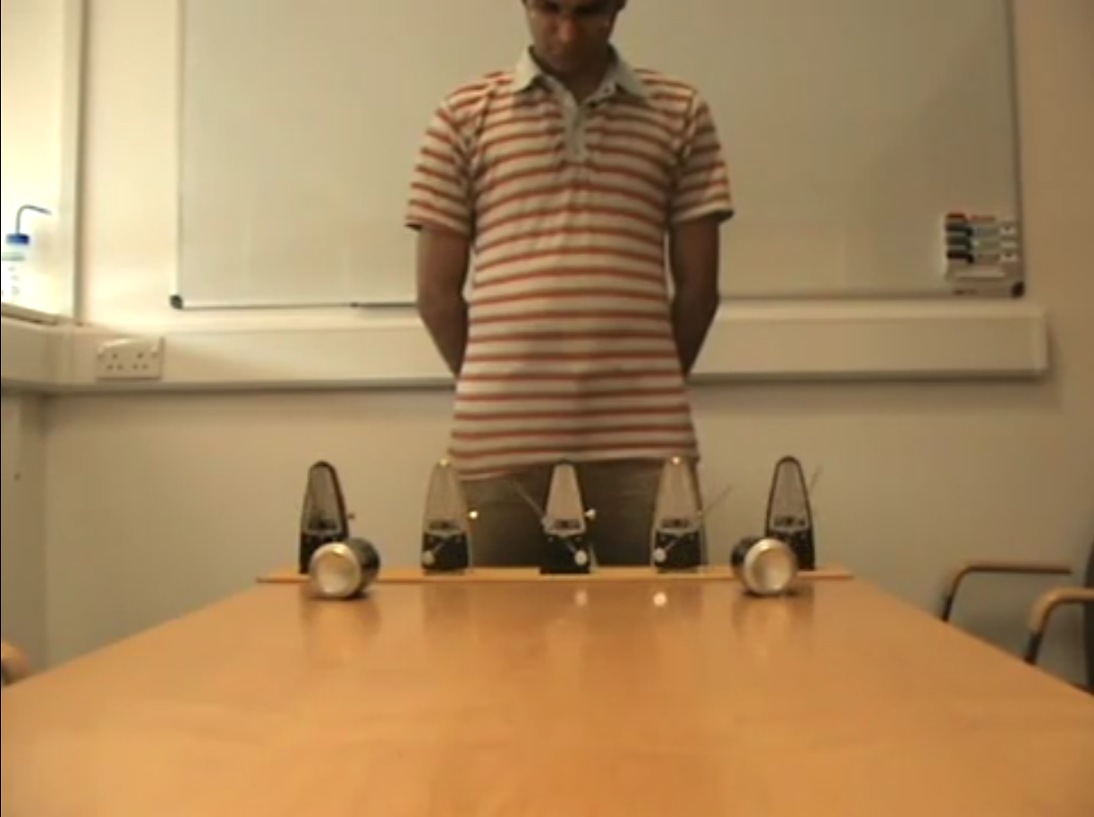
Clock Synchronization
Notes:
http://www.youtube.com/watch?v=W1TMZASCR-I&feature=related

Slide 49
Open Problems
global vs. local skew
worst-case vs. reality (Gaussian?)
accuracy vs. convergence
accuracy vs. energy efficiency
dynamic networks
fault-tolerance (Byzantine clocks)
applications, e.g. coordinating physical objects (example with cars)

