Slide 1


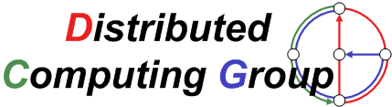


Combinatorial Agency with Audits
Raphael Eidenbenz
ETH Zurich, Switzerland
Stefan Schmid
TU Munich, Germany
TexPoint fonts used in EMF.
Read the TexPoint manual before you delete this box.: AAAAAAA
Notes:
Good morning, thanks for coming.

Slide 2

Introduction
Grid Computing...
  Distributed project orchestrated by one server
  Server distributes tasks
  Agents compute subtask
  Results are sent back to server
  Server aggregates result
Agents
Server / Principal
Notes:
Example: Decode DNA, count stars

Slide 3


Introduction: Grid Computing
  What are an agent‘s incentives?
    Payment, fame, altruism
  Why not cheat and return
  a random result?
    Will principal find out?
    Not really
      Individual computation is a hidden action
      Principal can only check whether entire project failed
Agents
Server / Principal

Slide 4

Introduction: Grid Computing
  Project failed
    Who did a bad job?
    Whom to pay?
  Maybe project still succeeds
    if only one agent exerts low effort
    If more than 2/3 of the agents exert high effort
    ...
    Whom to pay?
Agents
Server / Principal

Slide 5

Binary Combinatorial Agency [Babaioff, Feldman, Nisan 2006]
1 principal , n selfish risk-neutral agents
Hidden actions={high effort, low effort}
  High effort → subtask succeeds with probability δ
  Low effort → subtask succeeds with probability γ
Combinatorial project success function
  AND: success if all subtasks succeed
  OR: success if at least one subtask succeeds
  MAJORITY: success if more than half of the agents succeed
Principal contracts with agents
  Individual payment p_{i} depending on entire project‘s outcome
  Assume Nash equilibrium in the created game

Slide 6
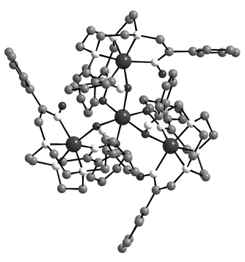
Results [Babaioff, Feldman, Nisan 2006]
AND technology
  Principal either contracts with all agents or with none
    Depending on her valuation v
  One transition point where optimal choice changes
OR technology
  Principal contracts with k agents, 0· k· n
  With increasing valuation v, there are n transition points where the optimal number k increases by 1

Slide 7

Combinatorial Agency with Audits
Grid computing: server can recompute a subtask
  Actions are observable at a certain cost κ.
  Principal conducts k random audits among the l contracted agents
    Agent i is audited with
    probability
  Sophisticated contracts
    If audited and convicted of low effort ! p_{i}=0 even if project successful
Agents
Server / Principal
≠
Notes:
Are actions entirely hidden?

Slide 8
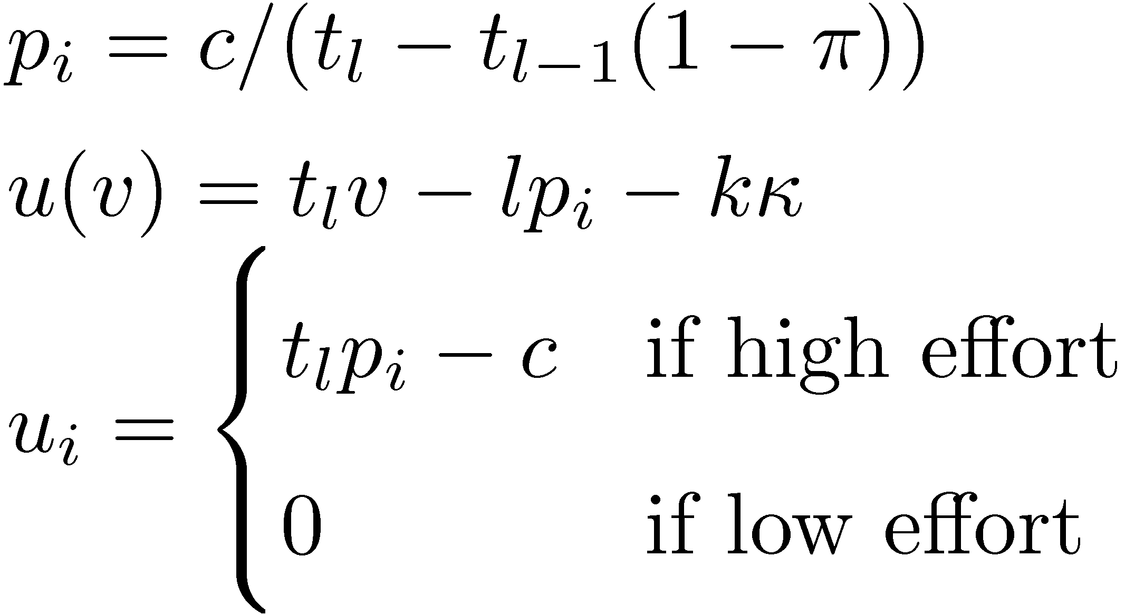
Some Observations
The possibility of auditing can never be detrimental
Nash Equilibrium if principal contracts l and audits k agents
  payment p_{i}
  principal utility u
  agent utility u_{i}

Slide 9
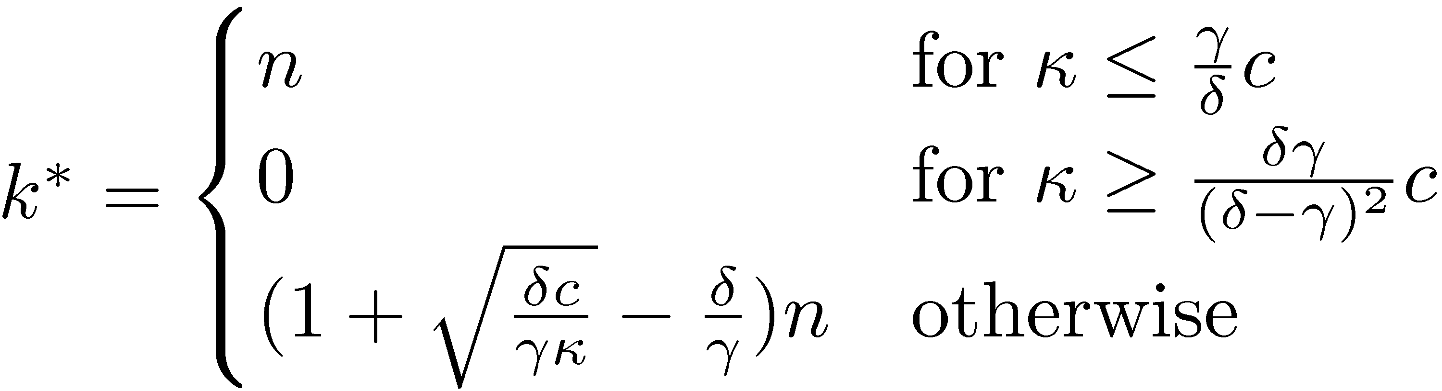
AND-Technology
Project succeeds if all agents succeed
δ: agent success probability with high effort
γ: agent success probability with low effort
There is one transition point v*
  for v· v*, contract no agent
  for v¸ v*, contract with all agents and conduct k* audits
Theorem
Transition earlier with the leverage of audits
Notes:
TODO: compare transition points

Slide 10
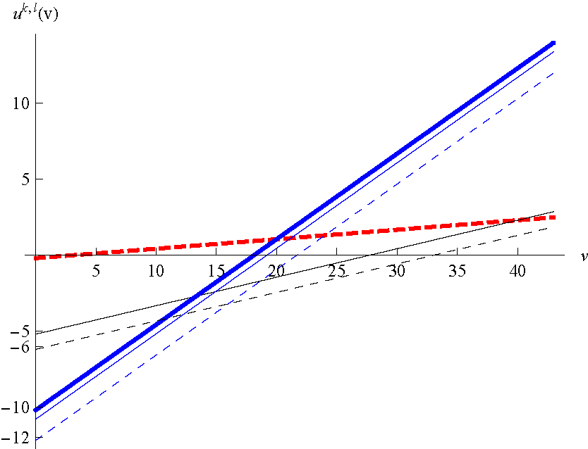
AND-Technology (2 Agents): Principal Utility

Slide 11
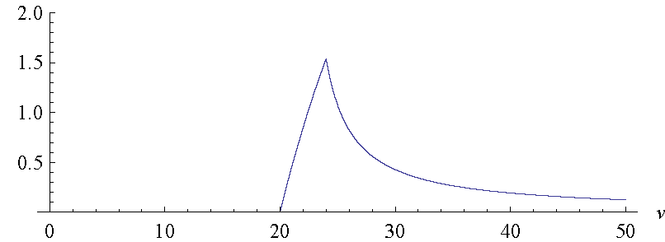
AND-Technology: Benefit from Audits in %

Slide 12
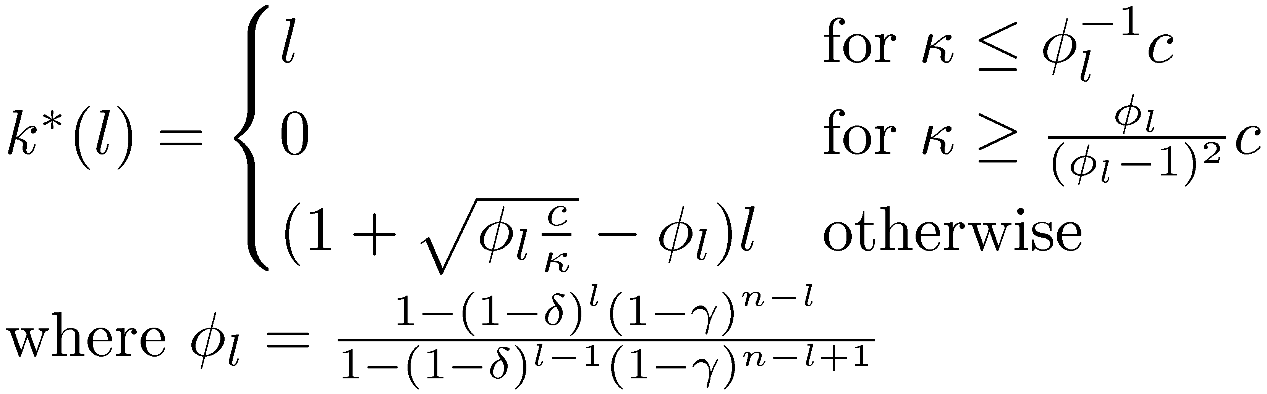
OR-Technology
Project succeeds if at least one agent succeeds
δ: agent success probability with high effort
γ: agent success probability with low effort
There are n transition point v₁*,v₂*, ... ,v_{n}*
  for v · v₁*, contract no agent
  for v_{l-1}*· v · v_{l}*, contract with l agents, conduct k*(l) audits
  for v¸ v_{n}*, contract with all agents and conduct k*(n) audits
Conjecture
Lemma

Slide 13
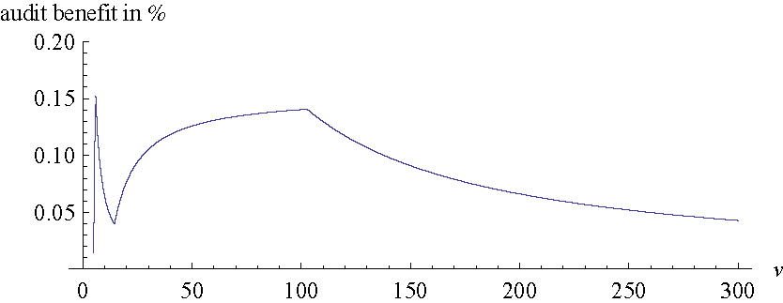
OR-Technology (2 Players): Benefit from Audits in %

Slide 14
Conclusion
If hidden actions can be revealed at a certain cost, the coordinator may improve cooperation and efficiency in a distributed system
AND technology
  General solution to optimally choose p_{i}, l and k
  One transition point with increasing valuation
OR technology
  Formula for number of audits to conduct if number of contracts given
    Principal can find optimal solution in O(n)
  Probably n transition points
Transition points occur earlier with the leverage of audits

Slide 15
Outlook
Test results in the wild
  Accuracy of the model?
  Does psychological aversion against control come into play?
Non-anonymous technologies
  Which set of agents to audit?
Solve problem independent of technology
  Are there general algorithms to solve the principal‘s optimization problem for arbitrary technologies?
  What is the complexity?
Total rationality unrealistic
Thank
you!

Slide 16
Bibliography
[Babaioff, Feldman, Nisan 2006]: Combinatorial Agency. EC 2006.
[Babaioff, Feldman, Nisan 2006]: Mixed Strategies in Combinatorial Agency. WINE 2006.
[Monderer, Tennenholtz]: k-Implementation. EC 2003.
[Enzle, Anderson]: Surveillant Intentions and Intrinsic Motivation. J. Personality and Social Psychology 64, 1993.
[Fehr, Klein, Schmidt]: Fairness and Contract Design. Econometrica 75, 2007.

Slide 17
Outline
Introduction: Grid Computing
Combinatorial Agency
  Binary Model
  Results by Babaioff, Feldman, Nisan
Combinatorial Agency with Audits
  First Facts
  AND technology
  OR technology
Conclusion
Outlook
Notes:
Prisonners Dilemma even useful for networking ☺

Slide 18
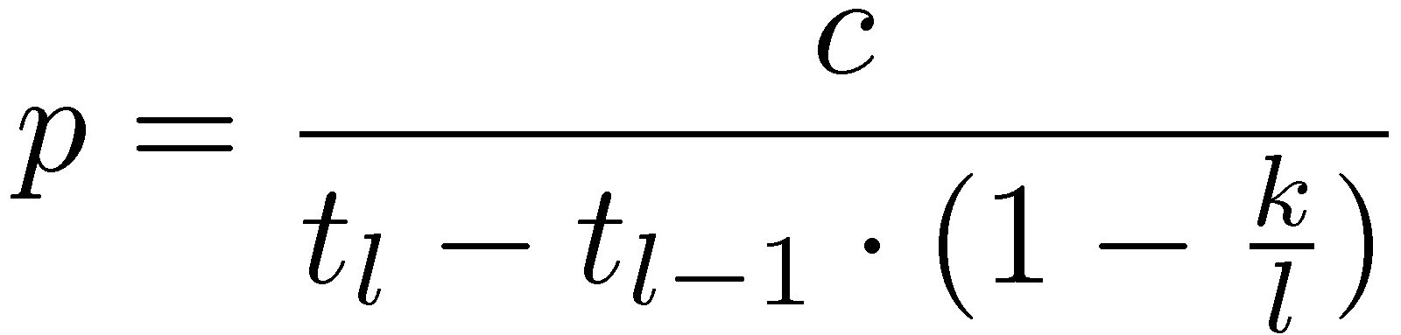
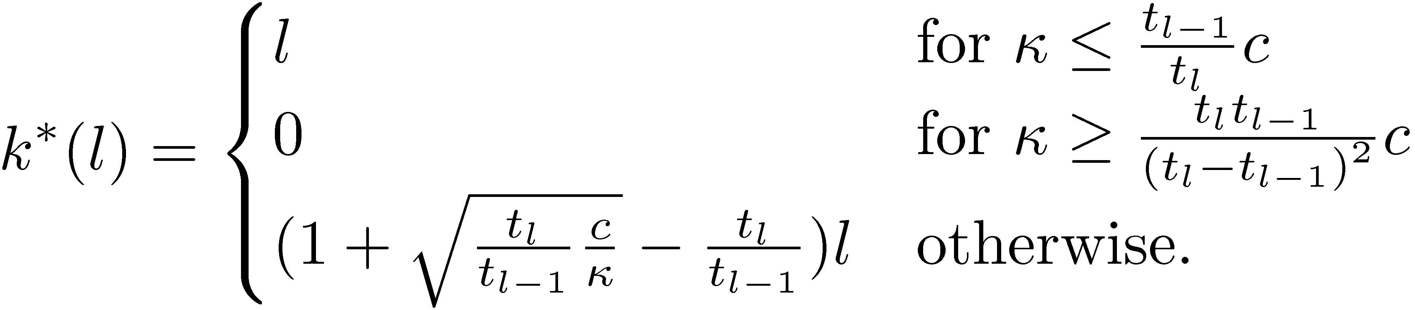
Anonymous Technologies
Success function t depends only on number of agents exerting high effort
  t_{m}: success probability if m agents exert high effort
Optimal payments
Principal utility
Optimal #audits

Slide 19
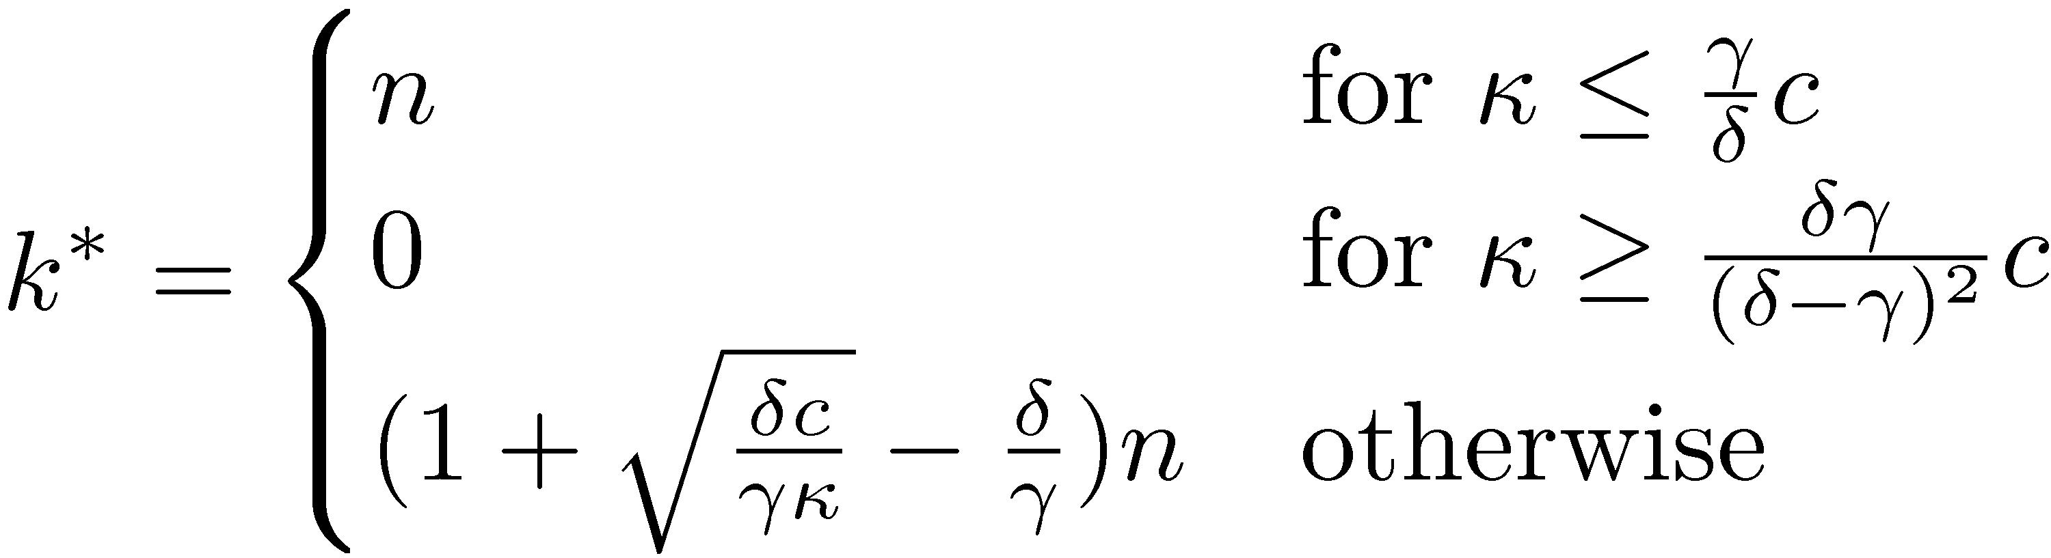
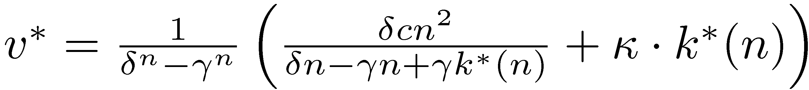
AND-Technology
Project succeeds if all agents succeed
Success function t_{m}=δ^{m}¢γ^{n-m}
There is one transition point v*
  for v· v*, contract no agent
  for v¸ v*, contract with all agents and conduct k* audits
Theorem
Notes:
TODO: compare transition points

Slide 20
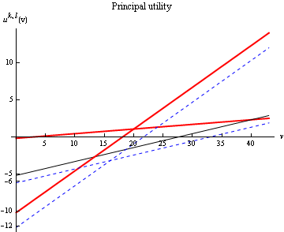
AND-Technology: Principal Utility

Slide 21
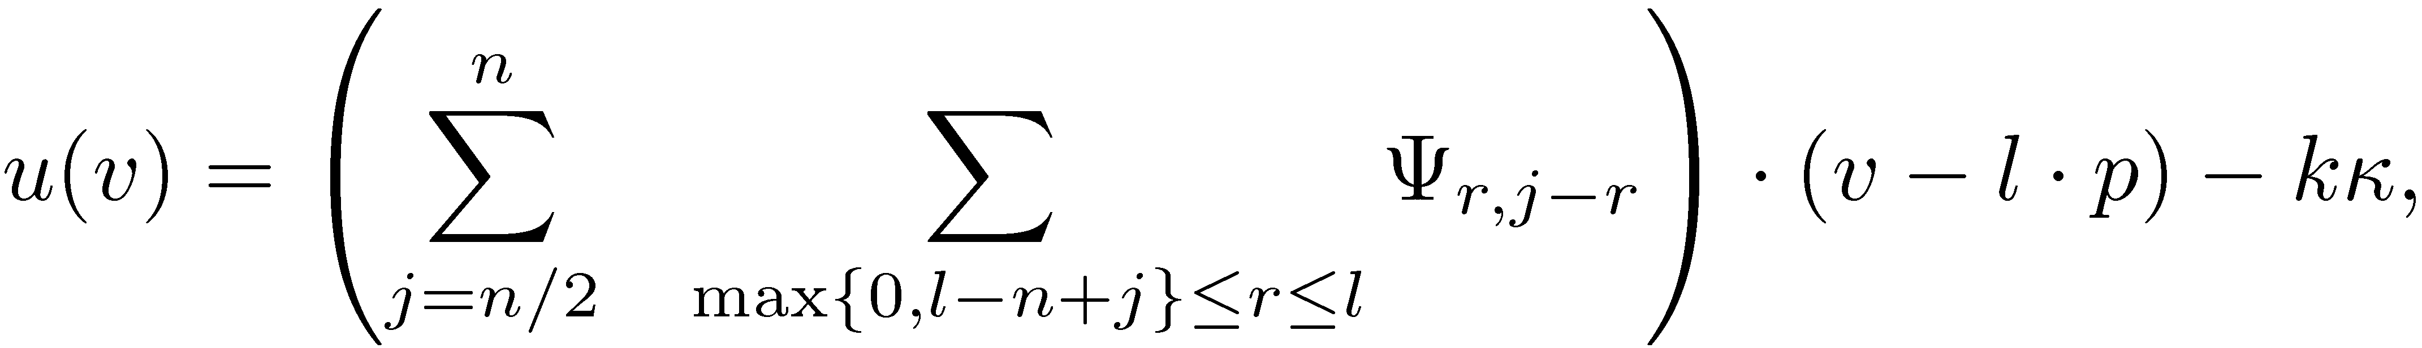
MAJORITY Technology
Optimal payment
where
Principal utility

