Slide 1

Networks Cannot Compute Their Diameter in Sublinear Time
Stephan Holzer
Silvio Frischknecht Roger Wattenhofer
ETH Zurich – Distributed Computing Group

Slide 2




Distributed network
Graph G of n nodes
2
1
5
3
4

Slide 3
Distributed network
Graph G of n nodes
2
1
5
3
4

Slide 4
Distributed network
Graph G of n nodes
2
Local infor-
mation only
1
1
5
3
4

Slide 5

Distributed network
Graph G of n nodes
2
Local infor-
mation only
1
5
3
2
4
1
3
Slide inspired by Danupon Nanongkai

Slide 6
Distributed network
Graph G of n nodes
2
Local infor-
mation only
1
5
3
2
4
?
1
3

Slide 7
Distributed network
Graph G of n nodes
Limited
bandwidth
2
log n
log n
Local infor-
mation only
log n
1
5
log n
3
log n
log n
2
4
?
1
3

Slide 8

Distributed network
Graph G of n nodes
Limited
bandwidth
2
Synchronized
Internal
computations
negligible
log n
log n
log n
1
5
log n
3
log n
log n
Local infor-
mation only
4
2
?
Time complexity:
number of communication rounds
1
3

Slide 9
Distributed algorithms: a simple example
Notes:
Should care… parallelism

Slide 10
Count the nodes!

Slide 11
Count the nodes!
Compute
BFS-Tree

Slide 12
Count the nodes!
Compute
BFS-Tree
0

Slide 13
Count the nodes!
Compute
BFS-Tree
1
1
1
0
1

Slide 14
Count the nodes!
Runtime: ?
Compute
BFS-Tree
2. Count
nodes in
subtrees
2
1
2
1
2
2
1
0
2
1
Diameter

Slide 15
Diameter of a network
Distance between two nodes = Number of hops of shortest path

Slide 16
Diameter of a network
Distance between two nodes = Number of hops of shortest path

Slide 17
Diameter of a network
Distance between two nodes = Number of hops of shortest path
Diameter of network = Maximum distance, between any two nodes

Slide 18
Diameter of a network
Diameter of
this network?
Distance between two nodes = Number of hops of shortest path
Diameter of network = Maximum distance, between any two nodes

Slide 19
Fundamental graph-problems
Spanning Tree – Broadcasting, Aggregation, etc
Minimum Spanning Tree – Efficient broadcasting, etc.
Shortest path – Routing, etc.
Steiner tree – Multicasting, etc.
Many other graph problems.
Thanks for slide to Danupon Nanongkai

Slide 20

Fundamental graph-problems
Spanning Tree – Broadcasting, Aggregation, etc
Minimum Spanning Tree – Efficient broadcasting, etc.
Shortest path – Routing, etc.
Steiner tree – Multicasting, etc.
Many other graph problems.
Global problems: Ω( D )
Local infor-
mation only
2
?
1
3

Slide 21
Fundamental graph-problems
Maximal Independent Set
Coloring
Matching

Slide 22
Fundamental graph-problems
Maximal Independent Set
Coloring
Matching
Local problems:
runtime independent of / smaller than D e.g. O(log n)

Slide 23

Fundamental problems
Spanning Tree – Broadcasting, Aggregation, etc
Minimum Spanning Tree – Efficient broadcasting, etc.
Shortest path – Routing, etc.
Steiner tree – Multicasting, etc.
Many other graph problems.
Diameter appears frequently in distributed computing

Slide 24
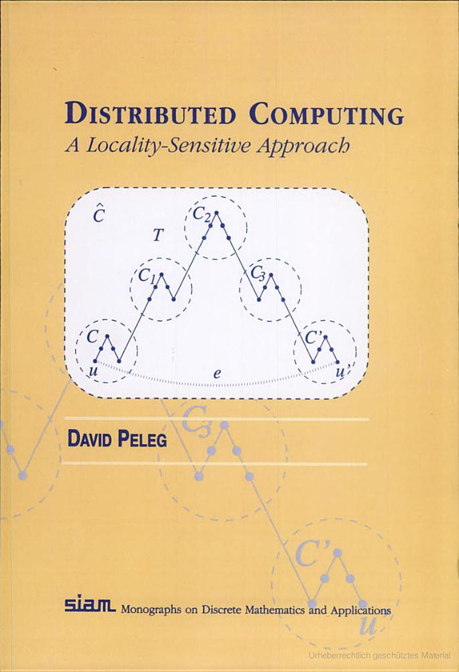
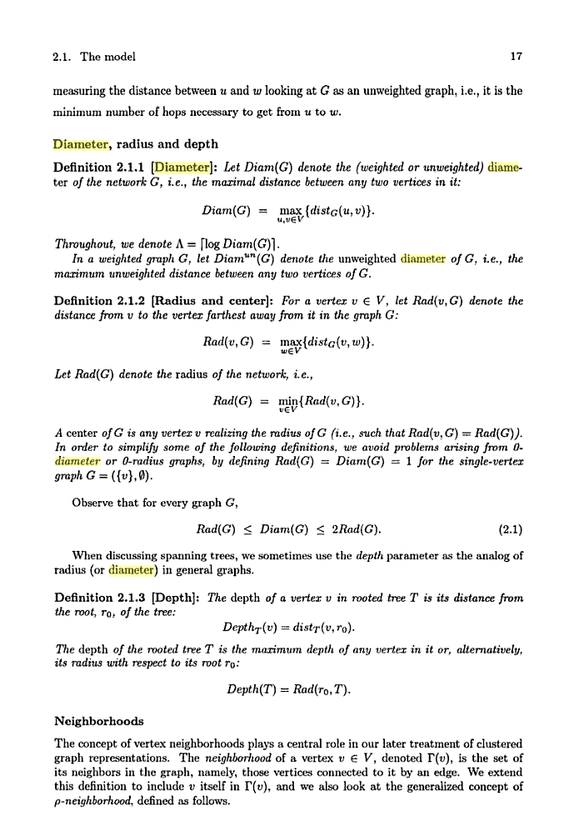
Fundamental problems
1. Formal definition?
Spanning Tree – Broadcasting, Aggregation, etc
Minimum Spanning Tree – Efficient broadcasting, etc.
Shortest path – Routing, etc.
Steiner tree – Multicasting, etc.
Many other graph problems.
Diameter appears frequently in distributed computing
Complexity of computing D? .
Known: Ω (D)
≈Ω(1)
Even if D = 3
This talk:
Ω(n)

Slide 25
Networks cannot compute their diameter in sublinear time!
Notes:
Should care… parallelism

Slide 26
Diameter of a network
Diameter of
this network?
Distance between two nodes = Number of hops of shortest path
Diameter of network = Maximum distance, between any two nodes

Slide 27
Networks cannot compute their
diameter in sublinear time!

Slide 28
Networks cannot compute their
diameter in sublinear time!

Slide 29
Networks cannot compute their
diameter in sublinear time!

Slide 30
Networks cannot compute their
diameter in sublinear time!

Slide 31
Networks cannot compute their
diameter in sublinear time!

Slide 32
Networks cannot compute their
diameter in sublinear time!
Base graph
has diameter 3

Slide 33
Networks cannot compute their
diameter in sublinear time!
has diameter 3
2?

Slide 34
Networks cannot compute their
diameter in sublinear time!
Pair of nodes not connected on both sides?
has diameter 3
2?

Slide 35
Networks cannot compute their
diameter in sublinear time!
Pair of nodes not connected on both sides?
has diameter 3
2?

Slide 36
Networks cannot compute their
diameter in sublinear time!
Pair of nodes not connected on both sides?
Now: slightly more formal

Slide 37
Networks cannot compute their
diameter in sublinear time!
Pair of nodes not connected on both sides?
Label potential edges

Slide 38
Networks cannot compute their
diameter in sublinear time!
Pair of nodes not connected on both sides?
Label potential edges
1
1

Slide 39
Networks cannot compute their
diameter in sublinear time!
Pair of nodes not connected on both sides?
Label potential edges
1
1
2
2

Slide 40
Networks cannot compute their
diameter in sublinear time!
Pair of nodes not connected on both sides?
Label potential edges
1
1
3
2
2
3

Slide 41
Networks cannot compute their
diameter in sublinear time!
Pair of nodes not connected on both sides?
Label potential edges
1
1
3
2
2
3
4
4

Slide 42
Networks cannot compute their
diameter in sublinear time!
Pair of nodes not connected on both sides?
1
1
3
2
2
3
4
4

Slide 43
Networks cannot compute their
diameter in sublinear time!
Pair of nodes not connected on both sides?
Given graph
1
1
3
2
2
3
4
4

Slide 44
Networks cannot compute their
diameter in sublinear time!
Pair of nodes not connected on both sides?
A
B
1
1
3
3
2
3
2
2
4
4
4
4
Θ(n) edges

Slide 45
Networks cannot compute their
diameter in sublinear time!
Pair of nodes not connected on both sides?
Same as “A and B not disjoint?”
A
B
1
1
2
3
3
2
3
2
2
3
4
4
4
4
4
Θ(n) edges

Slide 46
Networks cannot compute their
diameter in sublinear time!
Pair of nodes not connected on both sides?
Same as “A and B not disjoint?”
A ⊆ [n²]
B ⊆ [n²]
1
1
2
3
3
2
3
2
2
3
4
4
4
4
4
Θ(n) edges

Slide 47


Networks cannot compute their
diameter in sublinear time!
“A and B not disjoint?”
A ⊆ [n²]
B ⊆ [n²]
2
3
4
4

Slide 48

Networks cannot compute their
diameter in sublinear time!
Pair of nodes not connected on both sides?
Same as
“A and B not disjoint?”
Communication Complexity
randomized: Ω(n ²) bits
A ⊆ [n²]
B ⊆ [n²]
2
3
Ω(n) time
4
4
Θ(n) edges

Slide 49
Diameter Approximation

Slide 50
3/2-ε approximating the diameter takes Ω(n^{1/2})
Extend
2 vs. 3
D = 9 base graph

Slide 51
3/2-ε approximating the diameter takes Ω(n^{1/2})
Extend
2 vs. 3
D = 9 base graph

Slide 52
3/2-ε approximating the diameter takes Ω(n^{1/2})
Extend
2 vs. 3
D = 9 base graph
9

Slide 53
3/2-ε approximating the diameter takes Ω(n^{1/2})
Extend
2 vs. 3
D = 9 base graph

Slide 54
3/2-ε approximating the diameter takes Ω(n^{1/2})
Extend
2 vs. 3
D = 9 base graph
5

Slide 55
3/2-ε approximating the diameter takes Ω(n^{1/2})
Extend
2 vs. 3
D = 9 base graph
D = 7 good graph
-------------
Factor: 3/2
5
7

Slide 56
3/2-ε approximating the diameter takes Ω(n^{1/2})
Extend
2 vs. 3
D = 9 base graph
D = 7 good graph
-------------
Factor: 3/2 -ε
7

Slide 57
Technique is general

Slide 58
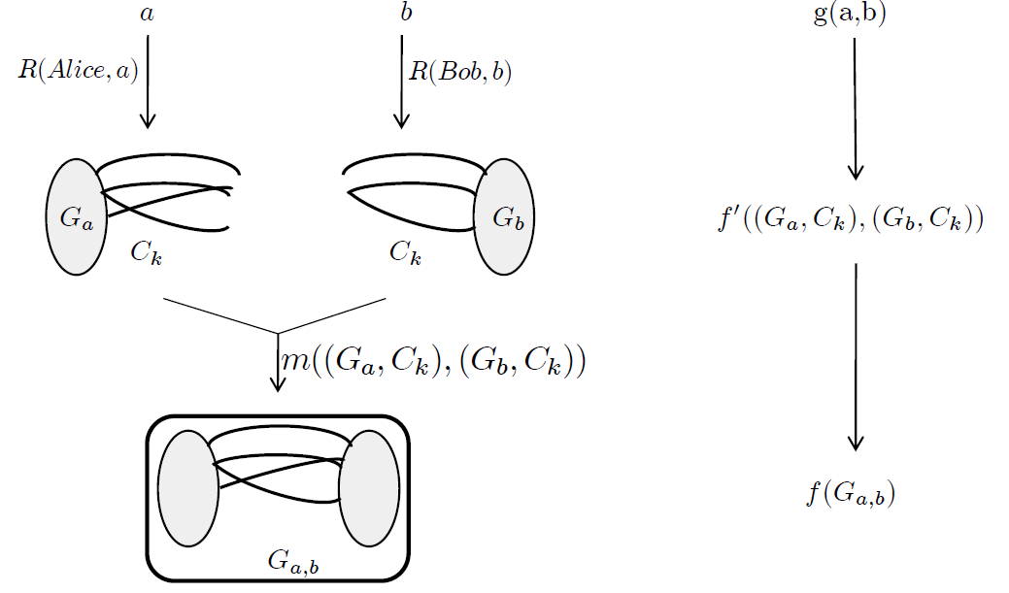
Technique is general
G

Slide 59
Technique is general
G

Slide 60
Technique is general
cut
G

Slide 61
Technique is general
cut

Slide 62
Technique is general
cut

Slide 63
f’(Ga,Gb)
cut

Slide 64
Alice Bob
f’(Ga,Gb)
cut

Slide 65
Alice Bob
f’(Ga,Gb)
cut

Slide 66
Alice Bob
f’(Ga,Gb)
cut

Slide 67
Alice Bob
f’(Ga,Gb)
cut
Time(g)
Time(f) ≥ -----------
|cut|

Slide 68
Summary
Diameter Ω(n)
7
3/2-eps approximation
takes Ω(n^{1/2})
cut
general technique

Slide 69
Thanks!

