Slide 1
Ikarus: Large-scale Participatory Sensing at High Altitudes
Michael von Känel
Philipp Sommer
Roger Wattenhofer

Slide 2
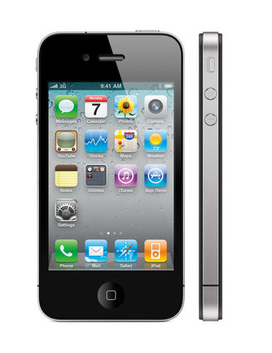
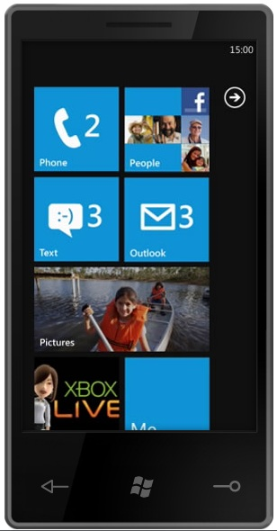
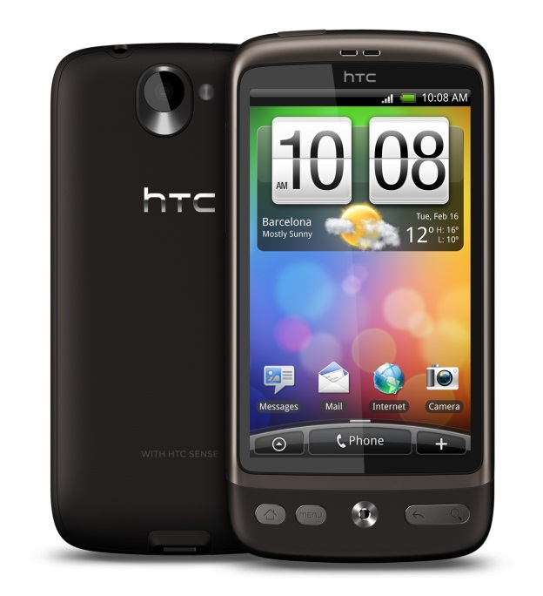
Mobile Phones
Over 5 billion mobile phones worldwide (72.6% of world population)
Smartphones account for 19% of sales in 2010

Slide 3
Phones as a Platform for Mobile Sensing
Smartphones have already many integrated sensors:
  Camera
  Microphone
  GPS
  Compass
  Accelerometers
  Gyroscope
  Proximity sensor
  Near-field communication

Slide 4
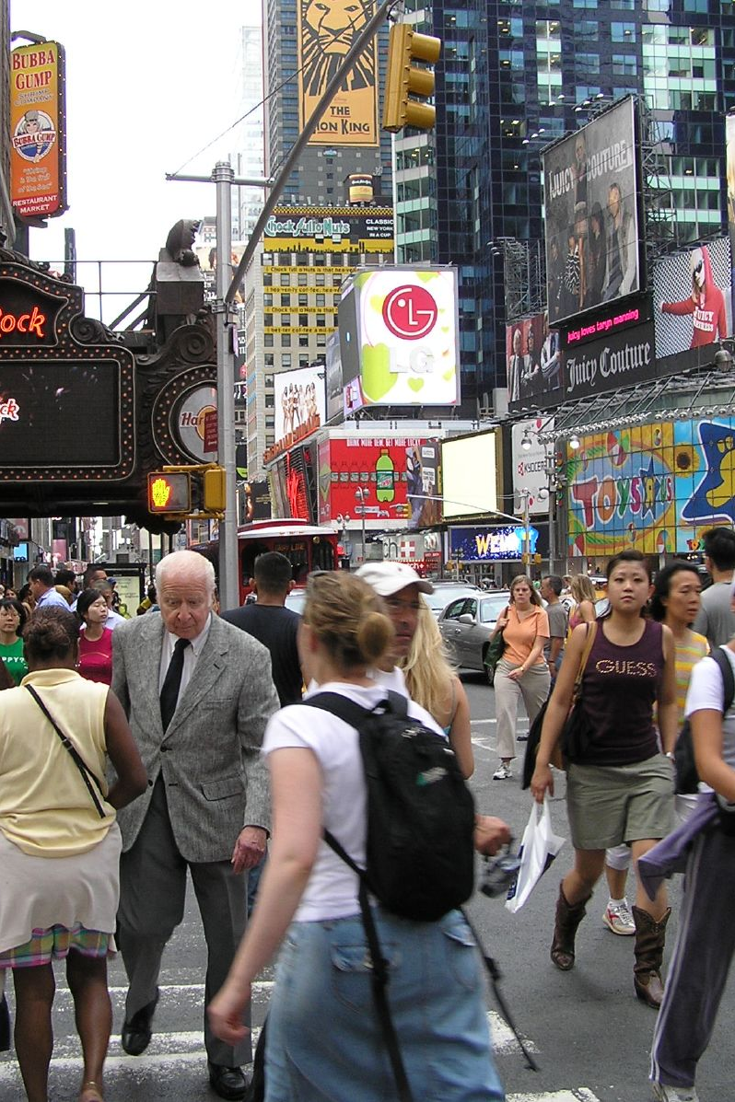
People-centric Sensing Applications
Sense your environment:
  Air quality/pollution
  Traffic congestion
Identify patterns in your behavior:
  Heart rate/stress level
  Personal fitness

Slide 5
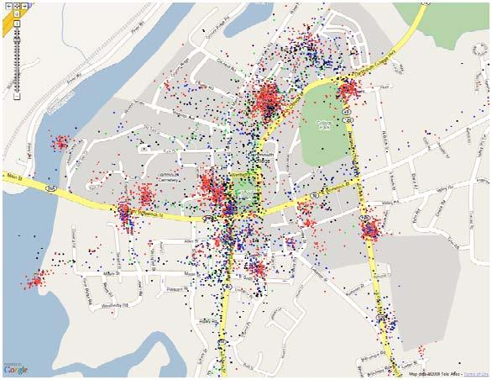
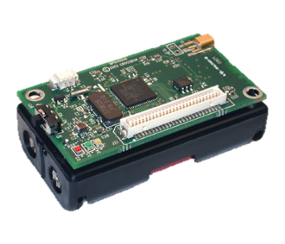

From Sensor Networks to Participatory Sensing
Collection and analysis of sensor measurements
Wireless Sensor Network
Participatory Sensing

Slide 6
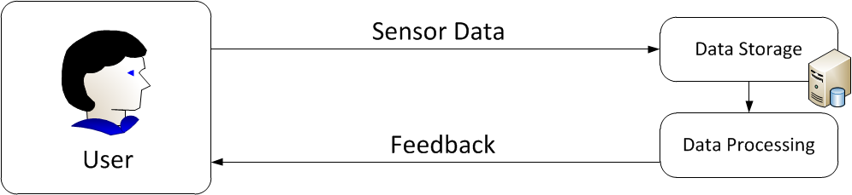
The Participatory Sensing Loop
How can participatory sensing be sucessful?
We identify three key challenges:
  Incentives for participation
  Ability to deal with faulty data
  Concise data representation
2.
3.
1.

Slide 7
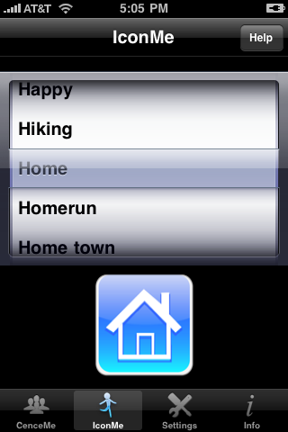
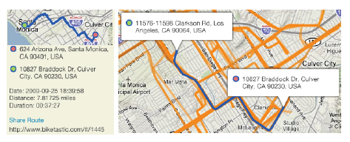
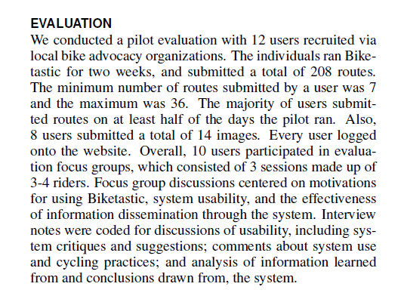
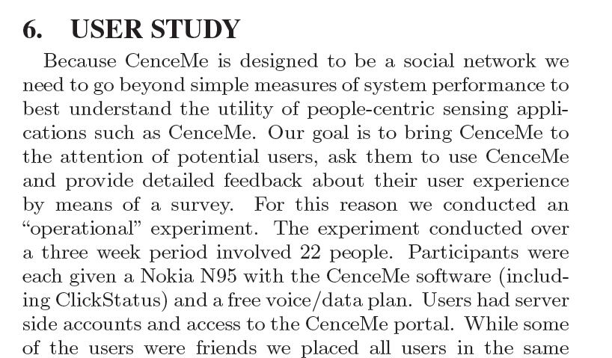
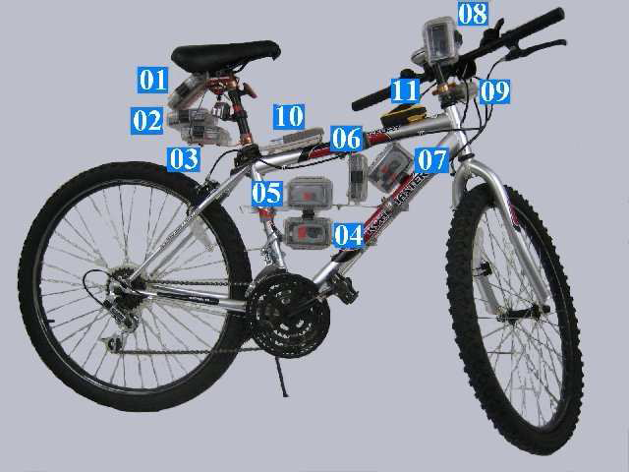
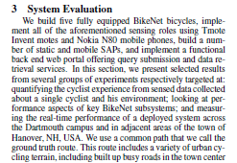
Related Work: Mobile Sensing Projects
Most former projects are only small scale
CenceMe
Biketastic
12 users
22 users
BikeNet
5 users

Slide 8
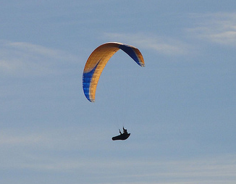
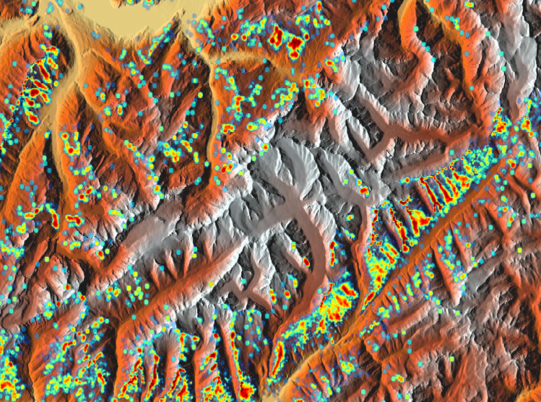
The Ikarus System
Goal:
  Use GPS flight records from paraglider pilots to generate maps of thermal active areas (hotspots)
Data provided by 2,331 unique users in Switzerland (2003-2009)
30,000 flight tracks analyzed, several GByte of data processed

Slide 9
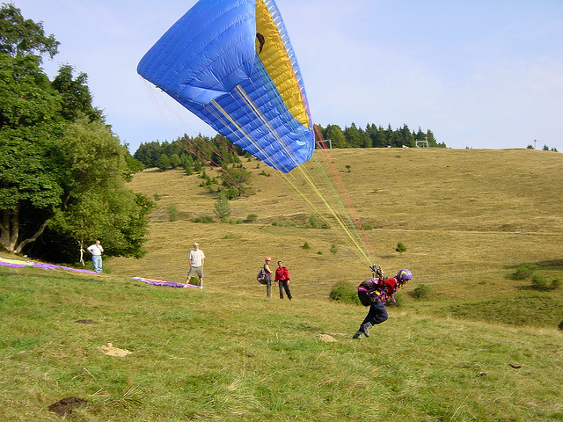
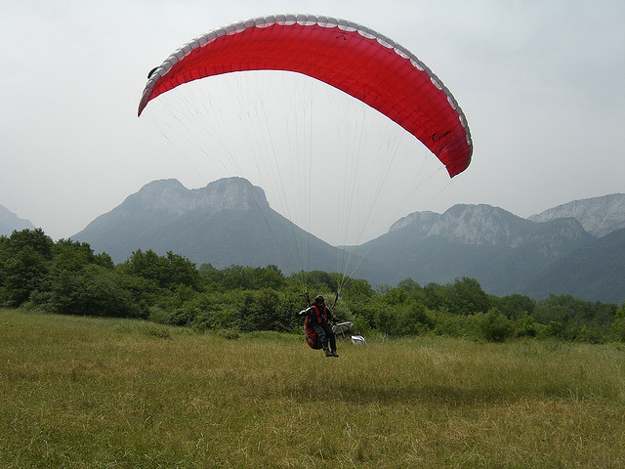
A Short Introduction to Paragliding
Recreational flying sport
Flying...
Launching...
... and Landing

Slide 10

A Short Introduction to Paragliding (2)
Cloud Base
Thermal band
Breakoff point

Slide 11
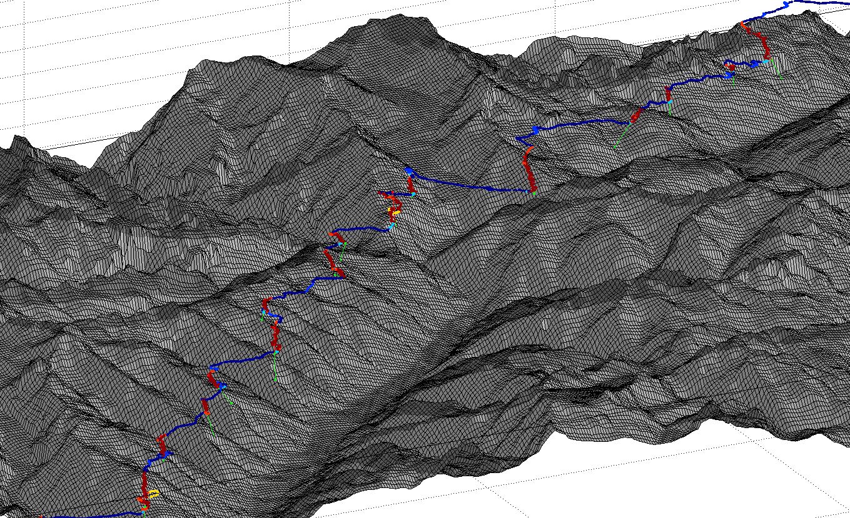
Example: Paraglider Flight

Slide 12
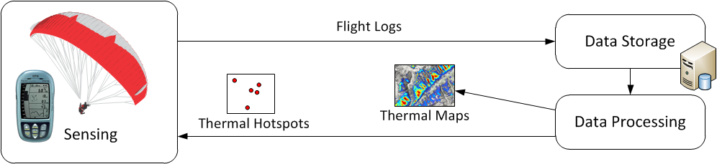
Ikarus: System Architecture

Slide 13
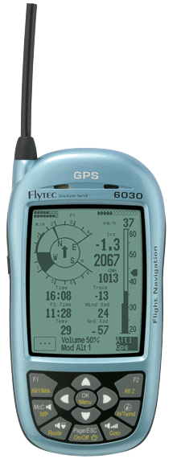
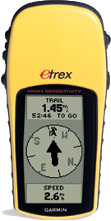
Sensing Flights
Flight navigation devices used by paraglider pilots
  Records time, GPS position
  Accurate height measured by barometric pressure
  Variometer reports climb rate
Data Integrity
  Tracks are signed by the device
Cheating is very hard!

Slide 14
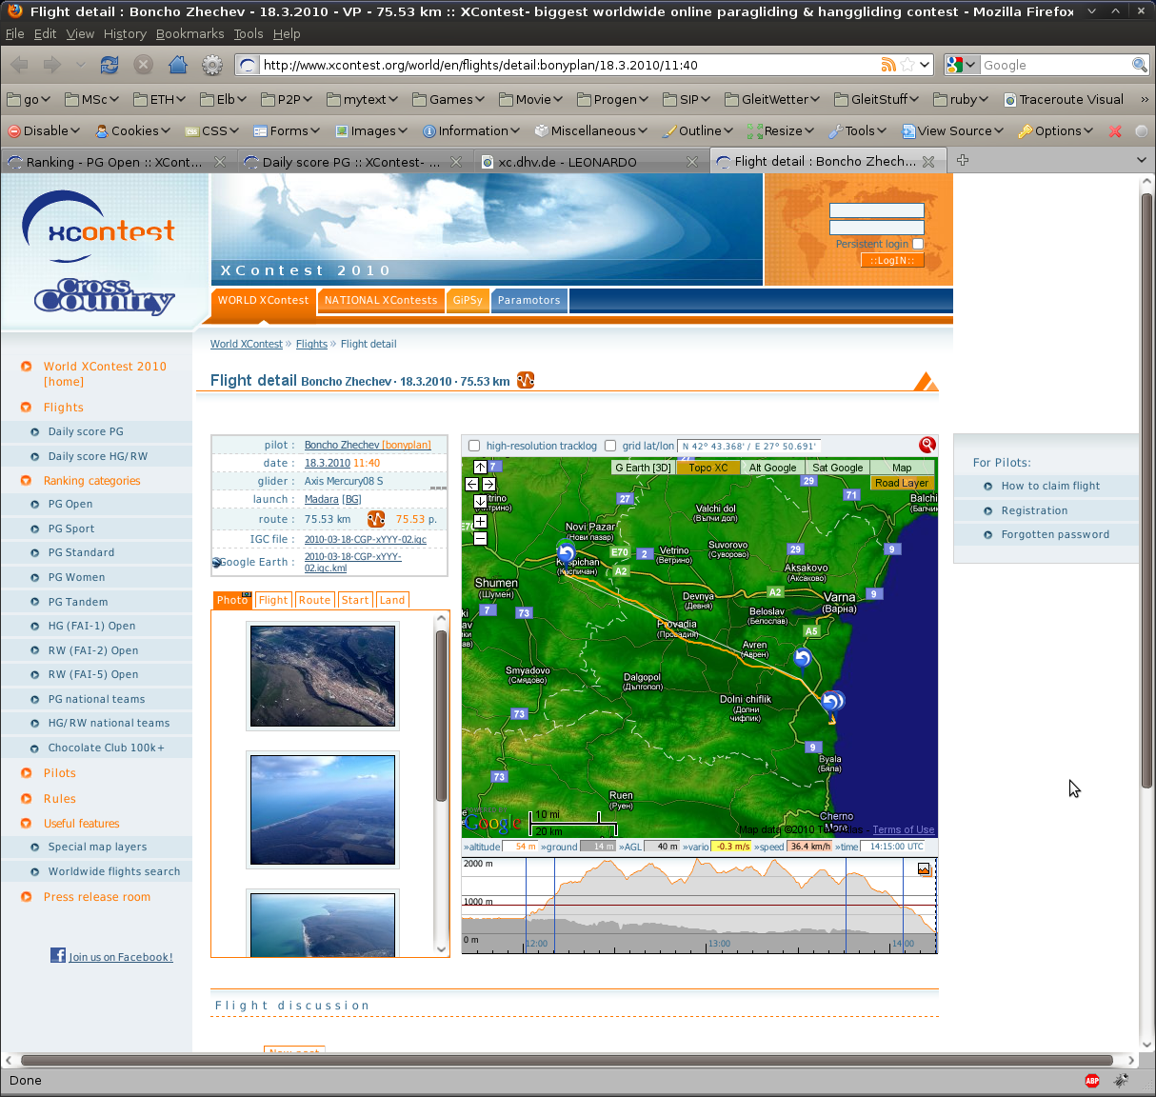
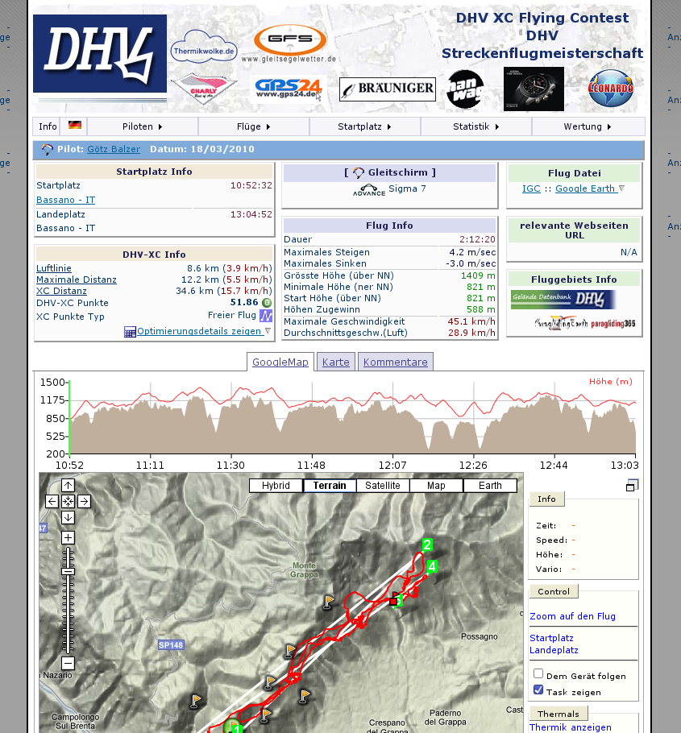
Participation Incentives
How can we make pilots to share their recorded tracks?
Pilots share recorded flights on community websites
  Tell friends about their flights (social networks)
Paragliding contests
  Credits awarded for
  distance or shape of
  the track (triangle)

Slide 15
Data Processing: Finding Thermal Columns

Slide 16
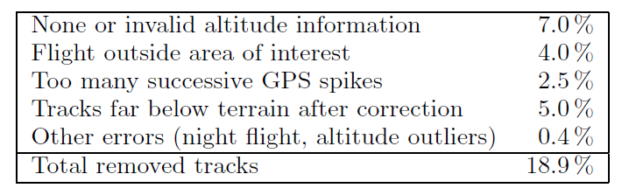
Data Quality
Hardware challenges of participatory sensing:
  Sensor device is owned by the user
  Different hardware
  Bad calibration (time, altitude)
Only 81.1% of all tracks could be used

Slide 17
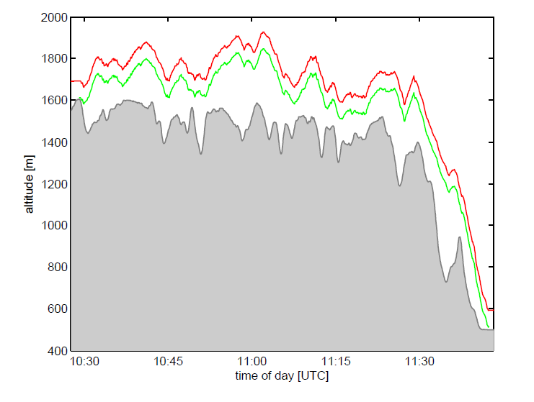
Data Quality: Example
Pilot forgot to calibrate alititude before launch

Slide 18
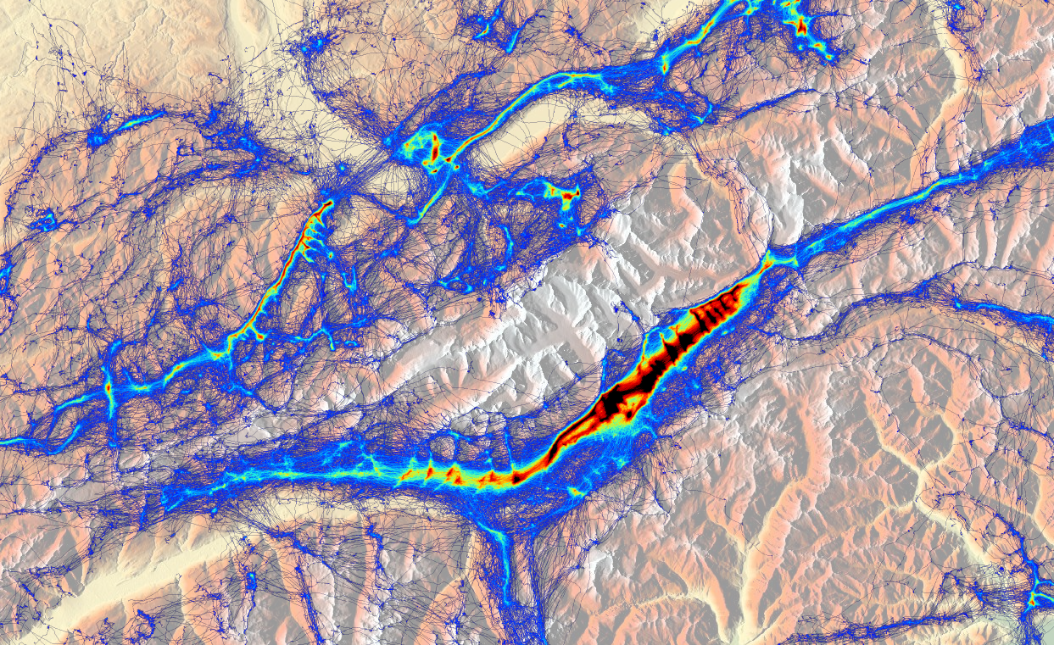
Problem: Flight Distribution
Flight tracks are distributed very unequally
Goms Valley, Switzerland, all flights from 2003-2010, 80 x 50 km

Slide 19

Solution: Probability based Thermal Maps
Assign an uncertainty value to each thermal trigger point

Slide 20
Closing the Loop
Feedback to users is crucial in participatory sensing
  Increase awareness for data quality (calibration)
  Encourage pilots to upload their flights

Slide 21
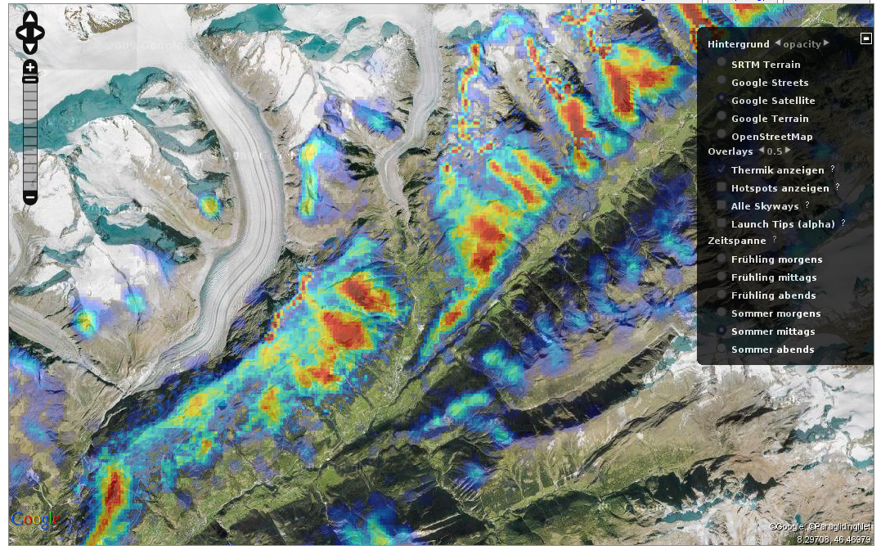
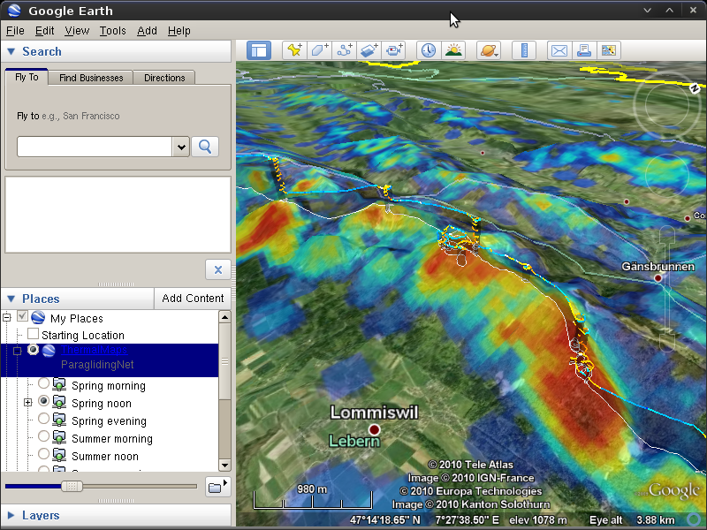
Feedback to pilots: Thermal maps
Thermal maps for flight preparation
Google Maps
Google Earth
Website: http://thermik.kk7.ch

Slide 22
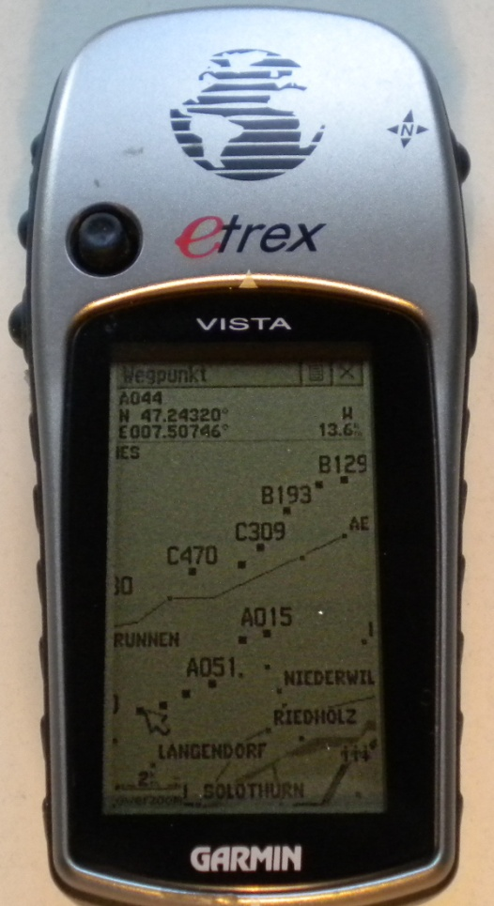
Feedback to pilots: Hotspots
Import thermal hotspots on the flight navigation device
  XML file with coordinates of strong thermal uplift
Recommendation system during flights
  Find good thermals in your area
  Explore new areas
Future devices will likely include 3G
connectivity
  Get live feedback from other pilots?

Slide 23
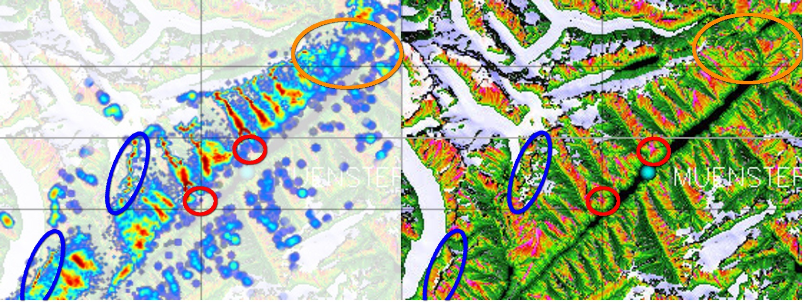
Evaluation: Ikarus vs. TherMap
Comparison with a physical simulation of thermal uplift

Slide 24
Conclusions
Ikarus: Large scale participatory sensing with 2331 users
First thermal maps based on GPS flight logs

