Slide 1
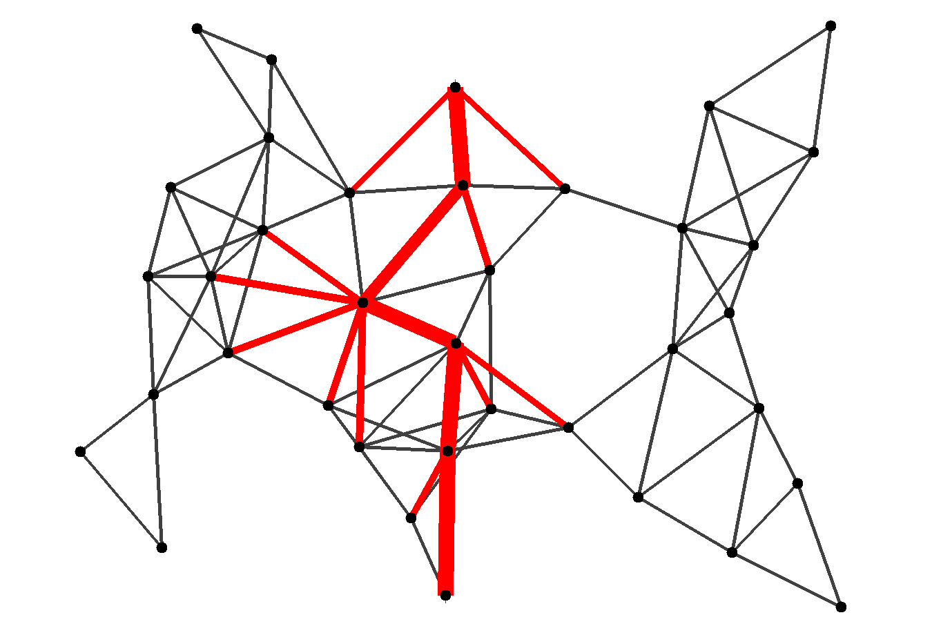
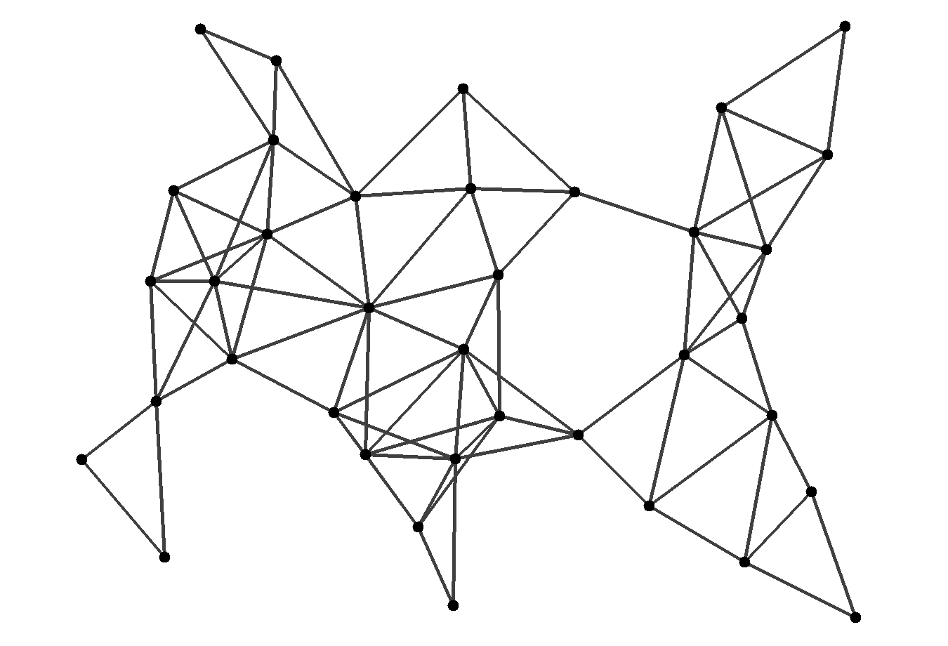
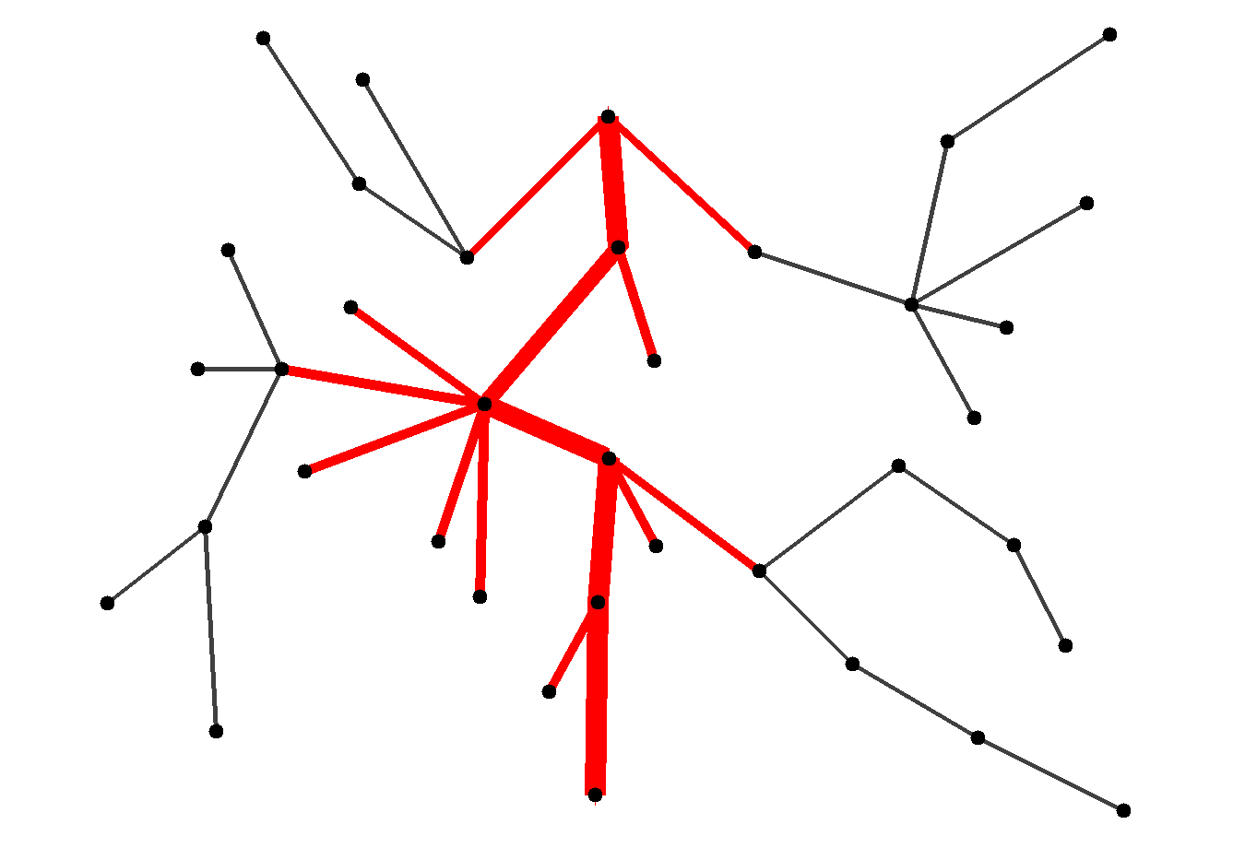
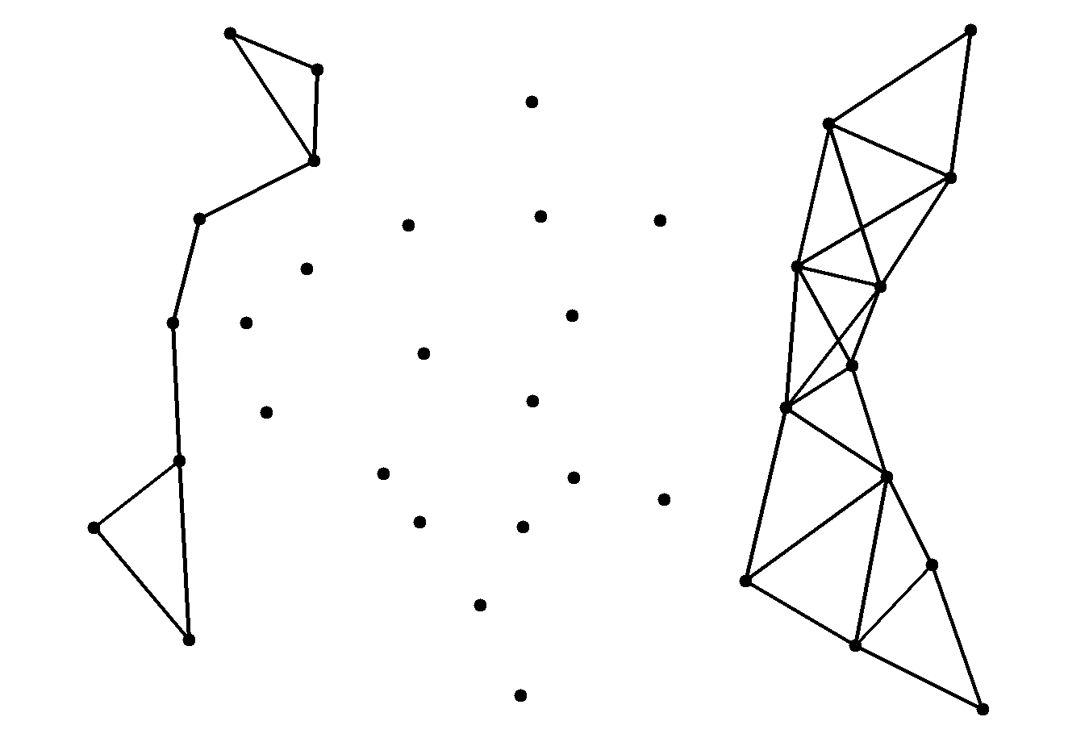
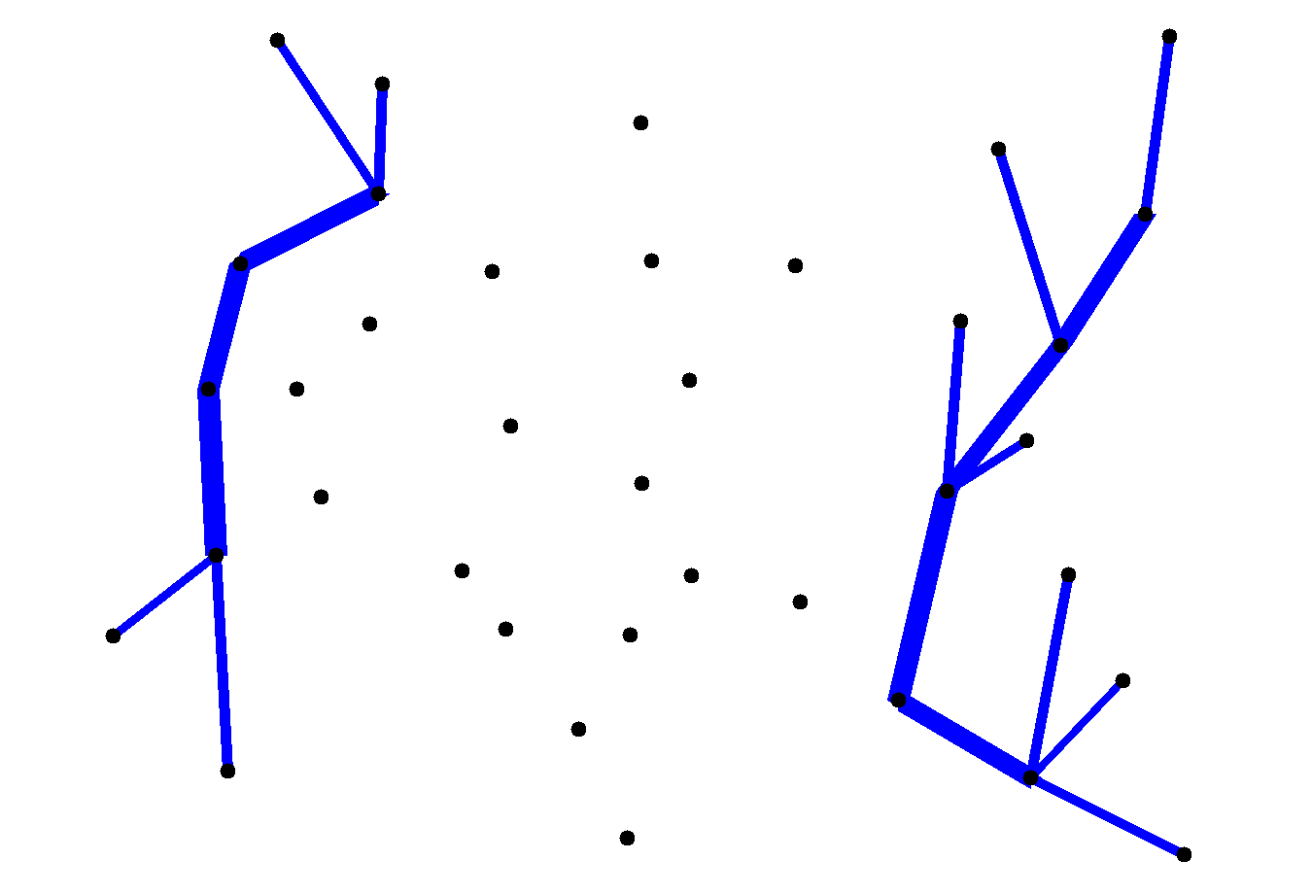
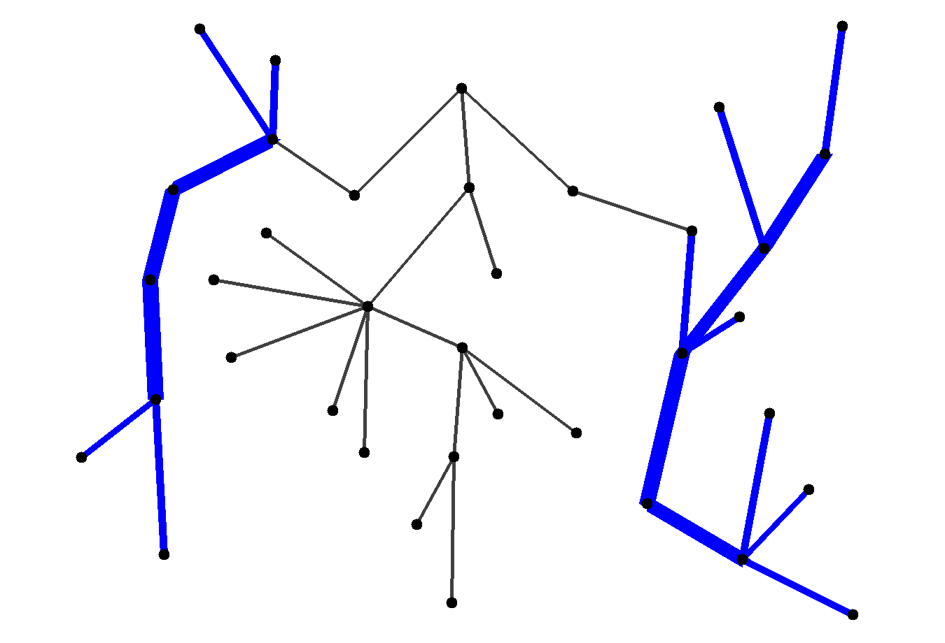
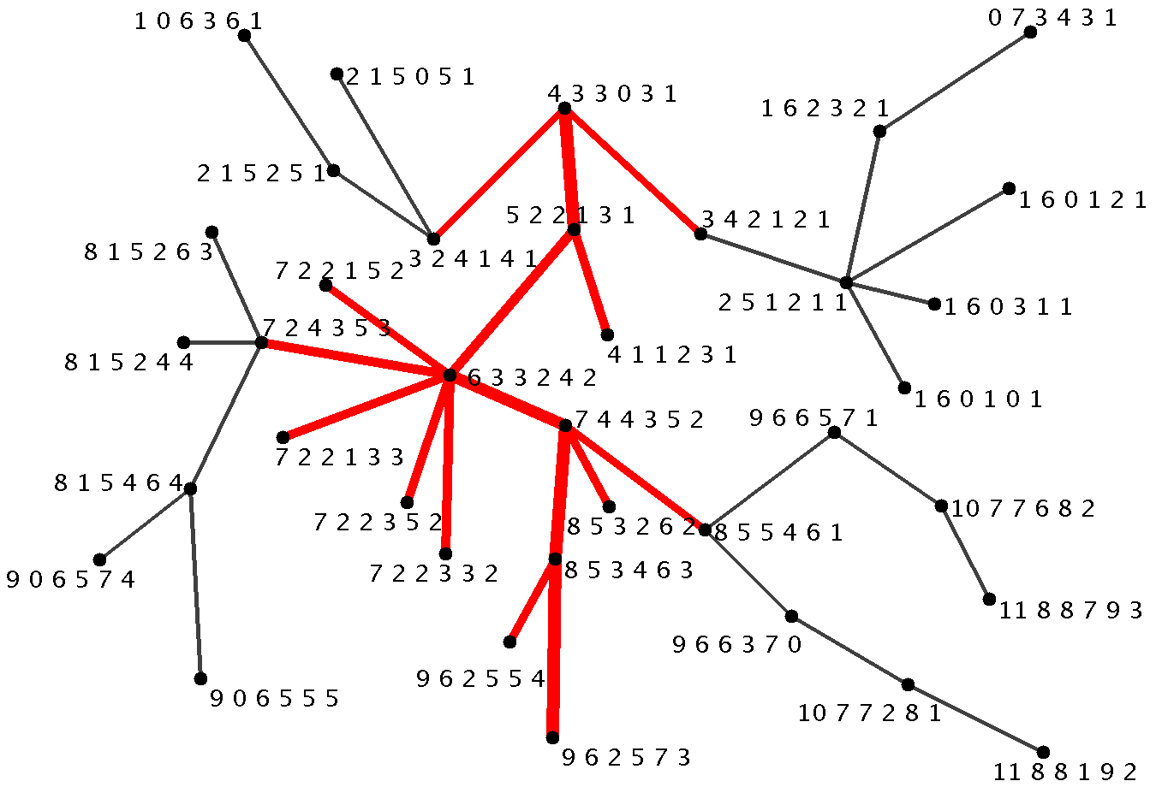
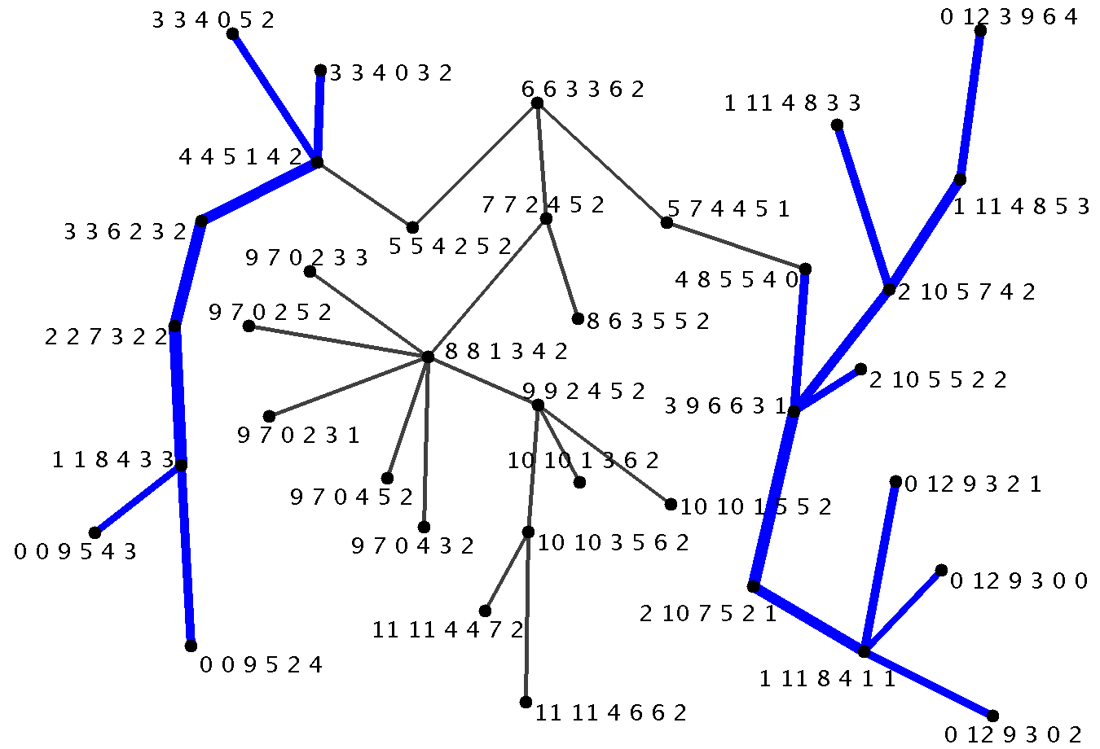

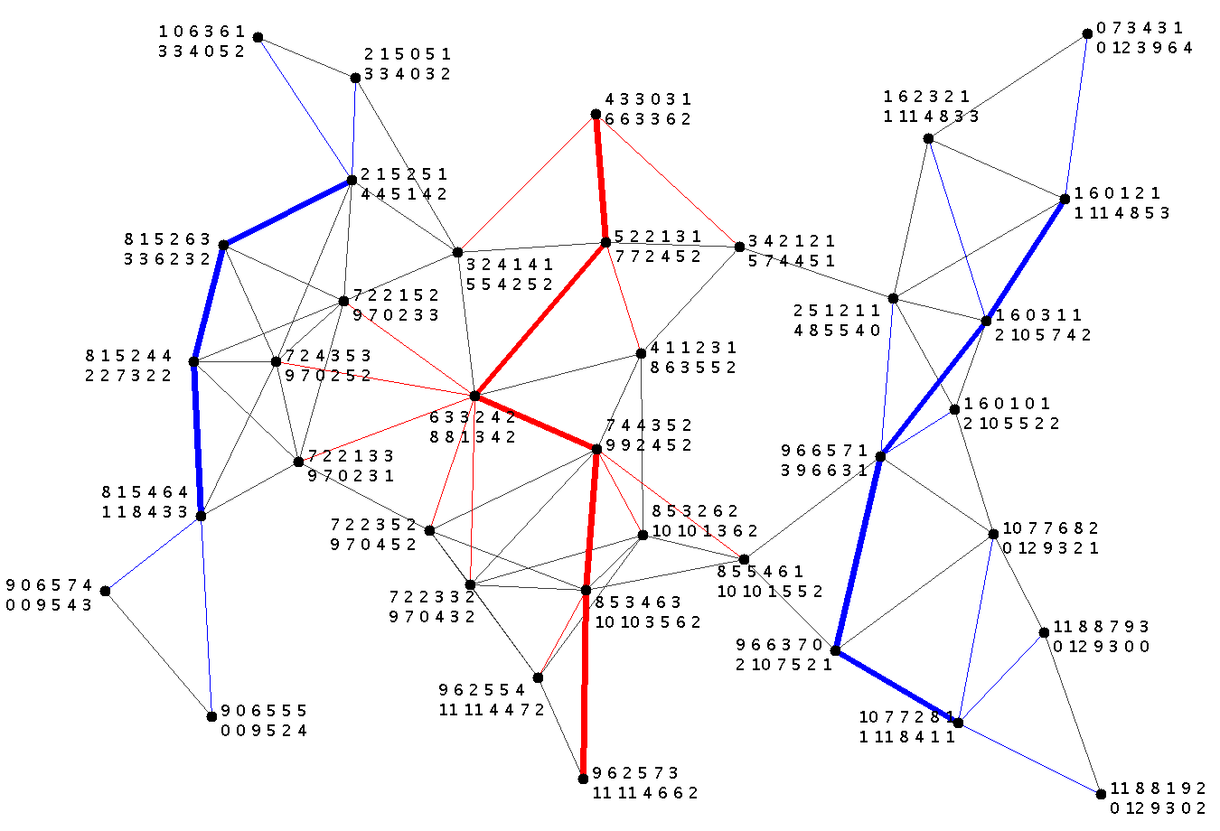

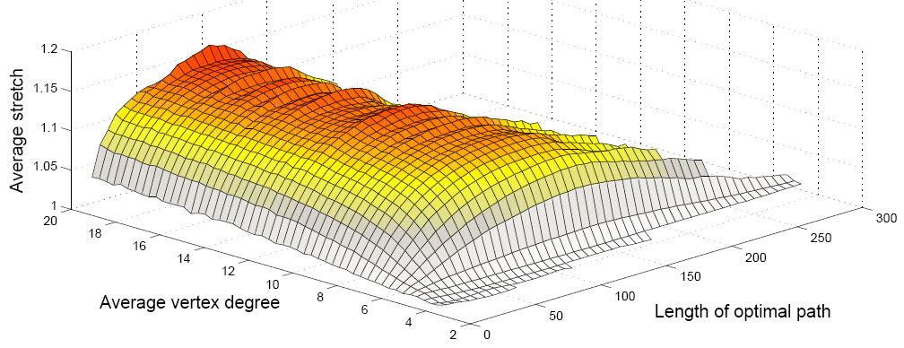
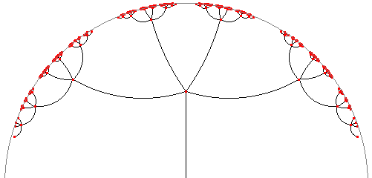
Greedy Routing with Bounded Stretch
Cluster 1
Roland Flury, Roger Wattenhofer (ETH Zurich), Sriram Pemmaraju (Iowa University)
Published at IEEE Infocom 2009
Introduction
We consider the problem of greedy routing where messages are forwarded to the neighbor which is closest to the destination node. Due to its simplicity, this routing scheme is very promising. For greedy routing, the nodes only need to know their position (which may be obtained from GPS or through a virtual placement).
In general, greedy routing does not work as messages may get stuck at local minima, nodes which have no neighbor that is closer to the destination, see Figure 1.
Many geometric solutions to escape such local minima have been proposed so far. We follow a different approach: assign coordinates such that greedy routing always works.
Greedy paths are not necessarily optimal. We measure the overhead through the stretch :
In our example, the greedy path uses 5 hops whereas the optimal path only needs 4. Thus, the path has a stretch of 1.25.
Ingredient 1: Tree Cover
Build a constant stretch tree cover of O(log n) trees
We choose a set of trees {T₁, T₂, …, T_{k}} such that
for any two nodes u, v ∃ T_{i} with d_{Ti(u,v)} ≤ ρ d_{G(u,v)}
Gupta et al. describe the construction of a constant stretch tree cover for planar graphs
We extend this result to CUDGs
Embedding Example
Introduction
To build the first tree of the tree cover, separate the network.
From the separator, grow a BFS tree to obtain the first tree.
Remove the separator from the network and continue recursively on the remaining connected components.
In our example, the recursion already stops as the new separators already cover the entire components.
The second tree is obtained by concatenating the components via the removed separator.
Ingredient 2: Separators
Any planar graph of n vertices can be separated such that each resulting connected component has at most 2/3 n vertices. [Lipton, Tarjan]
We show that this result also holds for CUDGs
Note: We need no geometric information.
3
9
8
Figure 1: The greedy path from node 2 towards node 6 falls into a local minimum at node 1 which has no neighbor closer to node 6.
2
4
7
1
Greedy
embedding
≤
2
n
≤
2
n
5
6
3
3
1
9
8
7
6
Figure 2: The network is embedded such that greedy routing between any two points is possible.
2
3
5
Ingredient 3: Distance Labeling
Any tree of n vertices can be embedded isometrically into c ∙ log n dimensions. [Linial et al.]
Given the coordinates of any two nodes, the exact distance (along the tree) can be obtained using the L∞ norm:
4
stretch :=
length of greedy path
Label each tree using the distance labeling.
length of optimal path
[1, 1, 1]
[2, 0, 2]
[3, 1, 3]
L ∞( [3, 1, 3] , [0, 2, 2] ) = 3
[0, 2, 0]
[0, 2, 2]
Our Results
A CUDG is a Combinatorial Unit Disk Graph, a UDG without any geometric information.
Note: without 2D coordinates, it is NP-hard to find an embedding given only the connectivity of the network.
This result can also be seen as a compact routing scheme with O(log³ n) bits.
Note: UDGs are not constant doubling
Our technique can be used for general graphs, where we obtain a O(log³ n)-dimensional embedding with O(log n) stretch.
Embedding & Routing Recipe
Build a constant stretch tree cover
using the separator theorem for CUDGs
Label each tree with the isometric embedding
Greedy routing from u to v : Forward along the tree which indicates the shortest distance.
Finally, combine the labels from the different trees to form the coordinate of each node.
A CUDG can be embedded in polynomial time
into O(log² n) dimensions
such that greedy routing has a constant stretch
[1, 1, 1]
[2, 0, 2]
[3, 1, 3]
[0, 2, 0]
[0, 2, 2]
How good is our greedy embedding?
Our greedy embedding is the first to ensure a constant stretch for greedy routing. To get a feeling about the quality of our embedding, we ran simulations on over 2000 random networks of varying size and analyzed over 10⁸ paths of 74 hops on average. The plot shows the stretch for different network densities and path lengths.
Related Work
Any planar 3-connected network has a
greedy embedding in 2D.
fewer samples
The average stretch is 1.1, which shows that our greedy routing has only 10% longer routes than an optimal solution.
The maximum stretch was found for an ‘unlucky’ short route, which was 3 times longer than the optimal route. In general, short routes tend to have low stretch as they are likely to be connected through a good tree.
Conjecture by Papadimitriou and Ratajczak
Proven by Moitra and Leighton in 2008
Any network has a greedy embedding into the hyperbolic space.
Robert Kleinberg, 2007
Improved by Eppstein & Goodrich in 2008 such that coordinates only need O(n) bits
Worst case stretch: O(n)
sparse, tree-like networks
short paths: good tree is likely

